Slide 1
Considerations on Vehicular Channel Models
Date: 2019-01-16
Authors:

Slide 2
Abstract
For performance evaluations of time-variant and/or location-dependent applications, use cases and scenarios average performance metrics are not sufficient, but resulting distribution including correlated events are needed.
The key to those enhanced performance evaluations are geometry-based stochastic channel models (GSCMs). These models can consider non-stationarity and spatio-temporal correlations of the environment and moving vehicles.
Therefore, we propose to use GSCMs.
Notes:
Straw poll afterwards

Slide 3
Performance Evaluation and Simulations
Communication Metrics
  Throughput
  Delivery rates
  Error rates
  Latency
  Update delay
Ranging and Positioning Metrics
  Relative distance error
  Absolute position error
  Dilution of precision (DOP)
Common Measures
  Average
  Root mean square error (RMSE)
  Circular error probability (CEP)
  of the absolute error
  Cumulative distribution function (CDF)
  of the absolute error
[1]

Slide 4



Update Delay (UD): Average and Distribution
Delay between two consecutive successfully received messages
Tx
Awareness Quality
PDR = $\frac{4}{7}$ = 57 %
Rx
UD1
UD2
UD3
Time
UD1
UD2
Time
UD3
Tx
PDR = $\frac{4}{7}$ = 57 %
Awareness Quality
Rx
UD1
UD2
UD3
Time
UD1
UD2
Time
[2]
Packet delivery rate (PDR)
UD3
Notes:
Not the average of the delay or the packet delivery is important, the problem is the distribution of the delay.
3GPP: packet inter reception (PIR) time

Slide 5
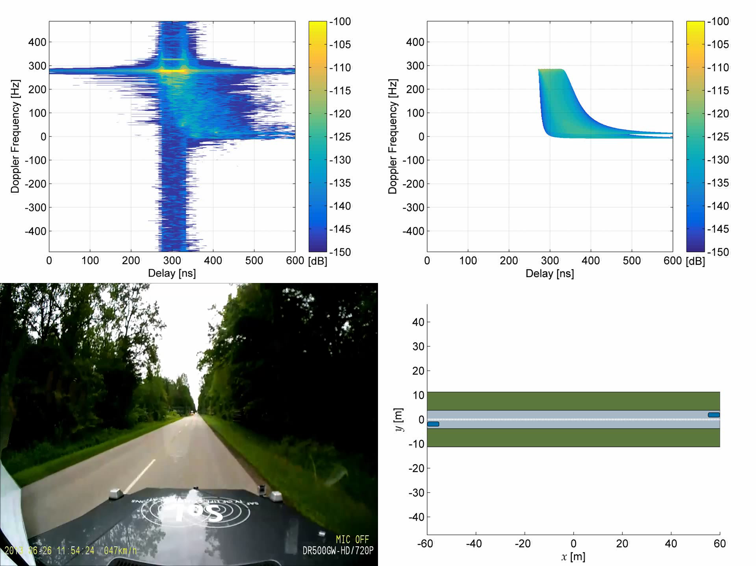
[3]

Slide 6
Use Cases, Related Scenarios, Key Indicators
 | Train-to-Train (T2T) | Vehicle-to-Train (V2T) | Sensor sharing |  | Vehicular position & location
Scenarios | Fast moving trains in fast changing environments | Dense and mixed urban mobility in harsh and fast changing environments | High mobility in harsh environments |  | Fast changing dynamics (V2P) and high mobility (V2V, V2T, A2A) in harsh environments
Applications | Exchange of safety critical information
 | Ranging |  |  |  | Localization
Key indicators | Uncorrelated errors, update delay
 | Detailed information of the environment
Assumptions | Non-wide sense stationary uncorrelated scattering (non-WSSUS)
 | Spatio-temporal correlation
[4]

Slide 7
Comparison of Channel Models
Stochastic channel models
Tapped delay line (TDL)
Cluster delay line (CDL)
Deterministic channel models
Ray-tracing
+ represents the physical radio propagation
+ respects the geometry of the environment
- Extremely high computational effort
- Detailed environment description necessary
+ Statistical parameters
+ Low complexity
- WSSUS
- No geometry
Geometry-based stochastic channel models (GSCM)
+ Includes Tx, Rx or scatterer motion
+ Respects the geometry of the environment
+ Relation to physical reality
- Channel sounder measurements
- Moderate computational effort
[5, 6]
Notes:
Classic approach: Stochastic channel models

Slide 8
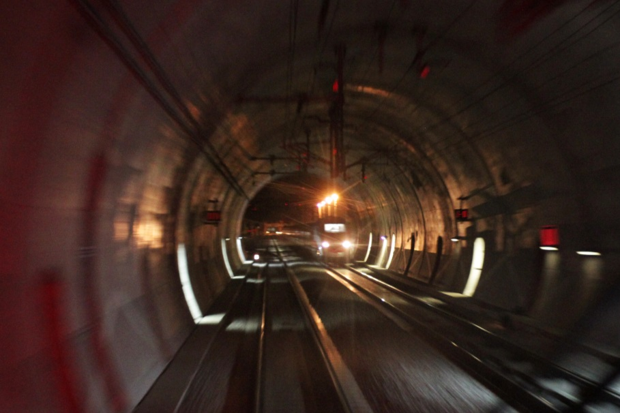
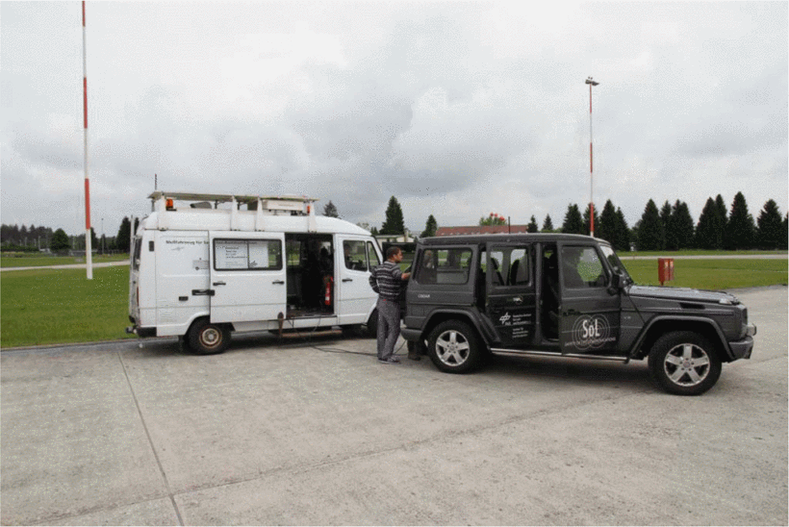
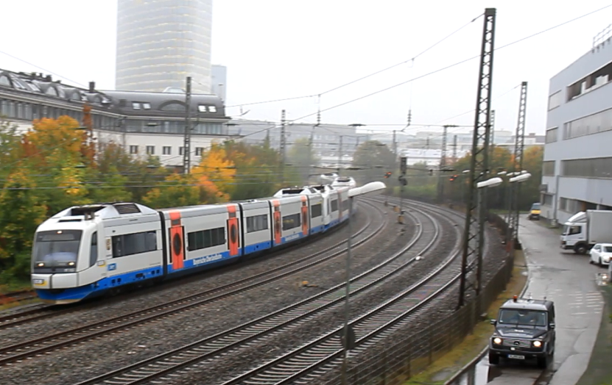
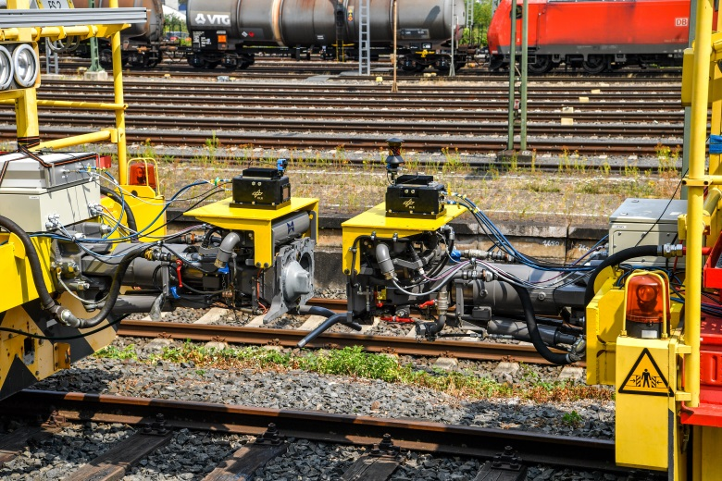
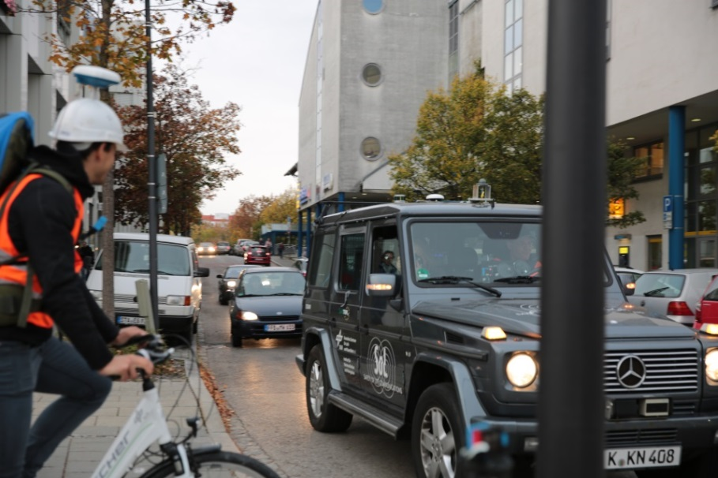
Measurements
T2T
V2V
V2T
T2T
V2P

Slide 9
Benefits of GSCMs
Temporal changing environments can be considered
WSSUS assumption can be dropped
Spatio-temporal correlation can be analyzed
Widely used:
  3GPP: GSCM used for system level simulations for road traffic (LTE-V2X and NR)
  ETSI ITS-G5: GSCM used for channel models and performance analysis framework
[3],[7]
Notes:
Uncorrelated scattering assumption is worst.
In ETSI it is in the draft.

Slide 10
Next steps with GSCM
Agreement on use cases and scenarios for GSCM
Definition of parameters for GSCM
Reference implementation of a GSCM in open source simulator
Performance evaluation of IEEE 802.11bd with GSCM
[8]
Notes:
Advantage of a certain feature e.g. GSCM can be evaluated with the performance evaluation at the end!!

Slide 11
Straw poll
Do you agree to use GSCMs in addition to TDLs in the performance evaluation of IEEE 802.11bd for applications, use cases and scenarios, where
WSSUS assumption is violated,
spatio-temporal correlations are needed (e.g. positioning),
error distributions are crucial?
Y/N/need more information:

Slide 12
References
[1] S. Sand, and A. Dammann, and C. Mensing, “Positioning in Wireless Communications Systems,” John Wiley & Sons, 2014, ISBN 0470770643.
[2] I. Rashdan, et al., “Performance Evaluation of Vehicle-to-Vehicle Communication for Cooperative Collision Avoidance at Urban Intersections,” IEEE 86th Vehicular Technology Conference: VTC2017-Fall, 24-27 Sep 2017, Toronto, Canada.
[3] S. Sand, et al., “Time-variant, non-stationary Vehicle-to-Vehicle Channel Model,” https://mentor.ieee.org/802.11/dcn/18/11-18-0924-01-0ngv-time-variant-non-stationary-v2v-channel-model.pptx
[4] B. Sun, “NGV SG Use Cases,” https://mentor.ieee.org/802.11/dcn/18/11-18-1323-02-0ngv-ngv-sg-use-cases.pptx
[5] P. Almers, et al., “Survey of Channel and Radio Propagation Models for Wireless MIMO Systems,” EURASIP Journal on Wireless Communications and Networking, vol. 2007, no. 1, p. 019070, Feb 2007.

Slide 13
References
[6] P. Unterhuber, et al., “A survey of channel measurements and models for current and future railway communication systems,” Mob. Inf. Syst., 2016, 2016, pp. 1–14. Available at: http://www.hindawi.com/journals/misy/2016/7308604/
[7] L. Wilhelmsson, et al., “Some (Measured) Characteristics of V2V Channels,” https://mentor.ieee.org/802.11/dcn/18/11-18-1217-01-0ngv-some-measured-characteristics-of-v2v-channels.pptx
[8] I. Sarris, “V2X Simulation Model,” https://mentor.ieee.org/802.11/dcn/18/11-18-1480-01-0ngv-v2x-simulation-model.pptx

