Slide 1
Simulation of NGV Channel Models
Date: 2019-01-11
Authors:
Name | Affiliations | Address | Phone | email
Prashant Sharma | Marvell | 5488 Marvell Ln, Santa Clara, CA 95054 |  | psharma@marvell.com
Rui Cao |  |  |  | ruicao@marvell.com
Hongyuan Zhang |  |  |  | hongyuan@marvell.com

Slide 2
Introduction
Car-to-Car (C2C) channel models have been proposed for NGV studies [1].
In this contribution, we present a methodology to generate the C2C channels based on the power, delay and doppler parameters as specified in [1].
We also propose the PHY impairment models to be used in the NGV link-level simulations.

Slide 3
C2C Channel Model Recap [1]
Table 1: Rural LOS Parameters
Table 4: Highway LOS Parameters
 | Tap1 | Tap2 | Tap3 |  | Units
Power | 0 | -14 | -17 |  | dB
Delay | 0 | 83 | 183 |  | ns
Doppler | 0 | 90 | -54 |  | Km/h
Profile | Static | HalfBT | HalfBT
 | Tap1 | Tap2 | Tap3 | Tap4 | Units
Power | 0 | -10 | -15 | -20 | dB
Delay | 0 | 100 | 167 | 500 | ns
Doppler | 0 | 126 | -90 | 162 | Km/h
Profile | Static | HalfBT | HalfBT | HalfBT
Table 2: Urban Approaching LOS Parameters
Table 5: Highway NLOS Parameters
 | Tap1 | Tap2 | Tap3 | Tap4 | Units
Power | 0 | -8 | -10 | -15 | dB
Delay | 0 | 117 | 183 | 333 | ns
Doppler | 0 | 43 | -29 | 90 | Km/h
Profile | Static | HalfBT | HalfBT | HalfBT
 | Tap1 | Tap2 | Tap3 | Tap4 | Units
Power | 0 | -2 | -5 | -7 | dB
Delay | 0 | 200 | 433 | 700 | ns
Doppler | 0 | 126 | -90 | 162 | Km/h
Profile | Static | HalfBT | HalfBT | HalfBT
Table 3: Urban Crossing NLOS Parameters
 | Tap1 | Tap2 | Tap3 | Tap4 | Units
Power | 0 | -3 | -5 | -10 | dB
Delay | 0 | 267 | 400 | 533 | ns
Doppler | 0 | 54 | -18 | 108 | Km/h
Profile | Static | HalfBT | HalfBT | HalfBT
Five C2C channel models to cover different scenarios
Main tap (1st tap) always has zero Doppler, and relative Doppler is modeled on other taps.

Slide 4
Delay Model
C2C channel models fixed tap delays at nano-second level.
Sampling rate of 10MHz gives time resolution of 100ns.
  Tap delays cannot be modeled accurately at this time resolution.
We suggest the simulation sampling rate to be at least 80MHz.
  Provides a resolution of at least 12.5ns.
  Good enough to model the tap delay for all C2C models.
  Each tap delay will be translated to the nearest resolvable tap index.
  The higher sampling rate can also be beneficial for ACI simulations.

Slide 5
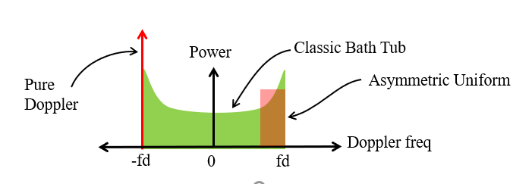
Doppler Model
C2C channels specify biased doppler profile for all channel taps.
There are different ways to model the doppler [2]:
  Classic Bathtub using Jakes’ model, Dents’ model, etc.
  Offset Classic Bathtub
  Asymmetric uniform
  Pure doppler
We propose to choose “pure Doppler” method: Doppler shift
  Every tap doppler is modeled as a single Doppler shift
  Captures the worst case instantaneous Doppler scenario
  Helpful in stress testing the performance
  Very simple to model, while other models needs to have knowledge on the number of reflectors, reflector phase, and etc.

Slide 6
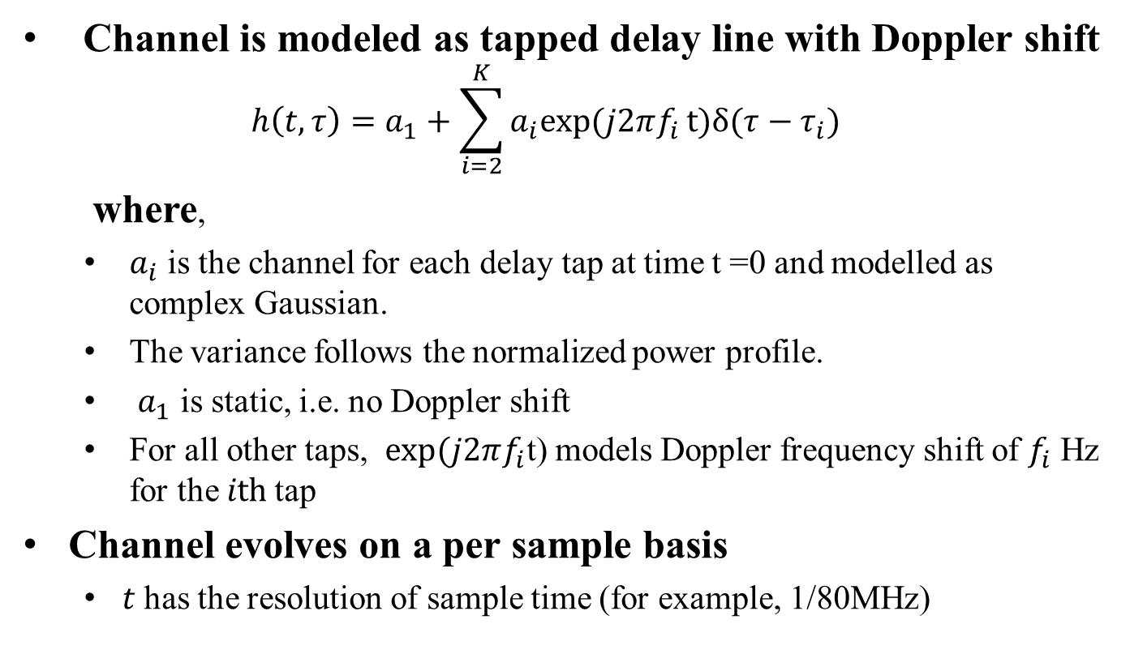
C2C Channel Model
Channel is modeled as tapped delay line with Doppler shift
  $$h\left(t,τ\right)=a_{1}+\sum_{i=2}^{K}{a_{i}exp⁡(j2πf_{i}}t)δ(τ−τ_{i})$$
  where,
  $a_{i}$ is the channel for each delay tap at time t =0 and modelled as complex Gaussian.
  The variance follows the normalized power profile.
  $a_{1}$ is static, i.e. no Doppler shift
  For all other taps, $exp⁡(j2πf_{i}$t) models Doppler frequency shift of $f_{i}$ Hz for the $ith$tap
Channel evolves on a per sample basis
  $t$ has the resolution of sample time (for example, 1/80MHz)

Slide 7
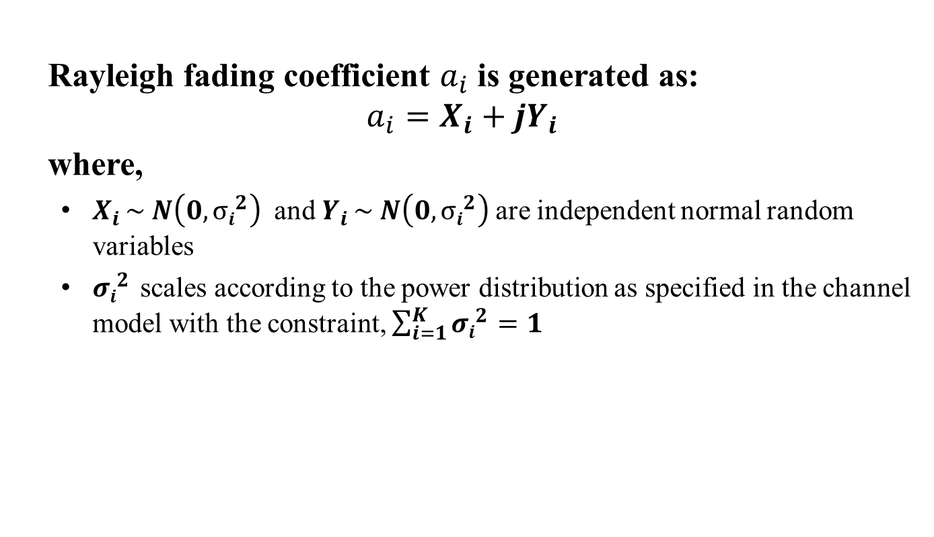
C2C Channel Model (contd.)
Rayleigh fading coefficient $a_{i}$ is generated as:
$$a_{i}=X_{i}+{jY}_{i}$$
where,
  $X_{i }\sim N\left(0,{σi}^{2}\right)$ and $Y_{i }\sim N\left(0,{σi}^{2}\right)$are independent normal random variables
  ${σi}^{2}$ scales according to the power distribution as specified in the channel model with the constraint, $\sum_{i=1}^{K}{{σi}^{2}=1}$

Slide 8

PHY Impairments
PHY impairments will affect the performance evaluation of the proposed schemes.
We suggest to follow 802.11ac functional requirement document [3] to define the PHY impairments for 802.11bd.
Summary(from [3])
  PA Non-linearity
    Use RAPP PA model as specified in document 00/294 with p = 3.
  Carrier Frequency Offset
    Randomly chosen from [-20 , 20] ppm with a uniform distribution.
  Phase noise
    The phase noise will be specified with a pole-zero model
    PSD(0) = -100 dBc/Hz
    Pole frequency fp = 250 kHz
    Zero frequency fz = 7905.7 kHz

Slide 9
Simulation
Settings
  Packet size : 300 bytes
  Packet format : 11p – BCC Coding with DFE Channel tracking
  Number of channel realizations: 1000
  Rx processing:
    Ideal timing
    CFO estimation and compensation in preamble portion
    CPE estimation and compensation in data portion
  Impairments: On/Off
    CFO
    Phase Noise

Slide 10
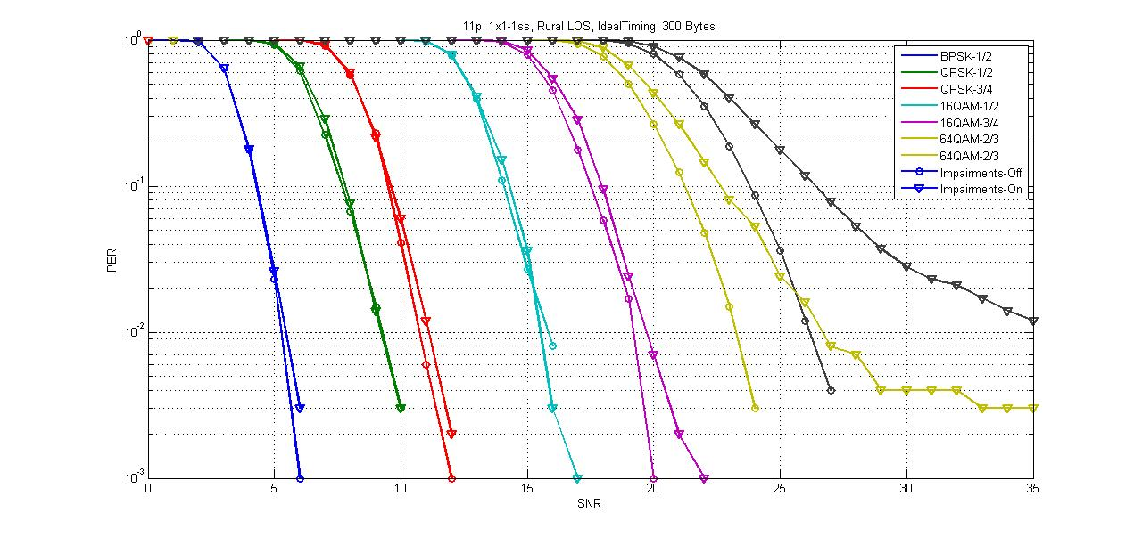
Results: Rural LOS

Slide 11
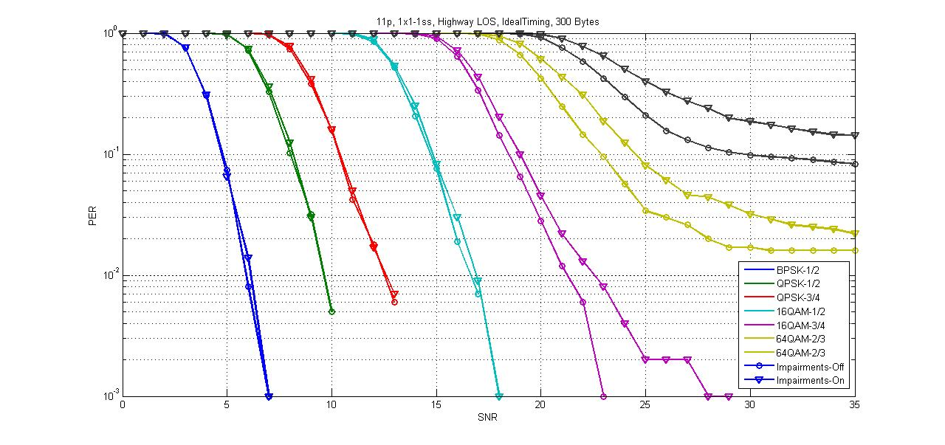
Results: Highway LOS

Slide 12
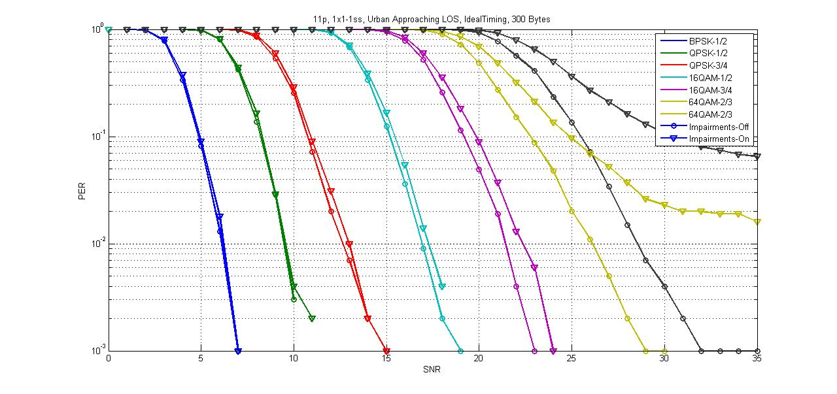
Results: Urban Approaching LOS

Slide 13
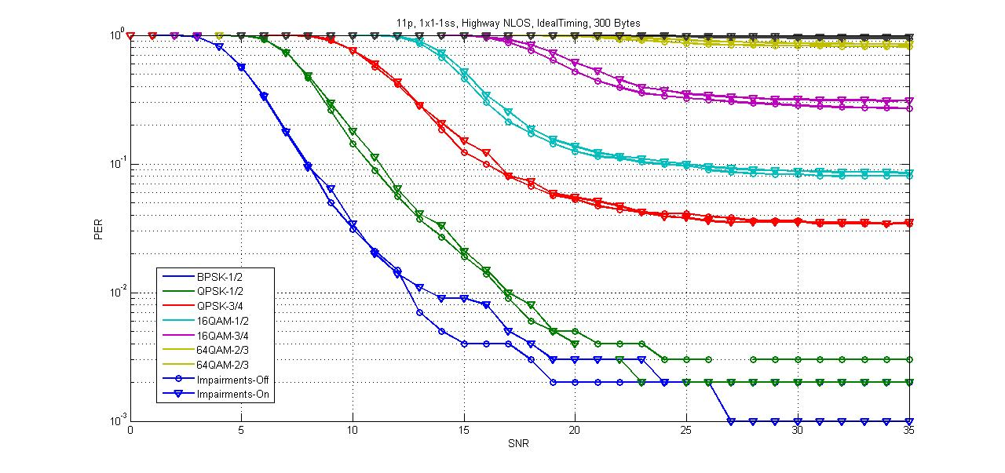
Results: Highway NLOS

Slide 14
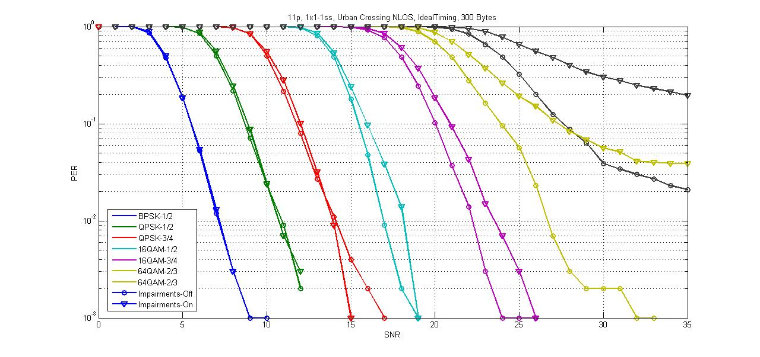
Results: Urban Crossing NLOS

Slide 15
Summary
Suggested a methodology to generate C2C channels.
  Need to oversample in order to model correct tap delay
  Use pure Doppler for each complex Gaussian channel tap
  Channel evolves on a per sample basis
Proposed to include PHY impairments based on 11ac in the simulation model for 11bd.
Provided simulation results for 11p under all C2C channels as a benchmark.
Suggest all interested personnel to simulate and calibrate their simulators for future proposals.

Slide 16
Reference
[1] Hongyuan Zhang and etc., “11-18-0858-00-0ngv-c2c-channel-model-overview”
[2] Malik Kahn, “11-14-0259-00-0reg-v2v-radio-channel-models”
[3] Peter Loc, Minho Cheong, “11-09-0451-16-00ac-tgac-functional-requirements-and-evaluation-methodology”

Slide 17
Appendix

Slide 18
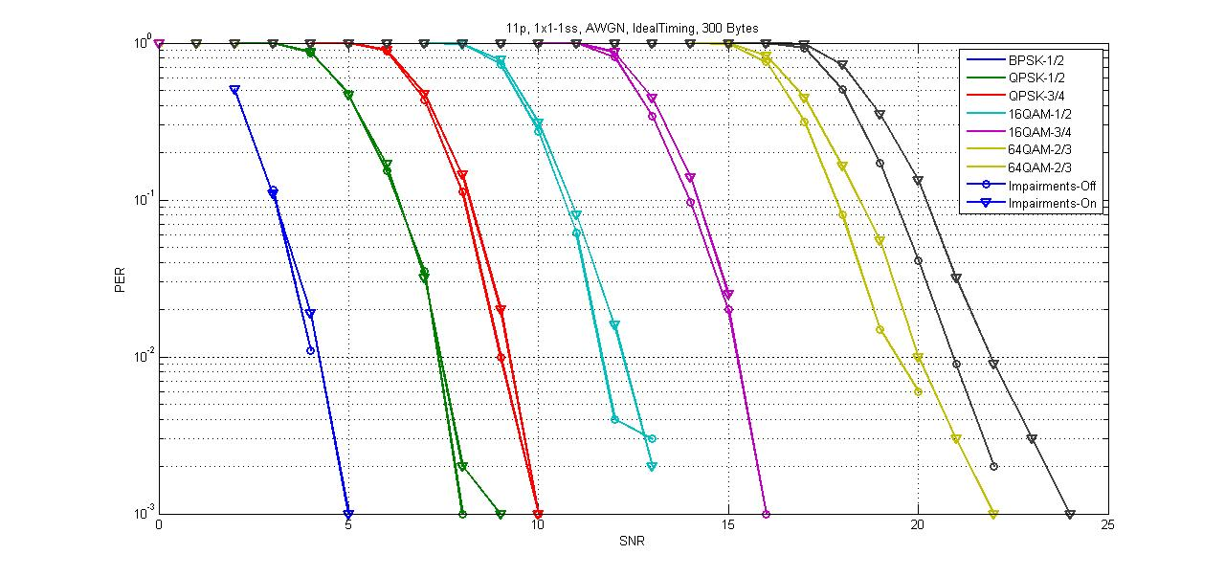
Results: AWGN

