Slide 1
WG11 Opening Report Snapshot slides 2019-01
Date: 2019-01-13
Authors:

Slide 2
Abstract
This presentation contains the IEEE 802.11 WG snapshot slides for the January 2019 session:
Editors Meeting
ANA
AANI SC
ARC SC (Architecture)
Coex SC
PAR Review SC
WNG SC (Wireless Next Generation)
JTC1
TGmd
TGax (High Efficiency WLAN)
TGay (Next Generation 60 GHz)
TGaz (Next Generation Positioning)
TGba (Wake-Up Radio)
TGbb (Light Communications)
TGbc (Enhanced Broadcast Services)
TGbd (Next Generation V2X)
EHT TIG (Extremely High Throughput)
RTA TIG (Real-time Applications)

Slide 3
Editors Meeting: Agenda for January 2019
Roll Call / Contacts / Reflector
Go round table and get brief status report
Numbering Alignment process / Spreadsheet
REVmd practice update
802.11 Mandatory Draft Review before SB
Review WG Style Guide
Additional discussion topics
Notes:
July 2007

Slide 4
ANA Status
The latest database is 11-11/0270r44 (January 2019)
Changes since last meeting:
Allocations for TGmd
Pending changes:
None

Slide 5
AANI SC
Goals:
Review the AANI SC status and activity
Report on response to Liaison Statement 11-18/1340r9
Report on Nendica
Contributions:
TBS
Agenda: See 11-18/1721r1 for background and details
AANI SC will meet for 1 session: Thu: AM1
Note: Nendica: “IEEE 802 network enhancements for the next decade” Industry Connections Activity is scheduled for Tuesday Eve (19:30-21:30).

Slide 6
ARC Architecture
Meeting slots: Tuesday PM2, Wednesday AM1, Thursday AM2
Tuesday:
IEEE 802 activities relevant to 802.11: 802.1CQ, LAAP, Proxy IPv6 Neighbor Discovery
IEEE 1588, 802.1AS (802.1ASrev) and use of 802.11 FTM
WBA liaison on MAC Address randomization follow-ups for 802.11
Wednesday:
TGba (WUR) continued discussion: 11-18/1017r0, 11-18/1020r5, 11-18/1494r2, 11-18/1641r0
Thursday:
Multiple MAC Addresses (and IPv6), “Multiple radios”
System architecture views for common use scenarios
Consider IETF DetNet/time-sensitive networking input (potential relationship to RTA TIG?)
“What is an ESS?”: 11-18/1051r3
Does TGba discussion lead into other “split” PHYs (LC, 28 GHz (Phazr))?
MLME-RESET, versus MLME-JOIN and MLME-START
AP/DS/Portal architecture and 802 concepts

Slide 7
Coexistence SC will meet twice in St Louis in Jan 2019
The Coex SC is working based on agreed goals
Discuss the use of PD, ED or other 802.11 coexistence mechanisms with the goal of promoting “fair” use of unlicensed spectrum
Promote an environment that allow IEEE 802.11ax “fair access” to global unlicensed spectrum
The Coex SC is meeting twice this week
Wed PM1
Thu PM1 (any motions)

Slide 8
Coexistence SC will focus on workshop, relationship & technical issues
Agenda items (11-18-2118) to be addressed include:
Prepare for Coexistence Workshop
Issue invitations
Discuss agenda topics
Issue call for speakers
Relationships
Review recent ETSI BRAN meeting results
Review recent 3GPP RAN1 activities
Discuss response from 3GPP RAN4 to LS
…

Slide 9
Coexistence SC will focus on workshop, relationship & technical issues
Agenda items (11-18-2118) to be addressed include:
…
Technical issues
Adaptivity in EN 301 893
LBT for management/control in NR-U
Use of preambles in NR-U
…
Motions (Thu PM1 only, if required)
Possible LS & Workshop motions

Slide 10
PAR Review SC
Not meeting this week
Will meet in March 2019 to review proposed PAR documents.
Upcoming Submission deadlines are
WG PAR submission to 802 EC: 25 Jan 2019
WG PAR Submission to NesCom: 8 Feb 2019 (for NesCom March mtg)
Notes:
May 2008
Page 10

Slide 11
WNG Wireless Next Generation
Tuesday 15 January AM1 (08:00-10:00)
Announcements
Presentations
“'Network Enablers for Seamless HMD-based VR (Virtual Reality) SG” – Subir Das (Perspecta Labs)
"An extension to 11ba: legacy transmitter solution for 802.11ba receivers” - Eduard Garcia Villegas (Universitat Politècnica de Catalunya)
Plans for March 2019
Chair will make a call for presentations in advance
Adjourn
Current agenda is document 11-18/2113r1

Slide 12
IEEE 802 JTC1 SC will meet in St Louis in Jan 2019
Agenda items (11-18-2078) addressed this week (Tue PM1) will include “the usual”:
Review extended goals
Review status of SC6 interactions
Review liaisons of drafts to SC6
Review notifications of projects to SC6
Review status of 60 day/FDIS ballots
Review SC6 activities
Update on withdrawal process of various standards, as proposed by IEEE 802
Discuss agenda & arrangements for SC6 meeting in April 2019

Slide 13
IEEE 802 has 84 standards in or through the PSDO pipeline
FDIS ballots
802.1CB passed on 26 Dec 2018
802.1Qci & 802.1Qch passed on 3 Jan 2019
802.1AC/Cor-1 closes on 17 Mar 2019
802c passed on 26 Dec 2018 (with “no” vote)
FDIS ballots
802.3bs & 802.3cc passed on 26 Dec 2018
WG | Completed | In-process
802.1 | 23 | 15
802.3 | 10 | 10
802.11 | 7 | 10
802.15 | 2 | 1
802.16 | 0 | 0
802.21 | 3 | 0
802.22 | 3 | 0
All | 48 | 36
FDIS ballots
802.11ah closes on 8 Feb 2019
802.11ai passed on 26 Dec 2018 (with “no” vote)
60-day ballots
802.11aj/ak/aq close on 10 Feb 2019

Slide 14
TGmd
Overall Status: LB236 on P802.11REVmd D2.0 passed with 92% approval, 723 comments
D2.0 incorporates all approved amendments
Since November 2018 meeting
Recirculation Working Group Letter Ballot held on P802.11REVmd D2.0
January 2019 meeting goals (4 timeslots):
Begin LB236 comment resolution
Plans for Jan - March: Comment resolution
Agenda: 11-18-2084
Notes:
doc.: IEEE 802.11-10/0503r4
May 2010
Michael Montemurro, Research in Motion
Page 14

Slide 15
TGax High Efficiency WLAN
Complete the resolution of all comments received on draft D3.0.
About 280 CIDs are still open mostly in the MAC and MU adhocs.
Pass a motion to enable the TG Editor to prepare draft D4.0 and start a 15-day recirculation motion.
Approve a new revision of the TG Coexistence Assurance document.
https://mentor.ieee.org/802.11/dcn/16/11-16-1348-04-00ax-coexistence-assurance.docx
Agenda for this meeting is available in document 11-18/2114r0.

Slide 16
TGay Next Generation 60 GHz
Since the November plenary
4 teleconference calls were held between November 28 and January 9 for comment resolution and technical presentation
50 comments are discussed
38 comments are resolved and ready for motion
3 presentations are reviewed
1 presentation is ready for motion
Draft 2.2 is posted
Coexistence assurance document (17/1288r3) is uploaded
7 sessions this week
Comment resolution against LB231 (D2.0)
Technical presentations
Review the draft readiness for working group recirculation ballot D3.0
Agenda for this meeting is available in document 11-18/2116r1

Slide 17
TGaz Next Generation Positioning
Current status:
In comment resolution coming out of CC28.
During the meeting expect to focus on comments resolution and amendment text submission targeted at improving draft quality in preparation of Jan 2019 initial WG ballot milestone (projected).
D0.6 of P802.11az available on member’s area.
Open call for volunteers for comment resolution.

Slide 18
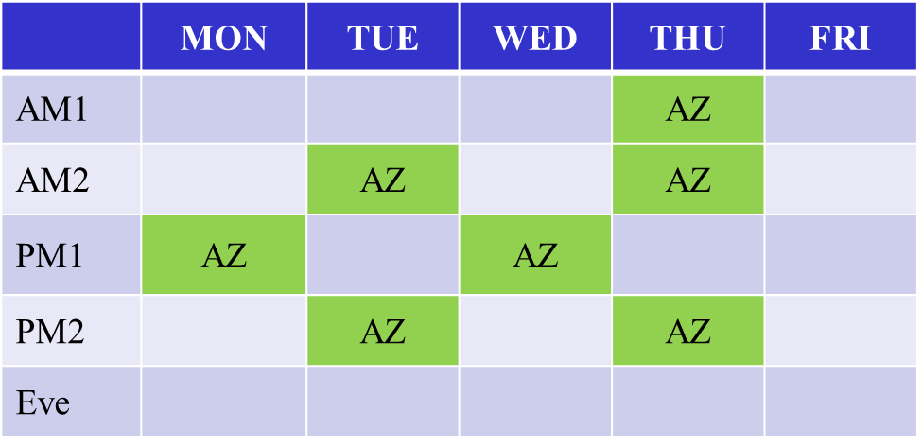
TGaz Next Generation Positioning
Upcoming milestones/approved plan:
Continue internal comment resolution during Jan. meeting.
Rejected any outstanding comment unresolved by end of Jan. meeting.
Target Initial WG ballot coming out of the Jan. 2019 meeting.
Agenda:
Refer to submission 11-18/2086

Slide 19
TGba Wake-up Radio
From the last F2F meeting
Comment resolution on TGba Draft 1.0
– In November 2018, resolved 582 comments out of 1253
Held four teleconference calls and reviewed four contributions
Reviewed TG timeline
Plan for this meeting
Complete comment resolution
Approve Working Group Technical Letter Ballot on TGba Draft 2.0
Review TG timeline
Agenda can be found in doc: IEEE 802.11-18/2109

Slide 20
TGbb
Light Communication
TGbb will discuss :
Approve minutes from the teleconferences
Use of front-end models and link to channel model
PHY evaluation metrics
Evaluation Framework document
Hear proposals
TGbb Timeline update
Four (4) meeting slots for the Jan. 2019 session
Mon – AM2; Tue – AM2; Wed – AM1 , PM2;
Proposed Agenda in doc. 11-18/2122r0

Slide 21
TGbc Enhanced Broadcast Services
Progress since November 2018:
last SG meeting as study group
TGbc approved by Standards Board on Dec. 5
Telco to plan the January meeting
January 2019 Goals:
Leadership elections
Timeline discussion
Technical submissions
3 Meeting slots: Mon PM1; Wed AM1; Thurs AM1
Agenda: 11-18/2124
Meeting / Chairs slides: 11-18/2126

Slide 22
TGbd Next Generation V2X
Since the forming of TGbd after Nov meeting
One conference call was held on Dec 11, 2018
Response to liaison feedback from WFA per NGV use cases were discussed and improved.
Liaison feedback from SAE was presented and discussed in the CC
Call for nomination for TGbd management positions: vice chair, technical editor and secretary.
Goal of 2019 Jan meeting
4 sessions scheduled for TGbd during Jan meeting
TGbd management positions election
Discussion on response to liaison feedback from WFA and SAE
TGbd timeline discussion
TGbd selection procedure discussion
Complete presentations submitted for the meeting, including use case, channel model and other technical proposals
Agenda for TGbd Jan meeting is available as in the latest revision of 11-18/2105

Slide 23
EHT SG Extremely High Throughput
Status:
Approved initial drafts for PAR and CSD submissions
Objectives:
Approve PAR and CSD documents for EC submission
Discuss technical submissions
Sessions:
Monday PM2, Wednesday PM2, Thursday AM2 & PM2

Slide 24
RTA TIG Real-Time Applications
Held two teleconferences covering several submissions on November 28th and December 12th
Goals for November meeting
Continue working on a preliminary draft of the RTA TIG report to submit to the working group
Review any final submissions
3 sessions scheduled for the RTA TIG during the January meeting
Tuesday PM1
Wednesday PM1
Thursday PM1
Agenda for this meeting is available in document 11-18/2111r0.

