Slide 1
LB234 Comment resolution for coex CIDs 3297 3361 3480 3658 3688 presentation
Date: 2018-12-18
Authors:

Slide 2
Abstract
Resolution of CIDs 3297, 3361, 3480, 3658, and 3688 is presented.

Slide 3
Beaconing role
Make known of the presence of the network
  Network Management: Scan, Neighbor report
DMG beamforming
  BTI, A-BFT, ATI/DTI

Slide 4
Proposal
DMG Beacon format
  The beacon PPDU contains RX TRN’s
  The TDD slot structure and the TDD slot schedule elements are optionally presented in the beacon
  Presence of the Extended schedule element is mandatory
  New IE DMG STA Tx Power and Rx Sensitivity parameters element is introduced to be conveyed in the DMG Beacon

Slide 5
Proposal (continuation)
Alternative beaconing procedure
  One DMG beacon frame is transmitted per each Tx antenna configuration that is established to communicate with the associated STA

Slide 6
DMG STA parameters
 | Element ID | Length | Element ID Extension | TRP | G_ADD_SENS
Octets: | 1 | 1 | 1 | 1 | 1
  TRP – Total Radiated Power
  G_ADD_SENS – Gain due to receiver’s additional sensitivity
  G_ADD_SENS = P_{min_sensitivity}-P_{sensitivity}
    where
    P_{min_sensitivity} is the receiver sensitivity for MCS 0 defined in Table 20-3,
    P_{sensitivity} is the actual PCP or AP receiver sensitivity
Figure xy —DMG STA Tx Power and Rx Sensitivity parameters element format

Slide 7
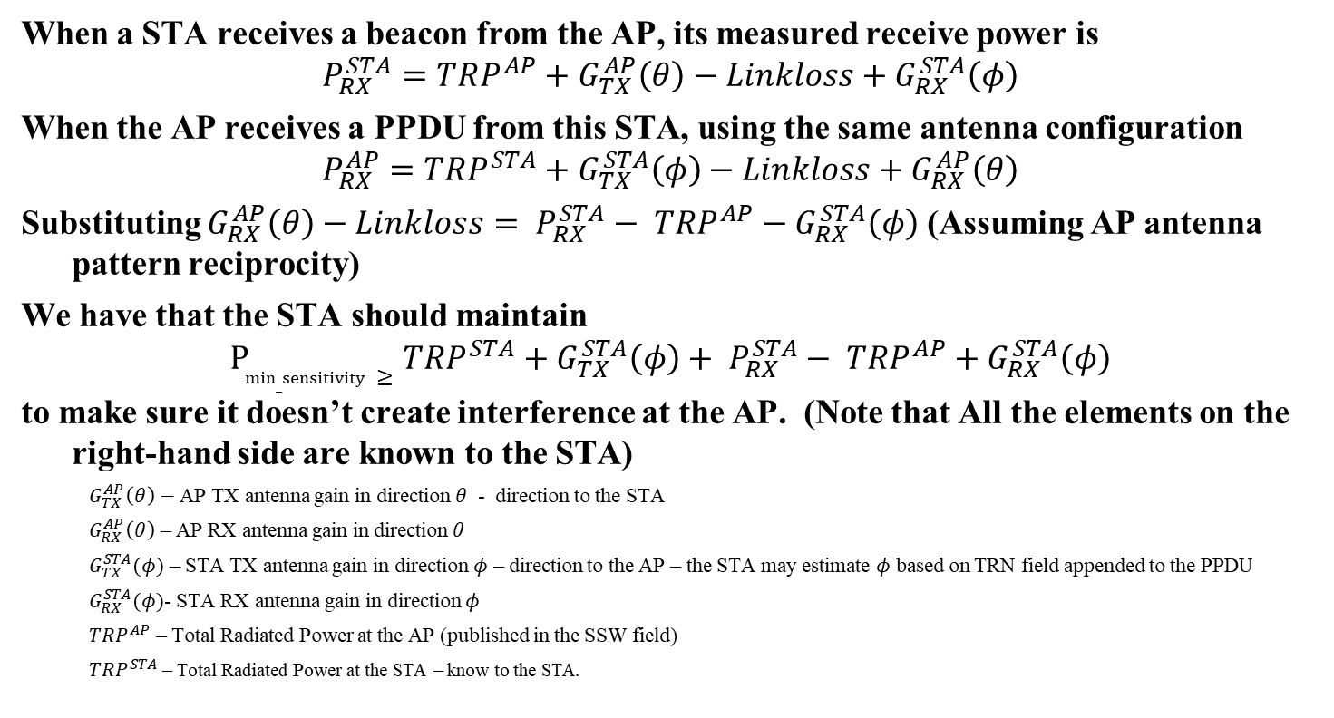
HOW TRP, G_ADD_SENS and TRN field may be used
When a STA receives a beacon from the AP, its measured receive power is
$$P_{RX}^{STA}=TRP^{AP}+G_{TX}^{AP}\left(θ\right)−Linkloss+G_{RX}^{STA}\left(φ\right)$$
When the AP receives a PPDU from this STA, using the same antenna configuration
$$P_{RX}^{AP}=TRP^{STA}+G_{TX}^{STA}\left(φ\right)−Linkloss+G_{RX}^{AP}\left(θ\right)$$
Substituting $G_{RX}^{AP}\left(θ\right)−Linkloss= P_{RX}^{STA}− TRP^{AP}−G_{RX}^{STA}\left(φ\right)$ (Assuming AP antenna pattern reciprocity)
We have that the STA should maintain
$$P_{min_sensitivity}≥TRP^{STA}+G_{TX}^{STA}\left(φ\right)+ P_{RX}^{STA}− TRP^{AP}+G_{RX}^{STA}\left(φ\right)$$
to make sure it doesn’t create interference at the AP. (Note that All the elements on the right-hand side are known to the STA)
  $G_{TX}^{AP}\left(θ\right)−$AP TX antenna gain in direction $θ$ - direction to the STA
  $G_{RX}^{AP}\left(θ\right)$ – AP RX antenna gain in direction $θ$
  $G_{TX}^{STA}(φ)$ – STA TX antenna gain in direction $φ$ – direction to the AP – the STA may estimate $φ$ based on TRN field appended to the PPDU
  $G_{RX}^{STA}(φ)$- STA RX antenna gain in direction $φ$
  $TRP^{AP}$ – Total Radiated Power at the AP (published in the SSW field)
  $TRP^{STA}$ – Total Radiated Power at the STA – know to the STA.

Slide 8
HOW TRP, G_ADD_SENS and TRN field may be used – cont.
For example,
if the TRP is 10dBm, and the STA receives the beacon at - -54dBm.
If the STA transmits at 10dBm (TRP^{STA}) and the STA and the AP have antenna reciprocity, the AP receives at -54dBm
In order for the STA to cause interference at the AP with receive power less that -78dBm, it needs to either reduce the TRP, or use an antenna pattern that has lower gain in the direction of the AP.

