Slide 1
LB234 Comment resolution for coex CIDs 3297 3361 3480 3658 3688 presentation
Date: 2018-12-18
Authors:

Slide 2
Abstract
Resolution of CIDs 3297, 3361, 3480, 3658, and 3688 is presented.

Slide 3
Proposal
An AP STA that employs TDD channel access operation (11-18-1801), transmits DMG beacon as defined below
  One beacon frame is transmitted per each Tx antenna configuration that is established to communicate with the associated STA - mandatory
  The beacon PPDU contains RX TRN’s
  The TDD slot structure and the TDD slot schedule elements are optionally presented in the beacon
  Presence of the Extended schedule element is mandatory

Slide 4
Proposal (continuation)
The beacon frame may contain G_ADD_SENS, and TRP parameters – optional
  TRP – Total Radiated Power
  G_ADD_SENS = P_{min_sensitivity}-P_{sensitivity}
    where
    P_{min_sensitivity} is the receiver sensitivity for MCS 0 defined in Table 20-3,
    P_{sensitivity} is the actual PCP or AP receiver sensitivity

Slide 5
SSW field format
B0 | B1 B6 | B7 B9 | B10 B15 | B16 B17 | B18 B22 | B23
Direction | TRP | Reserved | Sector ID | DMG Antenna ID | G_ADD_SENS | TDD channel access operation
1 | 6 | 3 | 6 | 2 | 5 | 1
Figure 105y —SSW field format when transmitted in a DMG Beacon frame of the TDD channel access operation

Slide 6
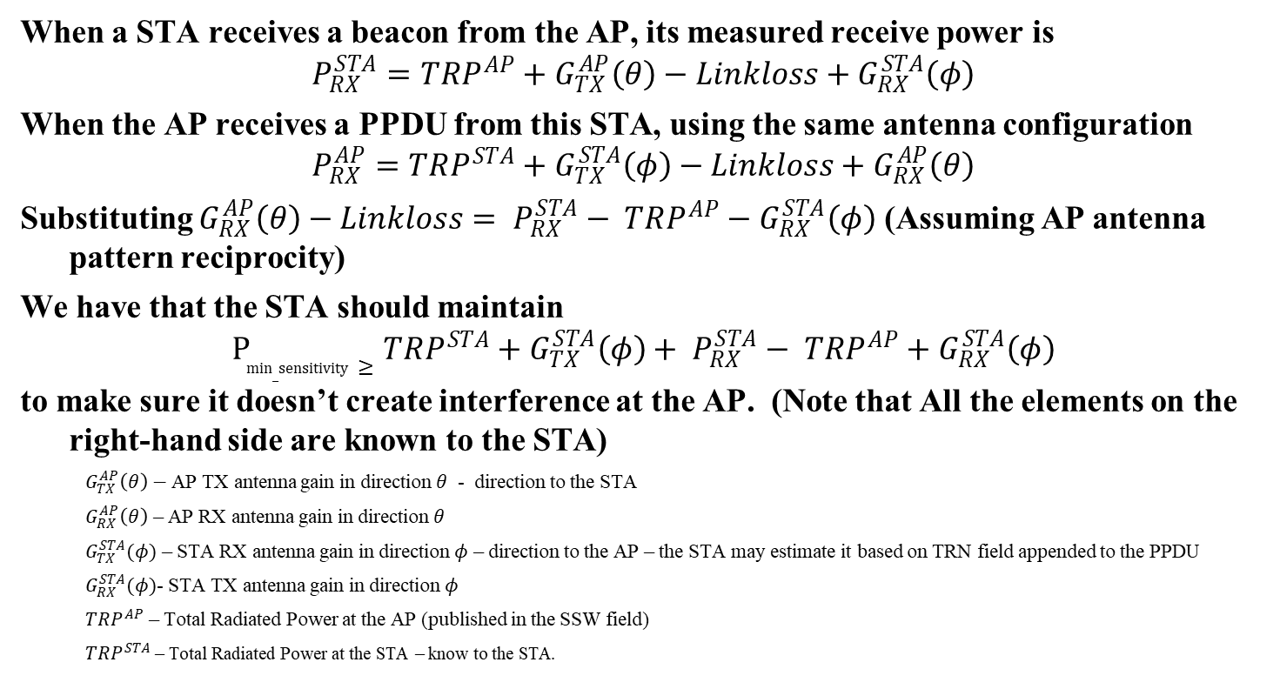
HOW TRP, G_ADD_SENS and TRN field may be used
When a STA receives a beacon from the AP, its measured receive power is
$$P_{RX}^{STA}=TRP^{AP}+G_{TX}^{AP}\left(θ\right)−Linkloss+G_{RX}^{STA}\left(φ\right)$$
When the AP receives a PPDU from this STA, using the same antenna configuration
$$P_{RX}^{AP}=TRP^{STA}+G_{TX}^{STA}\left(φ\right)−Linkloss+G_{RX}^{AP}\left(θ\right)$$
Substituting $G_{RX}^{AP}\left(θ\right)−Linkloss= P_{RX}^{STA}− TRP^{AP}−G_{RX}^{STA}\left(φ\right)$ (Assuming AP antenna pattern reciprocity)
We have that the STA should maintain
$$P_{min_sensitivity}≥TRP^{STA}+G_{TX}^{STA}\left(φ\right)+ P_{RX}^{STA}− TRP^{AP}+G_{RX}^{STA}\left(φ\right)$$
to make sure it doesn’t create interference at the AP. (Note that All the elements on the right-hand side are known to the STA)
  $G_{TX}^{AP}\left(θ\right)−$AP TX antenna gain in direction $θ$ - direction to the STA
  $G_{RX}^{AP}\left(θ\right)$ – AP RX antenna gain in direction $θ$
  $G_{TX}^{STA}(φ)$ – STA RX antenna gain in direction $φ$ – direction to the AP – the STA may estimate it based on TRN field appended to the PPDU
  $G_{RX}^{STA}(φ)$- STA TX antenna gain in direction $φ$
  $TRP^{AP}$ – Total Radiated Power at the AP (published in the SSW field)
  $TRP^{STA}$ – Total Radiated Power at the STA – know to the STA.

Slide 7
HOW TRP, G_ADD_SENS and TRN field may be used – cont.
For example,
if the TRP is 10dBm, and the STA receives the beacon at - -54dBm.
If the STA transmits at 10dBm (TRP^{STA}) and the STA and the AP have antenna reciprocity, the AP receives at -54dBm
In order for the STA to cause interference at the AP with receive power less that -78dBm, it needs to either reduce the TRP, or use an antenna pattern that has lower gain in the direction of the AP.

