Slide 1
EHT Use Case Discussion: VR Requirement Follow Up
Date: 2018-11-11
Authors:

Slide 2
Summary
Reference [1] has introduced the use case of VR, including the scenario and requirement of throughput and latency
This presentation further analyzes the effect of latency and interference

Slide 3



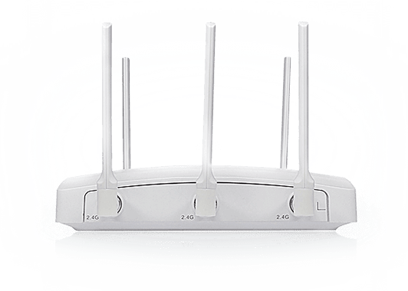
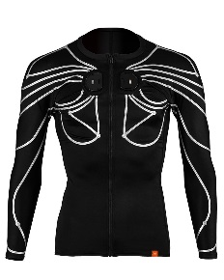
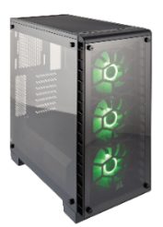


Background: VR Use Cases [1]
VR Movie, VR Gaming, Virtual Social, VR Live Broadcasting
  AP plays a key role in VR system
Bad Experience:
  Insufficient image clarity
  Image smearing
  Black border
  Dizziness
  Head display is very heavy because
  of lots of image processing
Cloud VR
Home VR
Portable VR

Slide 4
Background: VR Requirement
The requirement of VR is calculated in the following table [1]
Typical requirement of VR for Wireless Transmission
  Raw stream or lightly compressed stream is preferred → PHY Link Throughput > 30Gbps
  The total latency should be ≤20ms [2],
    total latency(video) = T_trans(Data) + T(Decompression) + T(Rendering) + T(Display);
    total latency(game) = T_trans(Data) + T_trans(Control) + T(Compression) + T(Decompression) + T(Rendering) + T(Display)
 | PPD | Horizontal FOV | Vertical FOV | Monocular Video Resolution | Bits per Pixel | Frame Rate | Yuv444/ yuv420 | Raw Rate (Gbps) | Lightly Compressed Rate (Gbps) | Compressed Rate (Gbps) | RTT Latency
Partial Immersion | 30 | 210 | 100 | 6300*3000 | 12 | 60 | 3/1.5 | 2D, 40.83/ 20.42 | 2D, 4.08/ 2.04 | 2D, 0.20/ 0.10 | 10ms
 |  |  |  |  |  |  |  | 3D, 81.66/ 40.84 | 3D, 9.66/4.04 | 3D, 0.48/0.20
Deep Immersion | 45 | 360 | 100 | 16200*4500 | 12 | 90 | 3/1.5 | 2D, 236.20/118.10 | 2D, 23.6/ 11.8 | 2D, 1.18/0.59 | 5ms
 |  |  |  |  |  |  |  | 3D, 472.40/236.20 | 3D, 47.2/23.6 | 3D, 2.36/1.18
Ultimate Immersion | 60 | 360 | 120 | 21600*7200 | 12 | 144 | 3/1.5 | 2D, 806.22/403.11 | 2D, 80.62/ 40.31 | 2D, 4.03/2.02 | 5ms
 |  |  |  |  |  |  |  | 3D, 1612.44/806.22 | 3D, 161.24/80.62 | 3D, 8.06/4.03
  * Assuming the compression ratio is 1/200 (H.265)

Slide 5

Case1: Latency from Compression/Decompression
Image/Video compression and decompression are good for reducing required data rate, but they increase the system latency at the same time
  Usually either compression or decompression takes several tens of ms → 10ms for each is an extremely small number
VR Video
VR Game
T(Compression)=10ms
T_trans(Data)
T_trans(Control)
T_trans(Data)
T(Decompression)=10ms
T(Rendering) ~= 3ms
T(Display) ~= 5ms
T(Decompression)=10ms
T(Rendering) ~= 3ms
T(Display) ~= 5ms

Slide 6
Analysis of Data Rate and Latency from Compression and/or Decompression
total latency(video)
  T_trans(Data) + T(Decompression) + T(Rendering) + T(Display) = T_trans(Data) + 10 + 3 + 5 ≤ 20ms → T_trans(Data) ≤ 2ms
  The transmission latency for data could be met for video
total latency(game)
  T_trans(Data) + T_trans(Control) + T(Compression) + T(Decompression) + T(Rendering) + T(Display)
  = T_trans(Data) + T_trans(Control) +28
  It is impossible to meet the latency requirement of VR (20ms) if we apply full compression at the server.
  Only uncompressed video or lightly compressed video can meet the requirement of latency of game.
 | Yuv444/ yuv420 | Raw Rate (Gbps) | Lightly Compressed Rate (Gbps) | Compressed Rate (Gbps)
Partial Immersion | 3/1.5 | 2D, 40.83/ 20.42 | 2D, 4.08/ 2.04 | 2D, 0.20/ 0.10
 |  | 3D, 81.66/ 40.84 | 3D, 9.66/4.04 | 3D, 0.48/0.20
Deep Immersion | 3/1.5 | 2D, 236.20/118.10 | 2D, 23.6/ 11.8 | 2D, 1.18/0.59
 |  | 3D, 472.40/236.20 | 3D, 47.2/23.6 | 3D, 2.36/1.18
Ultimate Immersion | 3/1.5 | 2D, 806.22/403.11 | 2D, 80.62/ 40.31 | 2D, 4.03/2.02
 |  | 3D, 1612.44/806.22 | 3D, 161.24/80.62 | 3D, 8.06/4.03

Slide 7


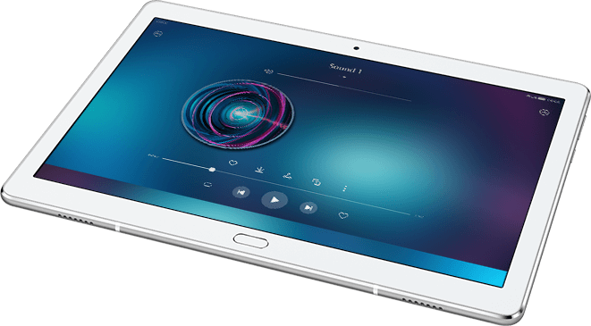
Case2: Latency from Contentions and Collisions
We have done a VR test for video transmission in the real environment
  Scenario: One VR transmission only with four surrounding neighbors
  11ac AP, 5GHz, BW: 20MHz, single stream, transmission rate: 40Mbps
Neighbor 3 (Upstairs)
Scenarios | User Experience
Two parallel transmissions in adjacent channels | Packet Loss: a few Latency: a few longer than 20ms
One co-channel transmission and two parallel transmissions in adjacent channels | Packet Loss: frequent Latency: almost all longer than 20ms →Continuously frozen
Neighbor 1
around -40dB
Neighbor 2
around -70dB
Neighbor 4 (Downstairs)

Slide 8
Analysis from the Test
Co-channel contentions/collisions result in a much longer latency, which affects the user experience of AR/VR a lot

Slide 9
Conclusion
WLAN should support sufficient throughput and try to limit the latency in an acceptable number
  Raw video or lightly compressed video has to be used in VR game → WLAN has to ensure the throughput requirement from the transmission of raw video or lightly compressed video as shown in page 6
  Interference is another key factor that has to be considered

Slide 10
Reference
[1] 11-18-0846-02-0wng-802-11-for-sub-7ghz-next-generation-phy-mac
[2] 21-1-0073-00-0000-hmd-based-vr-applications-issues-and-challenges

