Slide 1
HARQ in EHT
Date: 2018-11-12
Authors:
Name | Affiliation | Address | Email
Imran Latif | Quantenna Communications | 1704 Automation Parkway, 95131, San Jose, CA, USA | ilatif@quantenna.com
Sigurd Schelstraete |  |  | sschelstraete@quantenna.com
Debashis Dash |  |  | ddash@quantenna.com
Huizhao Wang |  |  | hwang@quantenna.com
Ambroise Popper |  |  | apopper@quantenna.com

Slide 2
Background
Hybrid-ARQ is a well-studied and widely used mechanism in wireless, especially cellular communications, to improve link efficiency
For example, LTE, LTE-A, 5G and it has been part of in 802.16
HARQ presentations were made in previous meetings[1][2]
EHT seems to have clear interest in exploring HARQ as a candidate technology
We present some simple results of our investigation and way forward for HARQ in EHT

Slide 3
HARQ Simulation Parameters
Pure PHY level simulation to observe the PHY gain
No MAC level overhead considered
MPDU = Codeword
SISO simulations
Only one retransmission
Channel D
Block channel (highly correlated channels between retransmissions)
iid channel (even between retransmissions)
Chase Combining (CC) HARQ (retransmission + combining of same packet)
Simulated MCS 0 - 7
Throughput results (total number of bits/total time)
Fair Link level performance evaluations
Retransmissions consume resources so gains should reflect that, i.e., PER analysis is not fair

Slide 4
CC HARQ - Results
High Complexity + High Storage Requirement
Low Complexity + Low Storage Requirement

Slide 5
HARQ take-away from Results
In previous results 3-4dB of gain for CC was shown
Our results verify that gain
HARQ gain highly depends on channel variation (only frequency domain is considered here)
Depending on correlation in channel, HARQ gain varies
Since ARQ always happen, combining data on the receiver side does no harm (of course at the expense of increased computational complexity + storage)
Higher MCS -> higher complexity + higher storage
Higher throughput gains
Lower MCS -> relatively lower complexity + lower storage
Range extension
➔ Sweet spot to use HARQ at lower rates for purposes of range extension

Slide 6
HARQ take-away from Results
With Incremental Redundancy (IR) version of HARQ, expected gains can be higher than CC (IR is not simulated here)
However, these type of throughput based results are not sufficient enough to evaluate the benefits of HARQ.
Detailed analysis of various implementation aspects of HARQ for EHT is required.

Slide 7
Implementation Aspects for HARQ in EHT
MAC level protocol support for HARQ on top of ARQ and combining with the effects of rate adaptation
HARQ based control information for each packet at PHY level
Simpler techniques of HARQ requiring less memory and low retransmission and acknowledgment overhead
New feedback mechanism to support HARQ retransmissions
feedback based on codeword and MPDU level
Storage on Tx side for sending either the failed codewords or failed MPDUs in retransmissions
Storage on Rx side to combine MPDUs and codewords until various (2-3) retransmissions
CC Vs. IR-HARQ for LDPC
Complexity Vs. Performance
L-STF
L-LTF
L-SIG
…
HARQ-SIG
DATA
Legacy Preamble

Slide 8
Summary
We present our findings about implementation of simplest HARQ scheme and show the gains which are being presented and discussed.
But does these gains fit EHT scope ?
Range extension for low complexity Vs. Throughput gain for higher complexity
It needs further analysis considering various implementation factors some of which we mentioned in this presentation.
It is essential to discuss these implementation aspects (and other aspects which we did miss in this presentation) and include them in evaluation study.

Slide 9
Reference
[1] Shimi Shilo – HARQ for EHT (DCN:1587) – 13 Sep 2018
[2] Ron Porat – Multi-AP-HARQ-for-EHT (DCN: 1116) – 6 July 2018

Slide 10
Backup Slides

Slide 11
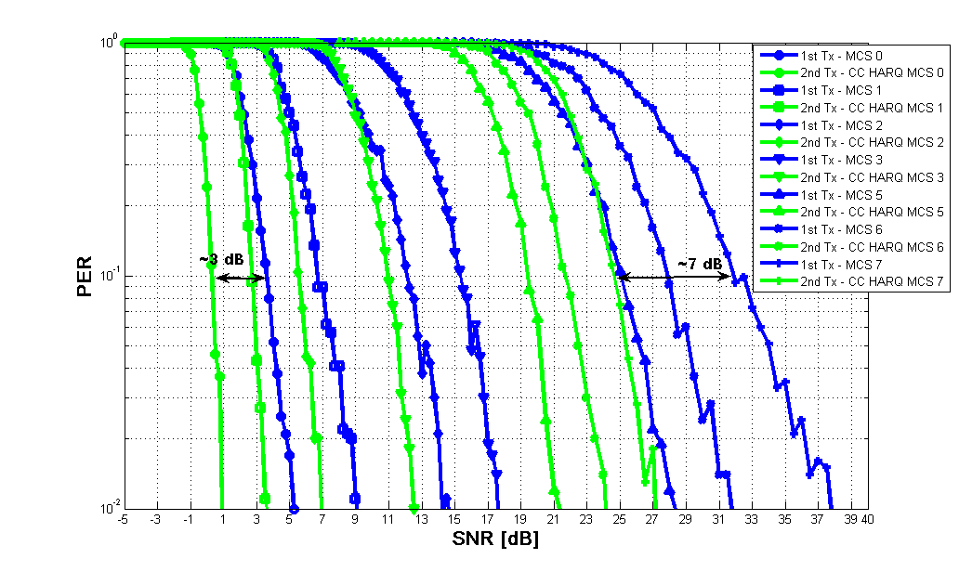
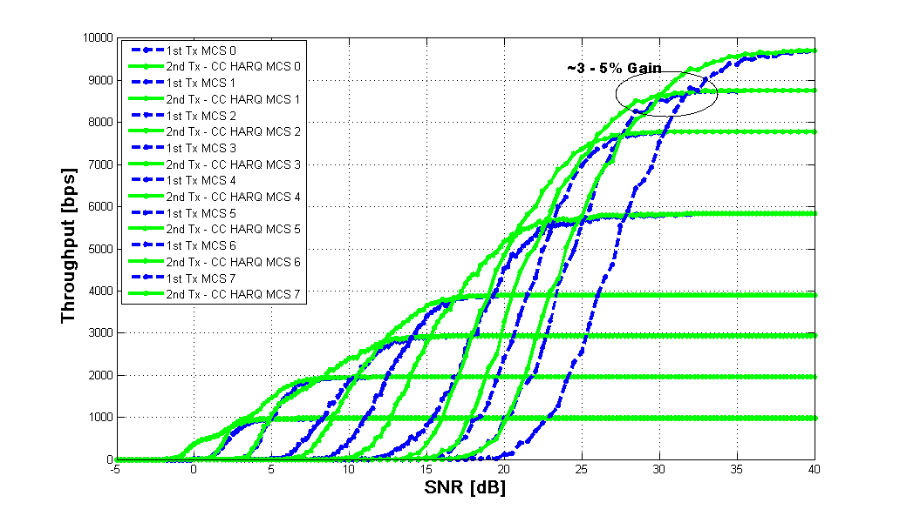
HARQ performance in Wi-Fi
3-4 dB gain was claimed for CC-HARQ lower MCS
PER results shown here confirm this
Results for channel D (iid realizations between retransmissions) are shown below using CC-HARQ
PER results do not translate directly into performance gain when compared as effective throughput (total number of bits/total time)

Slide 12
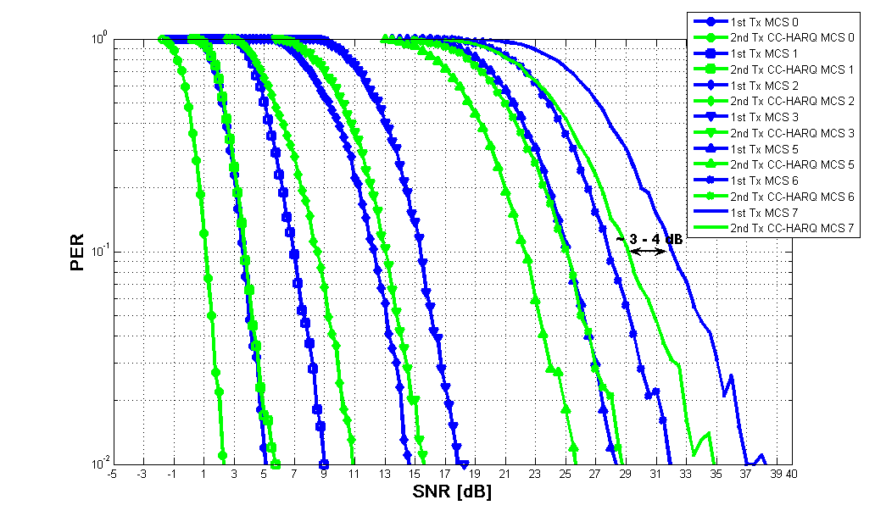
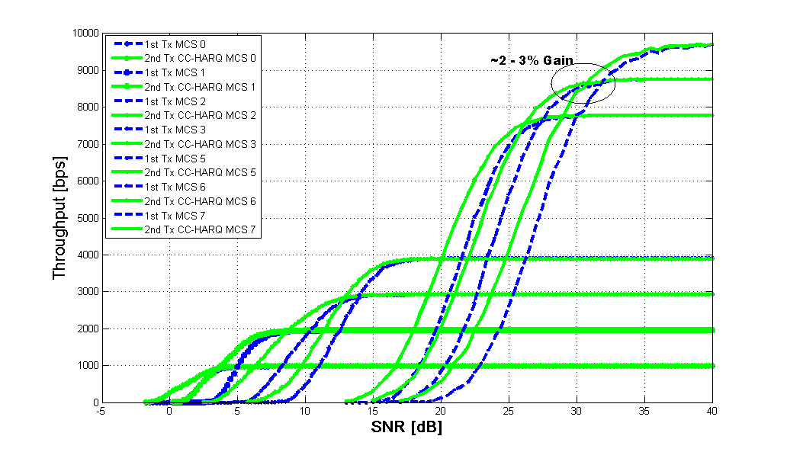
HARQ Performance Review
Results for block channel between retransmissions
Mostly range extension based on throughput
Depending on correlation in channel, throughput even reduces
Fair Link level performance evaluations
Retransmissions consume resources so gains should reflect that, i.e., PER analysis is not fair
Things to consider:
Relatively small gains at high MCS in throughput curves
Growing complexity to accommodate high rates with HARQ
➔ Sweet spot to use HARQ at lower rates for purposes of range extension

