Slide 1
Discussion on Target Use Cases of RTA
Date: 2018-11-13
Authors:
Notes:
Hello everyone. I am Akira Kishida from NTT.
I’d like to introduce my presentation entitled as “Discussion on Target Use Cases of RTA”.
The document number is 1978r0.

Slide 2
Abstract
This presentation introduces key use cases of RTA for industrial business.
  Haptic technology, drone control
  In these use cases, high stability is required while required data rate is low.
  In case of pushing “rich” contents such as video streaming, high data rate is required.
We also discuss use cases that require both low latency and high data rate such as AR/VR, 4K/8K video streaming.
  Some of real time gaming would be “rich” contents in the near future.
  We should decide whether high data rate RTA (Real Time Applications) should be included in the scope of RTA TIG or not.
Notes:
This presentation introduces key use cases of RTA for industrial business. That is, Haptic technology and drone control.
In these use cases, high stability is required while required data rate is low. On the other hand, in case of pushing “rich” contents such as video streaming, high data rate is required.
Then, we also discuss use cases that require both low latency and high data rate such as AR/VR, 4K/8K video streaming.
We think that some of real time gaming would be “rich” contents in the near future.
Therefore, we should decide whether high data rate RTA (or Real Time Applications) should be included in the scope of RTA TIG or not.

Slide 3
Additional use cases for RTA
Real-time gaming, robotics and industrial automation are the targets as use cases of RTA so far [1].
  These use cases require low data rate.
  Requirements concerning stability such as jitter and packet loss are important for these use cases.
We introduce some additional use cases to robotics and industrial automation.
  Haptic technology
  Drone control
“Guaranteed” communication might be promising in Wi-Fi systems and will be demanded.
Notes:
According to the draft of Report of RTA, real-time gaming, robotics and industrial automation are the targets as use cases so far.
These use cases require low data rate and requirements concerning stability such as jitter and packet loss are very important.
Then, we introduce some additional use cases to robotics and industrial automation with similar requirement, that is, Haptic technology and Drone control.
We believe that “Guaranteed” communication might be promising in Wi-Fi systems and will be demanded.

Slide 4

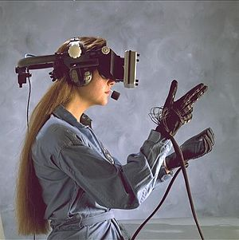

Haptic technology
Haptic technology recreates the sense of touch by applying forces, vibrations, or motions to the user.
  If we can replace wired connection from devices to the server, flexibility of application would be expanded.
Low latency, jitter, packet loss will be required.
  At least < 5ms latency should be demanded [2].
Notes:
We introduce a use case of Haptic technology.
Haptic technology is a technology that recreates the sense of touch by applying forces, vibrations, or motions to the user.
Like this illustration, almost connections from user equipment to a processing server are wired so far.
If we can replace wired connection from devices to the server, flexibility of application would be expanded.
In this use case, low latency, jitter, packet loss will be required.
According to Qualcomm’s whitepaper, at least less than 5ms latency should be demanded.

Slide 5
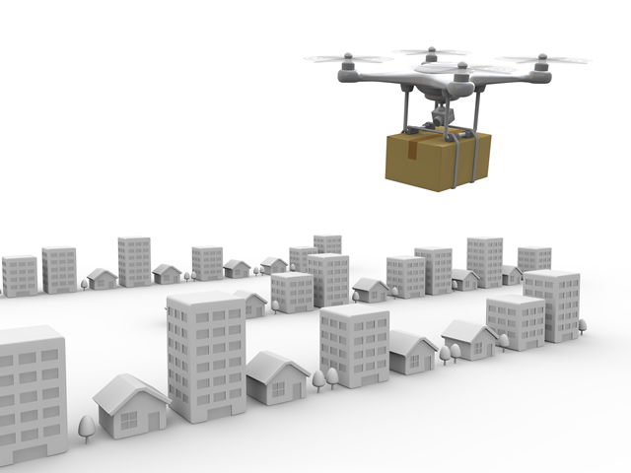
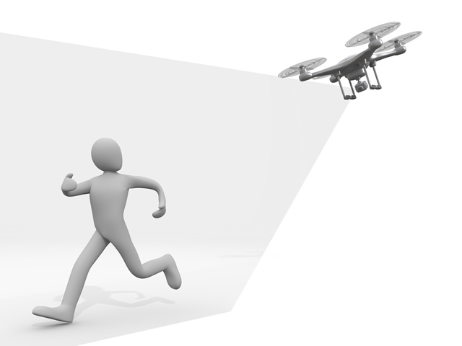
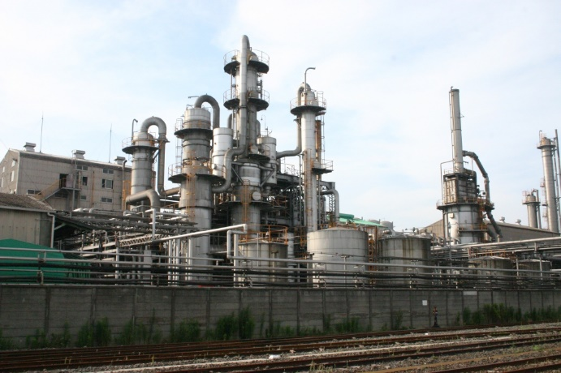
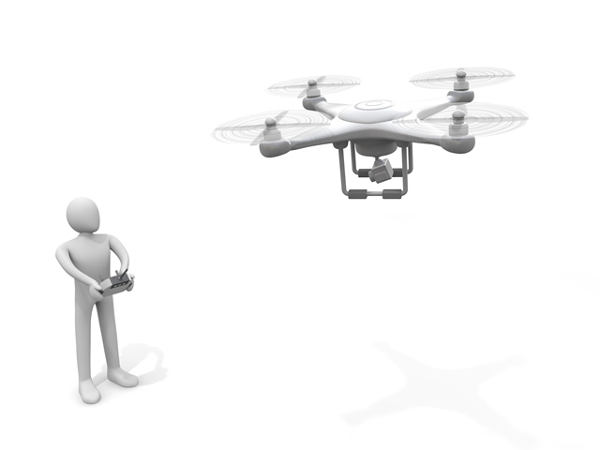
Drone control
Manufacturing and industry
Steamlines inspection, management.
Alternates high-place work.
Logistics
Wi-Fi would be utilized within limited site like warehouse.
Security
Drones equip a camera and take photos and/or videos.
Drone is a key device for several business.
  Manufacturing, industry, logistics, security, agriculture and entertainment for example.
Wi-Fi would be suitable wireless system for drone if either of the following requirements is achieved.
  Low data rate enough for control signals with low latency and jitter.
  High data rate with sufficient capacity for video streaming.
Notes:
We also introduce a use case of Drone control.
As shown in these illustrations, drone is a key device for several business such as
manufacturing, industry, logistics, security, agriculture and entertainment for example.
In this case, Wi-Fi would be suitable wireless system for drone if either of the following requirements is achieved.
One is low data rate enough for control signals with low latency and jitter.
The other is High data rate with sufficient capacity for video streaming.

Slide 6
Requirements of the additional use cases
Use cases |  | Latency | Jitter | Packet loss | Data rate
Robotics and industrial automation | Haptic technology | < 1 ms ~ 5 ms | < 0.2 ~ 2 ms | Loss less required | < 1 Mbps
 | Drone control | < 100 ms | < 10 ms | Loss less required | < 1 Mbps > 100 Mbps (with video streaming)
*Detailed numbers of the requirements are further investigation.
Requirements of data rate are low for control signals.
  However, required data rate would be high if these cases require “rich” contents such as video streaming.
  If 4K/8K video streaming is utilized, data rates of Gbps’ might be required.
Not “best effort”, but “guaranteed” communication is required.
Notes:
Tentative requirements of those use case are shown in this table.
As shown in the table, requirements of data rate are low for control signals.
However, required data rate would be high if these cases require “rich” contents such as video streaming.
If 4K/8K video streaming is utilized, data rates of Gbps’ might be required.
These use cases require “guaranteed” communication as well as other industry automation use cases.

Slide 7
Requirements of use cases on the RTA TIG’s report [1]
Use cases |  | Latency | Jitter* [4] | Packet loss | Data rate
Real-time gaming [1] |  | < 10 ms | < 5 ms | < 0.1 % | < 1 Mbps
Robotics and industrial automation [3] | Equipment control | < 1 ms ~ 10 ms | < 0.2 ~ 2 ms | Near-loss less | < 1 Mbps
 | Quality supervision | > 10’s ms | > 1 ms | Near-loss less | < 1 Mbps
 | Factory resource management | > 100 ms | > 20 ms | Varies | < 1 Mbps
 | Display | > 100 ms | > 20 ms | Varies | < 10’s Mbps
 | Human safety | < 1 ms ~ 10 ms | < 0.2 ~ 2 ms | Near-loss less | < 1 Mbps
*Jitter values are calculated from [3]
Requirements of data rate are low as well.
According to [4], most industrial automations require “loss less” (BLER of 10⁻⁷ % to 10⁻⁵ %).
Notes:
On the other hand, requirements of use cases on the RTA TIG’s report are shown in this table.
According to the table, requirements of data rate are low as well.
Moreover, most industrial automations require high stability with near loss less packet loss characteristics.

Slide 8
Real-time gaming in the future
According to the Report of RTA TIG, requirements of data rate is very low because only control signals are considered.
The communication bandwidth a console and a controller (a user equipment device) will be “rich” such as AR/VR application in the real-time gaming in the future.
  Approximately 5 Gbps will be required for AR/VR (8K, 90+FPS, HDR, 6 Depth of Field video or free-viewpoint) [2].
Notes:
According to the draft version of Report of RTA TIG, requirements of data rate is very low because only control signals are considered.
However, the communication bandwidth a console and a controller (a user equipment device) will be “rich” such as AR/VR application in the real-time gaming in the future.
Especially, approximately 5 Gbps will be required for AR/VR according to Qualcomm’s whitepaper.

Slide 9
Requirements of AR/VR, 4K/8K video [5]
Use cases |  | Latency | Jitter | Packet loss | Data rate
VR | Partial immersion | <10 ms | (not mentioned) |  | > 500 Mbps
 | Deep immersion | < 5 ms |  |  | > 1000 Mbps
Video | 4K (Compressed) | < 20 ms | < 20 ms | 3e-7 | > 100 Mbps
 | 8K (Compressed) | < 20 ms | < 20 ms | 3e-7 | > 200 Mbps
Required data rates are very high.
AR/VR is the one of the target use case of EHT SG.
Development of PHY layer technologies will be demanded.
Notes:
This table indicates requirements of AR/VR from David’s contribution in WNG SC.
Required data rates for those use cases are very high and AR/VR is the one of the target use case of EHT SG.
We think that development of PHY layer technologies will be required to achieve very high data rate.

Slide 10
Wireless VR in EHT [5]
According to the John Son’s contribution [6], latency characteristics of VR contents streaming under various configurations are investigated in EHT SG.
The wireless VR was discussed as one of the main use cases for EHT [5][7][8]
In July meeting, the motion for EHT SG formation was passed as follows: [9]
  Approve formation of the 802.11 Extremely High Throughput (EHT) Study Group to consider development of a Project Authorization Request (PAR) and a Criteria for Standards Development (CSD) responses for a new 802.11 amendment for operating in the bands between 1 and 7.125 GHz, with the primary objectives:
    To increase peak throughput and improve efficiency
    To support high throughput and low latency applications such as video-over-WLAN, gaming, AR and VR
Notes:
In EHT SG, the wireless VR was discussed as one of the main use cases.
Besides, according to the John Son’s contribution, latency characteristics of VR contents streaming under various configurations are investigate.
Moreover, In July meeting, the motion for EHT SG formation was passed as follows.
Approve formation of the 802.11 Extremely High Throughput (EHT) Study Group to consider development of a Project Authorization Request (PAR) and a Criteria for Standards Development (CSD) responses for a new 802.11 amendment for operating in the bands between 1 and 7.125 GHz, with the primary objectives:
To increase peak throughput and improve efficiency
To support high throughput and low latency applications such as video-over-WLAN, gaming, AR and VR.

Slide 11
Discussions
RTA missions
  Investigate latency and stability issues observed with real time applications such as mobile and multiplayer games, robotics and industrial automation.
  Potential mechanisms to address the identified issues.
Use cases that require both low latency and high data rate
  Some of industrial automation and robotic that push “rich” contents.
  AR/VR.
  Future real-time gaming that requires heavy data traffic.
Should we include those use cases or not?
  If it is yes, joining EHT SG is one of the options.
  If it is no, we should focus on the development of MAC layer and upper solutions, not in PHY layer.
Notes:
Then we would like to discuss about these use cases that require both low latency and high data rate.
RTA missions described the Report indicate that
Investigate latency and stability issues observed with real time applications such as mobile and multiplayer games, robotics and industrial automation.
Potential mechanisms to address the identified issues.
So, I would like to discuss that we should include those use cases or not.
If it is yes, I think that joining EHT SG is one of the options.
If it is no, I think that the development of MAC layer and upper solutions are good way to progress for RTA TIG.
In this case, PHY layer should be out of the scope.

Slide 12
Conclusions
Two additional use cases are introduced.
  Haptic technology, drone control .
  In these use cases, high stability is required while required data rate is low.
  In case of pushing “rich” contents such as video streaming, high data rate is required.
We should decide whether high data rate RTA (Real Time Applications) should be included in the scope of RTA TIG or not.
  AR/VR (discussions are in progress in EHT SG).
  Future real-time gaming that requires high data rate.
Notes:
Then, we summarize this presentation.
Two additional use cases are introduced. That is, Haptic technology and drone control .
In these use cases, high stability is required while required data rate is low.
Moreover, in case of pushing “rich” contents such as video streaming, high data rate is required.
We should decide whether high data rate RTA (Real Time Applications) should be included in the scope of RTA TIG or not.
Discussions of AR/VR are already in progress in EHT SG.
And some of real-time gaming might require high data rate in the future.

Slide 13
Straw Poll #1
Do you think that applications that require both low latency and high data rate such as AR/VR, 4K/8K video streaming should be included in the scope of RTA TIG?
  Y: N: A: Need more further investigations:
Notes:
I would like to ask my question as straw polls.
First, do you think that applications that require both low latency and high data rate such as AR/VR, 4K/8K video streaming should be included in the scope of RTA TIG?
Second, How should we continue our future activity? RTA should be:
(a) A separate SG and amendment and target at both PHY and MAC layer technologies.
(b) A separate SG and amendment and target at only MAC layer technologies and upper layer solutions.
(c) A part of the EHT and follow-on activities and amendmentor self cancellation.

Slide 14
Straw Poll #2
How should we continue our future activity?
RTA should:
  (a) Be a separate SG and amendment and target at both PHY and MAC layer technologies.
  (b) Be a separate SG and amendment and target at only MAC layer technologies and upper layer solutions.
  (c) Be a part of the EHT and follow-on activities and amendmentor self cancellation.
  (d) Continue discussions and not make a decision at this time.
  (a): (b): (c): (d): Other:
Notes:
I would like to ask my question as straw polls.
First, do you think that applications that require both low latency and high data rate such as AR/VR, 4K/8K video streaming should be included in the scope of RTA TIG?
Second, How should we continue our future activity? RTA should be:
(a) A separate SG and amendment and target at both PHY and MAC layer technologies.
(b) A separate SG and amendment and target at only MAC layer technologies and upper layer solutions.
(c) A part of the EHT and follow-on activities and amendmentor self cancellation.

Slide 15
References
[1] Kate Meng, “RTA report discussion,” IEEE 802.11-18-1690r0
[2] Qualcomm Technologies, Inc., “VR and AR pushing connectivity limits,”
https://www.qualcomm.com/media/documents/files/vr-and-ar-pushing-connectivity-limits.pdf
[3] Zein Nader, et al., “Wired/Wireless Use Cases and
Communication Requirements for Flexible Factories IoT Bridged
Network,” Nendica Draft Report 802.1-18-0025-06-Icne
[4] Richard Candell, “Reliable, High Performance Wireless System for Factory Automation,” IEEE 802.11-18/1784r0
[5] David Xin Yang, et al., “Next Generation PHY/MAC in Sub-7GHz,” IEEE 802.11-18-0846r2
[6] Jon Son, et al., “Experiments on Wireless VR for EHT,” IEEE 802.11-18-1606r0
[7] Laurent Carou, et al., “EXtreme Throughput (XT) 802.11,” IEEE 802.11-18-0789r10
[8] Dave Cavalcanti, et al., “Controling latency in 802.11,” IEEE 802.11-18/1160r0
[9] Ron Porat, et al., “EHT SG formation Motion,” IEEE 802.11-18-1263r3

