Slide 1
RTS CTS protection coverage
Date: 2019-01-14
Authors:

Slide 2
Problem statement
802.11ax OBSS PD rules allow in some cases OBSS STAs to reset the NAV when the STA has received CTS frame
  RTS CTS signaling protects smaller area than BAR BA signaling
The protection area of around the CTS transmitter should not leave unprotected holes
  OBSS STAs located in the holes can cause higher interference making the RTS CTS signaling unreliable

Slide 3
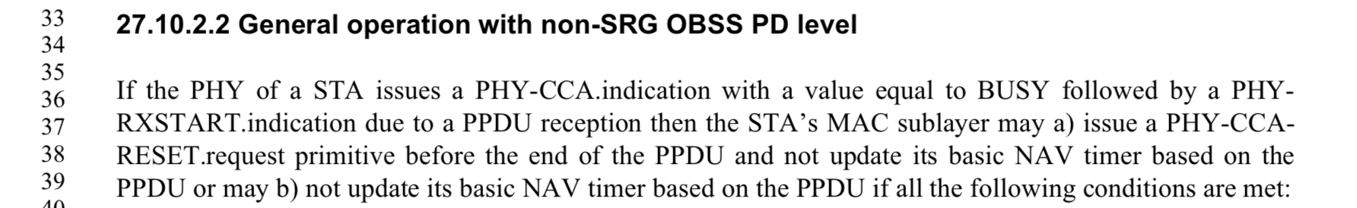
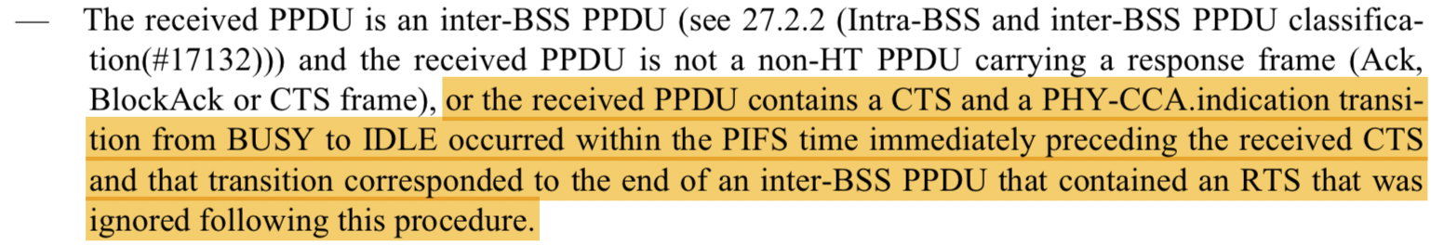
802.11ax D3.3 standard text
The highlighted text allows OBSS STAs that received both RTS and CTS to reset NAV

Slide 4
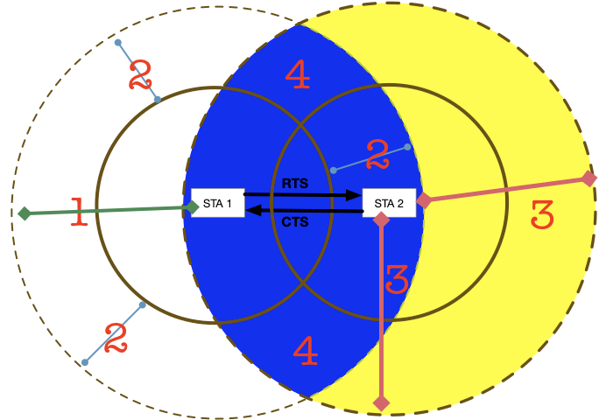
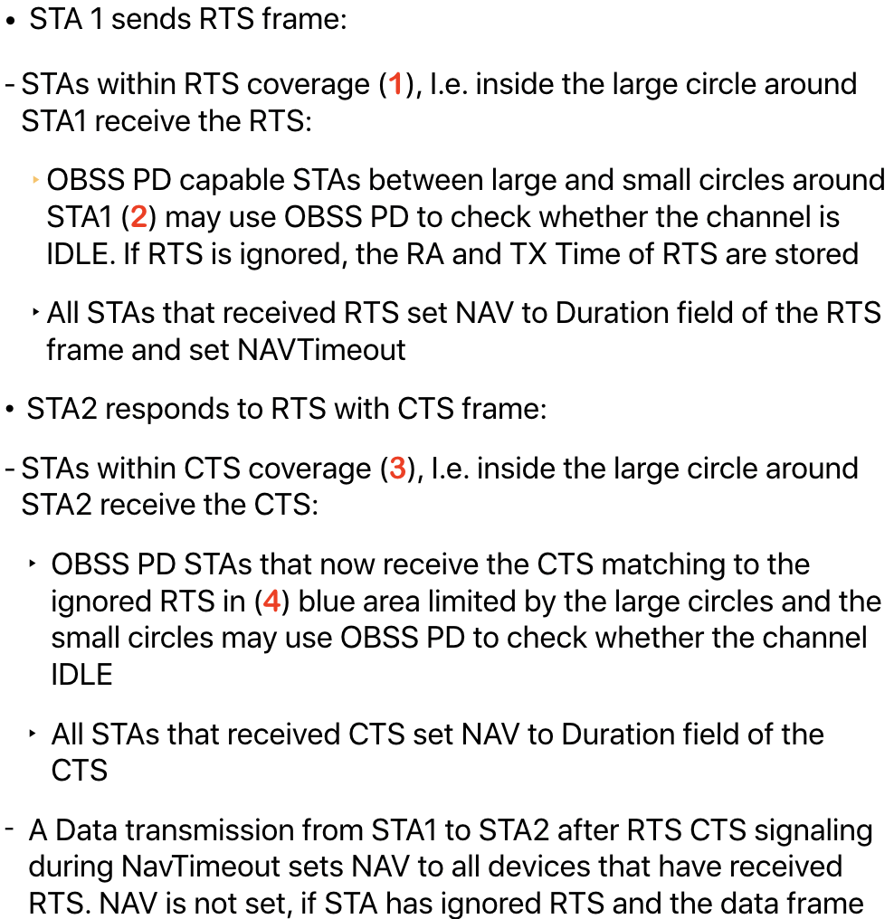
RTS CTS protection area

Slide 5
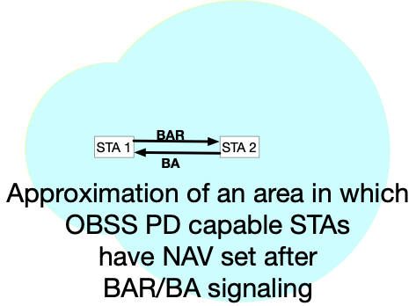
Protection areas of TXOP starting with BAR BA and RTS CTS signaling
Small protection area of RTS CTS may degrade WLAN throughputs
  The unprotected area is close to both the receiver and the transmitter
802.11ax non-AP STAs get solid protection area around the receiver by initiating TXOPS with BAR BA signaling
  If a BAR BA signaling initiates a TXOP, the BA transmitter may not consider whether channel is IDLE
  Lack of CS at BA transmitter may not protect the ongoing transmissions
Holes in the channel reservation area should not drive STAs to initiate TXOPs with BAR BA signaling instead of RTS CTS signaling

Slide 6
Summary
The protection area in RTS CTS signaling should not leave holes around the CTS transmitter
  The holes may allow some OBSS STAs to use different protection level which degrades the reliable reception of the data frames

Slide 7
Straw poll
Do you agree to delete the highlighted text from the 802.11ax specification?

