Slide 1
Consideration of Common Doppler in C2C Channel
Date: 2018-11-12
Authors:
Name | Affiliations | Address | Phone | email
Rui Cao | Marvell | 5488 Marvell Ln, Santa Clara, CA 95054 |  | ruicao@marvell.com
Sudhir Srinivasa |  |  |  | sudhirs@marvell.com
Hongyuan Zhang |  |  |  | hongyuan@marvell.com
Prashant Sharma |  |  |  | psharma@marvell.com

Slide 2
Introduction
Car-to-Car (C2C) channel models have been proposed for NGV studies [1].
All C2C channels are modeled with zero Doppler on the main tap, and relative Doppler on other delay taps.
This implies an assumption that common Doppler across all taps can be perfectly compensated at the receiver.
However, common Doppler estimation at the receiver may not be perfect with practical implementation.
In this contribution, we investigate the impact of common Doppler in C2C channel models.

Slide 3
C2C Channel Model Recap [1]
Table 1: Rural LOS Parameters
Table 4: Highway LOS Parameters
 | Tap1 | Tap2 | Tap3 |  | Units
Power | 0 | -14 | -17 |  | dB
Delay | 0 | 83 | 183 |  | ns
Doppler | 0 | 90 | -54 |  | Km/h
Profile | Static | HalfBT | HalfBT
 | Tap1 | Tap2 | Tap3 | Tap4 | Units
Power | 0 | -10 | -15 | -20 | dB
Delay | 0 | 100 | 167 | 500 | ns
Doppler | 0 | 126 | -90 | 162 | Km/h
Profile | Static | HalfBT | HalfBT | HalfBT
Table 2: Urban Approaching LOS Parameters
Table 5: Highway NLOS Parameters
 | Tap1 | Tap2 | Tap3 | Tap4 | Units
Power | 0 | -8 | -10 | -15 | dB
Delay | 0 | 117 | 183 | 333 | ns
Doppler | 0 | 43 | -29 | 90 | Km/h
Profile | Static | HalfBT | HalfBT | HalfBT
 | Tap1 | Tap2 | Tap3 | Tap4 | Units
Power | 0 | -2 | -5 | -7 | dB
Delay | 0 | 200 | 433 | 700 | ns
Doppler | 0 | 126 | -90 | 162 | Km/h
Profile | Static | HalfBT | HalfBT | HalfBT
Table 3: Urban Crossing NLOS Parameters
 | Tap1 | Tap2 | Tap3 | Tap4 | Units
Power | 0 | -3 | -5 | -10 | dB
Delay | 0 | 267 | 400 | 533 | ns
Doppler | 0 | 54 | -18 | 108 | Km/h
Profile | Static | HalfBT | HalfBT | HalfBT
Five C2C channel models to cover different scenarios
Main tap (1st tap) always has zero Doppler, and relative Doppler is modeled on other taps.

Slide 4
Consideration of Common Doppler
Common Doppler shift exists in real vehicular environment
  Relative movement between two cars will induce Doppler shifts for all channel taps.
  For max speed of 500Km/h, Doppler shift is ~2.7kHz in DSRC channels.
Common Doppler shift is not modeled in C2C channels [1]
  This is under the assumption that common Doppler shift is perfectly captured in CFO estimation and compensation at the receiver.
  In the simulations, receiver CFO estimation may be ignored.
Impacts of common Doppler shift
  Practical receiver CFO estimation is not perfect.
  The residual common Doppler may affect the time synchronization, auto-detection, CPE estimation, data detection and etc.
  For future new PHY proposals, common Doppler needs to be considered in the channel model for performance evaluation

Slide 5

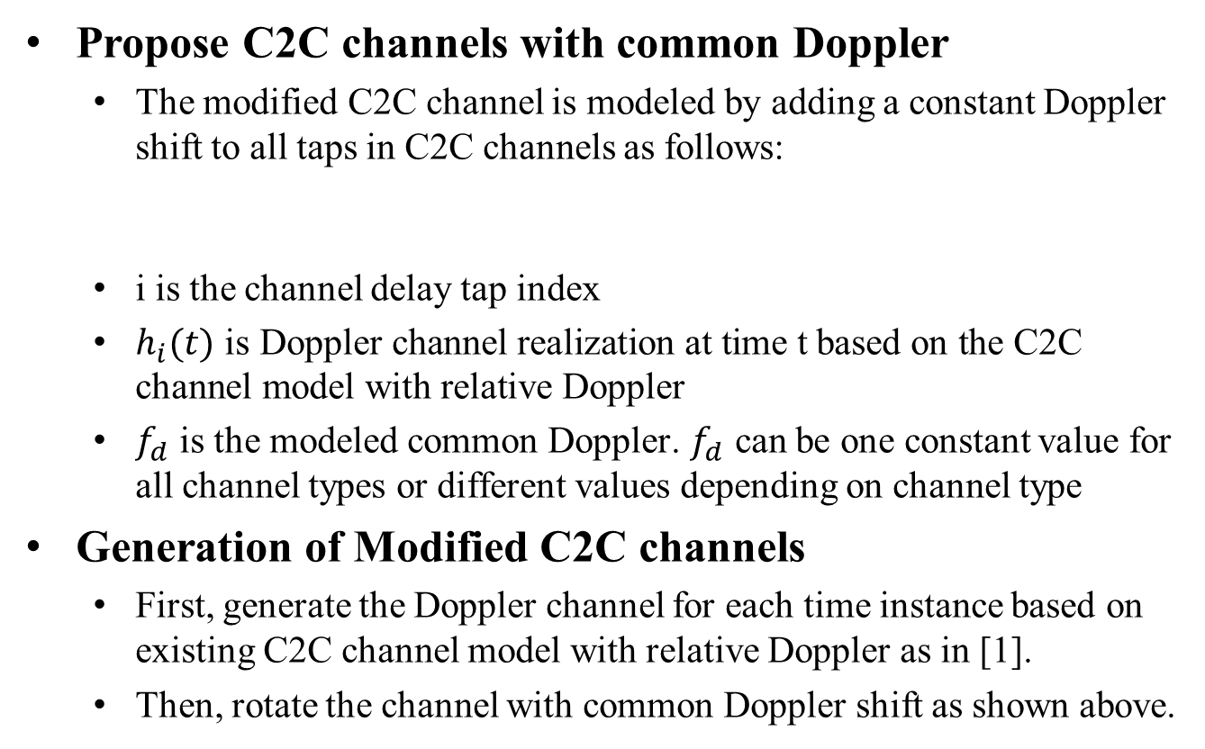
Modified C2C Channels
Propose C2C channels with common Doppler
  The modified C2C channel is modeled by adding a constant Doppler shift to all taps in C2C channels as follows:
  i is the channel delay tap index
  $h_{i}(t) \text{is} \text{Doppler} \text{channel} \text{realization} \text{at} \text{time} \text{t} \text{based} \text{on} \text{the} \text{C}\text{2}\text{C} \text{channel} \text{model} \text{with} \text{relative} \text{Doppler}$
  $f_{d}$ is the modeled common Doppler. $f_{d}$ can be one constant value for all channel types or different values depending on channel type
Generation of Modified C2C channels
  First, generate the Doppler channel for each time instance based on existing C2C channel model with relative Doppler as in [1].
  Then, rotate the channel with common Doppler shift as shown above.
$$h_{i}^{D}\left(t\right)=h_{i}(t)e^{j∙2∙π∙f_{d}∙t}$$

Slide 6
Simulation
Settings
  Packet size: 4000 bits
  NGV format: 11ac 20MHz with 2x Downclock and Midamble
  Midamble period = 1
  LDPC coding
  Common Doppler: 1.1kHz (200Km/h)
  Rx processing:
    Ideal timing
    CFO estimation and compensation in preamble portion
    CPE estimation and compensation in data portion
  Comparison:
    w/o common Doppler, w/o CFO/CPE compensation
    w common Doppler, w CFO/CPE compensation

Slide 7
Results: Highway NLOS
0.5-2dB loss when common Doppler is added to Highway NLOS channel
Loss comes from CFO/CPE estimation error

Slide 8
Results: Highway LOS
0.5-1dB loss when common Doppler is added to Highway LOS channel
Loss comes from CFO/CPE estimation error

Slide 9
Summary
Common Doppler shift is NOT modeled in C2C channels.
In practical receiver design, common Doppler shift in the channel will impact performance evaluation.
Our simulation shows ~1dB loss with only imperfect CFO/CPE estimation at the receiver.
For all future new PHY proposals, common Doppler shift may also impact performance evaluation.
We propose modified C2C channel models with common Doppler shift for NGV.

Slide 10
Reference
[1] Hongyuan Zhang and etc., 11-18-0858-00-0ngv-c2c-channel-model-overview

