Slide 1
Use Cases for NGV using High Data Rate
Date: 2018-11-12
Authors:

Slide 2
Abstract
The submission [1] proposes use of 60 GHz band communication for V2X to enable use cases which require high data rate.
NGV proposed PAR[2] includes in the scope text;
“optionally, in the 60 GHz frequency band (57 GHz to
71 GHz)”
This submission proposes use cases using high data rate, assuming use of 60 GHz band. Proposed use cases include:
  Traffic Offloading to 60 GHz band
  Rich Sensor Sharing
[1] 11-18/1187r03 mmW for V2X Use Cases
[2] 11-18/0861r09 802.11 NGV Proposed PAR

Slide 3
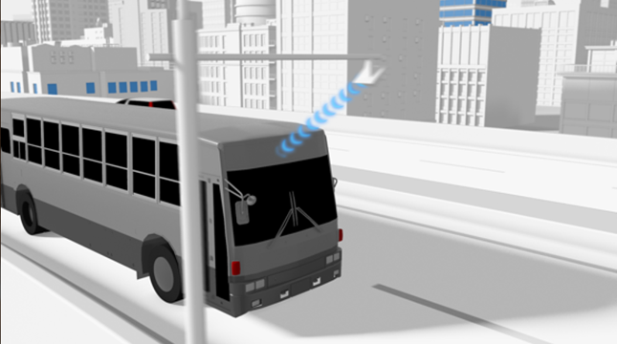
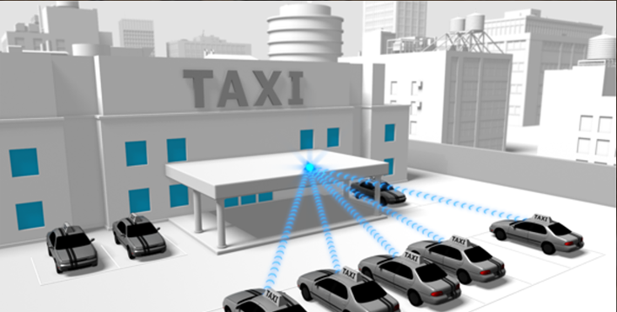
Traffic Offloading to 60 GHz band
Downloading 3D maps
Uploading sensor data
DSRC/WAVE supports unicast traffic as well as broadcast oriented applications
  IEEE1609 employs WSMP (Wave Short Message protocol) and IPv6 as higher layer
  Demands on bandwidth for both broadcast and unicast V2X will be increasing
IPv6 unicast traffic is suitable for offloading to 60 GHz
  distribute location dependent data: map, advertisement
  download/upload delay tolerant data: log/sensor data for non/semi-real time usage

Slide 4
Traffic Offloading to 60 GHz band
Overview: Offload unicast traffic from 5.9GHz to 60GHz band
  distribute location dependent data
  download/upload delay tolerant data
Target performance:
  >1 Gbps max data rate
  Vehicle mobility in a city (~60km/h)

Slide 5
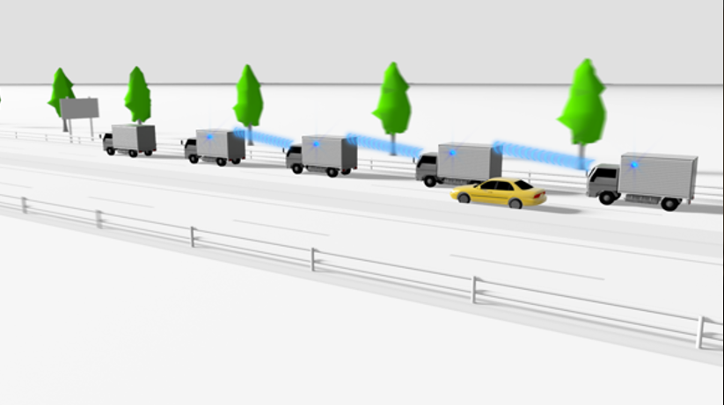
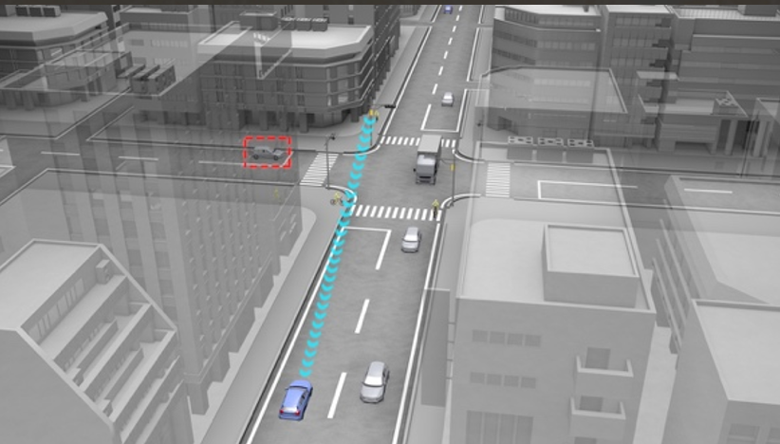
Rich Sensor Sharing
Bird’s-Eye View for Platoon (V2V)
Bird’s-Eye View for Intersection (V2I/V2X)
Vehicles and infrastructures share their own views to each other to construct bird’s eye views
  For safety: blind spot monitoring
    see-through view for platooning is one of the application
  For drivers/passengers: navigation, augmented reality

Slide 6
Rich Sensor Sharing
Overview: Vehicles and infrastructures share their own views to each other to construct see-through view, bird’s eye views
  the views are used for safety and driver/passengers usage
  example scenario: (1)around intersection; (2)around platoon
Target performance:
  >1 Gbps max data rate
  <10 ms latency for data packets
  Vehicle mobility in a city (~60km/h)

Slide 7
References
[1] 11-18/1187r03 mmW for V2X Use Cases
[2] 11-18/0861r08 802.11 NGV Proposed PAR
[3] 11-18/1323r01 NGV SG Use Cases

Slide 8
Straw Poll 1
Do you agree to adopt the “Traffic Offloading to 60 GHz band” use case on slide 4 as one of NGV use cases?
Y14 /N12/A22

Slide 9
Straw Poll 2
Do you agree to adopt the “Rich Sensor Sharing” use case on slide 6 as one of NGV use cases?
Y 22/N 7/A 13

Slide 10
Backup

Slide 11
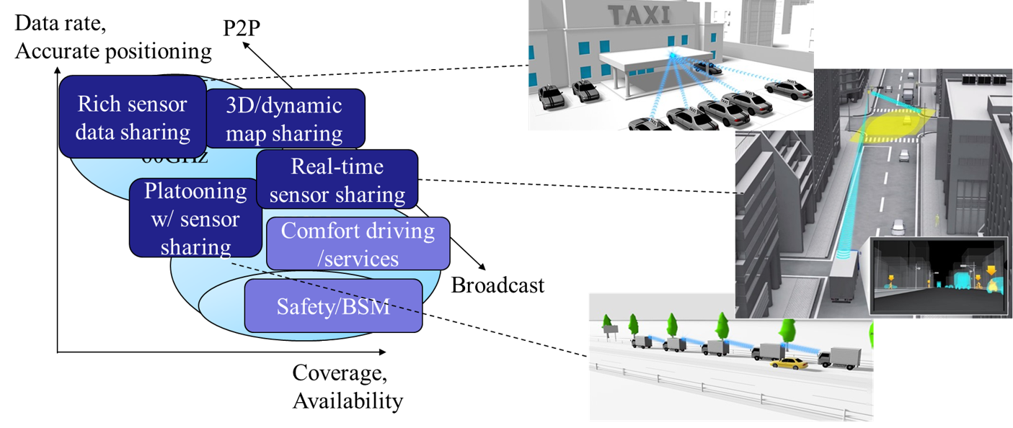
Use cases proposed in [1]
and mapping to the proposal in this submission
Traffic offloading to 60 GHz band
Rich Sensor Sharing

