Slide 1
Use Cases for NGV using High Data Rate
Date: 2018-11-12
Authors:

Slide 2
Abstract
The submission [1] proposes use of 60 GHz band communication for V2X to enable use cases which require high data rate.
NGV proposed PAR[2] includes in the scope text; “optionally, in the 60 GHz frequency band (57 GHz to 71 GHz)”
This submission proposes use cases using high data rate, assuming use of 60 GHz band. Proposed use cases include:
Traffic Offloading to 60 GHz band
Rich Sensor Data Sharing
[1] 11-18/1187r03 mmW for V2X Use Cases
[2] 11-18/0861r09 802.11 NGV Proposed PAR

Slide 3
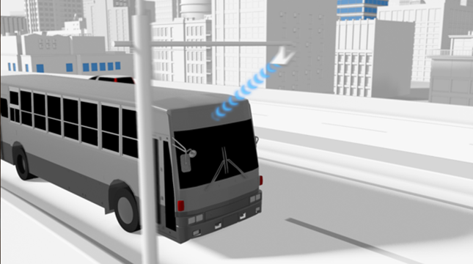
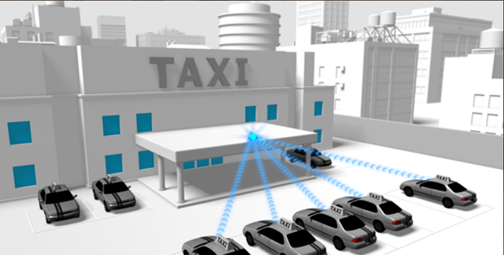
Traffic Offloading to 60 GHz band
Downloading 3D maps
Uploading sensor data
DSRC/WAVE supports unicast traffic as well as broadcast oriented applications
IEEE1609 employs WSMP (Wave Short Message protocol) and IPv6 as higher layer
Demands on bandwidth for both broadcast and unicast V2X will be increasing
IPv6 unicast traffic is suitable for offloading to 60 GHz
distribute location dependent data: map, advertisement
download/upload delay tolerant data: log/sensor data for non/semi-real time usage

Slide 4
Traffic Offloading to 60 GHz band
Overview: Offload unicast traffic from 5.9GHz to 60GHz band
distribute location dependent data
download/upload delay tolerant data
Target performance:
>1 Gbps max data rate
Vehicle mobility in a city (~60km/h)

Slide 5
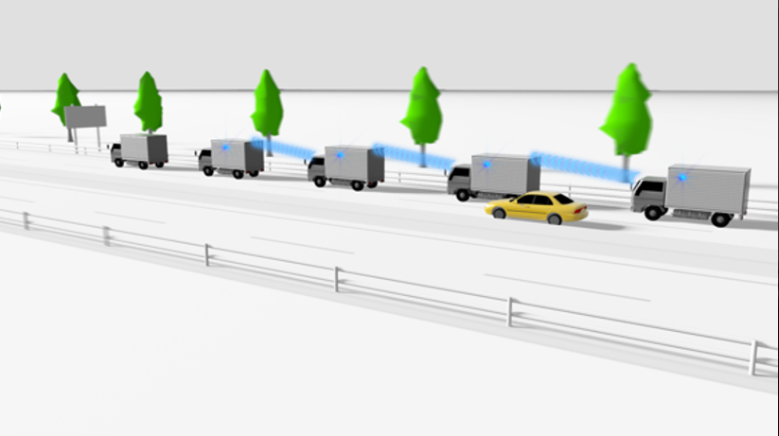
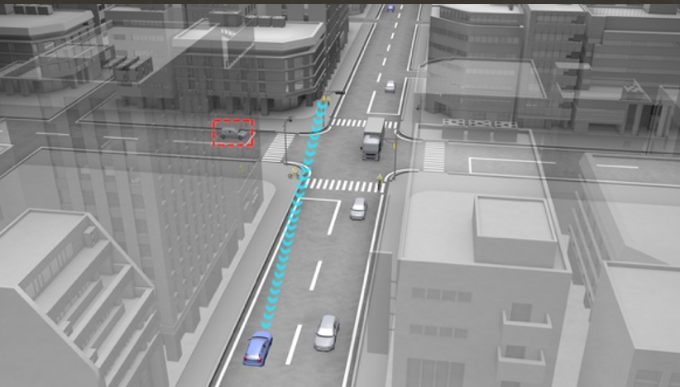
Rich Sensor Sharing
Bird’s-Eye View for Platoon (V2V)
Bird’s-Eye View for Intersection (V2I/V2X)
Vehicles and infrastructures share their own views to each other to construct bird’s eye views
For safety: blind spot monitoring
see-through view for platooning is one of the application
For drivers/passengers: navigation, augmented reality

Slide 6
Rich Sensor Sharing
Overview: Vehicles and infrastructures share their own views to each other to construct see-through view, bird’s eye views
the views are used for safety and driver/passengers usage
example scenario: (1)around intersection; (2)around platoon
Target performance:
>1 Gbps max data rate
<10 ms latency for data packets
Vehicle mobility in a city (~60km/h)

Slide 7
References
[1] 11-18/1187r03 mmW for V2X Use Cases
[2] 11-18/0861r08 802.11 NGV Proposed PAR
[3] 11-18/1323r01 NGV SG Use Cases

Slide 8
Straw Poll
Do you agree to adopt the “Traffic Offloading to 60 GHz band” use case on slide 4 as one of NGV use cases?
Y/N/A
Do you agree to adopt the “Rich Sensor Sharing” use case on slide 6 as one of NGV use cases?
Y/N/A

Slide 9
Backup

Slide 10
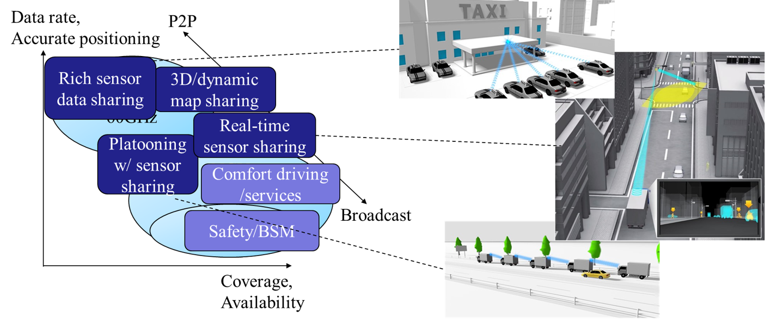
Use cases proposed in [1]
and mapping to the proposal in this submission
Traffic offloading to 60 GHz band
Rich Sensor Sharing

