Slide 1
Thoughts on RTA Development
Date: 2018-11-13
Name | Affiliation | Address | Phone | Email
Kazuyuki Sakoda | Sony | 1730 N. First Street, San Jose CA 95112 |  | kazuyuki.sakoda(at)sony.com
William Carney | Sony |  |  | William.Carney(at)sony.com

Slide 2
Table of Contents
Brief recap on the applications that drive interest in a RTA spec
Possible categorization of the targeted improvements
Application requirements: Is “Real Time” the only consideration?
How can we create innovation spaces for better implementation?

Slide 3
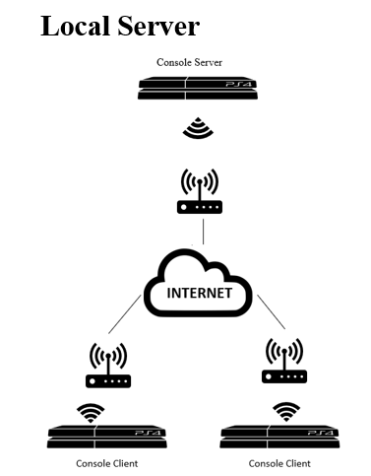
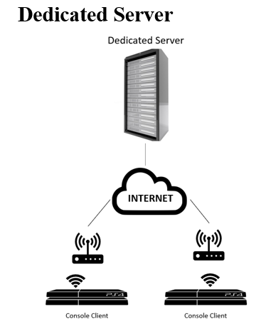
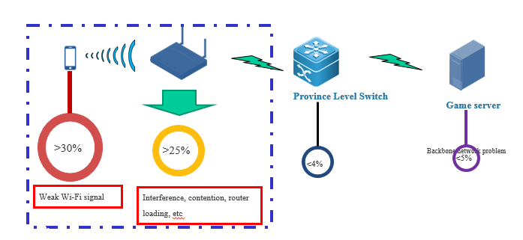
Brief recap on applications (1)
On-line gaming [1], [2], [3]:

Slide 4
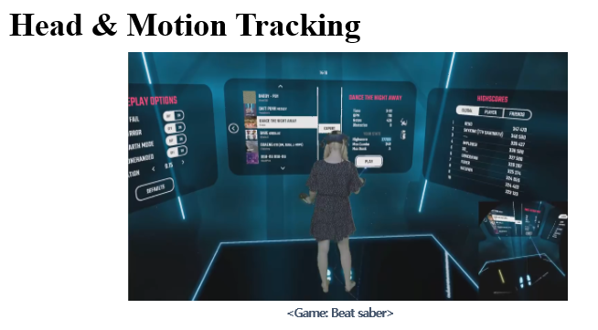
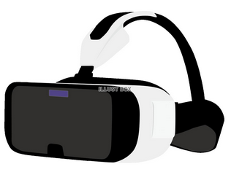
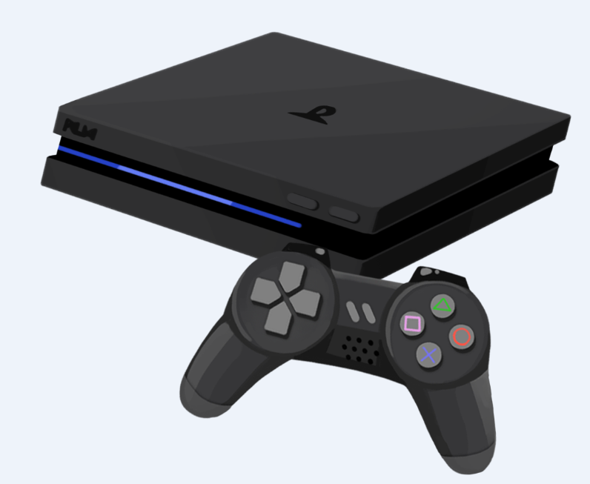

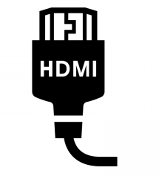
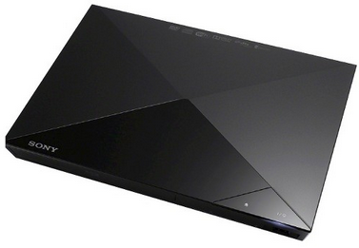
Brief recap on applications (2)
Real time video [4], [5]:

Slide 5
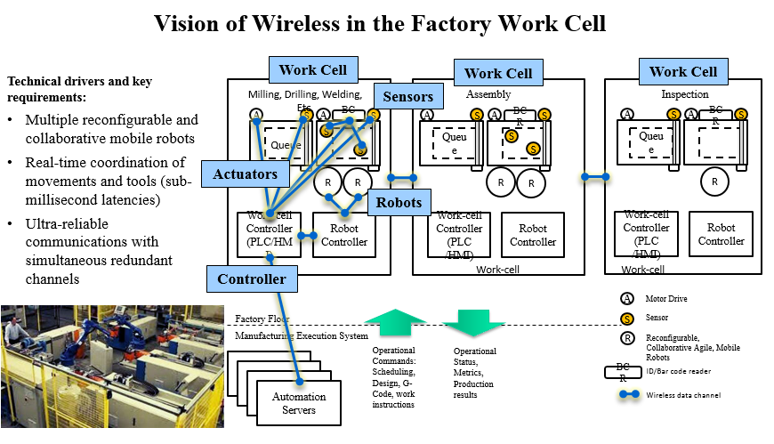
Brief recap on applications (3)
Control systems [6]:

Slide 6
Comparison of the Requirements per Apps
Application | Intra-BSS target latency | Bandwidth | Packet size | Robustness
On-line gaming [1], [2], [3] | 10[msec] | 0.2~1.0Mbps | 100~200 octet | < 3 consecutive packet loss, PER < 0.1%
Real time video [4], [5] | 3~10 [msec] | 0.1~20Gbps | >4000 octet | Must
Control System Class 0 [6], [8], [9] | 1-3 [msec] | 10~100kbps | < 100 octet | BLER < 10e-9
Control System Class 1 [6] | 10 [msec] | 10~100kbps | < 100 octet | BLER < 10e-9
Control System Class 2-3 [6], [7] | 10~100 [msec] | 1~10kbps | < 100 octet | BLER < 10e-9
Control system class 0 : emergency / force control
Control system class 1 : regulatory control / camera input
Control system class 2 : supervisory / no physical interaction
It may be useful to define categories that each application falls into

Slide 7
How Other Technologies Consider RTA
For instance, 3GPP defines 3 device categories: eMBB, mMTC, and URLLC [10]
  eMBB: enhanced Mobile BroadBand
  mMTC: massive Machine Type Communication
  URLLC: Ultra-Reliable and Low Latency Communications
Different user plane latency requirements are defined for each of the devices
  eMBB: 4msec for UL, and 4msec for DL
  mMTC: N/A
  URLLC: 0.5msec for UL, and 0.5msec for DL
Should we define similar categories for 802.11 RTA devices?

Slide 8
Is Low Latency the Only Consideration for a Potential RTA Specification?
Many of the applications benefit real time capability also require high-level robustness
None of these applications appreciates real time capability with large frame loss ratio
Do we want to bundle latency requirement together with reliability and/or robustness criteria?

Slide 9
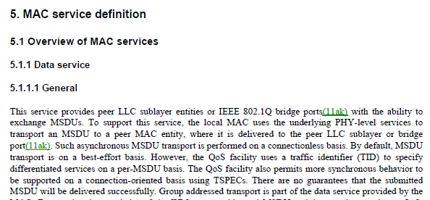
How does the RTA technology fit with 802.11 specification?
802.11 MSDU transport is on a best-effort basis. However, the spec defined some schemes to allow cross-layer operation, i.e., TSPEC [11]

Slide 10
RTA: A Tool for Cross-Layer Design?
Layering model makes system design easier. However, when the target requirements are extremely precise, a cross-layer design approach is often useful.
Should RTA also define APIs to facilitate cross-layer design?
Should RTA define APIs for cross-layer operation beyond just defining a latency framework?
  It may complicate the end specification, but could allow a more innovative implementation of RTA systems leveraging 802.11

Slide 11
Summary
Discussed on potential approach to define device types
Discussed how we could define RTA as a part of the 802.11 specification

Slide 12
Discussion/Questions
Develop a categorization schema of RTA types to guide specification development?
Low Latency focus only, or also include Robustness and Reliability?
Also consider informative content and APIs to facilitate cross-layer system design?

Slide 13
References
[1] IEEE 802.11-18/1234r0, “Real-time Mobile game vs Wi-Fi,” Kate Meng
[2] IEEE 802.11-18/1499r0, “Real-time Console Game Network Profile,” Karthik Iyer, et.al.
[3] IEEE 802.11-18/1542r2, “Time-Aware Traffic Shaping over 802.11,” Dave Cavalcanti, et.al.
[4] IEEE 802.21-18/0059r1, “Introduction to Concept of the ‘Network Enablers for seamless HMD based VR Content Service’ IG,” Dong-Il Dillon Seo, et.al.
[5] IEEE 802.11-18/1970r, “Old and new latency requirements,” Kazuyuki Sakoda
[6] IEEE 802.11-18/1784r0, “Reliable, High Performance Wireless Systems for Factory Automation,” Richard Candell

Slide 14
References
[7] IEEE 802.11-18/1618r0, “Discussion on Target Applications of RTA,” Akira Kishida, et.al.
[8] “Momentum Control with Hierarchical Inverse Dynamics on a Torque-Controlled Humanoid,” Alexander Hrzog, et.al, Journal on Autonomous Robots, Vol. 40 Issue 3, March 2016
[9] “An autonomous manipulation system based on force control and optimization,” Ludovic Righetti, et.al., Autonomous Robots, January 2014, Volume 36, Issue 1–2
[10] 3GPP TR 38.913 V15.0.0 (2018-06), “Study on Scenarios and Requirements for Next Generation Access Technologies”, Release 15
[11] Draft P802.11REVmd_D1.4.

