Slide 1
Initial Distributed MU-MIMO Simulations
Date: 2018-11-12
Authors:
Name | Affiliations | Address | Phone | email
Ron Porat | Broadcom |  |  | ron.porat@broadcom.com
Srinath Puducheri | Broadcom

Slide 2
Abstract
In the September meeting contribution number 1439 we introduced a framework for distributed MU-MIMO operation using wireless synchronization techniques building on mechanisms that exist in 11ax.
    Problem reminder – from the time of NDP (when channel feedback is collected) to the time of joint data transmission, each AP drifts based on its own (20ppm) clock and builds a relative phase offset.
    Proposed solution reminder – a designated master AP sends slave triggers before the NDP and before joint data transmissions to enable phase drift estimation by the slave AP.
    In here we estimate the phase drift and show that the impact of the error on performance is very small. Other synchronization issues are not addressed in this contribution.

Slide 3
Simulation Methodology
    We employ two sets of simulations – the first simulation is used to estimate common phase error. The second simulation performs joint MU-MIMO transmission whereby each slave AP has phase offset in the amount of the residual estimation error relative to the master AP.
    Both sets of simulations use 11nB and BW=80MHz.
    Common phase errors are simulated across 1000 channel realizations using one beamformed 4x LTF
    In the joint MU-MIMO simulation each slave AP is assumed to have as input the same 10% worst residual phase error for all channel instantiations.
    We calculate average MU SINR per STA per spatial stream with and without impairments and plot them.

Slide 4
Simulation Configurations
    We believe the vast majority of cases for mesh deployments will involve 4-antenna AP. Hence we focus on two configurations:
      Two 4-antenna AP (one master one slave)
      Four 4-antenna AP (one master three slaves)
    Each configuration is 75% loaded - 2 streams to three or six 2-antenna STA for a total of 6 or 12 streams
    In terms of SNR we have a 2D problem – AP-AP SNR and STA-AP SNR. For simplicity we ran simulations assuming 2 fixed AP-AP SNR values – 10 and 20 dB and varied the STA-AP SNR. We assume all STA have the same SNR to all AP.

Slide 5
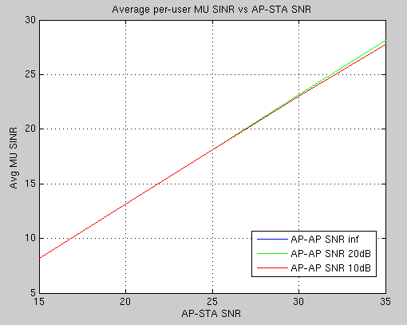
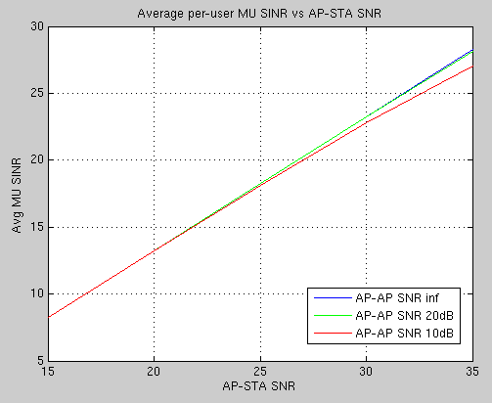
Results
    Two 4-ant AP Results
    Four 4-ant AP Results

Slide 6
Summary
Initial results demonstrate that phase estimation can overcome the errors due to independent slave AP clock drift to provide a synchronized initial state for a joint transmission

