Slide 1
Experimental Study of NOMA/SOMA in Wi-Fi
Date: 2019-03-11
Authors:
Name | Affiliation | Address | Phone | Email
Evgeny Khorov | IITP RAS |  |  | khorov@iitp.ru
Alexey Kureev | IITP RAS
Ilya Levitsky | IITP RAS

Slide 2
Outline
Motivation
NOMA and SOMA brief introduction
KPIs
Theoretical results
Testbed description
November’18 results for NOMA (and short links)
February’19 results for SOMA (and long links)

Slide 3
Motivation
In current networks, it is a typical situation when an AP serves several devices
located at different distances from the AP (thus having different channel attenuation)
having different traffic load.
In this case, Non-orthogonal multiple access (NOMA) can be a promising solution to increase spectrum efficiency.
This presentation considers theoretical and experimental results for DOWNLINK NOMA.
[1] proposes SOMA, which is actually a specific case of NOMA (having no SIC).
[1] doc.: IEEE 802.11-18/1462r0 SOMA for EHT

Slide 4


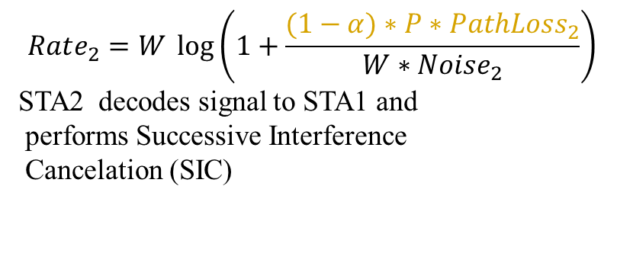
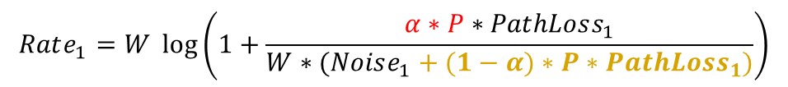
Basic Idea of Downlink NOMA
Power
NOMA
Different MCSs
Power
Traditional TDMA
P
P
To STA1
To STA2
To STA₂
$$α P$$
To STA₁
STA 2
AP
STA 1
$$Rate_{2}=W \log\left(1+\frac{(1−α)∗P∗PathLoss_{2}}{W∗Noise_{2}}\right)$$
STA2 decodes signal to STA1 and
performs Successive Interference
Cancelation (SIC)
$$Rate_{1}=W \log\left(1+\frac{α∗P∗PathLoss_{1}}{W∗(Noise_{1}+(1−α)∗P∗PathLoss_{1})}\right)$$

Slide 5
Signal Superposition
TX side
RX side
Q
STA1
I
STA2

Slide 6
A possible transmission process
SIFS
SIFS
DIFS
To STA₂
AP
To STA₁
STA1
ACK
STA2
ACK

Slide 7
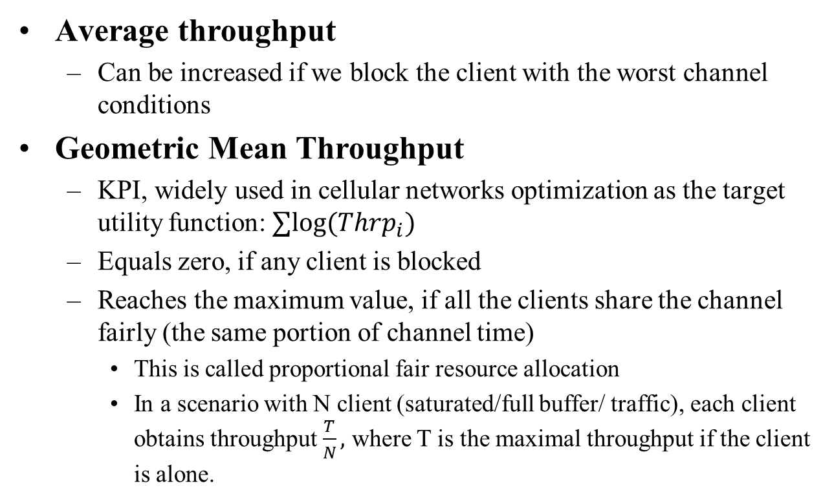
KPI
Average throughput
  Can be increased if we block the client with the worst channel conditions
Geometric Mean Throughput
  KPI, widely used in cellular networks optimization as the target utility function: $∑log⁡(Thrp_{i})$
  Equals zero, if any client is blocked
  Reaches the maximum value, if all the clients share the channel fairly (the same portion of channel time)
    This is called proportional fair resource allocation
    In a scenario with N client (saturated/full buffer/ traffic), each client obtains throughput $\frac{T}{N},$ where T is the maximal throughput if the client is alone.

Slide 8

With SOMA, no SIC is needed
AP
STA 2
Q
STA 1
STA 2
1011
1001
0001
0011
Gray-mapped superposed constellation
STA 1
1010
1000
0000
0010
I
Q
Q
Q
1110
1100
0100
0110
I
I
I
1111
1101
0101
0111
BPSK
QPSK
Result
Can be considered as multiplexing + reflection of constellations

Slide 9
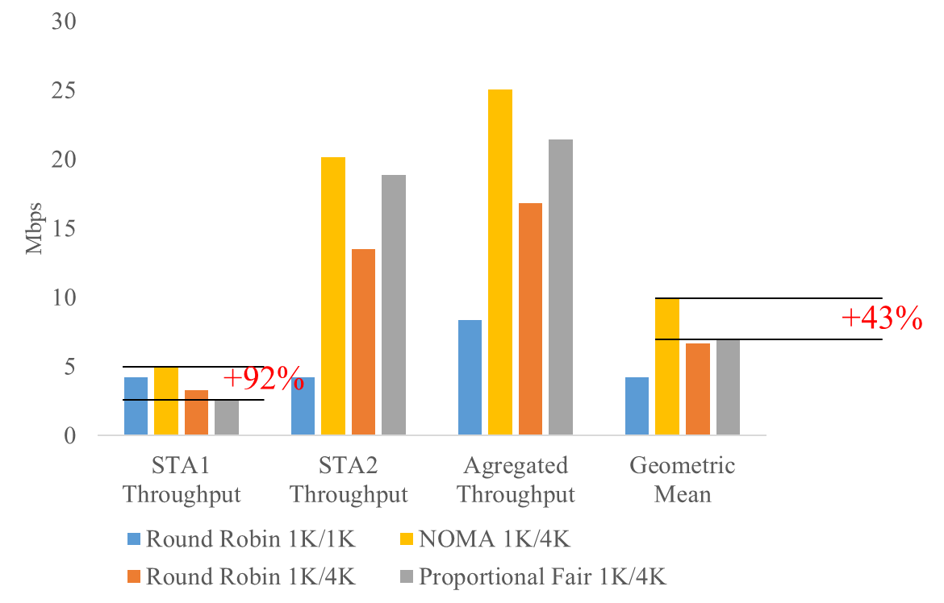
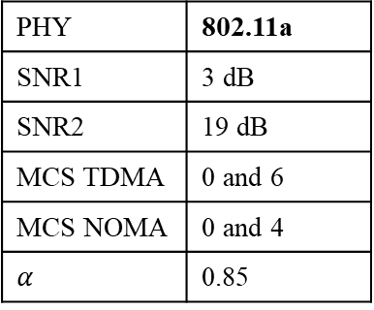
Theoretical Results for 11a
PHY | 802.11a
SNR1 | 3 dB
SNR2 | 19 dB
MCS TDMA | 0 and 6
MCS NOMA | 0 and 4
$α$ | 0.85
Payload 1K/4K to align NOMA payloads
Comments
Round Robin 1K/1K – Equal throughput for both STAs
Round Robin 1K/4K – Throughput for STA1 goes down, Throughput for STA2 is 4 times higher than for STA1
Proportional fair 1K/4K – Equal channel time. Thrp for STA1 even lower, Thrp for STA 2 even higher -> Max Geomeric Mean Thrp
NOMA 1K/4K – 92% gain in thrp for STA1, small gain in thrp for STA2, Overall gain +43%

Slide 10
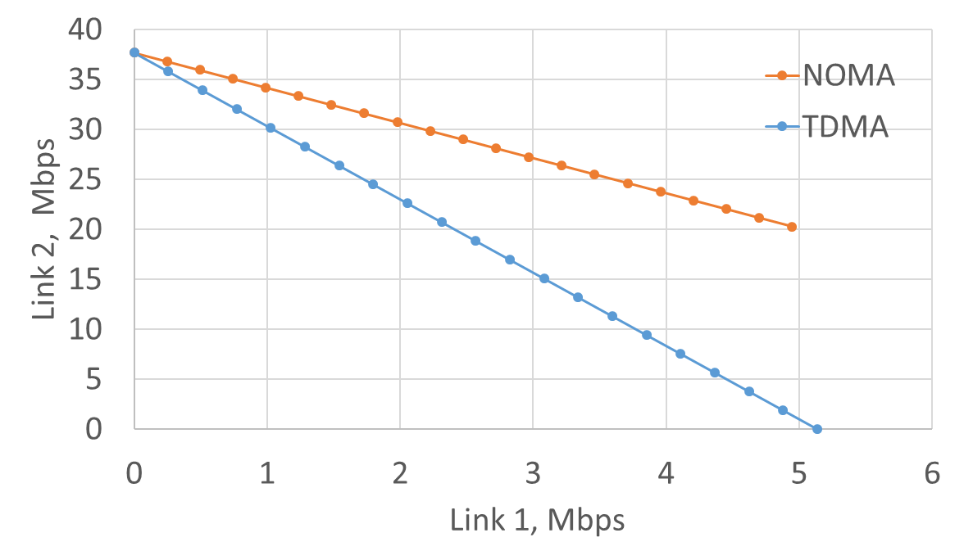


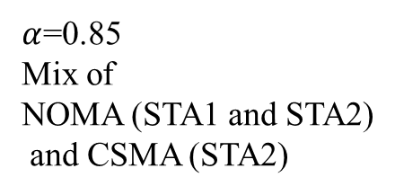
Trade-off between throughputs for STA1 & STA2
max average/total thrp is not a good target
$$CSMA (TDMA) only$$
Proportional fair operation point
$$NOMA only$$
$α$=0.85
Mix of
NOMA (STA1 and STA2)
and CSMA (STA2)
Round Robin
Operation point

Slide 11
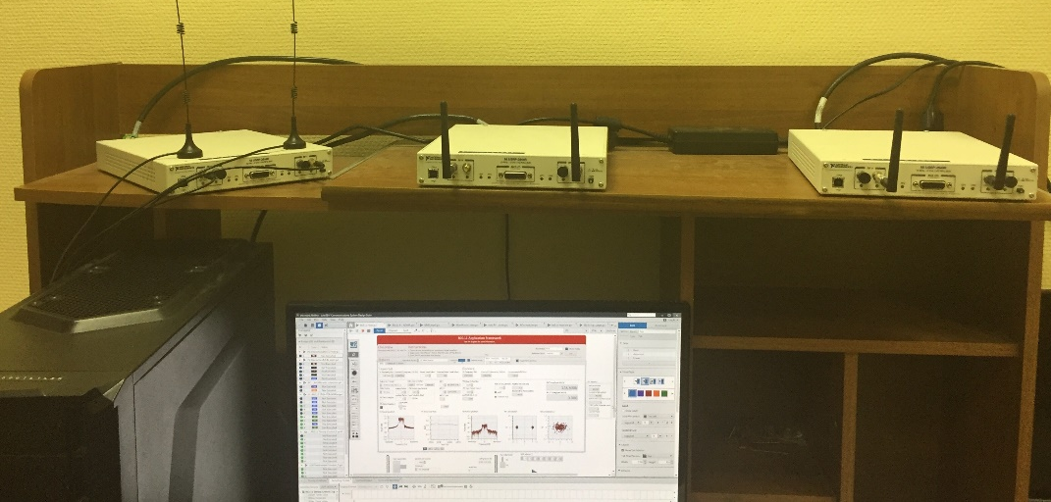
Testbed
AP (SDR)
Can be used with legacy
off-the-shelf device!
STA2 (SDR)
As NOMA device
Full description:
E. Khorov, A. Kureev, I. Levitsky. NOMA Testbed on Wi-Fi. //In Proc. of IEEE PIMRC, Bologna, Italy, 9-12 September 2018
STA1 (Laptop)
legacy device

Slide 12


TX Implementation
Source
TX IQ Processing
Data 1
Data bytes to bits
Encoder
Modulator
$$\sqrt{α}$$
FFT
to RF
Data 2
Data bytes to bits
Encoder
Modulator
$$\sqrt{1−α}$$
+reflection

Slide 13

RX Implementation
Demodulator & Decoder
Destination
Demodulator
Decoder
Bits to
data bytes
Data 1
RX IQ
Processing
$$\sqrt{\frac{α}{1−α}}=\frac{1}{s}$$
from RF
Demodulaor
Decoder
Bits to
data bytes
Data 2
weak signal is isolated here
Always trying to separate SOMA packets
If no SOMA, the following check fails:
Reserved bit, tail bits, parity bits, N_SYM1 ≥ N_SYM2
(NO additional “SOMA indication bits” used!)

Slide 14

Implementation
PHY RX State machine
for weak signal
False
L-SIG decoding
Reserved bit, tail bits, parity check passed & N_SYM1 ≥ N_SYM2
IDLE
Signal
detected
Done
$$\frac{1}{s}=\sqrt{\frac{α}{1−α}}$$
False
extracted
True
FCS check passed
Frame decoding
True
Done
Frame received

Slide 15
Minimal set of changes to the standard
Capabilities IE
  Indicator that a device is able to decode a NOMA/SOMA frame
  the other of NOMA/SOMA (optional)
The way how modulations are multiplexed
  For example, Gray-mapped superposed constellation

Slide 16
November results

Slide 17
Testbed. Experimental Setup
AP (SDR)
A legacy device is replaced with SDR
to simplify gathering statistics
STA2 (SDR)
As NOMA device
In November experiments, we located devices in the same room, reduced TX power and used 30dB attenuators to model different channel conditions
STA1 (SDR)
As legacy device

Slide 18
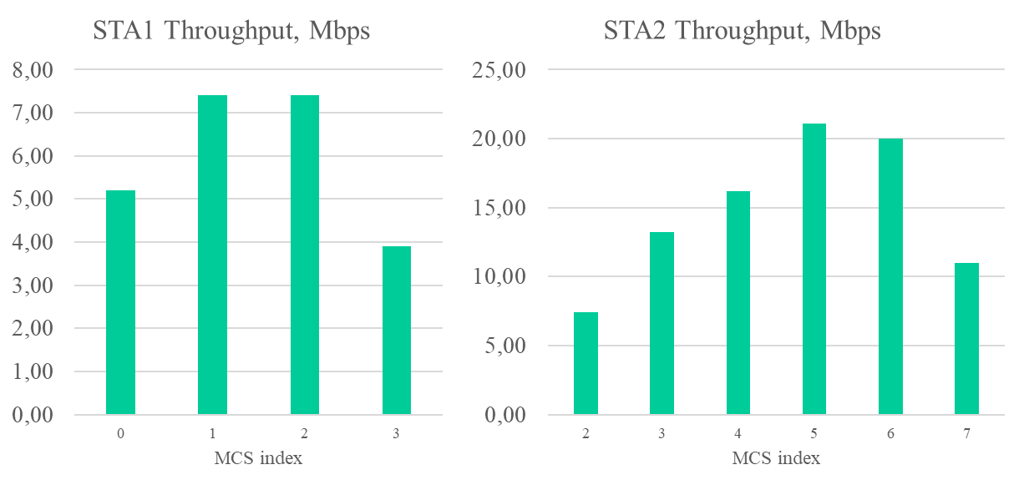
Evaluation. Reference Throughputs
STA1 Payload ~ 1kB
STA2 Payload ~ 2kB
Different payloads are needed to make multiplexed frames of the same duration

Slide 19
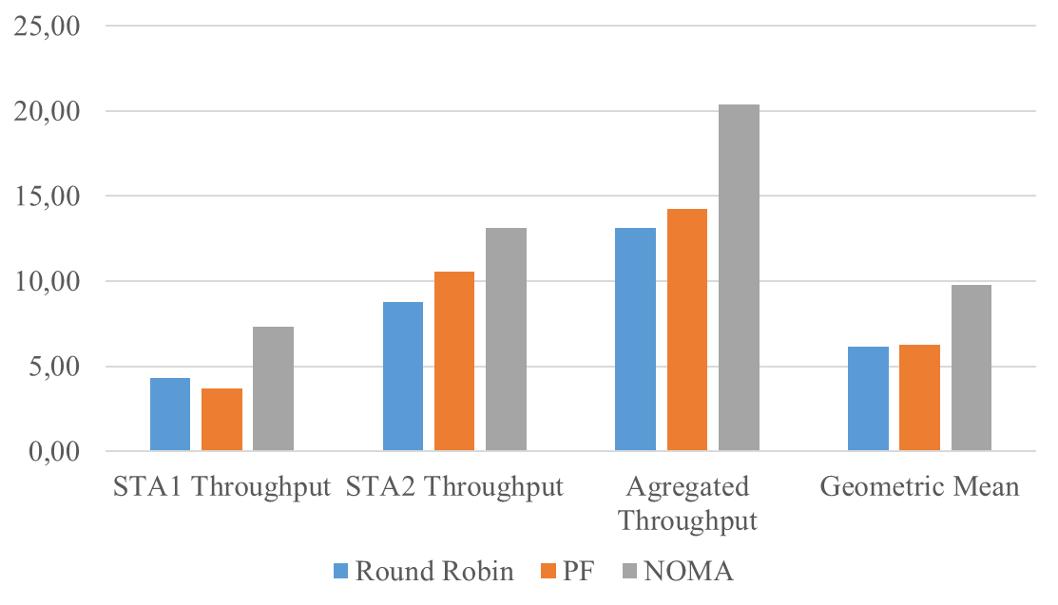
Testbed. Results
NOMA
Link1 MCS1
Link2 MCS3
STA1 Payload ~ 1kB
STA2 Payload ~ 2kB
x1.5
Obtained as the average throughput of STA 1 and STA2, when each of them has 50% of channel time

Slide 20
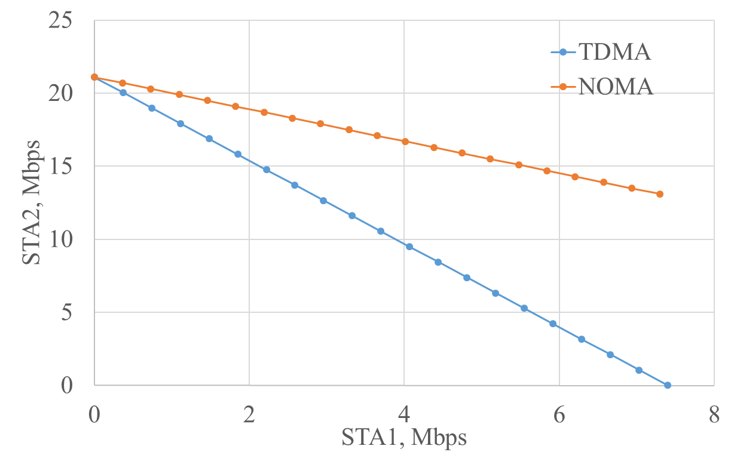

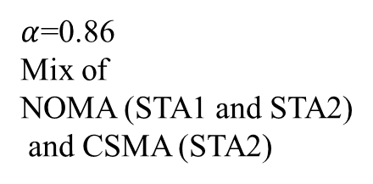
Balance between throughput for STA1 & STA2
$$CSMA (TDMA) only$$
$$NOMA only$$
$α$=0.86
Mix of
NOMA (STA1 and STA2)
and CSMA (STA2)

Slide 21
February results (SOMA)
March 2019

Slide 22
Testbed. Experimental Setup
AP (SDR)
STA2 (SDR)
As NOMA device
In February experiments, we located devices in separate rooms to provide different channel conditions for STA1 and STA2.
STA1 (SDR)
As legacy device

Slide 23
Location of devices
(AP)
Now, the devices are located in different rooms and no attenuators are used
STA1
STA2

Slide 24
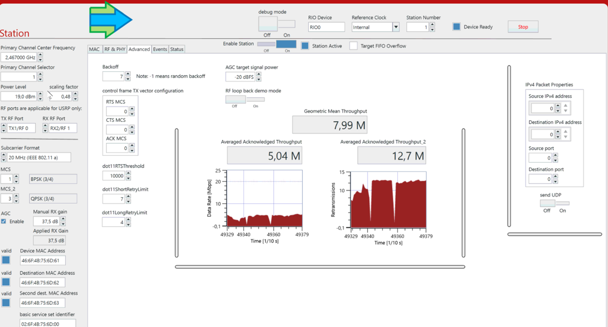
Example of stats

Slide 25
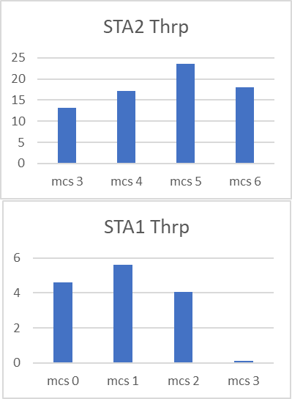
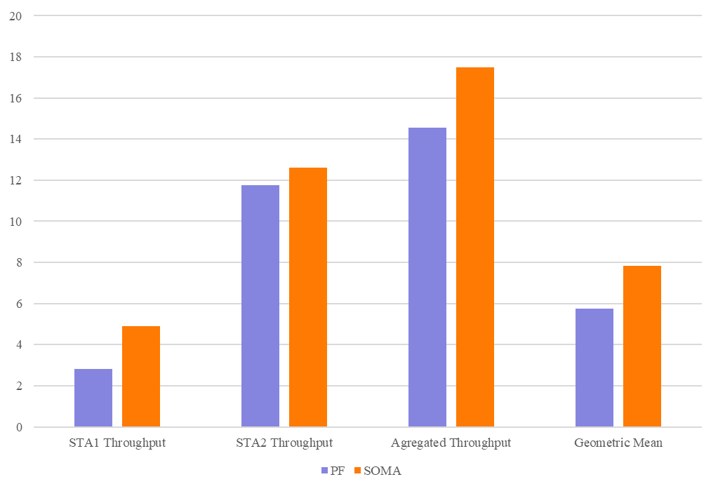
Testbed Results
PF
Link1 MCS1
Link2 MCS5
SOMA
Link1 MCS1
Link2 MCS3
Twice lower because of fair sharing
x1.4

Slide 26
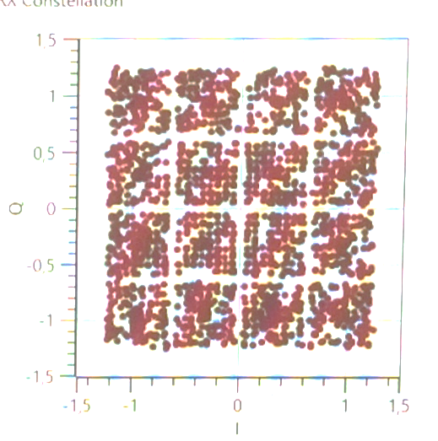
NOMA/SOMA Properties
Backward compatibility (STA 1 can be legacy)
  Even if not standardized, any vendor can use NOMA/SOMA for transmission between its own devices, and at the same time transmit data to other devices.
Almost double throughput for the STA with poor channel (in case of fare resource allocation) OR
Manifold gain in throughput of the nearest STA (STA 2) while providing guaranteed throughput for the far STA (STA 1)
If devices are close to each other higher modulations are possible.

Slide 27
Straw Poll
Should NOMA/SOMA be considered as a possible solution for future 802.11 standards?
Yes, for EHT
Yes, for another project
No
Need more info
Abstain

