Slide 1
Non-orthogonal Multiple Channel Access in Wi-Fi
Date: 2018-11-11
Authors:
Name | Affiliation | Address | Phone | Email
Evgeny Khorov | IITP RAS |  |  | khorov@iitp.ru
Alexey Kureev | IITP RAS
Ilya Levitsky | IITP RAS

Slide 2
Motivation
In current networks, it is a typical situation when an access point serves several devises located at different distances from the AP and having different traffic load.
In this case, Non-orthogonal multiple access (NOMA) can be a promising solution to increase spectrum efficiency.
This presentation considers theoretical and experimental results for DOWNLINK NOMA.
[1] proposes SOMA, which is actually a specific case of NOMA (having no SIC).
[1] doc.: IEEE 802.11-18/1462r0 SOMA for EHT

Slide 3


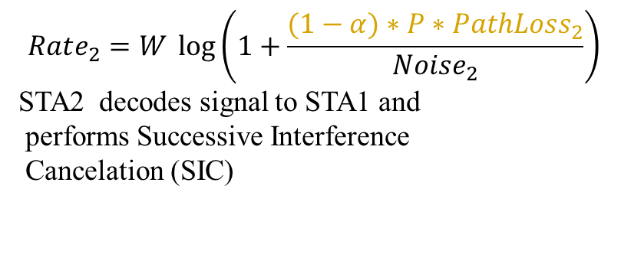
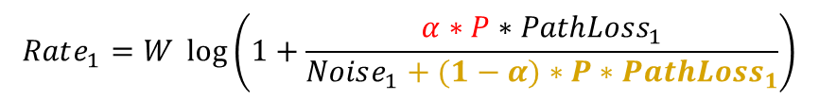
Basic Idea of Downlink NOMA
Power
NOMA
Different MCSs
Power
TDMA
P
P
To STA₁
To STA₂
To STA₂
$$α P$$
To STA₁
STA 2
AP
STA 1
$$Rate_{2}=W \log\left(1+\frac{(1−α)∗P∗PathLoss_{2}}{Noise_{2}}\right)$$
STA2 decodes signal to STA1 and
performs Successive Interference
Cancelation (SIC)
$$Rate_{1}=W \log\left(1+\frac{α∗P∗PathLoss_{1}}{Noise_{1}+(1−α)∗P∗PathLoss_{1}}\right)$$

Slide 4
Signal Superposition
TX side
RX side
Q
STA₁
I
STA₂

Slide 5
A possible transmission process
SIFS
SIFS
DIFS
To STA₂
AP
To STA₁
STA₁
ACK
STA₂
ACK

Slide 6
Theoretical Results

Slide 7
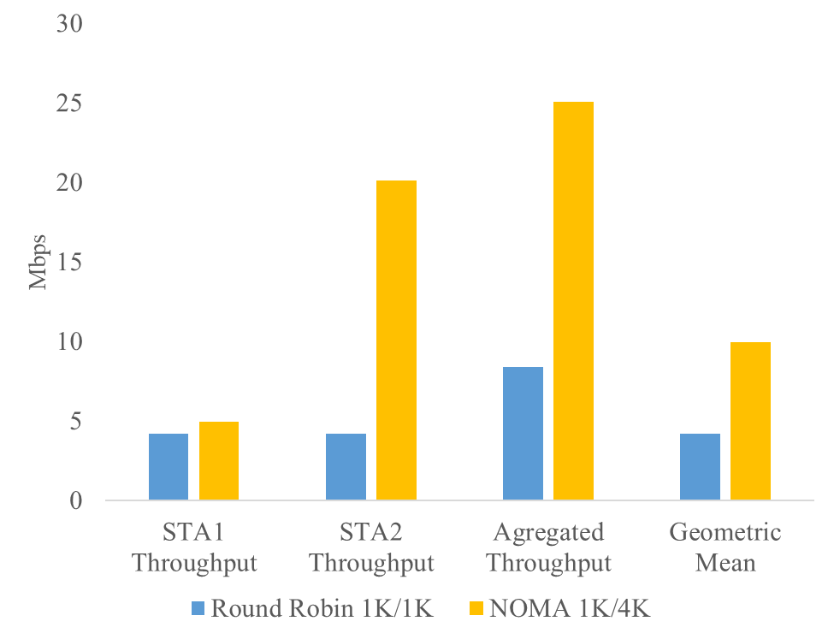
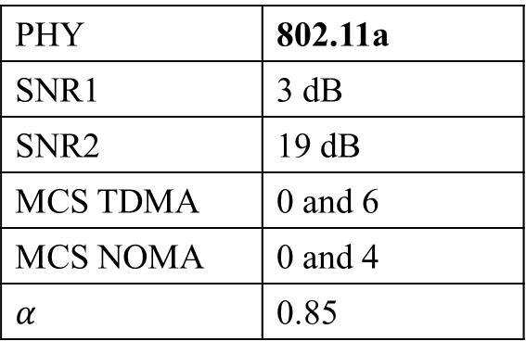
Theoretical Results
PHY | 802.11a
SNR1 | 3 dB
SNR2 | 19 dB
MCS TDMA | 0 and 6
MCS NOMA | 0 and 4
$α$ | 0.85

Slide 8
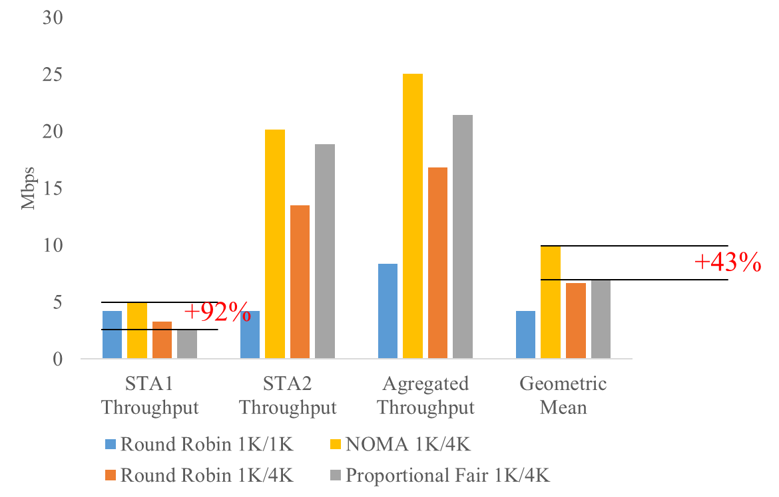
More fair comparison
PHY | 802.11a
SNR1 | 3 dB
SNR2 | 19 dB
MCS TDMA | 0 and 6
MCS NOMA | 0 and 4
$α$ | 0.85

Slide 9
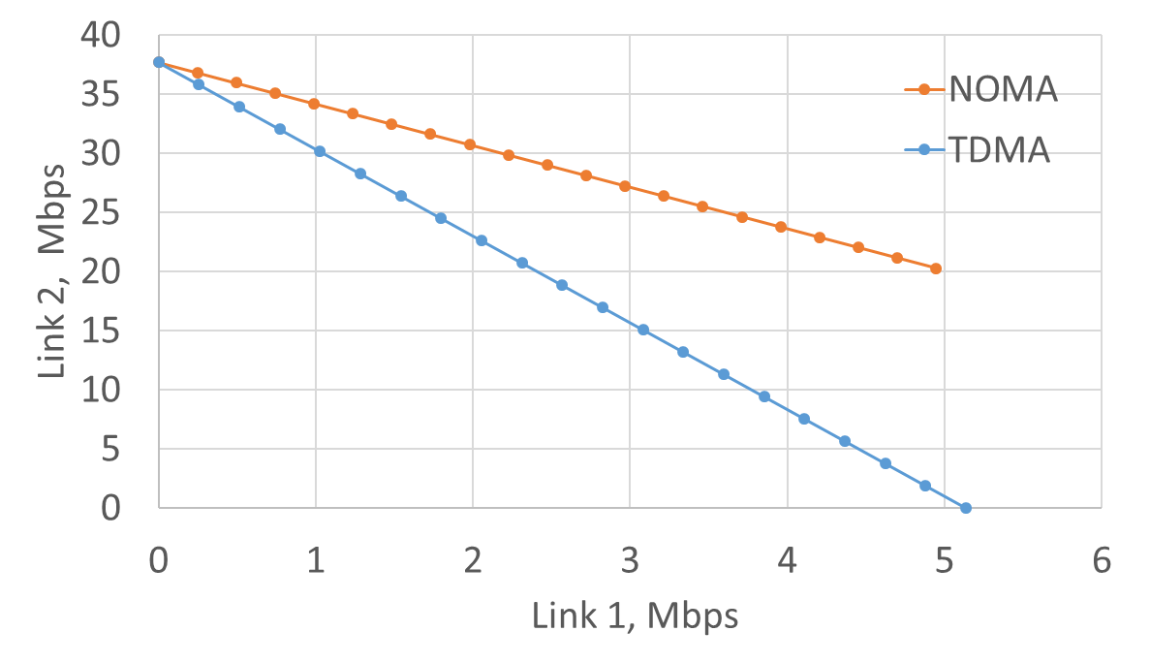


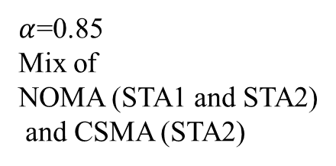
Balance between throughput for STA1 & STA2
$$CSMA (TDMA) only$$
$$NOMA only$$
$α$=0.85
Mix of
NOMA (STA1 and STA2)
and CSMA (STA2)

Slide 10
Experimental results

Slide 11
Testbed
AP (SDR)
STA₂ (SDR)
As NOMA device
Can be used with legacy
off-the-shelf device!
STA₁ (Laptop)
legacy device

Slide 12
Testbed. Experimental Setup
AP (SDR)
STA₂ (SDR)
As NOMA device
Replaced, to simplify gathering statistics
STA₁ (SDR)
As legacy device

Slide 13
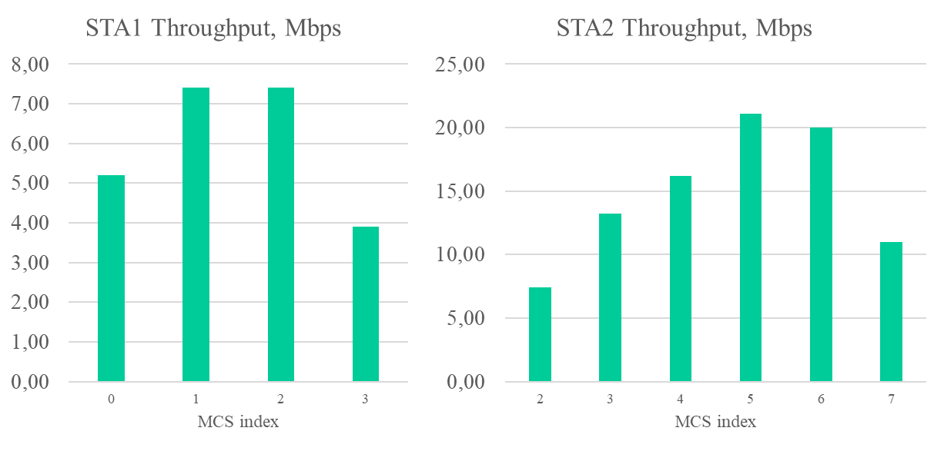
Evaluation. Reference Throughputs
STA1 Payload ~ 1kB
STA2 Payload ~ 2kB

Slide 14
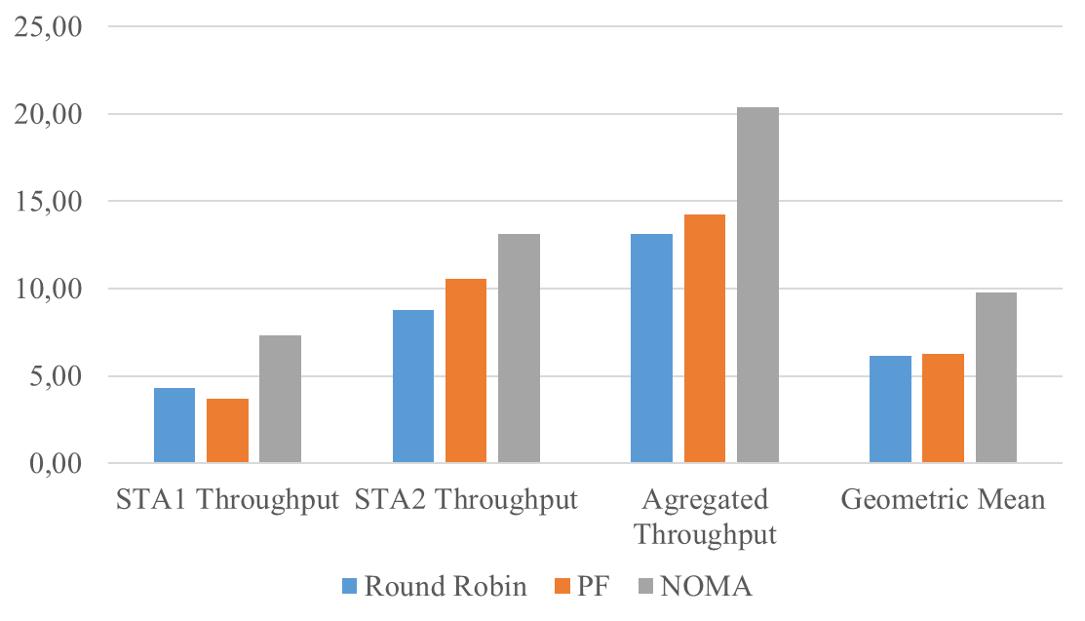
Testbed. Results
NOMA
Link1 MCS1
Link2 MCS4
+56%
STA1 Payload ~ 1kB
STA2 Payload ~ 2kB

Slide 15
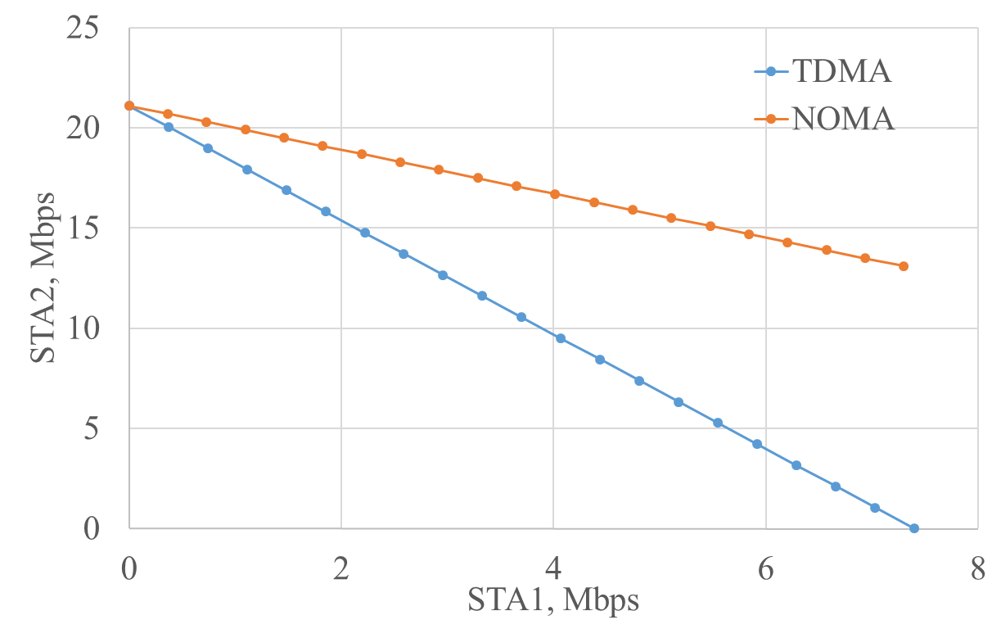

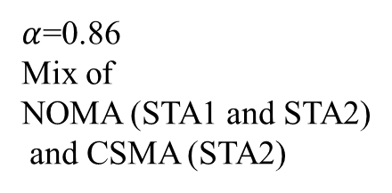
Balance between throughput for STA1 & STA2
$$CSMA (TDMA) only$$
$$NOMA only$$
$α$=0.86
Mix of
NOMA (STA1 and STA2)
and CSMA (STA2)

Slide 16
NOMA Properties
Backward compatibility (STA 1 can be legacy)
Almost double throughput for the STA with poor channel (in case of fare resource allocation) OR
Manifold gain in throughput of the nearest STA (STA 2) while providing guaranteed throughput for the furthest STA (STA 1)
The results should be also valid for SOMA

Slide 17
Straw Poll
Should NOMA/SOMA be considered as a possible direction for future 802.11 standards?
Yes, for EHT
Yes, for a separate project
No
Need more info
Abstain

