Slide 1
Non-orthogonal Multiple Channel Access in Wi-Fi
Date: 2018-11-11
Authors:
Name | Affiliation | Address | Phone | Email
Evgeny Khorov | IITP RAS |  |  | khorov@iitp.ru
Alexey Kureev | IITP RAS
Ilya Levitsky | IITP RAS

Slide 2
Motivation
In current networks, it is a typical situation when an access point serves several devises located at different distances from the AP and having different traffic load.
In this case, Non-orthogonal multiple access (NOMA) can be a promising solution.
This presentation only considers DOWNLINK NOMA.
DL NOMA can be implemented without drastic changes into PHY layer

Slide 3


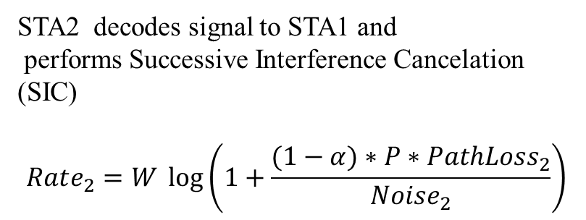
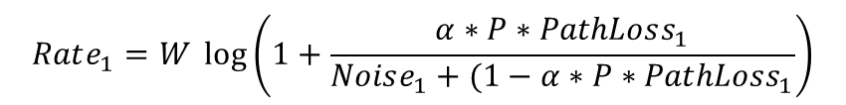
Basic Idea of Downlink NOMA (1)
Power
AP
P
STA 2
To STA₂
$$α P$$
To STA₁
STA2 decodes signal to STA1 and
performs Successive Interference Cancelation (SIC)
$$Rate_{2}=W \log\left(1+\frac{(1−α)∗P∗PathLoss_{2}}{Noise_{2}}\right)$$
STA 1
$$Rate_{1}=W \log\left(1+\frac{α∗P∗PathLoss_{1}}{Noise_{1}+(1−α∗P∗PathLoss_{1}}\right)$$

Slide 4
Basic Idea of Downlink NOMA (2)
TX side
RX side
Q
STA₁
I
STA₂

Slide 5
TX Scheme
SIFS
SIFS
DIFS
To STA₂
AP
To STA₁
STA₁
ACK
STA₂
ACK

Slide 6
Example
Standard | 802.11a
SNR1 | 3 dB
SNR2 | 19 dB
MCS TDMA | STA1 0 STA2 6
MCS NOMA | STA1 0 STA2 4

Slide 7
Example
Standard | 802.11a
SNR1 | 3 dB
SNR2 | 19 dB
MCS TDMA | STA1 0 STA2 6
MCS NOMA | STA1 0 STA2 4
+43%
+92%

Slide 8
Balance between Link 1 and Link 2

Slide 9
Testbed. Proof of concept
AP (SDR)
STA₂ (SDR)
As NOMA device
STA₁ (Laptop)
As legacy device

Slide 10
Properties
Backward compatibility (STA 1 can be legacy)
Almost double throughput for the STA with poor channel (in case of fare resource allocation) OR
Manifold gain in throughput of the nearest STA (STA 2) when providing guaranteed throughput for the furthest STA (STA 1)

Slide 11
Straw Poll
Is the problem of NOMA in 802.11 interesting to you?
Yes
No
Abstain

