Slide 1
V2X Reed-Solomon Simulation Model
Date: 2018-11-12
Authors:

Slide 2
Abstract
A new branch of the ubx-v2x simulation model [1] was created. It can be used for research on the use of Reed Solomon as an outer coding mechanism for NGV
ubx-v2x model (baseband 802.11p transceiver)
https://github.com/u-blox/ubx-v2x
NGV (Reed Solomon) branch
https://github.com/u-blox/ubx-v2x/tree/ngv_rs0

Slide 3
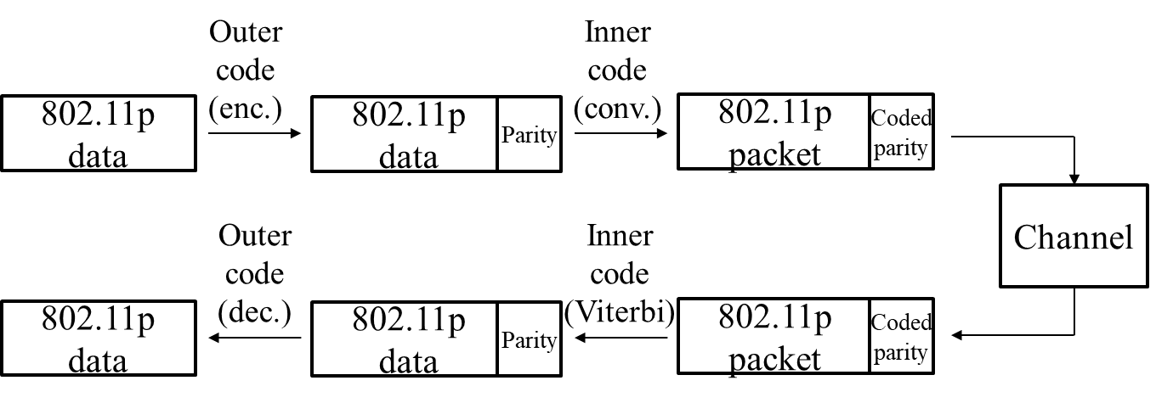
Introduction
Motivation is to promote collaboration among V2X experts on a common platform
Investigations were performed based on the configurations described in [2]
Fig. 1 – Reed Solomon outer coding (taken from [2])

Slide 4
Results (1/3): AWGN
AWGN
Payload: 239 bytes
MCS 1 (BPSK – ¾)
Standard (Viterbi)
Viterbi + Outer RS (255, 239)
Viterbi + Outer RS (86, 80)
Gain up to 0.7 dB

Slide 5
Results (2/3): Highway LoS
Highway LoS
Payload: 239 bytes
MCS 1 (BPSK – ¾)
Standard (Viterbi)
Viterbi + Outer RS (255, 239)
Viterbi + Outer RS (86, 80)
Gain up to 0.8 dB

Slide 6
Results (3/3): Highway Non-LoS
Highway Non-LoS
Payload: 239 bytes
MCS 1 (BPSK – ¾)
Standard (Viterbi)
Viterbi + Outer RS (255, 239)
Viterbi + Outer RS (86, 80)
Gain up to 0.8 dB

Slide 7
Conclusions & Next Steps
Reed Solomon outer coding seems to offer a gain compared to 802.11p
Performance gains appear to be less pronounced than quoted in [2]
However, the standard Doppler values from the C2C models were used, whereas in [2] enhanced Doppler values were quoted
Investigate collaboration opportunities for:
Evaluating scenarios of higher mobility
Extending the simulator to cover more recent contributions in this area

Slide 8
References
[1] I. Sarris, "V2X Simulation Model," IEEE 802.11-18/1480r1.
[2] O. Haran, “Backward compatible PHY feasibility,” IEEE 802.11-18/1214r0

