Slide 1
HARQ for EHT – Further Information
Date: 2018-09-14
Authors:

Slide 2
Background
Hybrid Automatic Repeat Request (HARQ) is a mechanism widely used in wireless/cellular technologies to improve link quality
There are several benefits associated with HARQ:
  Improved link performance due to combining several retransmissions
  Link range extension (improved coverage), particularly at the low SNR region
  Performance gain across the board, in every scenario/configuration (irrespective of BW, MIMO mode, etc.)
  Offers effectively an extended set of MCSs, with finer granularity, thus making link adaptation (a weak point in 802.11) more robust and efficient
  Supports operation with reduced backoff (smaller fade margin) in the rate selection algorithm → higher data throughput
In the previous meeting, we presented an overview of HARQ operation, simulation results and a complexity analysis; in this presentation, we address several issues and present some updated results

Slide 3
Freq. Diversity between Retransmissions
Before looking at what gains can be achieved by HARQ, let us look at an A-MPDU’s contents during a transmission and a re-transmission
Let’s assume an A-MPDU containing
5 MPDUs shown on the right
Assuming MPDUs #3 and #5 fail, they will
most likely be retransmitted within a new A-MPDU
Within the new A-MPDU, the QAMs
respective to the retransmitted MPDUs will
(in majority of cases) experience
some frequency (and time) diversity
time
MPDU #1
MPDU #2
MPDU #3
MPDU #5
frequency
MPDU #4
MPDU #3
time
MPDU #3
(re-Tx)
MPDU #5 (re-Tx)
MPDU #6
MPDU #8
frequency
MPDU #7
MPDU #6

Slide 4
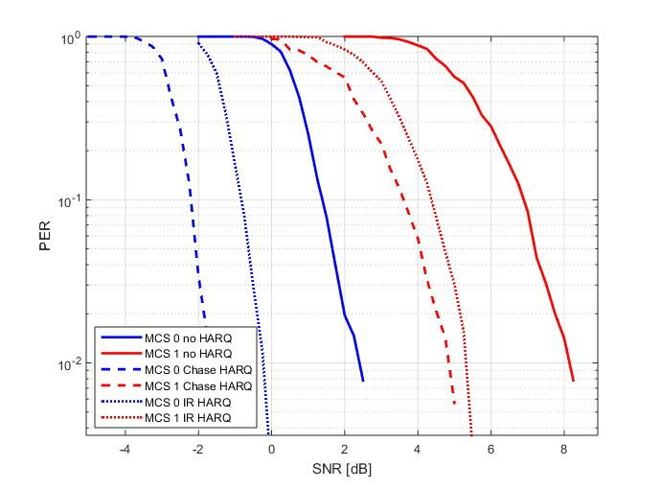
Simulation Results
In the following figure, we compare between MCS 0 and 1 with 1500B payload over a 242-tone RU and assuming 2x2 MIMO, in TGn-D NLOS, for three cases:
  Without HARQ: single
  transmission (no combining)
  With Chase HARQ: combining
  two transmissions
  With IR HARQ: combining
  two transmissions, each with a
  different puncturing
HARQ yields a significant
benefit of 2.5-4dB

Slide 5
Simulation Results – cont.
We want to look at the impact of HARQ over the entire range of practical SNR values
We begin by looking at the achievable throughput where the best MCS is chosen at each SNR, without HARQ; we then compute the throughput when incorporating HARQ using one of the following alternatives:
  Chase Combining (CC) where the exact same coded bits are transmitted using the existing coding rates; we compare between two cases:
    Using the existing LDPC parameters (puncturing etc.)
    Using an effective higher coding rate (more puncturing)
  Incremental Redundancy (IR) where we reuse existing LDPC codes with effectively higher coding rate (more puncturing); the original (existing) coding rate is reproduced after combining (in case a retransmission occurs)
We assume a 2x2 configuration over a TGn-D NLOS channel
The throughput computation takes into account all durations (including backoff, preamble+payload, SIFS, Block-ACK, retransmission)

Slide 6
Simulation Results – cont.
As shown below, HARQ yields benefits across the entire SNR range
The HARQ throughput
result is slightly
‘smoother’ which
effectively means
finer MCS granularity
Improved
throughput
and coverage
3.5-4dB gain
3.5-4dB gain

Slide 7
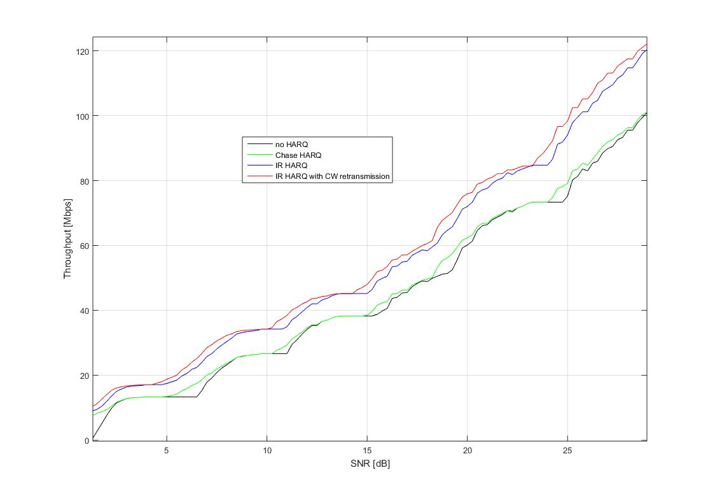
Retransmitting Failed Codewords
In most cases of an MPDU in error, not all LDPC codewords fail; this means retransmitting the entire MPDU is inefficient; instead, we can retransmit only the failed codewords
Such a mechanism can yield
a further ~0.75dB gain
4-5dB gain
4-4.5dB gain

Slide 8
HARQ and Interference/Collisions
A concern was raised (e.g. [1]) regarding combining retransmissions in the unlicensed band which is (sometimes) highly interfered – e.g., it may be preferable not to combine “contaminated” LLRs from frames which suffered from collisions
Suggested cure: Bits belonging to successfully decoded codewords are kept in the receiver’s memory, and LLRs are stored only for incorrectly decoded codewords, for potential combining later on upon retransmission
If on average ~half the codewords are successfully decoded, the receiver may have enough processing time for pursuing 2 options:
  First attempt decoding retransmitted codewords without combining
  Only if first attempt fails, combine new & stored old LLRs and retry decoding

Slide 9
Summary
HARQ is a proven technology, used in other wireless standards – also in the unlicensed bands (which are used for 802.11)
HARQ can be used in any scenario/configuration – regardless of the number of Tx or Rx antennas, MIMO mode, BW etc.
The performance improvements associated with HARQ can be used to significantly enhance the link adaptation mechanism in 802.11
We think that HARQ should be incorporated into the 802.11 protocol and become a part of the upcoming EHT standard

Slide 10
References
11-18-1549: EHT Candidate Technology Review, Sep. 2018

