Slide 1
ETSI Cooperative Awareness Message (CAM) generation rules
Date: 2018-11-05
Authors:

Slide 2
Abstract
ETSI EN 302 637–2 defines the structure and generation rules of CAMs:
Cooperative Awareness Message (CAM)
  Core message for a broad range of ITS use cases for day one and day two applications
  Will have to be support in a fully backward compatible way in all new versions of a NGV system
  CAM messages are non-deterministic in time and size
    Period varies from 1Hz to 10Hz depending on the generation rules based on speed, heading and acceleration
    Size varies from around 200 bytes to up to more than 700 Bytes depending on the environment and security content

Slide 3
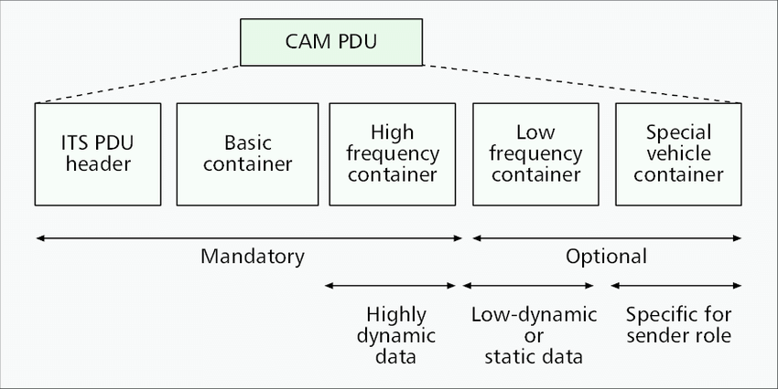
CAM structure

Slide 4
Basic generation rules
Speed: A change in position by more than 4m
Heading: a change of direction of equal or more than +/- 4°
Change of speed: A change of speed equal to or larger than 0,5m/sec
Extrem values:
  Minimum rate is 1Hz,
  Maximum rate is 10Hz

Slide 5
Inter-CAM spacing in seconds, Sub Urban scenario
Max speed: 60km/h
Sub-Urban/Industrial area
Main factor:
  Acceleration
  Steering

Slide 6
Variable CAM message size, highway scenario
Max speed: 130km/h
Rural highway

Slide 7
Conclusion
CAM generation based on ETSI EN 302 637–2 is a highly dynamic and non-deterministic process
The dynamic generation rule guarantees an efficient resource usage since only actually required information are send out (spectrum efficiency)
CAM instantaneous rate can vary from 1Hz to 10Hz from one generated CAM to the next one
CAM size is depending on the actual content an can vary from around 200 Bytes to more than 700Bytes
In the future smaller (pedestrian) and larger CAM sizes are possible

