Slide 1
Performance evaluation of Real Time Communications over Wi-Fi
Date: 2019-03-11
Authors:
Name | Affiliation | Address | Phone | Email
Evgeny Khorov | IITP RAS |  |  | khorov@frtk.ru
Dmitry Bankov | IITP RAS |  |  | bankov@iitp.ru

Slide 2
Contribution
This document describes two ways of how to organize real-time communications in IEEE 802.11 networks and evaluates their performance in simple scenarios

Slide 3
Outline
Preemptive Service
AX-like approach
Simulation results

Slide 4
What makes Wi-Fi not Real-Time
Packet Delay = Queueing Delay + Packet Transmission Time
A real-time (RT) packet shall wait while at least the head-of-line packet is being transmitted
Maximal PPDU duration in 11ax exceeds 5 ms
Packet Transmission Time includes channel access time and PPDU duration (plus retries, if any)
Because of unlicensed spectrum, the channel may be busy with transmission of other devices

Slide 5
Reducing Queueing Delay
Main idea: Stop transmitting a non-RT frame when an RT frame arrives.
This is similar to IEEE Std 802.1Qbu-2016
A STA can easily stop its own frame, but how to stop other frame transmissions

Slide 6
Preemptive service. Own RT packet
Main idea: to minimize channel access delay, stop transmitting a non-RT frame when a RT frame arrives.
RT packet arrives in the queue of the same STA
Data
Time
Data
Real Time Data
SIFS
Ack
Time
[1] WTSN (Wi-Fi Time Sensitive Networking) doc.:IEEE 802.11-17/1734r1

Slide 7
Preemptive service. Alien transmission
RT packet arrives in the queue of another STA
Non-RT STA
Data
Channel is busy
Data
Time
IFS
SIFS
RT STA
Data
Ack
Busy tone in the service channel
Time
The RT STA generates busy tone in the service channel when it has an RT frame.
Any ongoing transmissions should be cancelled.
If no busy tone is in the service channel, the RT frame can be transmitted PIFS after the main channel becomes idle. Otherwise, RT frames contend for the channel access according to EDCA (high priority queue)
[1] WTSN (Wi-Fi Time Sensitive Networking) doc.: IEEE 802.11-17/1734r1

Slide 8
AX-like approach
Frequency
TF
RU m
MSBA
Other Transmissions
TF
…
RU 2
RU 1
Time
SIFS
SIFS
Trigger Frame
Resource Units
Assigned to specific STAs or Random Access (RA)
Multi Station Block-Ack
The AP periodically generates TF

Slide 9
AX-like approach. Possible Algorithm
Frequency
TF
RU m
MSBA
TF
RU m
MSBA
TF
RU m
MSBA
…
…
…
RU 2
RU 2
RU 2
RU 1
RU 1
RU 1
Time
RU 1 is for RT Random Access
RU 2…m are used for usual DATA or RT DATA.
RU duration is short enough to allow 3 TX within delay budget.

Slide 10
AX-like approach. Possible Algorithm
Non-RT RU
RU m
STAs: m, 2m, …
STAs: m
RU m
RT RA RU, idle
…
…
STAs: 2m
…
RT RU, idle
RU 2
STAs: 2, m+2 , …
STAs: m+2
RU 2
RT RU, success
RU 1
STAs: 1, m+1 , …
STAs: 2
RU 1
RT RU Collision
RU 0
RU 0
RU 0
RU 0
STAs 1, 2, m, 2m transmit RT frames
Apart from that, STA m+2 transmits.
Time
By default, the AP allocates 1 RUs for random access
In case of collision, the remaining m RUs are allocated for RA RT uniformly for those STAs, which might participate in the collision
If the number of RT STAs is greater than m, each RU is allocated for several STAs

Slide 11
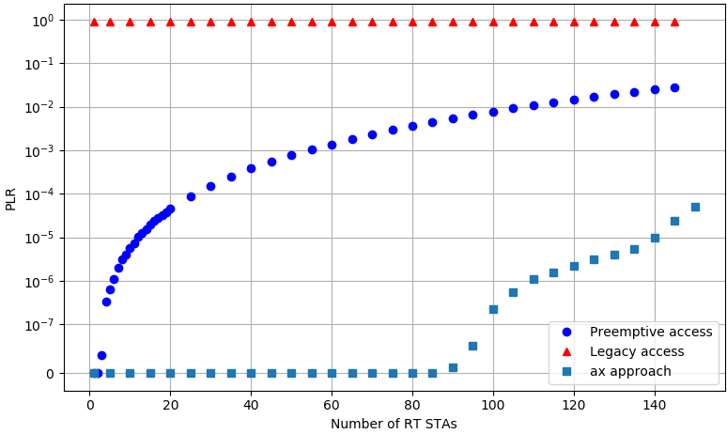
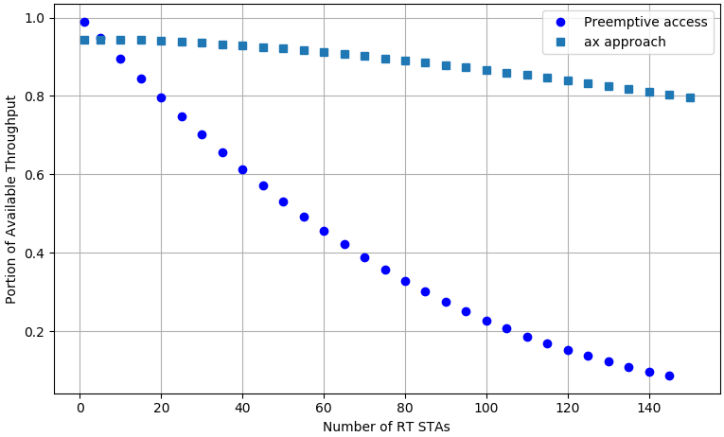
Performance evaluation
1 AP, 10 non-RT STAs transmitting frames in saturated mode
N RT STAs generate 32B frames (Poisson process with λ⁻¹ = 50 ms)
All STAs use MCS5
If a frame is not delivered within 1ms, it is dropped.
T_{data}= 0.9 ms (non-OFDMA), T_{rt}= 0.06 ms, Period of RUs = 0,28ms, BW=40MHz, N_{ru}=18
Packet loss ratio (both collisions and drops)
Portion of throughput for usual DATA

