Slide 1
IoT Onboarding for 802.11
Date: 2018-11-11
Authors:

Slide 2
Abstract
This document presents challenges around IoT onboarding for 802.11 based on IETF BRSKI work, and suggests a few areas of possible cooperation between 802.11 and IETF

Slide 3
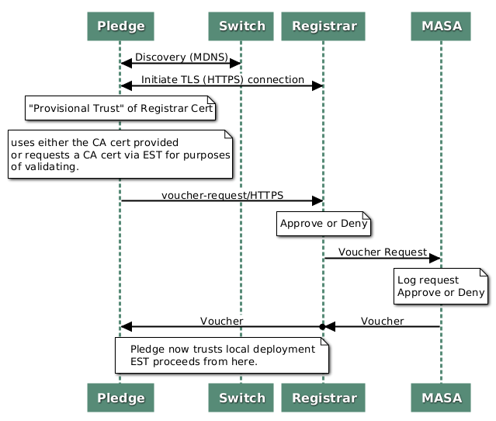
Bootstrapping with wired (ANIMA BRSKI)
Pledge=Device
Registrar=Store of known devices (tied to AAA infrastructure)
MASA=”Manufacturer Authorized Signing Authority”
EST -enrollment over secure transport
Slide 3
Jerome Henry, Cisco

Slide 4
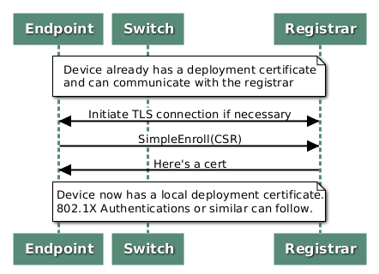
Client gets a certificate via EST (RFC 7030)
Slide 4
Jerome Henry, Cisco

Slide 5
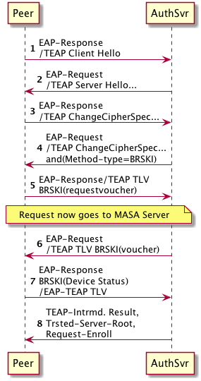
Getting there with wireless
Can do EAP-Success here if we recognize local cert
Use existing management path in the network: EAP
Keep onboarding capabilities in interface “bring up”
Reuse as much as possible
draft-lear-eap-teap-brski
Can skip BRSKI and go right to enroll if we need to re-enroll
Slide 5
Jerome Henry, Cisco

Slide 6
Steps needed to get a device to join a network
Out of the box
Device learns which network to join
Provision device to trust network
Provision network to trust device
Operational State
Slide 6
Jerome Henry, Cisco

Slide 7
Basic onboarding is simple
A headless IoT device needs to be told the SSID and its associated credentials
At this basic level (“level 1”), connectivity is the main objective
Level 1: just need the SSID / PSK
Level 1: I accept any client with the right credentials
Slide 7
Jerome Henry, Cisco

Slide 8
Basic Provisioning is simple
Several solutions have been developed to solve this provisioning problem
This can be seen as an “individual scale” provisioning problem
OOB (NFC, BT etc.) or P2P Wi-Fi
SSID, credentials
Level 1: just need the SSID / PSK
Level 1: I accept any client with the right credentials
Slide 8
Jerome Henry, Cisco

Slide 9
Provisioning at Scale is not solved yet
“individual scale” provisioning solutions are challenged for “building scale” provisioning scenarios
Slide 9
Jerome Henry, Cisco

Slide 10
Provisioning at Scale is not solved yet
“Individual scale” provisioning techniques only imperfectly solve the “building scale” case
Potential excessive airtime consumption
“Regular” 802.11 process vs “IoT” process mismatches
Individual P2P communication and provisioning
(times n individual devices)
Slide 10
Jerome Henry, Cisco

Slide 11
Provisioning at Scale is not solved yet
For “building scale” provisioning, the awaking IoThing needs to detect “IoT SSIDs” through which inline automated onboarding mechanism may exist
802.11u, 802.11aq can advertise IoT support
Temporal tunnel could be used for secure provisioning (e.g. RFC 8110, EAP-TEAP-BRSKI, others)
Infrastructure needs to:
Advertise “IoT friendliness”
Automate provisioning
Slide 11
Jerome Henry, Cisco

Slide 12
Conclusion 1
802.11 messaging could be augmented to facilitate IoT onboarding at scale
Specific “IoT onboarding” values in 802.11u/aq, in beacons and probe responses
Options could be set to signal secure provisioning (e.g. EAP-TEAP-BRSKI, RFC 8110, others)
Slide 12
Jerome Henry, Cisco

Slide 13
Increased IoThing side Requirements
In multi-tenant scenarios, the IoThing needs to know the ‘right’ SSID
“Honest neighbors” also should not want to onboard the Thing
This can be achieved when the infrastructure proves that it “knows” the IoThing
SSID1
SSID2
Level 2: IoT may need to determine the “correct” SSID
Slide 13
Jerome Henry, Cisco

Slide 14
Increased IoThing side Requirements
Requesting IoThing may position an “is it you” question in probe/association request frames
IoThing needs to add an identifier:
MAC address / serial
Vendor identifier
Public key (BRSKI, PKI)
SSID1
SSID2
Probe + “is it you?”
Level 2: IoT may need to determine the “correct” SSID
Slide 14
Jerome Henry, Cisco

Slide 15
IoThing Side Identifier Challenges
Some verticals will only need “what is that thing” value (object category)
Other verticals will need individual thing identification (thou shalst not onboard your neighbor lightbulb even if they use the same brand as yours)
Other verticals will mandate anti-spoofing provisions
SSID1
SSID2
Probe + “is it you?”
Level 2: IoT may need to determine the “correct” SSID
Level 2: AP only accepts the right client, with the right credentials
These different requirements are great area of potential cooperation with the IETF BRSKI* effort
*Bootstrapping Remote Secure Key Infrastructures
Slide 15
Jerome Henry, Cisco

Slide 16
Infrastructure Side knowledge proof
The AP can return a sign, or proof of knowledge, confirming that the IoThing communicates with the ‘right’ SSID:
Complementary value (e.g. serial)
Bloom filter
BRSKI Voucher, PKI
No proof
SSID1
SSID2
Proof that I know you
Level 2: IoT may need to determine the “correct” SSID
Level 2: AP only accepts the right client, with the right credentials
Complementary value, bloom filter are for IoThing level 2 needs,
PKI, BRSKI can fulfill infrastructure level 2 needs
Slide 16
Jerome Henry, Cisco

Slide 17
Infrastructure Side knowledge proof
Level 2: IoT may need to determine the “correct” SSID
SSID2
Is it you?
Response + comeback
Backend proof collection
Is it you?
Response + proof
If the proof is given at the probe phase, the AP may need to go search for an answer
This process may require a comeback phase
Slide 17
Jerome Henry, Cisco

Slide 18
Conclusion 2
Specific “IoT identifiers” fields could be added to probe/association requests
Identifiers may be associated with exchange type (in following slides)
AP probe/association response could include comeback values, proof IE values
Slide 18
Jerome Henry, Cisco

Slide 19
Level 3 for Secure networks
For higher security networks, and/or critical objects, a third level of security may be needed
IoThing may need anti-evil twin protection
Network may need anti-tempering (open boxes) measures for new IoThings
Manufacturer
AAA
Registrar
MASA
Level 3: prove that you are allowed to onboard me
Level 3: prove that you are allowed to onboard,
and were not tampered with
Slide 19
Jerome Henry, Cisco

Slide 20
Level 3 for Secure networks
Manufacturer
AAA
Registrar
MASA
Level 3: prove that you are allowed to onboard me
Level 3: prove that you are allowed to onboard,
and were not tampered with
IoThing provides a public cert
Cert is verified by MASA/Manufacturer and approved
Proof of ownership is returned
BRSKI allows for such level 3 requirements on both sides
Slide 20
Jerome Henry, Cisco

Slide 21
Approaches to onboarding
 | WPS | Simple Serial # | DPP / WiFI Easy Connect ^{tm} | BRSKI w/ sales integration | BRSKI no sales integration | BRSKI with POP
Correct Network Selection | Yes | Yes | Yes | Yes | No | Yes
Onboard without Internet access | Yes | Yes | Yes | No | No | Yes
Proof of ownership | No | No | No | Yes | Yes** | Yes***
Supply chain security | No | No | No | Yes | Yes*** | Partial
Hands free* | No | No | No | Yes | Yes | No
Well secured | No | Maybe | Yes | Yes | Yes | Yes
Status | Here | Not planned | Std | Partially standardized | Partially standardized | Beginning
Key type | None | Ser # | Asym. | X.509 | X.509 | X.509 + private
Manufacturing complexity | Nvram | Serial# | Public Key + label/BOM | Cert+Back End Integration | Cert | Cert+label/BOM
*Hands free = no label or BOM integration
**Assumes protection of proof of ownership
***Assumes Internet access to enterprise AAA at some point
Slide 21
Jerome Henry, Cisco

Slide 22
Conclusion 3
IoT onboarding presents new requirements for 802.11 exchanges
Collaboration with IETF may help better refine the associated needs for 802.11
New IEs in existing or new frames may be proposed to solve the various use cases

Slide 23
References
BRSKI over IEEE 802.11, draft-friel-anima-brski-over-802dot11-00, https://datatracker.ietf.org/doc/draft-friel-anima-brski-over-802dot11/
Proof of Possession to Devices for Onboarding, draft-lear-brski-pop-00, https://datatracker.ietf.org/doc/draft-lear-brski-pop/
Worth noting: IETF opsawg and anima mailing lists, upcoming iot-onboarding@ietf.org mailing list

