Slide 1
Aspects of multi-channel operation for NGV
Date: 2018-MM-DD
Authors:
Ron Toledano, Autotalks

Slide 2
Abstract
Existing DSRC deployments are using single channel
Some of the devices in market already support multi-channel capability
Upcoming V2X use-cases, such as platooning, and later cooperative perception, require multi-channel operation (MCO)
Limited spectrum doesn’t enable to spread channels
In this presentation we discuss implementation aspects related to MCO
Ron Toledano, Autotalks

Slide 3
Adjacent Channel Rejection (ACR) Assumptions
ACR defines tolerable interference-to-signal power difference under target receiver performance (sensitivity)
Increased ACR allows receiver to experience stronger interference on adjacent channel while maintaining target receiver performance at its dedicated channel
Limits of MCO with simultaneous RX from separate V2X channels (adjacent or non-adjacent) are defined by ACR
Ron Toledano, Autotalks

Slide 4
ACR and MCO – Single Receiver
RX1 has single receiver tuned to channel A (e.g. safety channel)
TX1 and TX2 transmit on channels A and B respectively
RX1 is at sensitivity range from TX1. Due to “interference” from channel B it does not detect TX1
Assuming current ACR requirements:
What is the lowest inter-vehicle distance (d2) that will
allow RX1 to detect channel A at sensitivity range?
Ron Toledano, Autotalks

Slide 5
ACR and MCO – Dual Receiver
RX1 has dual receiver tuned to channels A and B
TX1 and TX2 transmit on channels A and B respectively
What are (d1,d2) combinations that will allow RX1 to detect both
channels A and B?
Ron Toledano, Autotalks

Slide 6
Assumptions
Urban environment: WINNER II path-loss model for LOS [1]
MCS2 (QPSK R=1/2)
Target SNR = 6dB
ACR=25 dB and co-adjacent = 39 dB (enhanced sensitivity)
Receiver Noise figure: 9 dB
Mask C
Ron Toledano, Autotalks

Slide 7
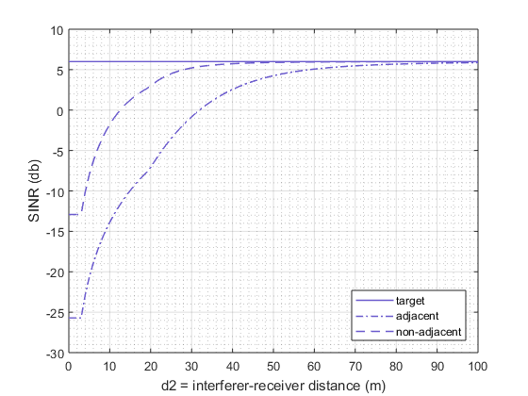
Results – Single Receiver
Distance between channel A vehicles is d1 (sensitivity range)
Varying distance (d2) for channel B vehicle
Ron Toledano, Autotalks

Slide 8
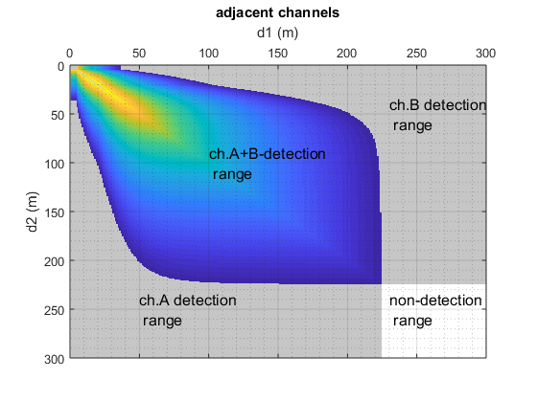
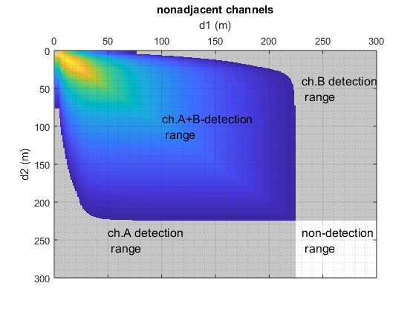
Results – Dual Receiver
Varying distances (d1,d2) for channel A and channel B vehicles
Ron Toledano, Autotalks

Slide 9
Observations
Adjacent channel transmission creates interferences to main channel within ~50 meters range
  Motivates modification of ACR and mask requirements
  Main channel DCC would further increase interferences impact
  Careful TX power balance should be applied for all channels
A vehicle transmitting in an adjacent channel is “deaf” to main channel
  Multi-channel operation would require coordination mechanisms
Ron Toledano, Autotalks

Slide 10
Appendix
[1] WINNER II Channel Models, D1.1.2 V1.2.
Ron Toledano, Autotalks

