Slide 1
IPv6 ND Proxy - why it matters for 802.11 -
November 2018
Date: 2018-11-09
Authors:

Slide 2
Abstract
This submission indicates a new IETF reference for the 802.11 WMN STA Proxy IPv6 Neighbor Discovery Service function
This submission also proposes 1 variations for the implementation of this proxy function, a pure routing version that does not leak the MAC addresses from the wireless side, and a L3 bridging version whereby the proxy advertises the IPv6 address of the STA together with its MAC address.

Slide 3
IPv6 ND proxy references
November 2018
https://datatracker.ietf.org/doc/draft-ietf-6lo-rfc6775-update/
https://datatracker.ietf.org/doc/draft-ietf-6lo-backbone-router/
https://datatracker.ietf.org/doc/draft-ietf-6lo-ap-nd/
Pascal Thubert

Slide 4
Unmet expectations
November 2018
Solicited node multicast requires highly scalable L2 multicast
IEEE does not provide it => turns everything into broadcast
IPv6 ND appears to work with broadcast on 802.1 fabrics up to some scale ~10K nodes
IPv6 ND requires reliable and cheap broadcast
Radios do not provide that => conserving 802.1 properties over wireless is illusory
RFC 4862 cannot operate as designed on wireless
Address uniqueness is an unguaranteed side effect of entropy
802.11 expects proxy operation and broadcast domain separation
802.11 provides a registration and proxy bridging at L2
Requires the same at L3, which does not exist (NULL ref to ND proxy)
Implementations provide proprietary techniques based on snooping (SAVI)
=> widely imperfect
RFC 6775 solves the problem for DAD in one BSS
This update enables a registration for proxy and routing services across the ESS

Slide 5
Use AND implementation of mCast in IPv6 ND
November 2018
IPv6 Discovery protocols use multicast flooding
Assuming a lower layer multicast support
Not just IPv6 NDP but also mDNS, etc…
Layer-2 destination set to 3333XXXXXXXX
Layer-2 fabric handles as broadcast (all nodes)
Broadcast clogs the wireless access at low access speed (typically 1Mbps) on all APs around the fabric
Broadcast self interferes on attached wireless mesh and drains the batteries on all nodes

Slide 6
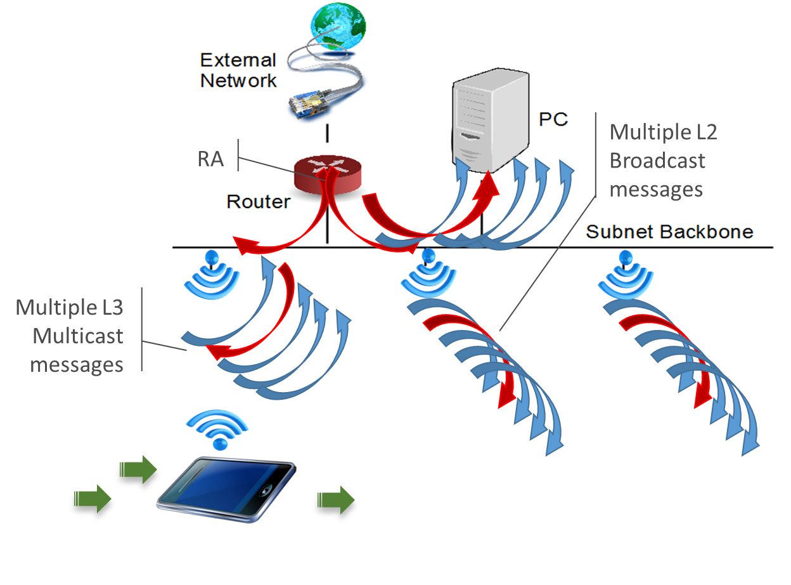
Flooding for mobility
November 2018
IPv6 STA moves from AP within ESS:
MAC address reachability flooded over L2 switch fabric
Device sends RS to all routers link scope mcast
Router answers RA (u or m)
Device sends mcast NS DAD to revalidate its address(es)
Device sends mcast NA(O)
An ND proxy, aka backbone router, limits the broadcast domain to the backbone

Slide 7
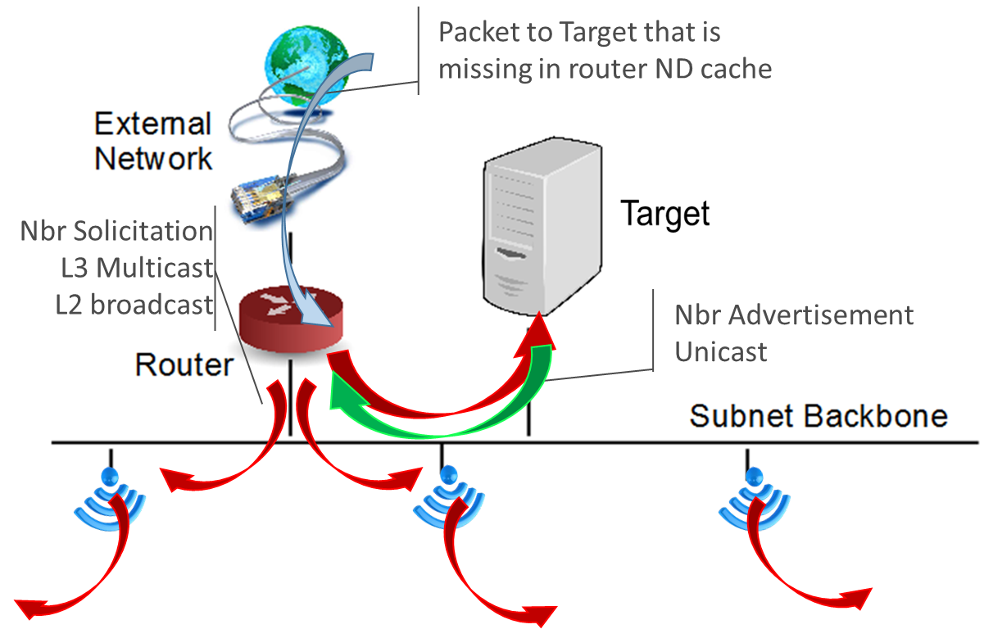
flooding for Neighbor Discovery
November 2018
Packet comes in for 2001:db8::A1
Router looks up ND cache (say this is a cache miss)
Router sends NS multicast to solicited-node multicast @;
here that is 3333 FF00 00A1
Targets answers unicast NA
Target revalidates ND cache for the router, usually unicast
Router creates ND cache entry
6TiSCH proxies at the backbone router on behalf of device

Slide 8
ND proxy drafts
November 2018

Slide 9
In a nutshell
November 2018
Provide for draft-thubert-6lo-rfc6775-update-reqs
draft-ietf-6lo-rfc6775-update (RFC-to-be 8505)
The Layer-3 equivalent to the wireless association by a STA
Enables registration to both ND proxy and IPv6 routing services
draft-ietf-6lo-ap-nd
Protects addresses against theft (Crypto ID in registration)
draft-ietf-6lo-backbone-router
Federates 6lo meshes over a high speed backbone
The Layer-3 equivalent to the bridging operation by an AP

Slide 10
RFC 6775 Update (RFC-to-be 8505)
P.Thubert, E. Nordmark, S. Chakrabarti, C. Perkins

Slide 11
November 2018
6LBR
Routerver
STA/6LN
6BBR
AP/6LR
Router/Server
Router/Server
Router/ver
Router
Router/Server
802.11
Bridged
Ethernet
RFC 6775
RFC 4861/4862
RA (u|mcast)
RA (u|mcast)
PIO
MTU
PIO
MTU
SLLA

Slide 12
November 2018
6LBR
STA/6LN
6BBR
AP/6LR
Trivial additions required to register things that are not IPv6 addresses e.g. IPv4 or MAC addressses
802.11
RFC-to-be 8505
Create binding state
NS (ARO)
SRC = 6LN LL **
DST = 6BBR LL **
TGT = 6LN
SLLA = 6LN
UID = ROVR
TID included
** link local
* Can be Anycast

Slide 13
November 2018
6LBR
AP/6LR
STA/6LN
6BBR
802.11
RFC-to-be 8505
NA (ARO)
SRC = 6BBR LL **
DST = 6LN LL **
TGT = 6LN
TLLA = 6LN
UID = ROVR
TID included
** link local

Slide 14
Status of the document
November 2018
IANA steps
https://www.iana.org/assignments/icmpv6-parameters/icmpv6-parameters.xhtml#icmpv6-parameters-codes-type-157-code-suffix
Done RFC Editor disambiguations and edition
RFC Editor state : RFC-EDITOR *
* Awaiting final validation by authors, 2 of them pending

Slide 15
draft-ietf-6lo-ap-nd
P. Thubert, B. Sarikaya, M Sethi, R. Struik

Slide 16
Expectations
November 2018
First come first Serve address registration
First registration for an address owns that address till it releases it
The network prevents hijacking
Source address validation
Address must be topologically correct
Source of the packet owns the source address
First Hop Security only?
Proxy ownership and routing advertisements not protected yet

Slide 17
November 2018
STA/6LN
AP/6LR
LP Node
6LR
802.11
AP-ND
NS (EARO(ROVR=Crypto-ID))
NA (EARO(status=Validation Requested), Nonce)
NS (EARO, CIPO*, Nonce and NDPSO**)
NA (EARO(status=0))
* Crypto-ID Parameters Option
** NDP Signature Option

Slide 18
Recent changes
November 2018
Published -08
René Struik joined as contributing author
Updated the computation of the Crypto-ID
Crypto-Id in EARO is a truncated hash of the node's public-key
Digital signature (SHA-256/NIST P-256 or SHA-512/EdDSA) in NDPSO is executed on additional material (nonces, etc…, see updated section 6.2) for proof of ownership of the private key
Uses both nonces from the 6LN and 6LR
Removed SHA-256 for EdCSA to comply with RFC 8032.

Slide 19
draft-ietf-6lo-backbone-router
P. Thubert

Slide 20
Unmet expectations
November 2018
Scale an IOT subnet to the tens of thousands
With device mobility (no renumbering)
Controlled Latency and higher Reliability using a backbone
Deterministic Address presence
Route towards the latest location of an address
Remove stale addresses

Slide 21
November 2018
6LBR
Router/Server
STA/6LN
AP/6BBR
6BBR
AP/6BBR
Router/Server
Router/Server
Router/Server
Router/Server
Router/Server
802.11
Bridged
Ethernet
RFC-to-be 8505
Backbone router
Create binding state
Create proxy state
NS (ARO)
SRC = 6LN LL **
DST = 6BBR LL **
TGT = 6LN
SLLA = 6LN
UID = OVR
TID included
NS DAD (ARO)
SRC = UNSPEC
DST = SNMA
TGT = 6LN
UID = ROVR
TID included
* Omitted in general
** link local
* Can be Anycast

Slide 22
November 2018
6LBR
Router/Server
STA/6LN
AP/6BBR
6BBR
AP/
6BBR
Router/Server
Router/Server
Router/Server
Router/
Server
Router/Server
802.11
Bridged
Ethernet
RFC-to-be 8505
Backbone router
DAD time out
NA (O) *
NA (ARO)
SRC = 6BBR LL **
DST = SNMA
TLLA = 2 modes
TGT = 6LN
SRC = 6BBR LL **
DST = 6LN LL **
TGT = 6LN
TLLA = 6LN
UID = ROVR
TID included
* Omitted in general
** link local

Slide 23
November 2018
6LBR
Router/Server
STA/6LN
AP/6BBR
6BBR
Router/Server
Router/Server
Router/Server
Router/
Server
Router/Server
802.11
Bridged
Ethernet
RFC-to-be 8505
Backbone router
Proxy NS (EARO)
NA (EARO)
NS lookup
NA (~Override)
Packet

Slide 24
6BBR Status
Quite Stable, no recent change
WGLC is needed to make final progress

Slide 25
Resulting flows

Slide 26
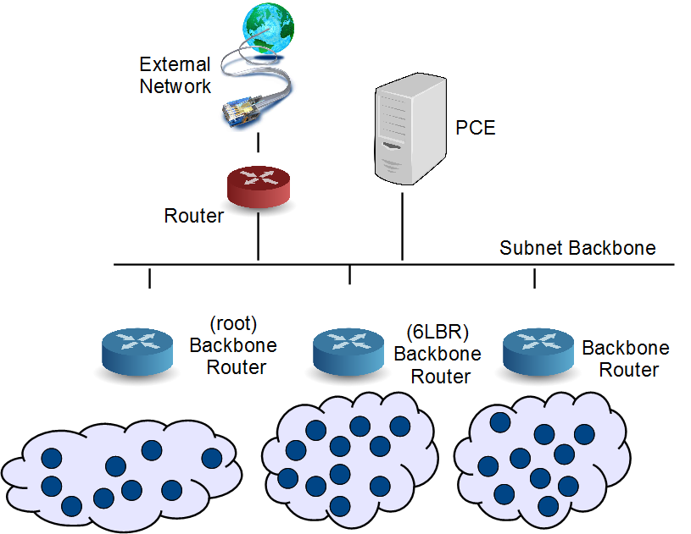
Initial time
November 2018
Routers within subnet have a connected route installed over the subnet backbone.
PCE probably has a static address in which case it also has a connected route
Connected
Route to subnet
Wireless
Domain

Slide 27
First advertisements from GW (RA, IGP, RPL)
November 2018
Gateway to the outside participate to some IGP with external network and attracts all extra-subnet traffic via protocols over the backbone
Default
Route
In RIB
Wireless
Domain
Wireless
Domain
Wireless
Domain
Wireless
Domain
Wireless
Domain

Slide 28
IPv6 ND Registration to 6LR and 6LBR
November 2018
Directly upon NS(ARO) or indirectly upon DAR message, the backbone router performs DAD on behalf of the wireless device.
NS DAD
(ARO)
DAD
NS
(ARO)
DAR
Wireless
Domain

Slide 29
IPv6 ND Registration and Proxy for NS ARO
November 2018
NA(ARO) or DAC message carry succeful completion if DAD times out.
NA(Override) is optional to clean up ND cache stale states, e.g. if node moved.
Optional NA(O)
NA
(ARO)
DAC
Wireless
Domain

Slide 30
IPv6 ND Proxy for RPL
November 2018
The BR maintains a route to the WSN node for the DAO Lifetime over instance VRF. VFR may be mapped onto a VLAN on the backbone.
Optional NA(O)
RPL
DAO
Host
Route
Wireless
Domain

Slide 31
RPL over the backbone
November 2018
The BBR maintains a route to the WSN node for the DAO Lifetime over instance VRF that is continued with RPL over backbone.
RPL DAO
RPL
DAO
Host
Route
Wireless
Domain

Slide 32
Duplication
November 2018
DAD option has:
Unique ID
TID (SeqNum)
Defend with NA if:
Different OUID
Newer TID
NS DAD
(ARO)
NA (ARO)
NS
(ARO)
Wireless
Domain

Slide 33
Duplication (2)
November 2018
DAD option has:
Unique ID
TID (SeqNum)
Defend with NA if:
Different OUID
Newer TID
DAD
NA
(ARO)
DAR
Wireless
Domain

Slide 34
Mobility
November 2018
DAD option has:
Unique ID
TID (SeqNum)
Defend with NA if:
Different OUID
Newer TID
Optional NA(ARO)
NA (ARO) with older TID (loses)
RPL
DAO
Host
Route
Wireless
Domain

Slide 35
Resolution
November 2018
NA ARO option has:
Unique ID
TID (SeqNum)
NS
lookup
NA (ARO)
Packet
Wireless
Domain

Slide 36
Resolution (2)
November 2018
NS
lookup
Mixed mode ND
BBR proxying over the backbone
NA (ARO)
Packet
Wireless
Domain

Slide 37
Conclusion
Proxy ND Service for IPv6 is complex; a real specification from the IETF was missing so far and the description in 802.11 was very high level
The IETF is finally producing a specification for IPv6 ND proxy; 802.11 might consider adding a reference to that specification as the recommended IPv6 ND proxy technique
Additionally, as 802.11 11.22.14 mentions a Layer 3 function, 802.11 might consider integrating the routing proxy function as one of the accepted ND proxy modes in addition to the bridging proxy.

