Slide 1
Proposed resolution of CID 3518
Date: 2018-11-14
Name | Affiliation | Address | Phone | Email
Mohamed Abouelseoud | Sony | 1730 N. First Street, San Jose CA 95112 |  | Mohamed.Abouelseoud(at)sony.com
Kazuyuki Sakoda |  |  |  | kazuyuki.sakoda(at)sony.com

Slide 2
CID | PP.LL | Comment | Proposed Change
3518 | 11.31.6 | Multi-band discovery assistance allows discovery of an AP or PCP that this STA is connected to however this is not enough. For some use cases, the STA might need to talk to a non-AP/PCP STAs in the same BSS or even in other BSSs . A STA should find other non-AP in that BSS and other BSS | The standard should define a mechanism to allow new STA to find neighbor STAs in an on-demand fashion. Commenter is willing to provide resolution text.

Slide 3
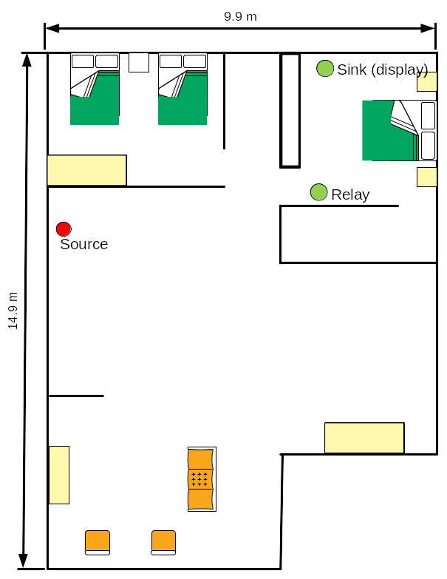
Overview (1)
For latency constrains, DMG beacons are not transmitted exhaustively all the time→ on-demand SSW
Multi-band discovery assistance is included in 802.11ay D2.0 to allow a new STA to trigger on-demand sector sweeping instead of the continuous exhaustive sector sweeping all the time by AP
New STA can use lower band connection to trigger an AP (source) mmW beamforming
New STA
Lower band signal
mmW band signal

Slide 4
Overview (2)
Home use cases include cases where the sink is not in mmW band range of the source to form mmW link
using L3 relay to extend coverage is one solution
New STA (sink) needs to find other neighbor STAs (relay) that might not be multi-band capable in an on-demand fashion
New STA (sink) can use the lower band connection to trigger source and relay on-demand SSW
New STA
Lower band signal
mmW band signal

Slide 5
Example
PCP
STA1
STA1
mmw link
mmw link
Potential mmW link
Potential mmW link
AP
AP
Potential mmW link
Potential mmW link
Established sub-6GHz link
Multi-band capable AP
Established sub-6GHz link
Multi-band capable AP
New STA
New STA
Multi-band capable STA
Multi-band capable STA
New STA can use multi-band capability to trigger on-demand SSW (Multi-band Discovery Assistance)
A multi-band capable AP can start on-demand SSW for the new STA
The multi-band AP should inform STA 1 about the new STA to trigger on-demand SSW

Slide 6
Recap: multi-band discovery assistance
New STA connects to AP using lower band signal
New STA sends DMG discovery assistance request to AP on lower band
AP responds with DMG discovery assistance response to new STA on lower band
AP starts TXSS on mmW band
STA2
AP
(multi-band)
(New STA, multi-band)
DMG Discovery Asst.
Request
AP
(multi-band)
DMG Discovery Asst.
Response
STA 2
(New STA, multi-band)
Joining BSS request
DMG discovery signal to STA2 (TXSS)
Lower band signal
mmW band signal

Slide 7
Extending neighbor STA discovery
AP propagates a DMG discovery assistance request to STA 1 on mmW band
STA 1 responds to AP with DMG discovery assistance response if it supports discovery assistance on mmW band
AP responds to new STA with DMG discovery assistance response on lower band
STA 1 starts TXSS on mmW band
STA2
AP
(multi-band)
STA1
(Existing STA)
(New STA, multi-band)
STA 1
(Existing STA)
Ask to perform TXSS
DMG Discovery Asst.
Request
DMG Discovery Asst.
Request
TXSS
DMG Discovery Asst.
Response
AP
(multi-band)
DMG Discovery Asst.
Response
STA 2
(New STA, multi-band)
Joining BSS request
DMG discovery signal to STA2 (TXSS)
Lower band signal
mmW band signal

Slide 8
Extending neighbor STA discovery
It would be beneficial if we can perform both discovery process
altogether
STA2
AP
(multi-band)
STA1
(Existing STA)
(New STA, multi-band)
STA 1
(Existing STA)
Ask to perform TXSS
DMG Discovery Asst.
Request
DMG Discovery Asst.
Request
TXSS
DMG Discovery Asst.
Response
AP
(multi-band)
DMG Discovery Asst.
Response
STA 2
(New STA, multi-band)
Joining BSS request
DMG discovery signal to STA2 (TXSS)
Lower band signal
DMG discovery signal to STA2 (TXSS)
mmW band signal

Slide 9
How to enable neighbor discovery
DMG Discovery Assistance element is already defined in the 802.11ay D2.0
The Information Request frame can be used to propagate the DMG Discovery Assistance element from the STA requesting discovery assistance to other STAs
The Information Response frame can be used to send the DMG Discovery Assistance element including a response to the propagated discovery assistance request
AP processes the responses and sends one response to the STA requesting discovery assistance ( FST Setup Response frame)

Slide 10
Propagated discovery assistance request
Information Request frame
New STA DMG Capabilities element
DMG Discovery Assistance element
Discovery Assistance Control
Discovery Assistance Request Status
Discovery Assistance Window Length
Sector Sweep Start Time (optional)
Temporary AID (optional)
Dwelling Time (optional)
Element ID
Length
Element ID Extension
Discovery Assistance Type
Dwelling Time Present
Reserved

Slide 11
Discovery assistance response
Information Response frame
DMG Discovery Assistance element
Discovery Assistance Control
Discovery Assistance Request Status
Discovery Assistance Window Length
Sector Sweep Start Time (optional)
Temporary AID (optional)
Dwelling Time (optional)
Element ID
Length
Element ID Extension
Discovery Assistance Type
Dwelling Time Present
Reserved

Slide 12
Discovery assistance response to new STA
AP sets the discovery assistance response to the new STA as follows:
  If discovery assistance is performed through scheduling DMG beacon transmission sweeping all sectors or initiating TDD beamforming:
    Sector Sweep Start time and Discovery Assistance Window Length fields represent the discovery assistance campaign
  If the discovery assistance is performed through scheduled beamforming training period or scheduled TDD beamforming period:
    Discovery Assistance Window Length field is the time duration of the all STAs beamforming periods
* Details in document 1910r0

Slide 13
Straw Poll
Do you support the proposed resolution of CID 3518?
  Yes
  No
  Abstain

