Slide 1
Overview of Full Duplex over
Multi- Band (FD-MB) for EHT
Date: 2018-11-13
Authors:
Name | Affiliation | Address | Phone | Email
Insun Jang | LG Electronics | 19, Yangjae-daero 11gil, Seocho-gu, Seoul 137-130, Korea |  | insun.jang@lge.com
Jinsoo Choi |  |  |  | js.choi@lge.com
Jeongki Kim |  |  |  | jeongki.kim@lge.com
Eunsung Park |  |  |  | esung.park@lge.com
Suhwook Kim |  |  |  | suhwook.kim@lge.com
Taewon Song |  |  |  | taewon.song@lge.com
Sungjin Park |  |  |  | allean.park@lge.com
Saehee Bang |  |  |  | saehee.bang@lge.com
Sanggook Kim |  | 10225 Willow Creek Rd, San Diego, CA, USA |  | sanggook.kim@lge.com
Kiseon Ryu |  |  |  | kiseon.ryu@lge.com

Slide 2
Introduction
Since we started EHT discussion, the concept and some advantages of Flexible DL/UL [1-5] have been addressed as one of promising techniques for multi-band aggregation and operation in EHT
  We have called this Full duplex over multi-band (FD-MB) [5] (or multi-channel TDD as in [4])
At this point, we need to identify considerations to enable FD-MB and to enhance FD-MB, satisfying EHT objectives, which is discussed in this contribution
  We mainly focus on those from the MAC perspective

Slide 3
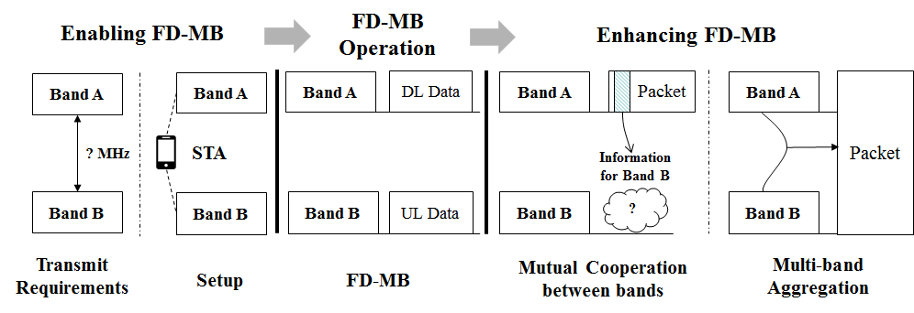
Overview of FD-MB
FD-MB enables simultaneous (independent) DL/UL Tx over multi-bands, in which we can expect to increase the BSS throughputs (average / peak (if aggregated))
From our view, there are some considerations to enable FD-MB and to operate FD-MB more efficiently, as follows

Slide 4
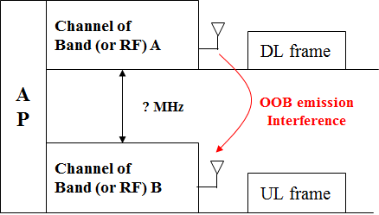
  #1: Transmit Requirements
Simultaneous TX/RX of FD-MB can cause the interference by out-of-band (OOB) emission unless their channels are sufficiently away
  It mainly would occur between channels in a band (e.g., 2 RFs in 5GHz) or two bands (e.g., 5GHz and 6GHz)
Therefore, we need to consider how far channels should be to be able to operate FD-MB without such interference

Slide 5
  #1: Transmit Requirements: Example
Assume that AP with 2 RFs 240MHz apart transmits 160MHz mask PPDU with 20 dBm TX power to a STA using an RF, thereby the OOB emission would interfere with the other RF receiving an UL frame
  As defined in TGax draft [6], PSD of 160 MHz shall not exceed -40 dBr at 240 MHz frequency offset; therefore, OOB emission at 240 MHz offset is the maximum of -20 dBm (from 20dBm TX power)
  We can see the level of interference is still very high even when the channels are 240MHz apart
Therefore, we should review the transmit requirements carefully and/or determine a minimum of channel spacing* by considering the worst case for the interference from OOB emission
√
*Defines the frequency difference between adjacent channels

Slide 6
  #2: FD-MB Setup
If transmit requirements are satisfied, it is necessary to set up FD-MB, i.e., actually enable simultaneous TX/RX over multi-bands for exchanging data
  Developing new technologies? Utilizing/Modifying the existing technologies?
As a proper alternative, we could adopt fast session transfer (FST) developed from 11ad [7], which
  Enables the simultaneous operation across different bands/channels by transferring (a part of) sessions (traffic streams) from one band to other bands
  Provides two reference architectures, i.e., transparent and non-transparent FST according to “whether upper layers are aware of multi-band operations”
    The level of shared information and the number of MAC addresses are different

Slide 7
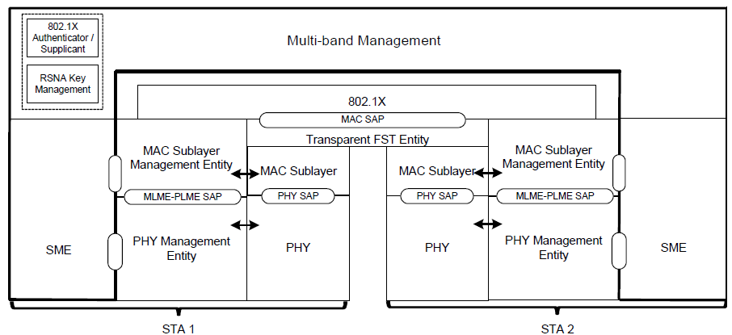
  #2: FD-MB Setup (Cont’d)
Example: Reference model of Transparent FST
Even if FST is available for FD-MB, we need to figure out and discuss additional issues for operating FD-MB, e.g.,
  Reconsidering several BSS related parameters based on multi-band environments
    For example, One MAC address/BSS/PCH vs. Multiple MAC addresses/BSSs/PCHs
  Deciding kinds of information shared between bands according to EHT functions to be developed in addition to sessions (i.e., non-PHY state information) in FST

Slide 8
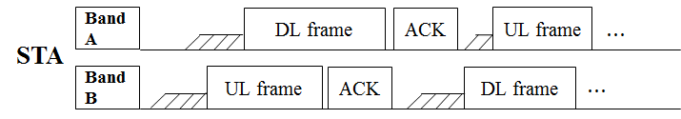
  FD-MB Operation
After resolving considerations mentioned in previous slides, STAs would transmit or receive frames in each separate band without affecting each other, as originally intended in FD-MB
Even if FD-MB operates well, we can consider some ways to enhance FD-MB, e.g.,
  Mutual cooperation between bands (to improve the efficiency)
  Multi-band aggregation (to increase the peak throughput)

Slide 9
  #3: Mutual Cooperation between bands
Current legacy STAs have exchanged packets by utilizing numerous sequential control/management operations on the same channels only in one band (e.g., 2.4 or 5GHz)
Even though those have been well-designed, multi-band capable STAs are able to expect the better performance (e.g., reduction of control overhead and latency) via opportunities of using the cooperation of operating bands in parallel, e.g., Information Sharing and Assisted Transmission

Slide 10
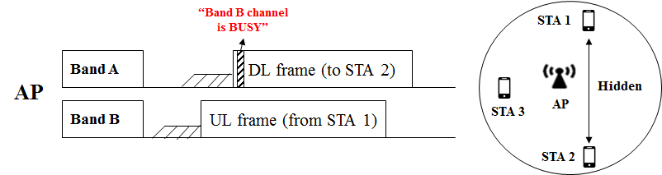
  #3: Mutual Cooperation between bands (Cont’d)
Information Sharing
  Multi-band capable STAs can provide their BSS members with timely information (e.g., channel status, NAV [5],…)
Example: Channel status
  An AP informs STA 2 of the channel status of band B after recognizing UL transmission from STA 1, which could solve the Hidden node problem because STA 2 can defer the UL transmission from the information

Slide 11
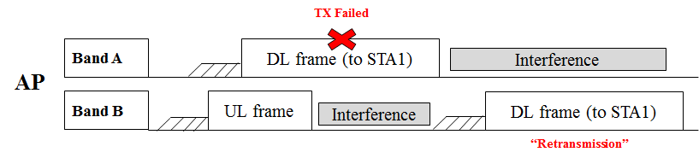
  #3: Mutual Cooperation between bands (Cont’d)
Assisted Transmission
  Multi-band capable STAs can assist a band, e.g., channels of which are congested, by transmitting control/management frames [1] and data in other bands on behalf of the band
Example: Assisted Retransmission
  A DL frame an AP sends to a STA 1 is failed in band A, but it cannot be transmitted again because its channel of band A gets congested
  Instead, the AP can transmit the DL frame to the STA 1 in band B available (not congested) and besides, contention window of band B might be lower than that of band A
  It could reduce the transmission latency

Slide 12
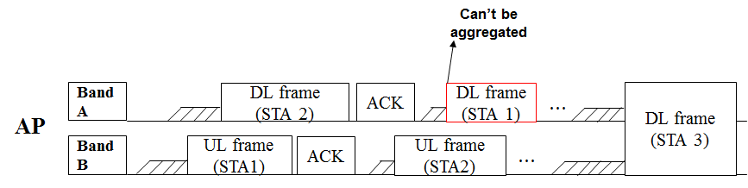
  #4: Multi-Band Aggregation
FD-MB can support multi-band aggregation as one of candidate feature in EHT to increase the peak throughput, but the start of TXOP in each band couldn’t be often aligned in some environments (e.g., highly dense environments), which might make the aggregation difficult
Therefore, we need to consider aggregation rules for more cases of multi-band aggregation

Slide 13
Summary
In this contribution, we have identified four considerations in order to be fully utilized for FD-MB in EHT to achieve its objectives, i.e.,
  Transmit Requirements and FD-MB Setup for enabling FD-MB
  Mutual Cooperation between bands and Multi-band Aggregation for enhancing FD-MB

Slide 14
References
[1] 802.11-18/1155r1 Multi-AP Enhancement and Multi-Band Operations
[2] 802.11-18/1161r0 EHT Technology Candidate Discussions
[3] 802.11-18/1171r0 View on EHT Objectives and Technologies
[4] 802.11-18/1518r0 EHT Multi-Channel Operation
[5] 802.11-18/1525r1 EHT features for Multi-Band Operation
[6] IEEE P802.11ax/D3.0, June 2018
[7] IEEE P802.11ad, December 2012

