Slide 1
EHT Channel Modeling
Date: 2018-10-22
Authors:
Name | Affiliations | Address | Phone | Email
Jianhan Liu | Mediatek |  |  | jianhan.liu@mediatek.com
Alireza Ghaderipoor
Thomas Pare

Slide 2
Introduction
Some well accepted features for EHT are listed as follows
  Multi-AP Coordination
  320MHz bandwidth (including operations in 6GHz band)
  16 Spatial Streams
Technical proposal selection requires a more precise channel model for link level simulations and PHY abstractions for system level simulation in EHT.
  Channel models for 6GHz band and 320MHz BW need to be added for EHT.
  To enable 16 spatial streams, the correlations among the antennas must be taken into account due to the foot size of an AP and large number of antennas;

Slide 3
Channel models for 6GHz band and 320MHz BW
Given that 6GHz band is close to 5GHz band, we suggest that the channel models for 6GHz band use the same model as in 5GHz band.
Generation of 320MHz Channel:
  Using the channel generation method described in [1]:
Table 1: Channel sampling rate expansion (tap spacing reduction) factors
System Bandwidth W | Channel Sampling Rate Expansion Factor | PDP Tap Spacing
W ≤ 40 MHz | 1 | 10 ns
40 MHz < W ≤ 80 MHz | 2 | 5 ns
80 MHz < W ≤ 160 MHz | 4 | 2.5 ns
160 MHz < W ≤ 320 MHz | 8 | 1.25 ns
320 MHz < W ≤ 640 MHz | 16 | 0.625ns

Slide 4
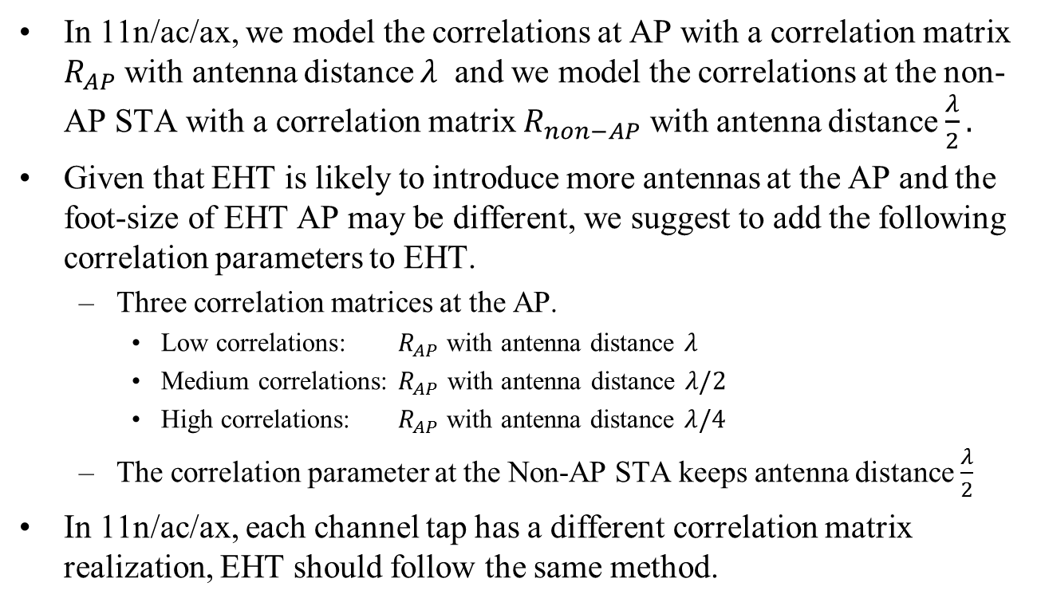
Correlations in Multiple Antennas Systems
In 11n/ac/ax, we model the correlations at AP with a correlation matrix $R_{AP}$ with antenna distance $λ$ and we model the correlations at the non-AP STA with a correlation matrix $R_{non−AP}$ with antenna distance $\frac{λ}{2}.$
Given that EHT is likely to introduce more antennas at the AP and the foot-size of EHT AP may be different, we suggest to add the following correlation parameters to EHT.
  Three correlation matrices at the AP.
    Low correlations: $R_{AP}$ with antenna distance $λ$
    Medium correlations: $R_{AP}$ with antenna distance $λ/2$
    High correlations: $R_{AP}$ with antenna distance $λ/4$
  The correlation parameter at the Non-AP STA keeps antenna distance $\frac{λ}{2}$
In 11n/ac/ax, each channel tap has a different correlation matrix realization, EHT should follow the same method.

Slide 5
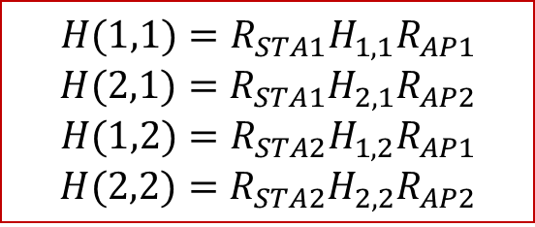
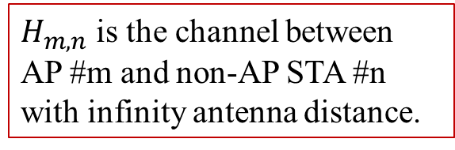
Channel Models for Multiple AP Systems
Base on the assumption is the antenna distances between two APs and two non-AP STAs are large, we have
$$H(1,1)=R_{STA1}H_{1,1}R_{AP1}$$
$$H(2,1)=R_{STA1}H_{2,1}R_{AP2}$$
$$H(1,2)=R_{STA2}H_{1,2}R_{AP1}$$
$$H(2,2)=R_{STA2}H_{2,2}R_{AP2}$$
$H_{m,n}$ is the channel between AP #m and non-AP STA #n with infinity antenna distance.

Slide 6
On Outdoor Channel Modelling and Doppler
In 11ax, UMi channel models have been adopted as the outdoor channel models with Doppler modifications [2].
  However, some of the scenarios for UMi channel models are not applicable to WLAN. For example, delay spread of UMi channels can be up to 16us.
In 11n/ac channel generator for channels A,B,C,D and F, the Doppler generation is different from UMi channel model.
Two suggestions:
  1. Limit the delay spread to TBD (<16us) us for UMi channel model
    Make the scenarios more suitable for WLAN
  2. Unify the Doppler generation for other channel types using method in UMi model.
    It can be shown that UMi model can generate the same Doppler spectrum as measured in 11n channel model document [3].
    The 11n/ac channel generator just generator Doppler based on average sense.

Slide 7
References
[1] “TGac Channel Model Addendum”, IEEE 802.11-09/0308r12, Greg Breit, etc.
[2] “Tgax channel model document”, IEEE 802.11-14/0882r4, Jianhan Liu, etc.
[3] “TGn Channel Models”, IEEE 802.11-03/0940r4, Vinko Erceg, etc.

