Slide 1
Time-Aware shaping (802.1Qbv) support in the 802.11 MAC
Date: 2018-11-10
Authors:

Slide 2
Abstract
This presentation describes potential solutions to enable Time-Aware (8021Qbv) Traffic Shaping over the 802.11 MAC in order to control latency for time-sensitive and real-time applications.

Slide 3
Outline
TSN Background
Time-Aware (802.1Qbv) traffic shaping
Time-Awareness within the 802.11 MAC
Conclusions

Slide 4
IEEE 802.1 Time-Sensitive Networking (TSN)
Standard Ethernet with Synchronization, small and/or fixed latency, and extremely low packet loss
TSN Components Common Standards
Time synchronization: Time Synchronization (802.1AS)
Ultra reliability: Frame Replication and Elimination (P802.1CB) Path Control and Reservation (802.1Qca) Per-Stream Filtering and Policing (802.1Qci) Reliability for time sync (P802.1AS-Rev)
Synchronization
√ 802.1AS over 802.11
Timing Measurement (TM)
Fine Timing Measurements (FTM)
Reliability
Reliability
Latency
Bounded low latency: Time-Aware traffic shaping (802.1Qbv) Preemption (802.1Qbu/802.3br) Cyclic Scheduling (802.1Qch) Asynchronous Scheduling (802.1Qcr)
Resource Mgmt
Dedicated resources & API Stream Reservation Protocol (802.1Qat) TSN configuration (P802.1Qcc) YANG (P802.1Qcp) Link-local Registration Protocol (P802.1CS)
Zero congestion loss
Time-Aware shaping (802.1qbv) over 802.11 (extension to address latency)
√ 802.11aa (SRP over 802.11 for AV)
√ 802.11ak (802.11 links in an 802.1Q network)
Credit: János Farkas, Ericsson
TSNA Conference 2017, http://www.tsnaconference.com/

Slide 5
Time-Aware Traffic Shaping
Scheduling time-critical frame transmissions while avoiding contention with lower priority frames can give low jitter and guarantee worst case latency
802.1Qbv defines Time-Aware shaper for Ethernet switches
Queues/Traffic classes
Multiple queues are controlled based on a repeating schedule (time, gate open/closed), time reference is provided by 802.1AS
T
T
T
T
T
T
T
T
Qbv can be very effective, especially for predictable, periodic traffic
frame selection
Transmission time
gate open
gate open
gate closed
gate open
gate closed

Slide 6
Time-Aware Shaping over Wireless
Time-Aware shaping sitting on top of 802.11 MAC can resolve contention within each device and across multiple STAs/AP that share the medium
Assumptions: managed network and 802.11 admission control is used for TSN traffic
AP
Example Scenario
Time-Sensitive Traffic
Other Traffic
…
AP
gate open
gate open
gates closed
T
T
T
T
All gates open
STA 1
gates closed
gate open
(Normal Operation)
Shared medium
STA 2
gates closed
gate open
T
T
T
T
T
T
T
T
The Qbv schedule defines when the gates open/close (implementation specific)
The schedule can take into account the 802.11 MAC/PHY mode (e.g. EDCA, 11ax DL/UL OFDMA, TWT, …)
STA 1
STA 2

Slide 7
Simplified TSN Reference Stack
Application
Transport
Direct L2 access
IP Encapsulation
IP
IEEE 802.1 Network
TSN Capabilities: time sync, time-aware, reservations, and many others …
Link Layer
MAC/PHY
IEEE 802.3
(Ethernet)
IEEE 802.11
(Wi-Fi)
Media Specific Support required for TSN Capabilities
802.11 requirements for Time-Aware (Qbv) capability:
Exchange the 802.1Qbv schedule between managed STAs
Rules to certify the release of frames from the 802.11 queues according to the 802.1Qbv defined times and avoid contention between queues

Slide 8
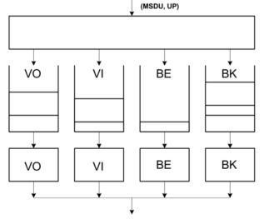
Intra-STA contention problems for time-sensitive frames
Time-sensitive frame
Collisions between EDCA functions are resolved within STAs
high priority AC frames are transmitted and lower priority AC(s) backoff
On avg, high priority AC should get faster access, but a time-sensitive frame may still have to wait in some situations, e.g.:
other frames in the same AC Queue
other ACs get access first
ongoing (long) TXOP from another AC
The time-aware concept can prevent some of the situations that increase worst case latency for time-sensitive frames
Time-sensitive frame
TXOP (AC_VI)

Slide 9
Time-Awareness in the 802.11 MAC (option 1 – TSN queue)
A Time-Aware schedule defined (e.g. 802.1Qbv layer, other higher layer, …)
A queue for TSN traffic
A Time-Aware Shaper Function pauses/resumes EDCAFs to avoid contention
A frame selection function (implementation dependent) selects TSN frame(s) for transmission within SP
TSN Access Function: follows selected access mode rules (e.g. EDCA with existing/new AC parameters, 11ax Trigger-based access, …)
Service Internal
Service Period
Service Period
EDCAFs resume normal operation
1. TSN Queue→ Open
2. Other EDCAFs paused
3. Time-Sensitive frames selected/transmitted

Slide 10
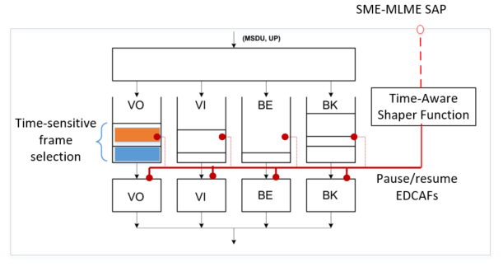
Time-Awareness in the 802.11 MAC (option 2 – TSN reuses EDCA queue)
A Time-Aware schedule defined (e.g. 802.1Qbv layer, other higher layer, …)
A TSN stream uses one of the EDCA queues (e.g. VO)
A Time-Aware Shaper Function pauses/resumes competing EDCAFs to avoid contention
A frame selection function (implementation dependent) selects TSN frame(s) for transmission within SP
Frame is transmitted using EDCAF (e.g. AC_VO), other access methods could also be used (e.g. 11ax Trigger-based)
Service Internal
Service Period
Service Period
EDCAFs resume normal operation
1. AC_VO (Time-sensitive Queue)→ Open
2. Other EDCAFs paused
3. Time-Sensitive frames selected/transmitted

Slide 11
Time-Aware Shaping within managed BSSs
The 802.11 MAC provides an interface (primitive at the SME-MLME SAP) to configure the Time-Aware Shaper Function in each managed STA
A 802.1Qbv scheduler (higher layer implementation) is responsible for resolving contention across all managed STAs
The schedule must be communicated to managed STAs (new management frame can be defined)
A Time-Aware Scheduler may control multiple BSSs
The schedule can be distributed by higher layers
All managed BSSs (and STAs) must synchronize to the same time source as the Time-Aware scheduler

Slide 12
Access mechanism for time-sensitive traffic
The Time-Aware functionality is independent of the access mechanism used
Various access modes can be used: EDCA, 802.11ax Trigger-based Access, …
Access mode could be a configuration parameter for the TSN Access Function (option 1)
Admission control can be used to ensure low latency performance
802.11ax capabilities help increase efficiency
STAs can be configured to use Trigger-based access
The AP can schedule UL/DL to comply with the SP boundaries
The AP may opportunistically schedule other traffic without impacting the time-sensitive traffic

Slide 13
Impact of unmanaged BSSs
Time-Aware shaping operates on managed STAs
Interfering transmissions may impact the capability to guarantee bounded latency
Unmanaged STAs/BSSs are seen as interference
The Time-Aware scheduler can take into account the level of interference when admitting TSN flows and defining SP durations
Latency bound vs. capacity tradeoffs will depend on the level of interference and deployment scenario

Slide 14
Conclusions
Time-Aware traffic shaping is a TSN capability to control congestion and worst case latency in managed networks
The 802.11 MAC can enable this capability through a Time-Aware Shaper Function
Avoid contention from competing traffic between managed STAs, and reduce worst case latency (important for real-time/time-sensitive applications)
Modifications are limited to controlling queues and do not require new channel access mechanism
This capability will also enable 802.11 to be integrated with Ethernet-based TSN

Slide 15
References
IEEE Std 802.1Qbv-2015.

