Slide 1
Comment Resolution on Spectral Flatness Spec
Date: 2018-11-08
Authors:

Slide 2
WG Letter Ballot Comment
In WG Letter Ballot the following comment was submitted
Comment # | Comment
968 | The Draft does not include a spectral flatness requirement that would prevent putting all the power on 2 MHz. Since the intent of the standard is to use a 4 MHz waveform, I believe an additional Spectral Flatness requirement is needed.
This contribution provides a recommended comment resolution for this comment, along with supporting material

Slide 3
Background
Draft 1.0 includes a Spectral Flatness specification in Clause 32.2.11.2 stating
  “The requirement is that the total transmitted power in the center 4 MHz is at least 3 dB higher than the maximum transmitted power in any contiguous 1 MHz segment as described above.”
This limits putting too much power within a 1 MHz segment of the center 4 MHz
However, this does not put a constraint on how little power is put on a 1 MHz segment of the 4 MHz channel
  For example, It is possible to put virtually all the power in a 2 MHz segment, and almost no power in the other 2 MHz
Here we propose a specification for the ratio of the power in the center 4 MHz to the minimum power in any contiguous 1 MHz segment, to address this concern

Slide 4
Presentation Outline
We analyze the ratio of the power in the center 4 MHz to the minimum power in a contiguous 1 MHz segment
  We perform this analysis for all three example 2 µs MC-OOK symbols and all three example 4 µs MC-OOK symbols
  For reference we also provide the ratio of the power in 4 MHz to the maximum power in a contiguous 1 MHz segment
  We also provide PSD plots for the center 4 MHz
We provide recommended text for the specification on the ratio of the power in the center 4 MHz to the minimum power in a contiguous 1 MHz segment

Slide 5
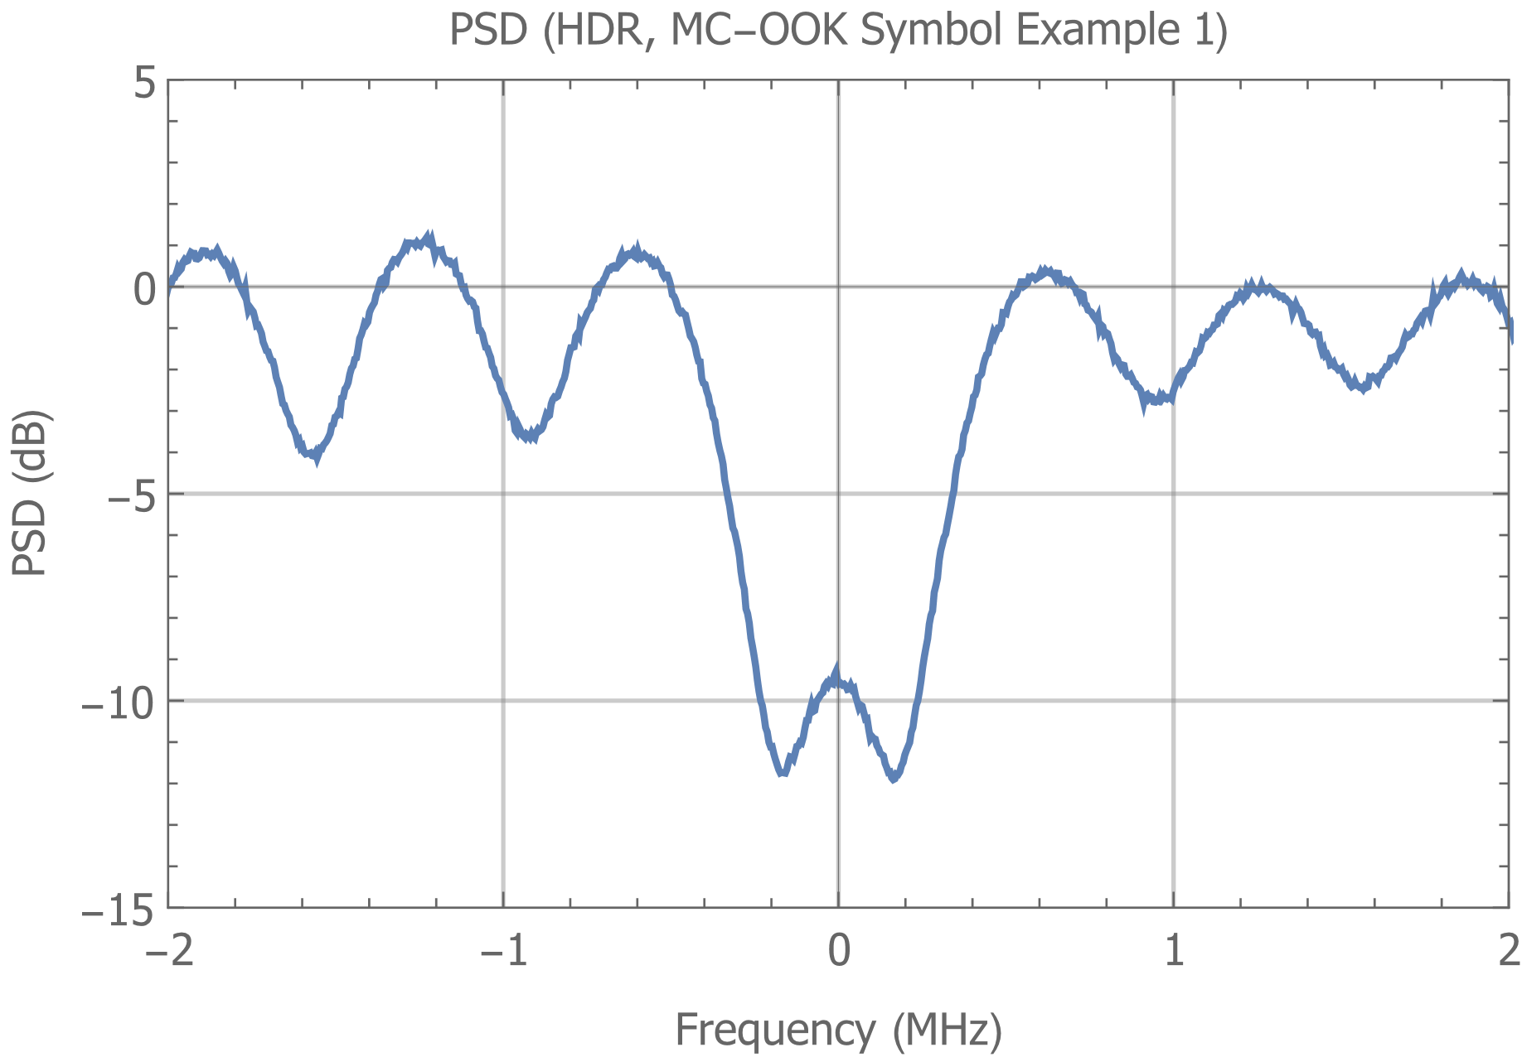
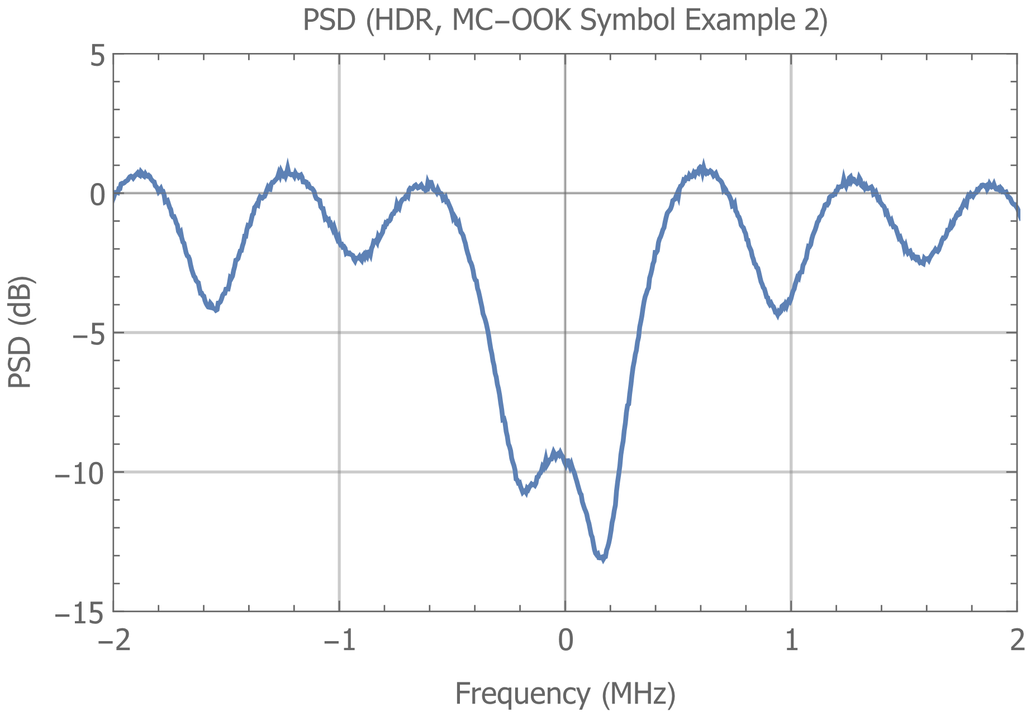
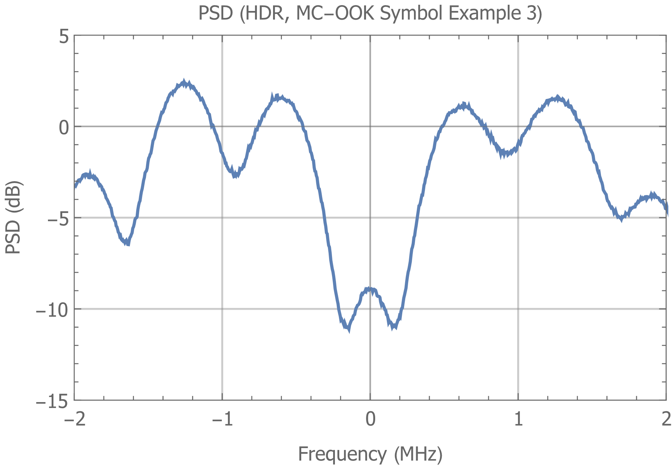
Spectrum of HDR Data Field (2 µs symbols)

Slide 6
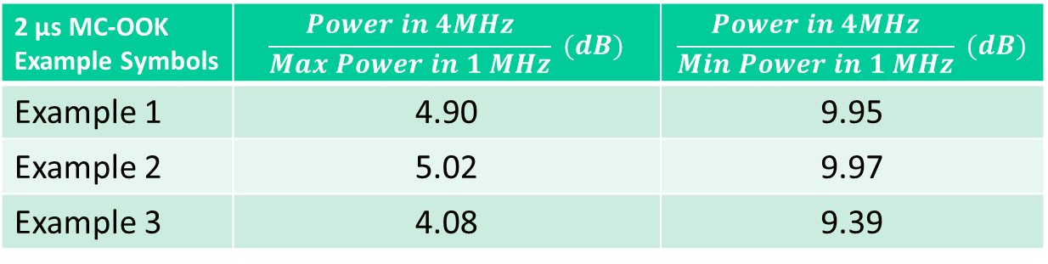
Power Ratios for 2 µs MC-OOK Symbols
2 µs MC-OOK Example Symbols | $$\frac{Power in 4MHz}{Max Power in 1 MHz} (dB)$$ | $$\frac{Power in 4MHz}{Min Power in 1 MHz} (dB)$$
Example 1 | 4.90 | 9.95
Example 2 | 5.02 | 9.97
Example 3 | 4.08 | 9.39
Note that the ratio of the power in the center 4 MHz divided by the Maximum power in 1 MHz is well above 3 dB in these cases
The power in the center 4 MHz divided by the Minimum power in 1 MHz is around 9.4 to 10 dB

Slide 7
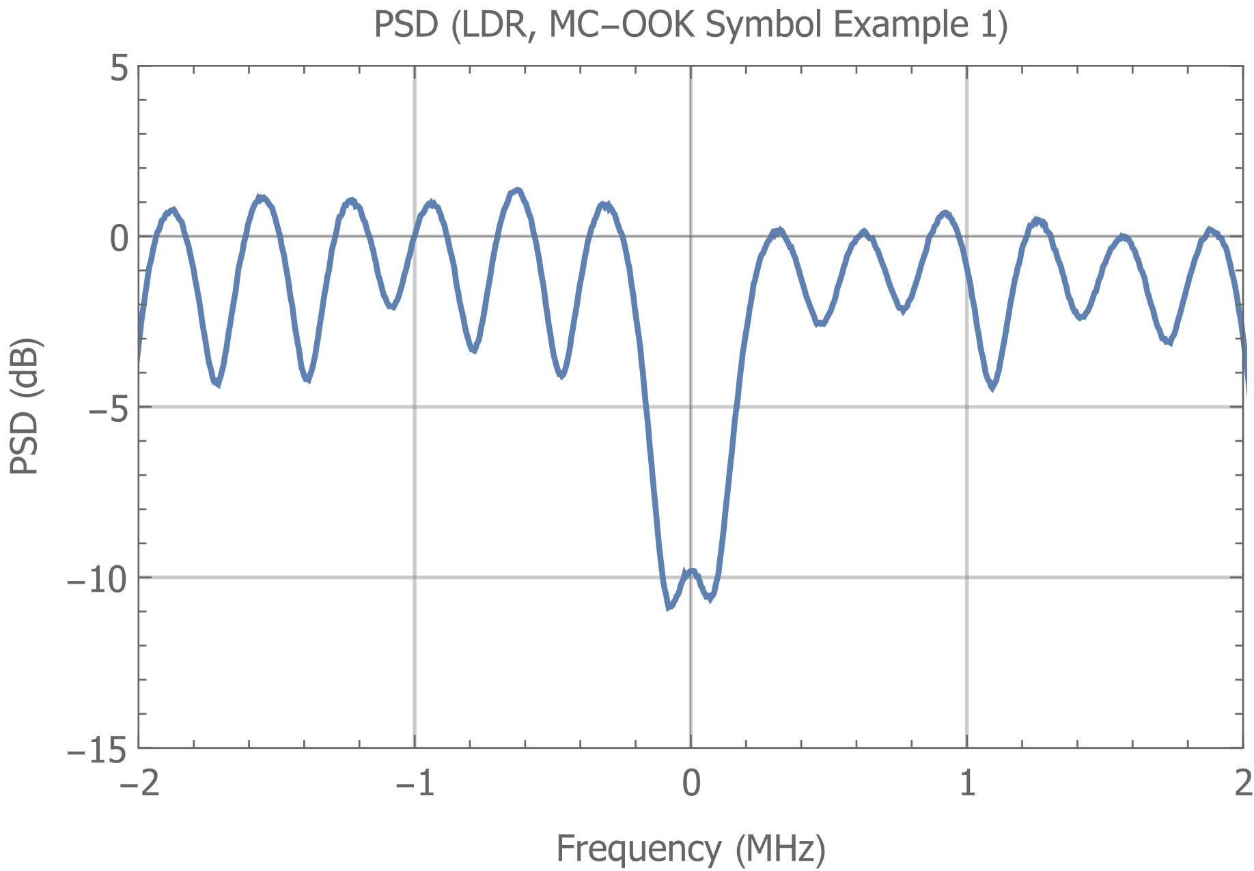
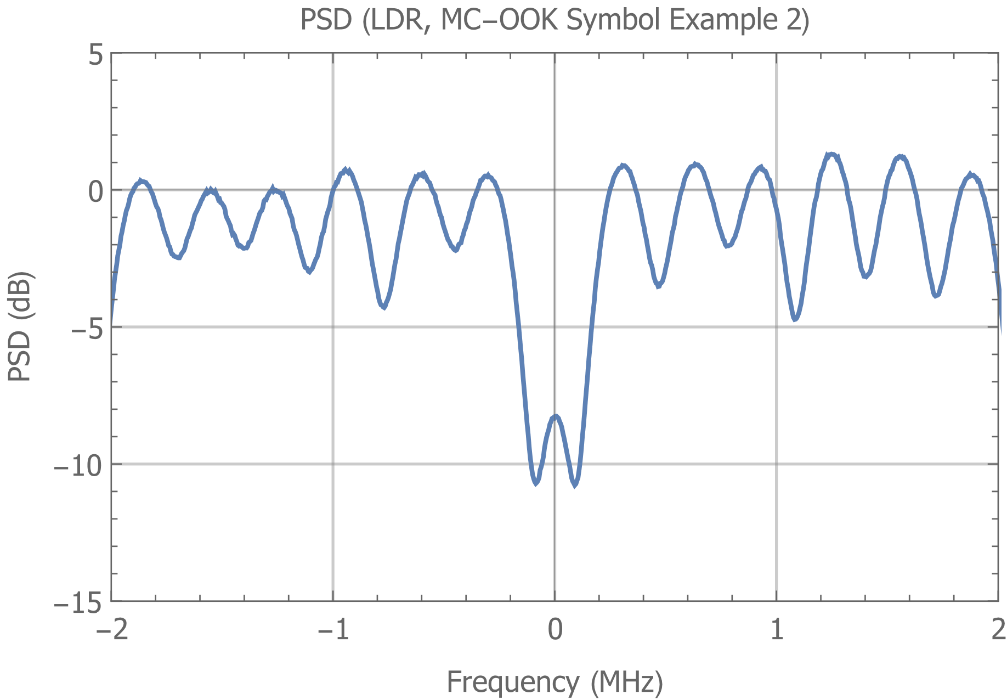
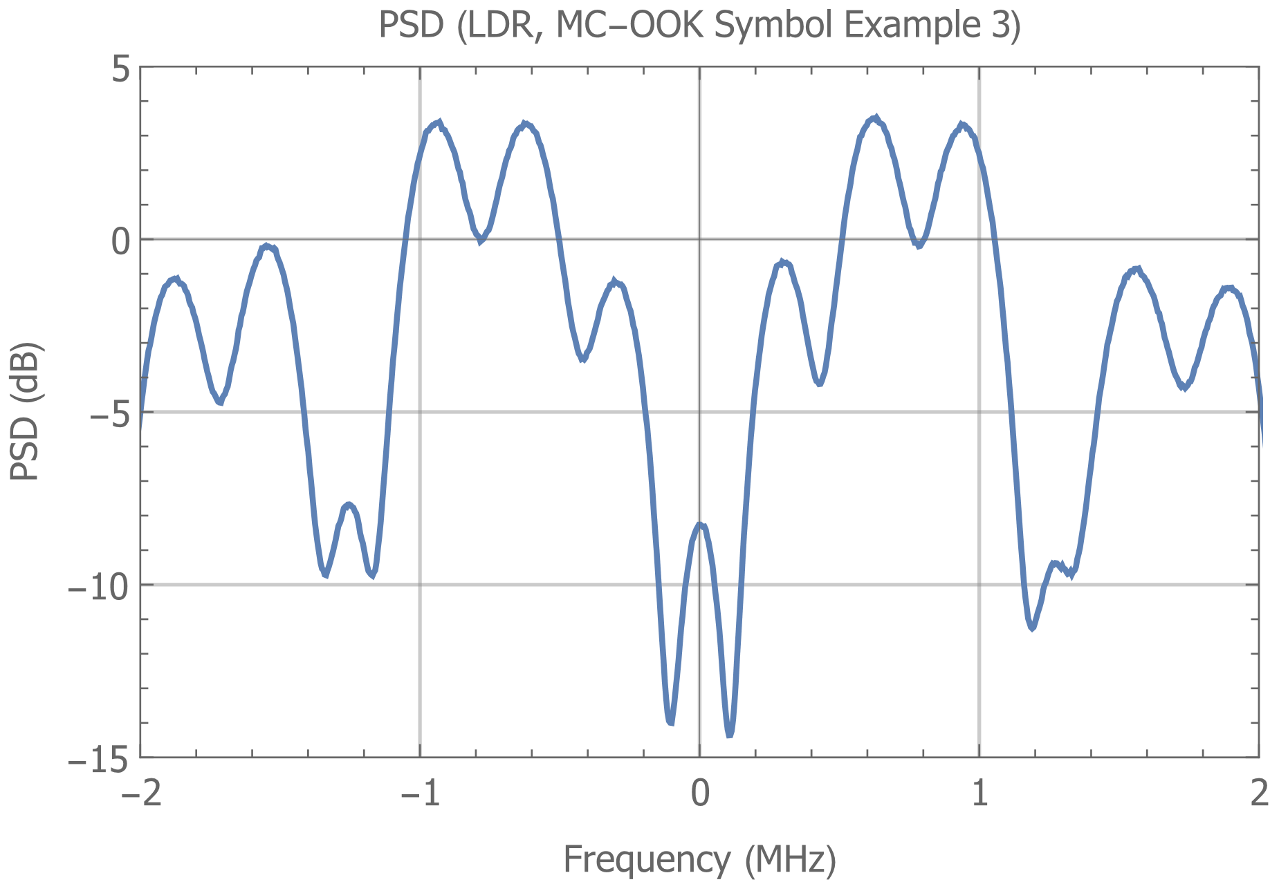
Spectrum of LDR Data Field (4 µs symbols)

Slide 8

Power Ratios for 4 µs MC-OOK Symbols
4 µs MC-OOK Example Symbols | $$\frac{Power in 4MHz}{Max Power in 1 MHz} (dB)$$ | $$\frac{Power in 4MHz}{Min Power in 1 MHz} (dB)$$
Example 1 | 5.26 | 7.45
Example 2 | 5.34 | 7.34
Example 3 | 4.30 | 8.68
Note that the ratio of the power in the center 4 MHz divided by the Maximum power in 1 MHz is well above 3 dB in these cases
The power in the center 4 MHz divided by the Minimum power in 1 MHz is around 7.3 to 8.7 dB

Slide 9
Observations
The ratio of the power in 4 MHz divided by the minimum power in a contiguous 1 MHz segment varies in these examples from between around 7.3 to almost 10 dB
We want a few dB margin, so we recommend a limit of 12 dB

Slide 10
Recommended Text
Make the following change to Clause 32.2.11.2
The spectral flatness is measured by comparing the total transmitted power in the center 4 MHz of the 20 MHz channel with the transmitted power in any contiguous 1 MHz segment within the center 4 MHz., where the wake-up signal is transmitted at the maximum power.
The requirement is It is required that the total transmitted power in the center 4 MHz is at least 3 dB higher than the maximum transmitted power in any contiguous 1 MHz segment as described above.
It is required that the total transmitted power in the center 4 MHz is less than 12 dB above than the minimum transmitted power in any contiguous 1 MHz segment as described above.

