Slide 1
6 GHz operation for 11ax follow up
Date: 2018-11-13
Name | Affiliation | Address | Phone | Email
Wook Bong Lee | Samsung |  |  | wookbong.lee@samsung.com
Ravi Gidvani | Samsung |  |  | ravi.gidvani@samsung.com
Sharan Naribole | Samsung |  |  | n.sharan@samsung.com
Tianyu Wu | Samsung |  |  | tianyu.wu@samsung.com
Shailender Karmuchi | Samsung |  |  | karmuchi.s@samsung.com

Slide 2
Introduction
In [1], we proposed two step behavior in 6GHz which will bridge the gap between current implementations and proposed complete scheduled access
In this presentation, we follow up on this

Slide 3
Discussions
Why we need new operation mode?
  There are benefit of restricted EDCA + Triggered access, and there are problems of EDCA + Scheduled network (see slide 4-6)
  In 2.4 or 5GHz band, there is legacy STA, so proposed operation may not help much
Can we just not do complete scheduling mode?
  There are problem with pure scheduling mode (see slide 7)
What is solution?
  Allowing EDCA only when it is necessary
  Specification text proposal can be found in appendix

Slide 4
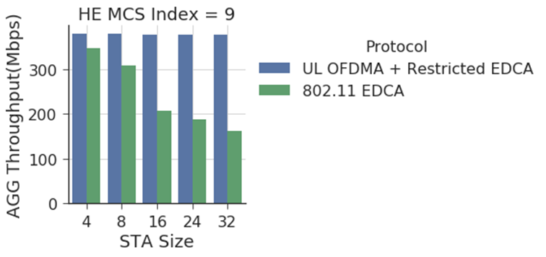
Benefit of
Restricted EDCA + Triggered access
Scheduled Access shows higher network throughput
  EDCA suffers from collision with increased congestion
  Even without UL OFDMA power benefit, UL OFDMA provides more than 2x gain

Slide 5
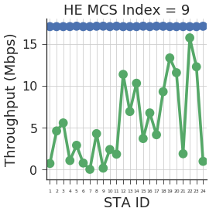
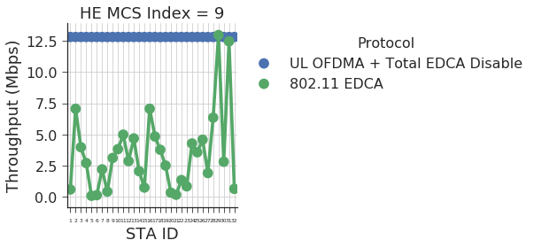
Benefit of
Restricted EDCA + Triggered access
Scheduled Access shows stable throughput under fair AP
  Fair RU allocation significantly improves network fairness
  Following figure shows some instance of 10s evaluation
24 STA network
32 STA network

Slide 6
Problem of Mixed Network
(EDCA and Scheduled)
Performance of UL OFDMA STAs are affected by trigger frame Queue
MU EDCA STAs will have quite different performance depending on which Queue AP choose for trigger frame
  Following simulation shows average throughput of EDCA STAs and scheduled STAs
  There are 4 or 8 EDCA STAs and 4 Scheduled STAs
  All EDCA STAs has AC_BE packets only
 |  | AC_BE | AC_VO
4 EDCA STAs + 4 Scheduled STAs | Scheduled STAs | 26.25 Mbps | 42.53 Mbps
 | EDCA STAs | 58.77 Mbps | 44.50 Mbps
8 EDCA STAs + 4 Scheduled STAs | Scheduled STAs | 15.17 Mbps | 25.99 Mbps
 | EDCA STAs | 31.74 Mbps | 25.90 Mbps

Slide 7
Problem of Fully Scheduled Network
STA may not be able to send QoS data using scheduled RU when size of scheduled RU is too small
STA may want to send “QoS Null frame with PM bit set to 1” or “OM Control subfield” immediately, e.g. power saving, operation mode change, coexistence
STA may want to send disassociation or deauthentication frame immediately

Slide 8
Proposed Scheme
Limiting use of disable UL OFDMA
Transmitting following frames using EDCA
  QoS Null frame containing BSR, PM=1, OM Control subfield
  DISASSOC
  DEAUTH

Slide 9
Reference
[1] 11-18/1607r1, “6 GHz operation for 11ax”
[2] 11-18/1828r0, “D3.0 CR for 6GHz Post Association”

