Slide 1
Introduction to TDD General and TDD MLME comment resolution
Date: 2018-11-12
Authors:

Slide 2
Abstract
Resolution of CID’s:
3358, 3479, 3481, 3578, 3586, 3626, 3627, 3628, 3629, 3633, 3641, 3642, 3643, 3654
The CID’s are of TDD General, TDD Scheduling, and TDD MLME comment groups

Slide 3
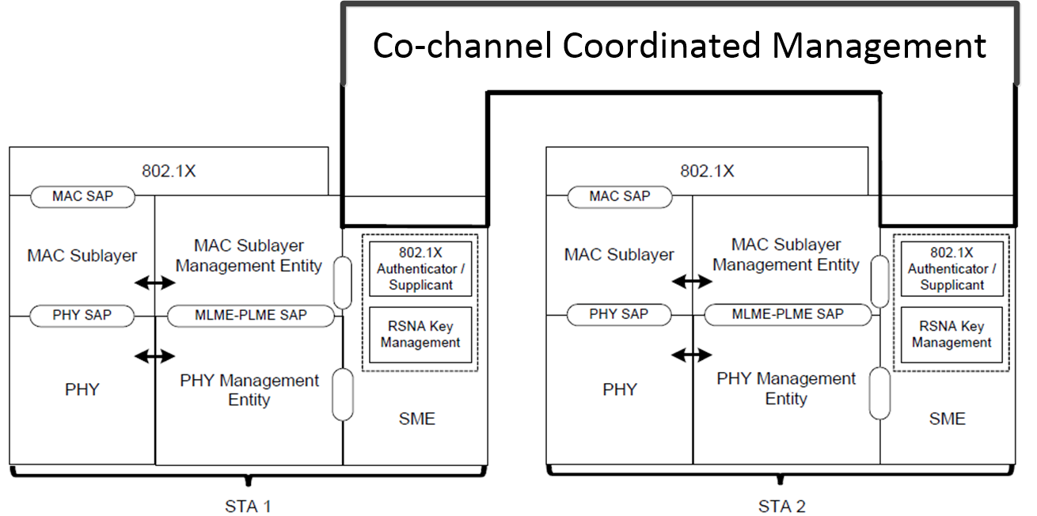
4.9.5 Reference model for co-channel coordinated management operation
The STA 1 and the STA 2 belong to the same Coordinated Management Operation device

Slide 4
11.yy TDD channel access Operation
11.yy.1 General
11.yy.2 Life cycle of the operation of the TDD channel access
The operation of the TDD channel access becomes active after successful completion of the secure authentication.
The active operation of the TDD channel access inactivates when the beam link is lost, and no frames can be delivered for a long time.
The Initial TDD Beamforming is defined in 11.36.2-11.36.4 and in 10.43.10
Scheduling for association and authentication and the relevant operation are defined in 11.yy.3.
Scheduling for data traffic is defined in 11.yy.4,
Data traffic under TDD access is defined in 10.40.6.2.2
Ongoing beamforming (TBD)
Link maintenance in defined in10.44.5
Operation is Suspended if expected RX/TX handshake does not success at the time longer than AckTimeout (10.3.2.11). Beam link is indicated as lost if no RX/TX handshake happens multiple times in a row.

Slide 5
11.yy.3 Scheduling for association and secure authentication
Figure 11yy3 Scheduling for association and secure authentication
Operation of STA’s over the air
After delivery of the schedule, the MLME-START.request can be used to initiate DMG beacons transmission by the AP STA

Slide 6
Scheduling of STA’s that belong to the same Co-channel Coordinated Management Operation device
Figure 11yy4 high-level delivery of schedule to the STA’s that belong to the same Co-channel Coordinated Management Operation device

Slide 7
11.yy.4 Scheduling for data traffic and supported functionality (1)
Figure 11yy5 AP STA delivery of schedule for data traffic and supported functionality
A schedule delivered by the AP may be a response to the non-AP STA bandwidth request or it is initiated by the AP STA w/o getting the request.
After delivery of the schedule, the MLME-START.request can be used to initiate DMG beacons transmission by the AP STA

Slide 8
11.yy.4 Scheduling for data traffic and supported functionality (2)
Figure 11yy6 Mutual delivery of schedule for data traffic and supported functionality
Operation of STA’s over the air

Slide 9
9.6.yy Protected Dual of Unprotected DMG Action
Modifications of the Table 9-54—Category values of the 9.4.1.11 Action field (IEEE P802.11-REVmd/D1.5, September 2018)
Code | Meaning | See subclause | Robust | Group addressed privacy
<ANA> | Protected Dual of Unprotected DMG Action | 9.6.yy | Yes | No
Action field value | Description | Defined in
0 | Protected Announce | 9.6.21.2
1 | Protected BRP | 9.6.21.3
2 | Protected MIMO BF Setup | 9.6.21.4
3 | Protected MIMO BF Poll | 9.6.21.5
4 | Protected MIMO BF Feedback | 9.6.21.6
5 | Protected MIMO BF Selection | 9.6.21.7

