Slide 1
Reliable, High Performance Wireless Systems for Factory Automation
Date: 2018-08-24
Authors:

Slide 2
Abstract
In this presentation, we will share our perspectives on wireless requirements for factory automation. Our motivation is to present our understanding of the true wireless requirements for industrial applications and also present our approach to improving industrial wireless at NIST.

Slide 3
What NIST does
World Leading Scientific and Engineering Research
Provide measurement and standards solutions for industry and the nation
Manufacturing Extension Centers
Nationwide network of centers helps smaller manufacturers compete globally
Program in Performance Excellence
Strengthens performance excellence in U.S. organizations
Advanced Manufacturing National Program Office
Manufacturing USA Program enhances new technologies scale-up for U.S. production

Slide 4
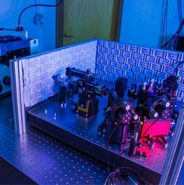
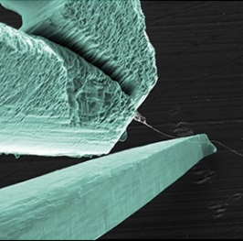
NIST Laboratory Programs
Material
Measurement
Laboratory
Physical Measurement
Laboratory
Engineering Laboratory
Information Technology Laboratory
Communication
Technology Laboratory
Center for Nanoscale Science and Technology
NIST Center for Neutron Research
Metrology Laboratories
Technology Laboratories
National User Facilities
Driving innovation through
Measurement Science and Standards
Accelerating the adoption and deployment of advanced technology solutions
Providing world class, unique, and cutting-edge research facilities
Trustworthy Systems, Components, and Data for Smart Manufacturing

Slide 5
Past Work
NIST Industrial Wireless Systems

Slide 6
Approach to Industrial Wireless Since 2014
Field Data
Passive RF
Channel Models
Interference Models
Propagation Models
Simulation & Testing
RF Emulation
Benefits to Industry
Wireless Devices
Plant Processes
Human Operations
Channel Models
Wireless network simulations
More Robust and Effective Wireless Comms.
Live Shops & Factories
Active RF
High Fidelity “RF Sounding”
High-fidelity RF site surveys Measure factory performance
Measure wireless network performance
Notes:
It doesn’t make sense to deliver guidelines without considering the factory performance under different scenarios.

Slide 7
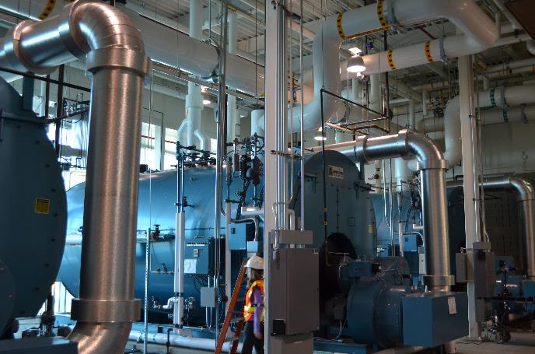
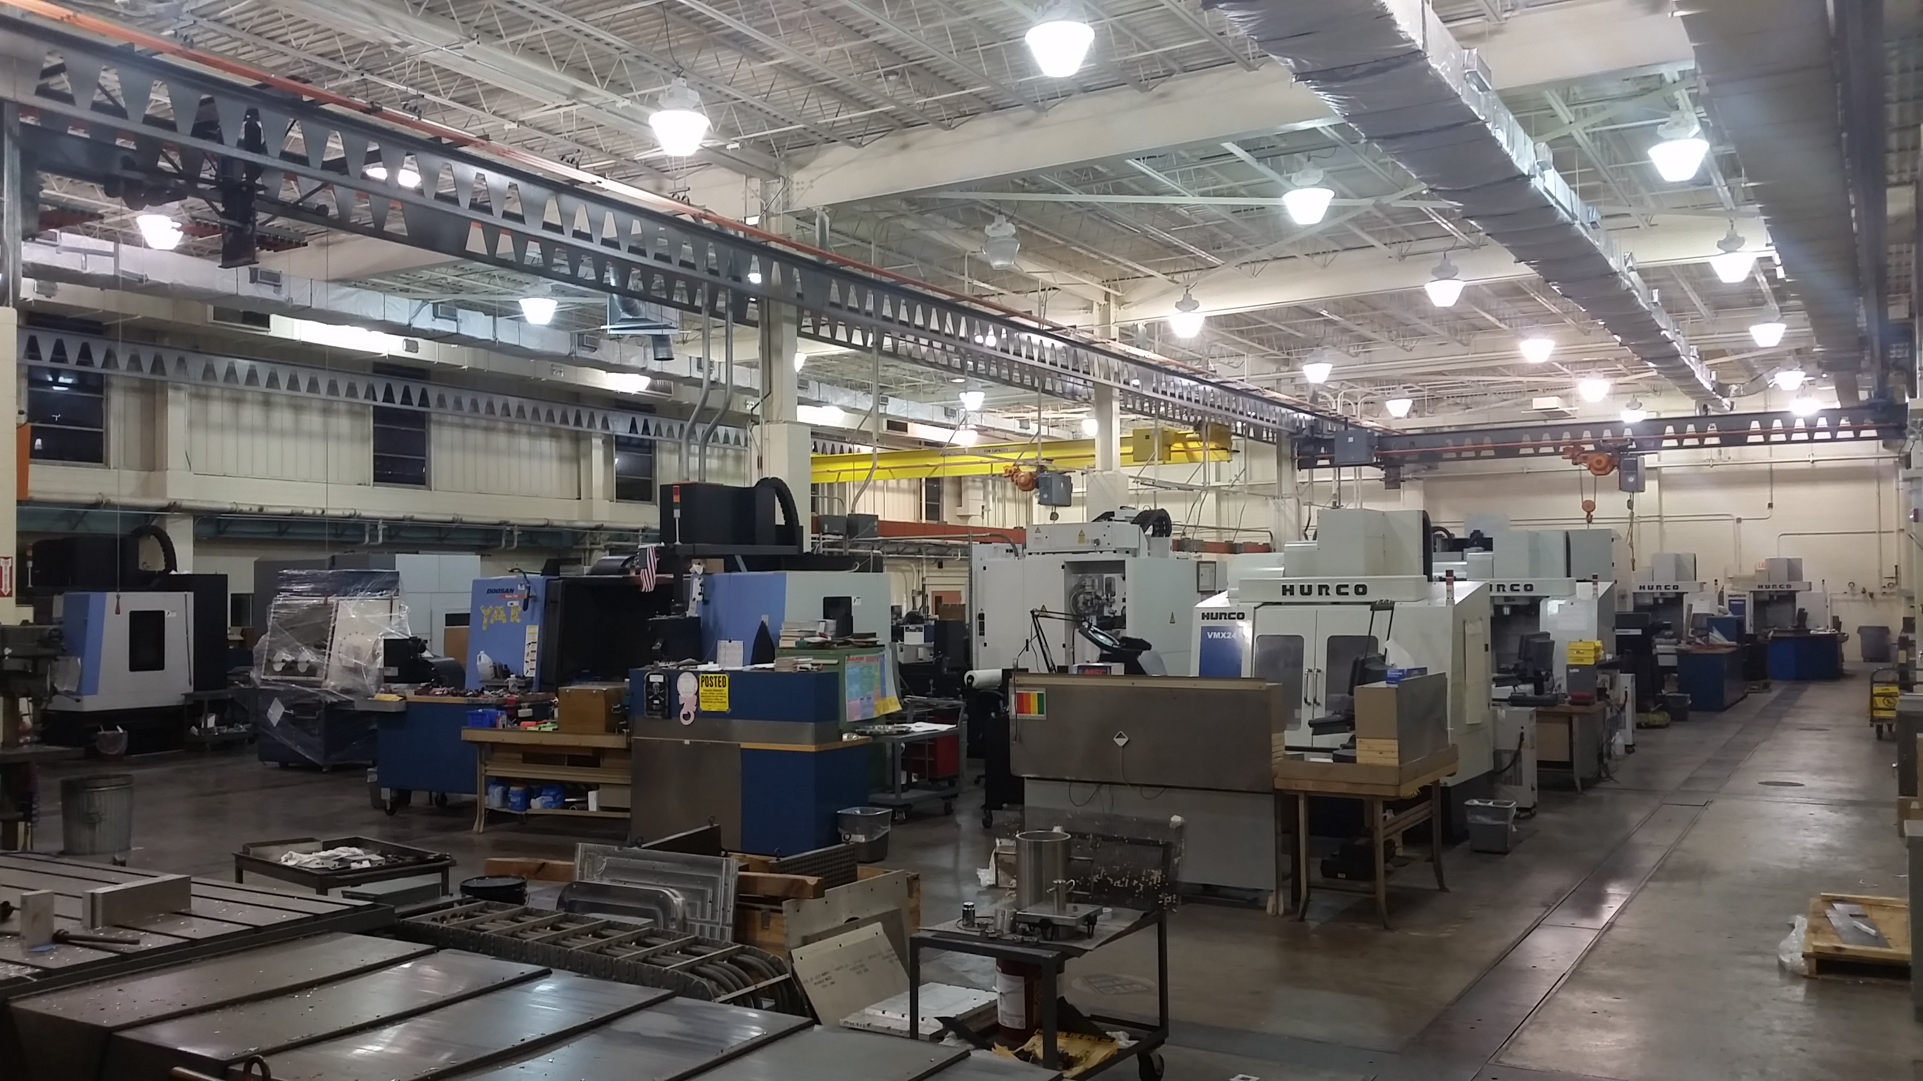
Measurement Campaigns
Auto Factory
Boulder Steam Plant
Machine Shop

Slide 8
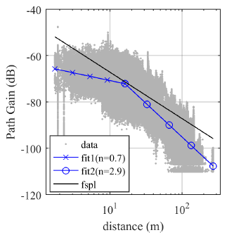
Results: NIST-TN 1951 Measurement Report
Three different factories
Two years of study, 125 pages
EM Propagation
Industrial Path Loss
Reflections/Multipath
Statistical Analysis
Path Loss
Delay Spread
Doppler
Measurement Data Openly Available for Download

Slide 9
Key Capability: RF Channel Emulator
Transmission Delay
Path loss
Multipath
Fading
Interference
Mobility Radios
Mobile Surroundings
Recreates the Factory’s Radio Environment in the Lab

Slide 10
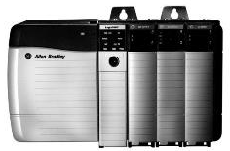
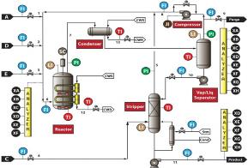
Chemical Reactor Process Control Example
Controller
Path Loss
Delays
Multipath
Interference
Actuators
Valve position
ON/OFF
Set-points
Reconfigure
Thresholds
Sensors
Level
Temperature
Pressure
Flow
Composition
Position

Slide 11
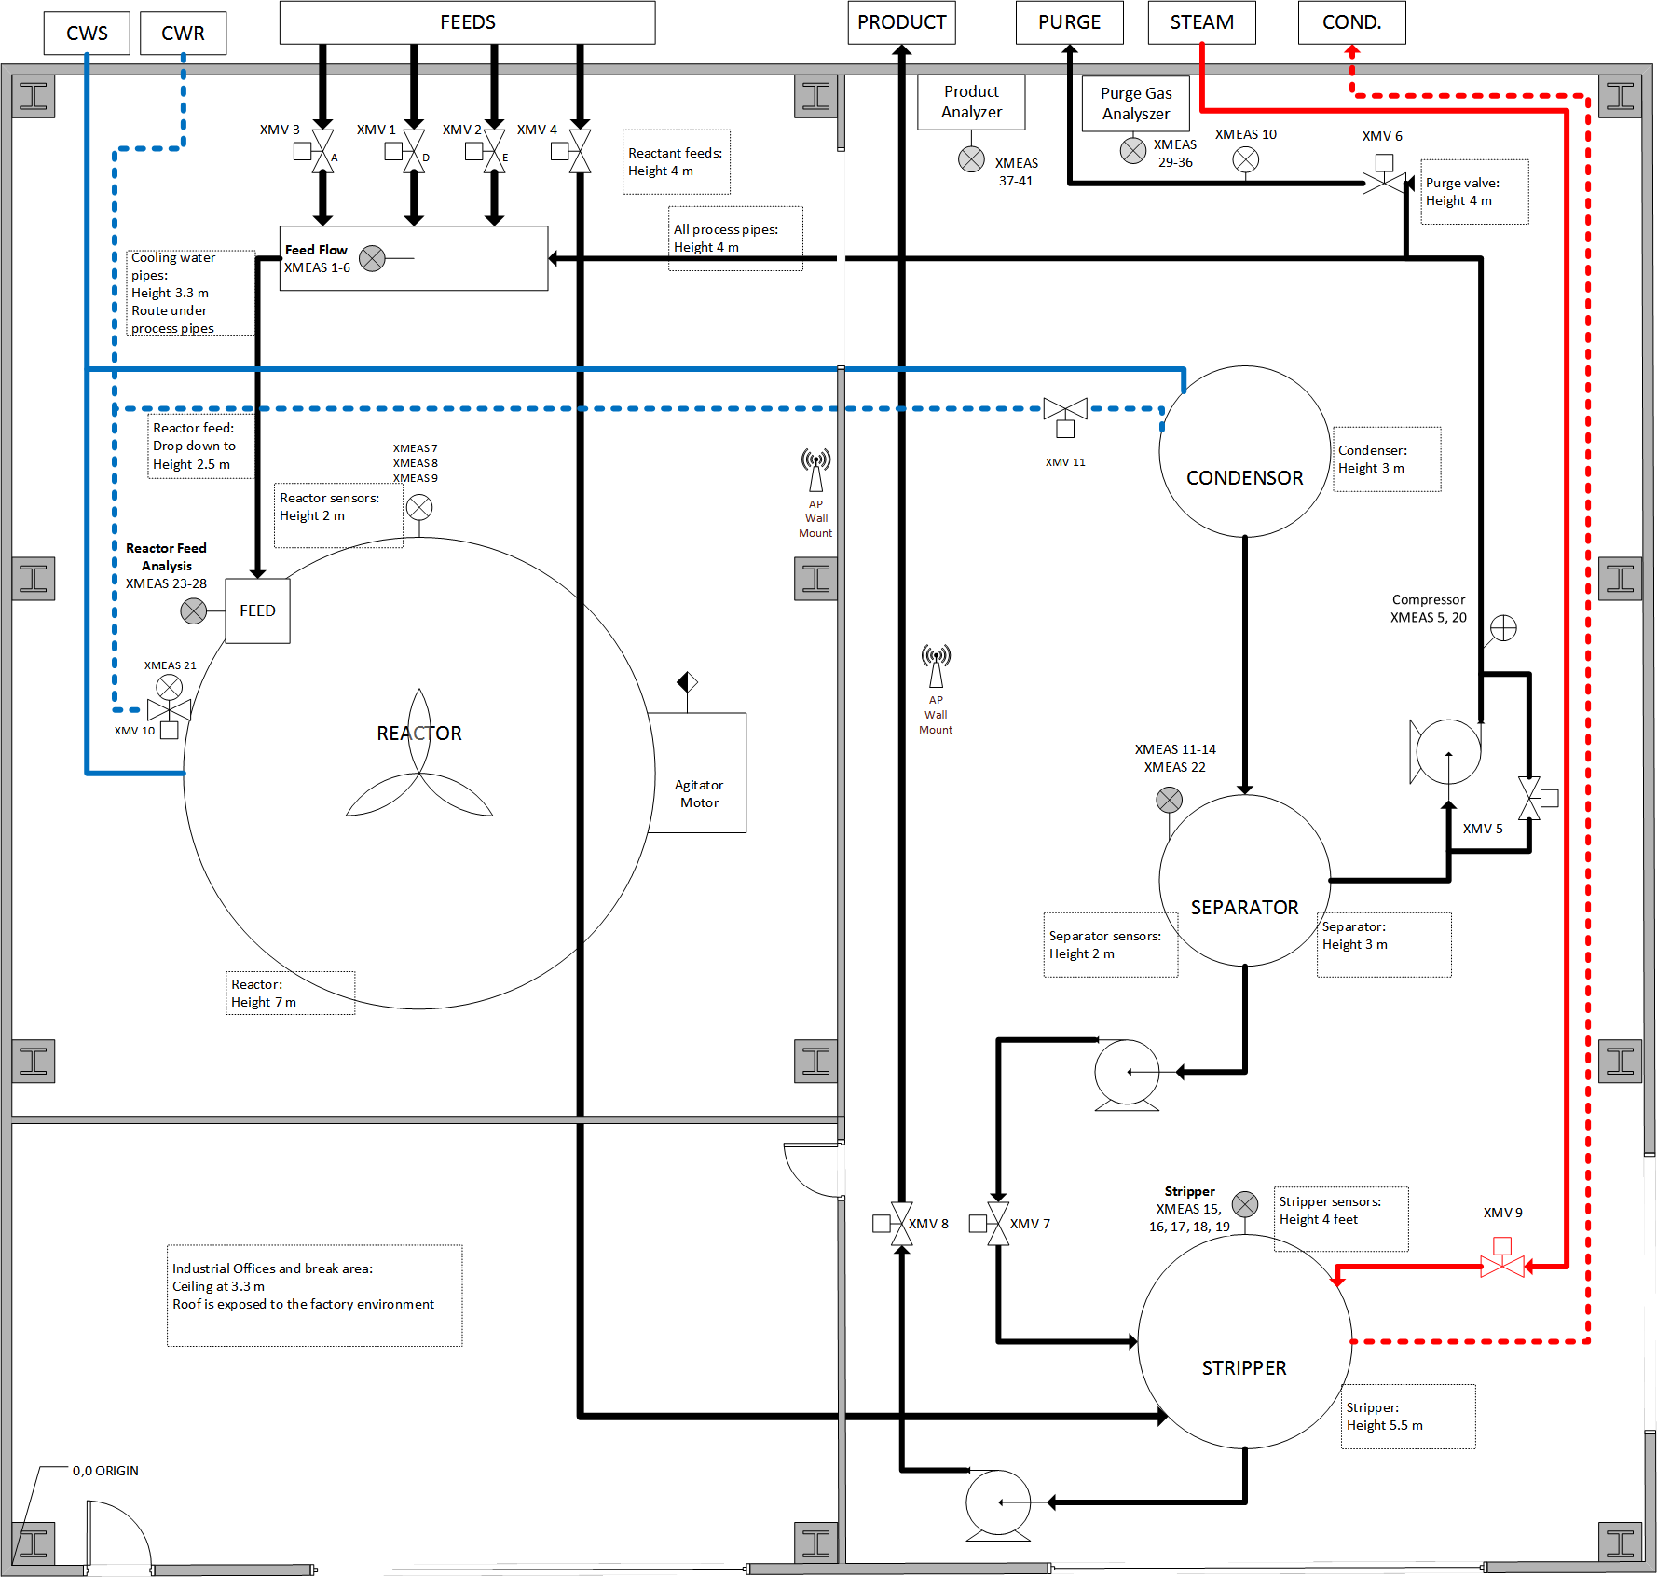
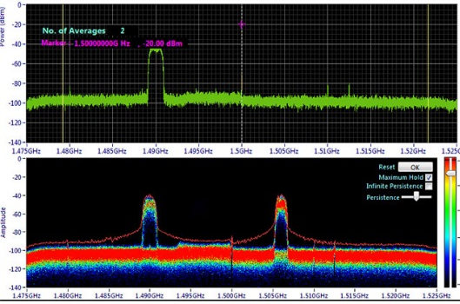
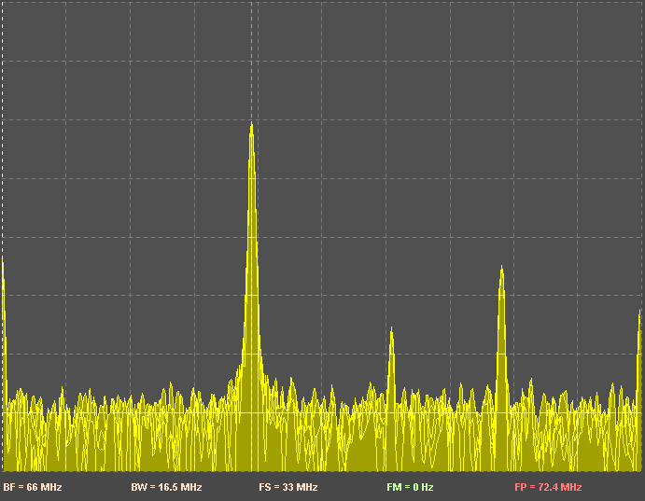
Radio Monitoring and Integration
Node
Node
Benefits of Spectrum Monitoring
Know your factory RF patterns
Real-time alarms and analytics
Predict spectrum capacity
Determine level of interference
Locate sources of interference
Record historical events
React quickly to correct problems
Node
Node

Slide 12
Moving Forward
Wireless for Factory Automation
October 1, 2019 – September 30, 2024

Slide 13
Our Plan for the Next 5 Years
Objective
Develop robust requirements, system models, recommended architectures, and guidelines for the integration of trustworthy wireless systems within factory work-cells where wireless is the primary mode of communication.

Slide 14
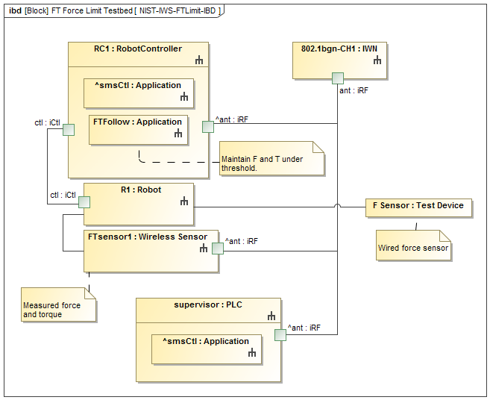
Reliability and Latency Sensitive Industrial Applications
Potential Use Cases (High-Low)
Testbed Configurations
End-effector/Tool Control
Boolean I/O Sensing and Control
Gripper feedback control
End-effector path following using F/T sensor feedback
Cooperative data exchange amongst robots and edge devices
Safety systems
Collision and obstacle avoidance
Mobile vehicles, Mobile manipulators
Remote observers

Slide 15
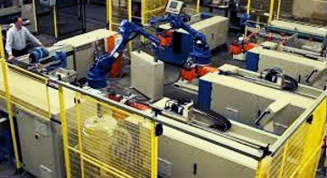
Vision of Wireless in the Factory Work Cell
Work Cell
Work Cell
Work Cell
Technical drivers and key requirements:
Multiple reconfigurable and collaborative mobile robots
Real-time coordination of movements and tools (sub-millisecond latencies)
Ultra-reliable communications with simultaneous redundant channels
Milling, Drilling, Welding, Etc.
Sensors
Assembly
Inspection
A
S
A
BCR
S
A
S
A
BCR
S
A
S
A
BCR
S
Queue
S
Queue
S
Queue
S
S
Actuators
R
R
R
R
R
Robots
Work-cell Controller (PLC/HMI)
Robot Controller
Work-cell Controller (PLC /HMI)
Robot Controller
Work-cell Controller (PLC /HMI)
Robot Controller
Work-cell
Work-cell
Work-cell
Controller
A
Motor Drive
Factory Floor
S
Sensor
Manufacturing Execution System
R
Reconfigurable, Collaborative Agile, Mobile Robots
Automation Servers
Operational Commands:
Scheduling, Design, G-Code, work instructions
Operational Status,
Metrics,
Production results
Automation Servers
BCR
ID/Bar code reader
Automation Servers
Automation Servers
Wireless data channel

Slide 16
Adapted ISA-TR100.00.03-2011 Wireless User Requirements for Factory Automation
Wire substitution
Robot End-effectors
Track-mounted carriers
Torque and Gauge Tools
Mobile Containers for movement and tracking
Distant Observe for Safety Critical Systems (e.g., SISs)*
Vision/Optical systems*
Mobile High-Value Assets
Localization
Identification
Mobile test and calibration assets
i.e., high-value test, measurement, and calibration device
* Added by NIST

Slide 17
Stated User Requirements from Industry ISA-TR100.00.03-2011 Perspective
October 2018
Use Case Class | Latency (ms) | Jitter (%) | BLER
Class 0* | 1 | +/- 10% | 10⁻⁹
Class 1 | 10 | +/- 10% | 10⁻⁹
Class 2 and 3 | 10 – 100 | <10% | 10⁻⁹
Class 4 and 5 | 100 avg. | +/-10% | 10⁻⁹
Class 0: Emergency
Class 1: Closed loop regulatory control
Class 2: Closed loop supervisory control
Class 3: Open loop control
Class 4: Alerting
Class 5: Logging, Downloading, Uploading
Table adapted from: (International Society of Automation). 2011. “ISA-TR100.00.03-2011 Wireless User Requirements for Factory Automation.” Research Triangle Park. https://www.isa.org/store/products/product-detail/?productId=116660.

Slide 18
Stated User Requirements from Industry ETSI TR 102 889-2-2011 Perspective
October 2018
 | Cell | Factory Hall | Plant Level
Number of devices (typically) | 30 | 100 | 1000
Maximum allowable latency including jitter/retransmits [ms] | 5 ± 10 % | 20 ± 10 % | 20 ± 10 %
Update Time [ms] | 50 ± 10 % | 200 ± 10 % | 500 ± 10 %
Packet Loss Rate (outside latency) | 10⁻⁹ | 10⁻⁹ | 10⁻⁹
Cell: Typically lower range (e.g. 10 m to 30 m range) but most demanding for latency and robustness.
Factory Hall: Covers a larger area (e.g. 100 m x 100 m).
Plant Level: The data volume rises, so throughput, security and reliability become more important.
Table adapted from: European Telecommunications Standards Institute, “ETSI TR 102 889-2 V1.1.1 (2011-08) Electromagnetic compatibility and Radio spectrum Matters (ERM); System Reference Document; Short Range Devices (SRD); Part 2: Technical characteristics for SRD equipment for wireless industrial applications using technol.” 2011.

Slide 19
Perspective from Wireless-HP (Luvisotto, et. al.)
October 2018
Targeted Control Use Cases
Power electronics
Power automation
Factory automation
Constraints:
Range 3 – 10 meters
Data rate 500 Mbps – 2 Gbps
Latency 10 microseconds
Reliability of 10⁻⁹
Latency is achievable given bit rates of higher order protocols
Reliability is only achievable given the diversity in time, frequency, and space
Packet sizes are small: <100 bytes
Luvisotto, Michele, Zhibo Pang, and Dacfey Dzung. 2017. “Ultra High Performance Wireless Control for Critical Applications: Challenges and Directions.” IEEE Transactions on Industrial Informatics 13 (3): 1448–59. doi:10.1109/TII.2016.2617459.

Slide 20
Combined Perspective: Targeting the Wireless Automation Work-cell
October 2018
All requirements are application-specific. One-size fits-all is not possible.
Can we determine requirements that meet most demands for industry?
Can wireless systems be more configurable for particular requirements?
Use Case Class | Latency (ms) | Jitter (%) | BLER | N*10^{x} (x)
Class 0* | 1 | +/- 10% | 10⁻⁹ | 0
Class 1 | 10 | +/- 10% | 10⁻⁹ | 1
Class 2 | 10 – 100 | <10% | 10⁻⁹ | 1
Class 3 | 100 | +/- 10% | 10⁻⁹ | 2
Class 4 | 100 | +/-10% | 10⁻⁷ | 3
Class 5 | 100 avg. | N/A | 10⁻⁹ | 2
Class 0: Emergency
Class 1: Closed loop regulatory control
Class 2: Closed loop supervisory control
Class 3: Open loop control with a human in the loop
Class 4: Monitoring and Alerting
Class 5: Logging, Downloading, Uploading
Focus is the factory work-cell for job-based factory automation. N is an integer factor. Not 100% accurate, work-in-progress.

Slide 21
Perspective – Whole Factory Network
Asserted Benefits
Ease of installation
Single point of network control/management
Single frequency
No power control needed
Deterministic scalability
Challenges
One network - Single point of failure
High-bandwidth requirement >> 1 Gbps
Large-scale device synchronization
Difficult edge coverage
mm-Wave antennas

Slide 22
Perspective – Segmented Factory Network
Asserted Benefits
Eased wireless system requirements
May be realizable with existing technology
Distributed failure modes
More energy efficient
Possible Challenges
Frequency planning
Power planning
Edge co-interference

Slide 23
NIST Testbed Approach
October 2018
Channels, Testbeds, and Simulation

Slide 24
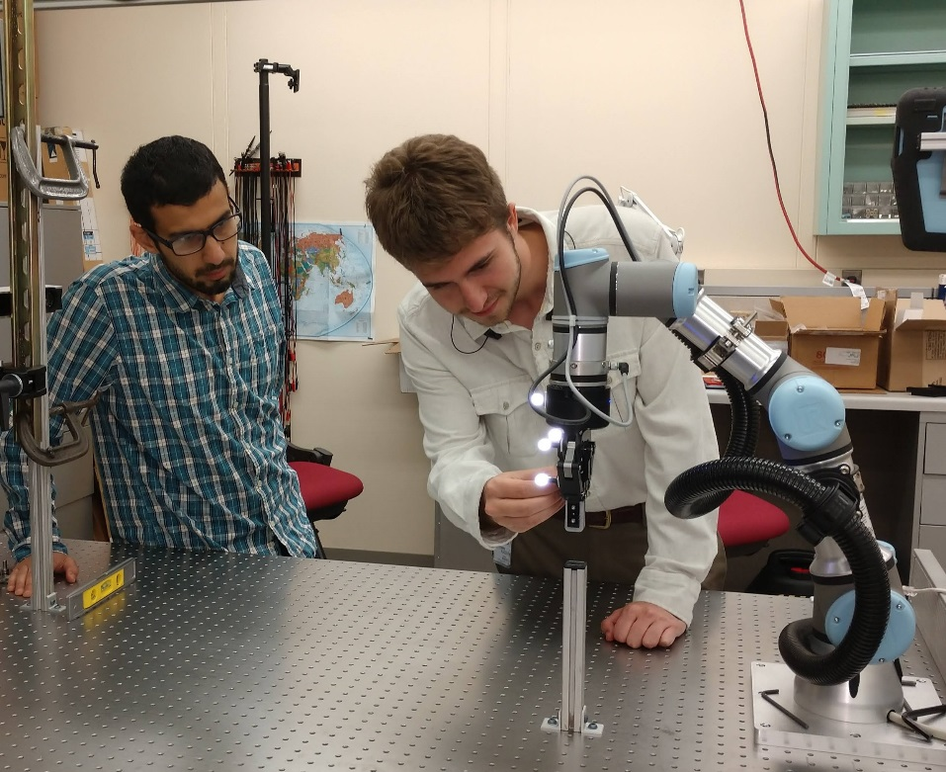
Testbed: Single Robot Uses
Use Cases
Pick and place operations
Force seeking
Force limiting
Safety interrupt
Remote Observer
Analysis
Uncertainty Measurements
Predictive assessments
Machine learning application for performance assessments

Slide 25
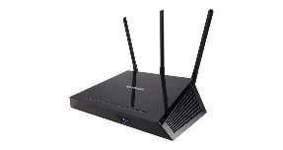
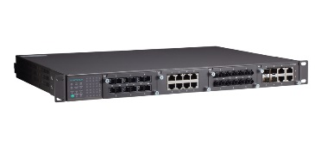
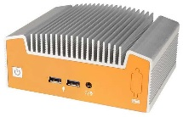
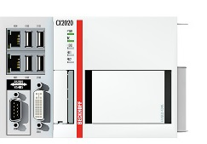
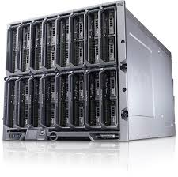
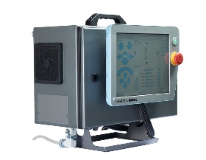
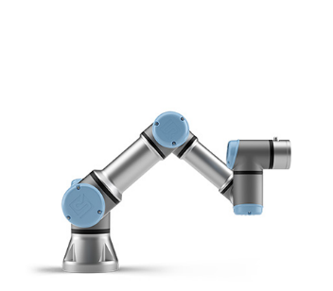
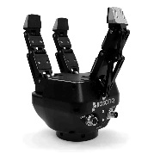
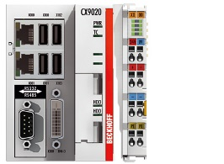
NIST Testbed
October 2018
AP
Switch
PLC
Supervisor
NUC/ROS
NUC/ROS
Controller
Analysis device
(Server)
Controller
Process data (Wired)
Machine Simulator
REES
UR3
UR3
REES
Process data (Wireless)
Operator
Work Station Array
Inspector
Measurement data
Notes:
Phase 1

Slide 26
Collectable Testbed State Information
Supervisor
Scheduling information with time stamps: remote node status, scheduling decision
Order/job information: type, status with time stamps, and quantities (assigned/good/failed) per order
Error/Diagnostic information: error codes
CNC Emulators
Status with time stamps
Error/diagnostic information: error codes
UR3 Robots
Positions/waypoints with time stamps
Actuation events with time stamps
F&T sensing data
Inter-node communications messages
(using Wireshark)
Sender/receiver
Timing
Message content
October 2018

Slide 27
Performance Metrics
Work-Cell Operations
Order statistics: assigned/good/failed part numbers
Production time
Work-cell Efficiency Parts in production CNC utilization
Network Performance
Message reception: packet loss, retries
Bandwidth: average and variance
Latency: end-to-end link

Slide 28
References
Luvisotto, Michele, Zhibo Pang, and Dacfey Dzung. 2017. “Ultra High Performance Wireless Control for Critical Applications: Challenges and Directions.” IEEE Transactions on Industrial Informatics 13 (3): 1448–59. doi:10.1109/TII.2016.2617459.
“Electromagnetic Compatibility And Radio Spectrum Matters (Erm); System Reference Document; Short Range Devices (Srd); Part 2: Technical Characteristics For Srd Equipment For Wireless Industrial Applications Using Technologies Different From Ultra-wide Ban.” Sophia-Antipolis, 2011.
(International Society of Automation), “ISA-TR100.00.03-2011 Wireless User Requirements for Factory Automation,” Research Triangle Park, 2011.

