Slide 1
Discussion on CID 1263
Date: 2018-10-10
Authors:

Slide 2
Introduction (1/2)
CID 1263 is a comment on the 11ah relay feature
11ah relay was originally defined as two-hop relay
It is later expanded to multi-hop relays without restrictions on the number of hops
A relay needs to indicate to its Parent AP the reachable STAs that are reachable through itself by providing a reachable address update [1]:
  An S1G relay STA shall send a Reachable Address Update frame that contains the current list of reachable addresses to the AP to which it is associated when one of the following conditions occurs:
    — A new non-AP STA associates with the S1G relay AP of the relay.
    — A non-AP STA is disassociated or deauthenticated from the S1G relay AP of the S1G relay.
    — A Reachable Address Update frame is received at the S1G relay AP of the S1G relay.

Slide 3
Introduction (2/2)
The Reachable Address Update frame has the following format [1]:

Slide 4
Problems with the Current Reachable Address Update Procedure (1/2)
The current Reachable Address Update Procedure [1]:
  An S1G relay STA shall send a Reachable Address Update frame that contains the current list of reachable addresses to the AP to which it is associated when one of the following conditions occurs:
    — A new non-AP STA associates with the S1G relay AP of the relay.
    — A non-AP STA is disassociated or deauthenticated from the S1G relay AP of the S1G relay.
    — A Reachable Address Update frame is received at the S1G relay AP of the S1G relay.
Addresses in the current list of reachable address may not be up to date
  A STA may roam to another relay AP without disassociation, but its address will still be included in the current reachable address
Unpredictable update timing for correction:
  No mechanisms is defined for when a STA leaves without disassociation, how long it take to have a correct set of current reachable address
  A relay AP may include the ID of a STA that has already roamed to another relay AP and hence overwrite the correct routing table

Slide 5
Problems with current Reachable Address Update Procedure (2/2)
RootAP/Parent AP have no idea how to route packets:
  A rootAP/Parent AP may receive multiple current reachable addresses from a number of downstream relays that says a particular STA is reachable through them (could be several hops away from the relay)
  The rootAP/Parent AP has no way to know through which relay to send the packets or make a determination which reachable address update is the current one

Slide 6
Erroneous reachable address update
CID 1263
The reachable address update procedure may create an error in the following situation:
Step 1: STA1 who is originally associated with relay AP1, moves to relay AP2, under the same root AP, without performing disassociation with relay AP1
Step 2: relay AP2 performs reachable address update to the root AP based on condition 1) in L23
Step 3: Before the max idle period expiry of STA1 in relay AP1, another STA2 associates with relay AP1
Step 4: relay AP1 sends reachable address update frame containing "current list" STA1 and STA2 to root AP based on condition 1) in L23, overwriting the correct forwarding entry for STA1 in root AP
Step 5: Later traffic to STA1 is forwarded to relay AP1, causing relay AP1 disassociation of STA1, which triggers another reachable address update frame sent to root AP, based on condition 2) in L23. This completely removes STA1 from root AP's "current list" of reachable addresses
This situation is illustrated on Slide 7

Slide 7
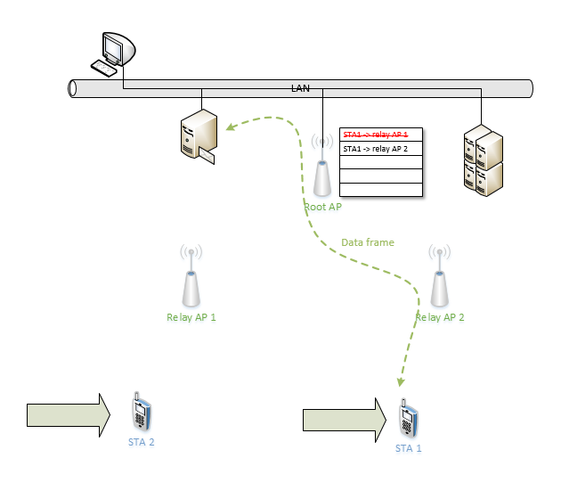
Erroneous reachable address update
Step 1~3
Step 4

Slide 8
Erroneous reachable address update
Suggested remedies:
Option 1:
The reachable address element only contains differential updates
  The relay STA x with the “initiator MAC address” only reports the STA joining or leaving the BSS of the corresponding relay AP
  The intermediate relays between the root AP and the relay x ignores reachable address removal if an address has been previous updated by another “initiator MAC address”
Option 2:
The reachable address element contains the time of last radio contact for each updated address, e.g. the last contact with STA y was n TUs before the time of sending this reachable address update.

Slide 9
References
[1] 802.11 RevMD Draft 1.5, September 2018
[2] 11-18/1654r0, CR for CID 1263, September 2018

Slide 10
SP 1
Which option do you prefer to resolve CID 1263
Option 1: differential reachable address update
Option 2: timestamp for the latest radio contact for each reachable address
Other

