Slide 1
802.11 Working Group Opening Report
November 2018
Authors:
Date: 2018-11-12

Slide 2
Introduction
This presentation, together with the reports cited on the next slide, forms the opening report of the IEEE 802.11 Working Group for November 2018.
Subgroup status is reported in the “Snapshots” submission (see documents slide for link). This is incorporated by reference into this opening report.
“Mx.y.z” terminology indicates that the item was on the tentative agenda for the Monday 802.11 plenary, and was agenda item x.y.z.

Slide 3
M1.3 Meeting Decorum
%
Please observe proper decorum in meetings
Photography or recording is not allowed
Press (i.e., anyone reporting publicly on this meeting) are to announce their presence (December 2015 IEEE-SA Standards Board Ops Manual 5.3.3.3)
Laptop speakers, cell phone / tablet ringers off
Wear your badges at all times in meeting areas
  Help the hotel security staff improve the general security of the meeting rooms
  Laptops HAVE BEEN STOLEN at previous meetings
  DO NOT assume that meeting areas are secure

Slide 4
M2.3.1 Summary of Liaisons - Incoming
2018-09 Liaison Response from 3GPP re: 6GHz Coexistence workshop, https://mentor.ieee.org/802.11/dcn/18/11-18-1686-00-0000-2018-09-liaison-from-3gpp-ran-re-proposed-joint-coexistence-workshop.docx
2018-09 Liaison from 3GPP RAN re: certain channel combinations for LAA, see https://mentor.ieee.org/802.11/dcn/18/11-18-1687-00-0000-2018-09-liaison-from-3gpp-ran-re-certain-channel-combinations-for-laa-in-5ghz.docx
2018-10 Liaison response from CAR 2 CAR Consortium, see https://mentor.ieee.org/802.11/dcn/18/11-18-1754-00-0000-2018-10-liaison-from-car-2-car-consortium-re-ngv-use-cases-and-requirements.docx
NGV will consider
2018-10 Liaison from ETSI, https://mentor.ieee.org/802.11/dcn/18/11-18-1771-01-0000-2018-10-liaison-reply-from-etsi-its-re-ngv-use-cases-and-requirements.docx
2018-11 Liaison statement from Wi-Fi Alliance – to be posted 11-18-1843
2018-09 in progress
  Liaison statement from WBA on MAC randomization impacts, see https://mentor.ieee.org/802.11/dcn/18/11-18-1579-01-0000-2018-09-liaison-from-wba-re-mac-randomization-impacts.docx

Slide 5
M2.4 802 EC decisions
September - November 2018 EC decisions
EHT Study Group and RTA TIG Press Release approval, https://standards.ieee.org/news/2018/ieee-802_11-extremely-high-throughput-study-group.html
Pending for November 2018
P802.11bc Broadcast Services
P802.11bd Next Generation V2X

Slide 6
M2.4 IEEE-SA Standards Board (SASB) decisions
P802.11ax PAR Extension approved 2018-09-27
Pending for December 2018
P802.11bc Broadcast Services
P802.11bd Next Generation V2X

Slide 7
M3.1 802.11 Working Group Session Documents
WG Session Reports
WG Agenda | https://mentor.ieee.org/802.11/dcn/11-18-1709
Opening report | https://mentor.ieee.org/802.11/dcn/11-18-1710
Snapshots | https://mentor.ieee.org/802.11/dcn/11-18-1747
1st vice chair | https://mentor.ieee.org/802.11/dcn/11-18-1706
2nd vice chair | https://mentor.ieee.org/802.11/dcn/11-18-1748
Treasurer | https://mentor.ieee.org/802.11/dcn/11-18-1705
Chair's Supplementary Material | https://mentor.ieee.org/802.11/dcn/11-18-1711
Motions | https://mentor.ieee.org/802.11/dcn/11-18-1746
Closing report | https://mentor.ieee.org/802.11/dcn/11-18-1749
Previous Session Minutes | https://mentor.ieee.org/802.11/dcn/11-18-1414

Slide 8
M3.2 Joint meetings and Reciprocal Credit
Reciprocal credit is provided to 802.11 voters for attendance at: 802.18, 802.19, 802.24, 802.1, NENDICA Industry Connections Activity**
  Reciprocal credit for 802.1 is for 801.1Qbz, 802.1CF, 802E
** When meeting

Slide 9
M3.2 802.18 details
Agenda: 18-18/143
Meeting times: Tuesday AM2, Thursday AM1, potentially AM2
Discussion items this week of interest to 802.11 include
  ITU Region 3 Presentation from Masanori Kodo, Deputy Secretary General of APT, Asia-Pacific Telecommunity (APT)
  6GHz Spectrum FCC comments
  IEEE Position on Intelligent Spectrum allocation published: https://mentor.ieee.org/802.18/dcn/18/18-18-0142-00-0000-ieee-sa-intelligent-spectrum-allocation-and-management-statement.pdf

Slide 10
M3.2 802.19 details
Agenda: 19-18/79
  Meeting times: Monday PM2 (Opening Plenary), Thurs PM2 (Closing Plenary
802.19 ballot on 802.11ba Coexistence Assurance Document
  Ballot closed on November 5
  Vote(Y/N/A): 19/1/0 Ballot Passed
  1 comment received
Discussion items this week of interest to 802.11 include
  Sub-1GHz Coexistence Study Group, see https://mentor.ieee.org/802.19/dcn/18/19-18-0078-00-S1GH-sub-1ghz-sg-agenda-nov.xlsx Wednesday AM1, AM2, PM1

Slide 11
M4.1.1 Type of Groups
Type of Group | Description
WG | Working Group
SC | Standing Committee
TG | Task Group
SG | Study Group
TIG | Topic Interest Group
AHG | Ad Hoc Group

Slide 12
M4.1.1 IEEE 802.11 Groups
Type | Group | WG & Infrastructure
WG | WG11 | The IEEE 802.11 Working Group
SC | AANI | Advanced Access Networking Interface (AANI)
SC | ARC | Architecture
SC | COEX | Coexistence
SC | PAR | PAR review
802 SC | JTC1 | ISO/IEC JTC1/SC6
Type | Group | Amendments/Revision
TG | AX | High Efficiency Wireless LAN (HEW)
TG | AY | Next Generation 60 GHz (NG60)
TG | AZ | Next Generation Positioning (NGP)
TG | BA | Wake-up Radio
TG | BB | Light Communication (LC)
TG | MD | Revision (REVmd)
Type | Group | New Work
SG | BCS | Broadcast Services
SG | EHT | Extremely High Throughput
TIG | FD | Full Duplex
SG | NGV | Next Generation V2X
SC | WNG | Wireless Next Generation
TIG | RTA | Real Time Applications

Slide 13
M4.1.2 PAR Expiration/Renewal Schedule
Project | PAR Expiration Date
AQ | 31-DEC-2018
AX | 31-DEC-2020
AY | 31-DEC-2019
AZ | 31-DEC-2019
BA | 31-DEC-2020
BB | 31-DEC 2022
802.11 (REVmd) | 31-DEC 2021
http://www.ieee802.org/11/PARs/index.html

Slide 14
M4.1.3 802.11 WG Appointed positions
WG Secretary – Stephen McCann
Treasurer – Jon Rosdahl
ANA Authority – Robert Stacey
WG Technical Editors – Robert Stacey, Peter Ecclesine

Slide 15
M4.1.3 Officers
Cat | Group | Chair | Vice Chair | Technical Editor | Secretary
WG |  | Dorothy STANLEY | Jon ROSDAHL, Robert STACEY | Robert STACEY Peter ECCLESINE | Stephen MCCANN
SC | AANI | Joseph LEVY
SC | ARC | Mark HAMILTON | Joseph LEVY |  | Joseph LEVY
SC | Coex | Andrew MYLES |  |  | Guido HIERTZ
SC | PAR | Jon ROSDAHL | Michael MONTEMURRO |  | Michael MONTEMURRO
SC | WNG | Jim LANSFORD | Lei WANG |  | Lei WANG
TG | MD | Dorothy STANLEY | Mark HAMILTON Michael MONTEMURRO | Emily QI Edward AU (subeditor) | Jon ROSDAHL
TG | AX | Osama ABOUL-MAGD | Alfred ASTERJADHI, Ron PORAT | Robert STACEY | Yasuhiko INOUE
TG | AY | Edward AU | Sang KIM | Carlos CORDEIRO | Jeorge HURTARTE
TG | AZ | Jonathan SEGEV | Assaf KASHER | CC WANG | Roy WANT
TG | BA | Minyoung PARK | Yunsong YANG, Eunsung PARK | Po-Kai HUANG | Leif WILHELMSSON
TG | BB | Nikola SERAFIMOVSKI | Oliver Pengfei LUO Tuncer BAYKAS | Volker JUNGNICKEL Gaurav PATWARDHAN | Volker JUNGNICKEL
SG | BCS | Marc EMMELMANN | Hitoshi MORIOKA, Stephen MCCANN |  | Xiaofei WANG
SG | EHT | Michael MONTEMURRO
TIG | FD | James GILB |  |  | Kome OTERI
SG | NGV | Bo SUN | Hongyuan ZHANG |  | Amelia ANDERSDOTTER
TIG | RTA | Allan JONES |  |  | Kate MENG
New last meeting

Slide 16
M4.1.4 IEEE 802.11 Revisions
802.11
-2016
802.11
-2012
802.11
-2007
802.11
-2003
11aa
Video Transport
11k
RRM
11s
Mesh
11e
QoS
MAC
11u
WIEN
11v
Network
Management
11h
DFS & TPC
IEEE
Std
802.11
-1997
11ae
QoS Mgt Frames
11z
TDLS
11i
Security
11d
Intl roaming
11w
Management
Frame
Security
11r
Fast Roam
11f
Inter AP
11af
TV Whitespace
11n
High
Throughput
(>100 Mbps)
11j
JP bands
11a
54 Mbps
5GHz
PHY & MAC
11ac -VHT
>1 Gbps @ 5GHz
11p
WAVE
11y
Contention
Based
Protocol
11g
54 Mbps
2.4GHz
11b
11 Mbps
2.4GHz
11ad - VHT
>1 Gbps @ 60GHz
Notes:
doc.: IEEE 802.11-11/0483r0
May 2011
Bruce Kraemer (Marvell)
Page 16

Slide 17
M4.1.4 IEEE 802.11 Standards Pipeline
MAC
802.11aq
PAD
802.11
-2016
802.11
REVmd
802.11ak
GLK
Broadcast
Services
(BCS) SG
802.11az
NGP
Real Time
Applications
(RTA) TIG
802.11ai
FILS
802.11ba
WUR
WNG
Next Gen
V2X SG
802.11ax
HEW
802.11ah
< 1Ghz
Ex. High
Throughput
SG
802.11ay
NG60
Full Duplex
(FD) TIG
802.11bb
LC
802.11aj
CMMW
MAC & PHY
Discussion Topics
TIG/Study
groups
TG without
Approved draft
WG
Letter Ballot
Sponsor
Ballot
Published
Amendment
Published
Standard
17
Notes:
doc.: IEEE 802.11-11/0483r0
May 2011
Bruce Kraemer (Marvell)
Page 17

Slide 18
M4.1.5 Summary of ballots and comment collections
Type | Label | Group | Opened (mm-dd) | Dur (d) | # Comments | Ballot Group | Approve | Disapprove | Abstain | Return % | Approve % | Result
T | 235 | TGba | 09-24 | 30 | 1253 | 319 | 159 | 62 | 23 | 79 | 72 | Fail
CC | CC29 | TGbb | 09-15 | 16 | 98

Slide 19
M4.1.6 Current Membership Status
Data as of 2018-07-13
Status | Number
Aspirant | 80
Potential Voter | 54
Voter | 319
Ex Officio Voter | 11
Definitions:
  Aspirant: a member who has attended 1 qualifying meeting
  Potential Voter: a member who has attended 2 qualifying meetings and will become a voter at the start of the next plenary they attend
  Ex Officio Voter: a voter who has voting rights by virtue of their membership of the 802 EC and has requested to be recorded as an ex officio voter in 802.11

Slide 20
M4.1.6 Recent voting member history

Slide 21
background data

Slide 22
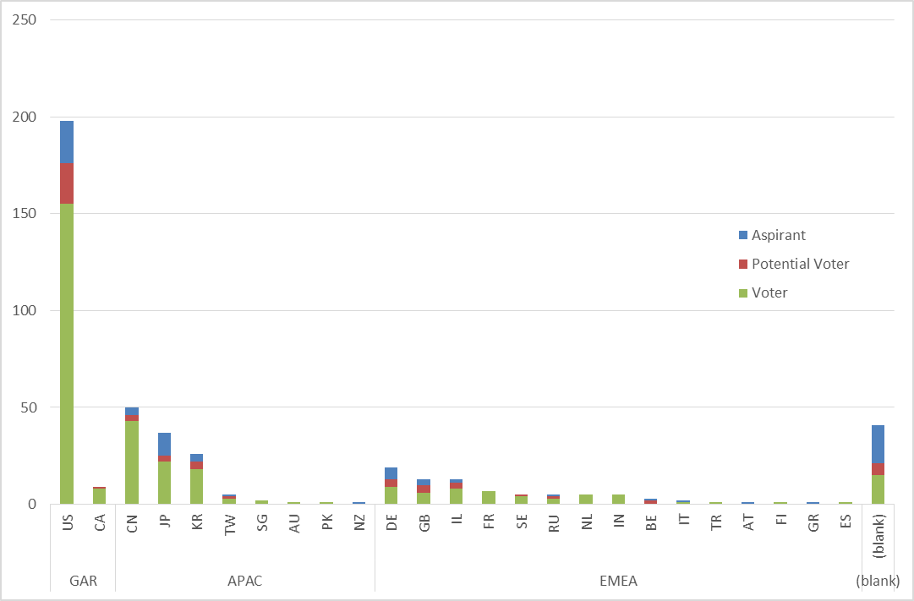
Members by country and region

Slide 25
Membership – Historic Data

