Slide 1
Availability Window Update
Date: 2018-09-10
Authors:

Slide 2
Motivation
In HEz ranging RSTA performs simultaneous ranging with multiple ISTAs inside periodic availability windows.
Occasionally, RSTA and/or ISTA may want to stop performing ranging in current Availability Window due to e.g.,
  RSTA/ISTA observes many failed ranging attempts/ high interference in current window.
  RSTA/ISTA has data transmission schedules with STAs that overlaps with current window.
  ISTA may need ranging with higher or lower refresh rates than negotiated (e.g., when user starts moving after sitting in a room for half an hour).
  RSTA cannot support the computational complexity of ranging with all the ISTAs participating in current Availability Window.
Problem: how to signal termination/modification of Availability Windows ?

Slide 3
Challenges
Type of termination/modification: ISTA initiated/triggered, RSTA initiated/triggered.
  each has ISTA and RSTA perspective/challenges.
From ISTA perspective,
  signal termination of existing Availability Window schedule.
  possibly request a new session with different ranging parameters.
From RSTA perspective,
  signal termination/modification of existing Availability Window schedule.
  avoid possibly large number of new simultaneous ranging requests.

Slide 4
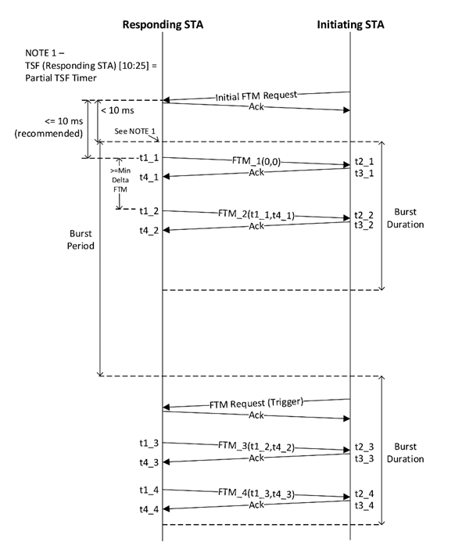
Existing scheme (FTM)
In FTM, expected session termination occurs after negotiated # of Burst Periods expire.
RSTA can also terminate by transmitting FTM with Dialog Token = 0.
ISTA can also terminate by
  Transmitting FTM Request with Trigger field = 0.
  Transmitting FTM Request with Trigger = 1 and new FTM Parameters element.
FTM sequence [802.11-spec-2016]

Slide 5
Proposed ISTA Termination Scheme
For simplicity, ISTA terminates session by transmitting
  Option 1(baseline approach): an FTMR transmitted outside the availability window.
    Trigger = 0 means termination without re-negotiation; Trigger = 1 means termination and new ranging session request.
  Option 2: some specific response in the Poll response (e.g., Duration = 1).
    Unprotected Ctrl frame.
    May be hard to process the response within SIFS.
Prefer Option 1 because of simplicity.

Slide 6
Straw Poll 1
Do you support the following behavior for ISTA to signal termination to RSTA:
ISTA sends an FTM Request frame and indicate termination. Once the FTM Request is acknowledged the session is terminated. ?

Slide 7
Straw Poll 2
Do you support the following behavior for ISTA to request an RSTA for session parameters change :
ISTA sends an FTM Request with either a new HEz Specific Parameters subelement including a new unavailability bitmap or a VHTz Specific Parameters subelement. Once the FTM Request frame is transmitted and acknowledged the ongoing session is terminated and the FTM frame provides the new session assignment ?

Slide 8
Proposed RSTA Termination Scheme
RSTA terminates session by transmitting
  Option 3: some indication in or alongside RSTA2ISTA LMR.
  Option 4: some indication in the in the User Info (or STA Info) field of the Trigger Frame of Subtype Poll/Sounding (or DL-NDPA).
    Issue: unprotected control frame.
Prefer Option 3 because of simplicity and protection of frames.

Slide 9
Proposed RSTA Modification Scheme
Motivation: allow RSTA flexibility to make small adjustments to existing schedule without re-negotiation overhead.
Proposed mechanism: Assign a new Availability Window to ISTA while terminating current Availability Window.
  Signaling carried in an FTM frame aggregated with the RSTA2ISTA LMR.
  RSTA does not cancel current ranging session.
  If new assignment is not acceptable, ISTA renegotiates thereby ending current ranging session.
  Similarly for VHTz.
LMR for ISTA-2 + FTM (new AW: S2)
Polling TF
Polling TF
LMR for ISTA-1 + FTM (new AW: S1)
IFTM (accept)
….
….
RSTA
Av Window S1
Av Window S2
Av Window S3
ISTA-1
Response (ISTA-1)
IFTMR (request S3)
Response (ISTA-2)
ISTA-2

Slide 10
Straw Poll 3
Do you support the following behavior for RSTA to signal termination or update to RSTA:
For RSTA to terminate or modify an HEz or a VHTz session of a specific ISTA, the RSTA sends an FTM frame and a RSTA2ISTA LMR as an aggregated AMPDU. The FTM frame will be of type Action no ACK ?

Slide 11
Summary
Discussed signaling options for termination in HEz ranging.

