Slide 1
Simulation Scenario for Underground Mining
Date: 2018-09-11
Authors:

Slide 2
Summary
Motivation
Simulation Scenario for Underground Mining

Slide 3
Motivation
Current Status of Simulation Scenario
  In IEEE 802.11-18/1422r0, four kinds of simulation scenario are discussed
  for the specification
  In Industrial Wireless, it assumes the Robotic Work Cell (e.g., 8m x 10m x 7m or ~5m x 5m x 3m size) from IEEE802.11ax document
It is needed to add simulation scenario for underground environment
  Li-Fi can be most effective in narrow and special indoor industrial environments,
such as underground mining, subway and so on.
  Underground mining requires reliable communication, monitoring and tracking systems
  that guarantee safety and maximize productivity.
  Wi-Fi is easily affected by electromagnetism, IrDA is harmful to miner’s
  eyes with too high power, BLE is more expensive and also needs high electronic storage.

Slide 4
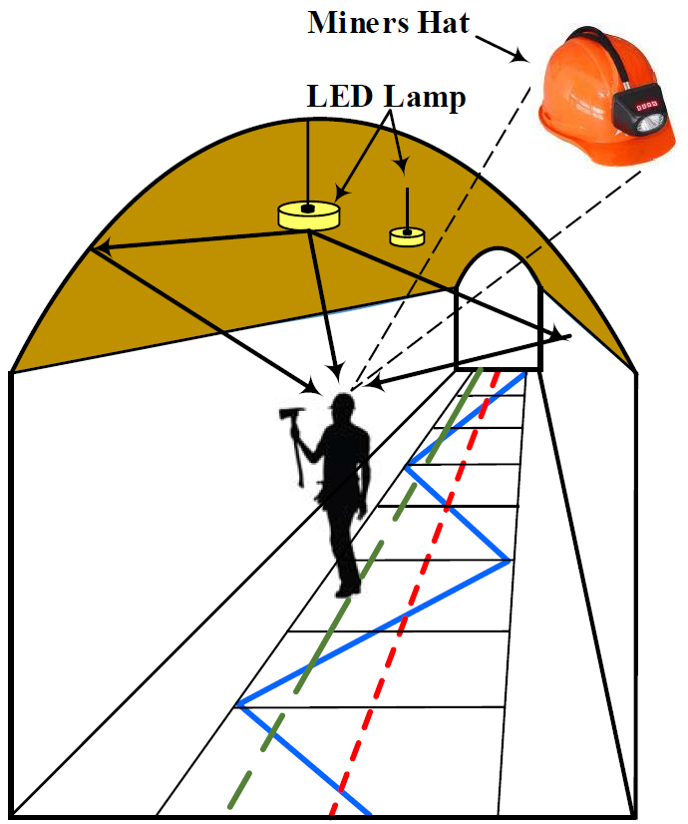
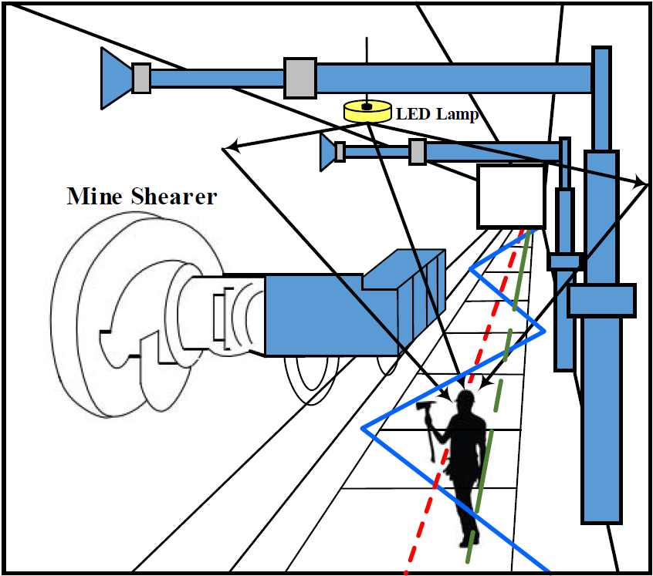

System Model
(a) Mining roadway
(b) Mine working face
Two separate scenario can be considered [2]
  Mining Roadway
  Mining Working Face

Slide 5


Topology
L=5M
W=2M
LED
Optical Signal
Lane
Miner’s Lamp
H=3~5M
D=1M

Slide 6
Proposed Set of Simulation Scenarios
 | Scenario Name | Topology | Management | Channel Model | Traffic profile [tentative]
1 | Underground (mining, subway, etc..) | E - Mining Roadway and Working Face e.g. ~2m x 5m x 3.7m (Mining Roadway) or ~2m x 5m x 4.7m (Working Face) size ~5s of STAs/AP, P2P pairs | Managed | Path Loss & Delay Spread [2] | Industrial
Parameter | Value
Environment description | 1 Mining Roadway and Mining Working Face Floors height : 3.7 m, 4.7 m Work cell size : 2 m x 5 m x 3.7 m
APs location | 1 per work cell, installed at ceiling of underground mining, with multiple transceivers facing different directions
STAs location | N per AP, located on the top of the work cell boundary
Channel Model | Path Loss and Delay Spread [2]

Slide 7
Conclusion
It is observed that simulation scenario for industrial
wireless does not cover various industrial application
Li-Fi for underground environment (e.g., mining,
subway, railway, etc….) can be very effective since
it is indoor environment and many LED infrastructure
It is considerable that the narrow-width topology for
underground industry can be included in the current
simulation scenario for industrial wireless
in order to provide the various performance evaluation

Slide 8
References
1. https://mentor.ieee.org/802.11/dcn/18/11-18-1422-00-TGbb-simulation
-scenarios.ppt
J. Wang, A. Al-Kinani, J. Sun, W. Zhang and C. Wang, “A Path Loss Channel
Model for Visible Light Communications in Underground Mines”, in Proc.
ICCC ‘17, 2017.
3. J. Wang, A. Al-Kinani, W. Zhang, and C.-X. Wang, “A new VLC channel
model for underground mining environments,” in Proc. IEEE IWCMC’17,
Valencia, Spain, June 2017.
4. G. Wu and J. Zhang, “Demonstration of a visible light communication
system for underground mining applications,” in Proc. IECT’16, Shanghai,
China, pp. 1–7, June 2016.
5. S. Yarkan, S. Guzelgoz, H. Arslan, and R. R. Murphy, “Underground
mine communications: A survey,” IEEE Commun. Surveys Tuts., vol. 11,
no. 3, pp. 125–142, 2009, 3rd Quarter.

