Slide 1
Simulation Scenario for Underground Mining
Date: 2018-09-10
Authors:

Slide 2
Summary
Motivation
Simulation Scenario for Underground Mining

Slide 3
Motivation
Current Status of Simulation Scenario
In IEEE 802.11-18/1422r0, four kinds of simulation scenario are discussed
for the specification
In Industrial Wireless, it assumes the Robotic Work Cell (e.g., 8m x 10m x 7m or ~5m x 5m x 3m size) from IEEE802.11ax document
It is needed to add simulation scenario for underground environment
Li-Fi can be most effective in narrow and special indoor industrial environments,
such as underground mining, subway and so on.
Underground mining requires reliable communication, monitoring and tracking systems
that guarantee safety and maximize productivity.
Wi-Fi is easily affected by electromagnetism, IrDA isharmful to miner’s
eyes with too high power, BLE is more expensive and also needs high electronic storage.

Slide 4
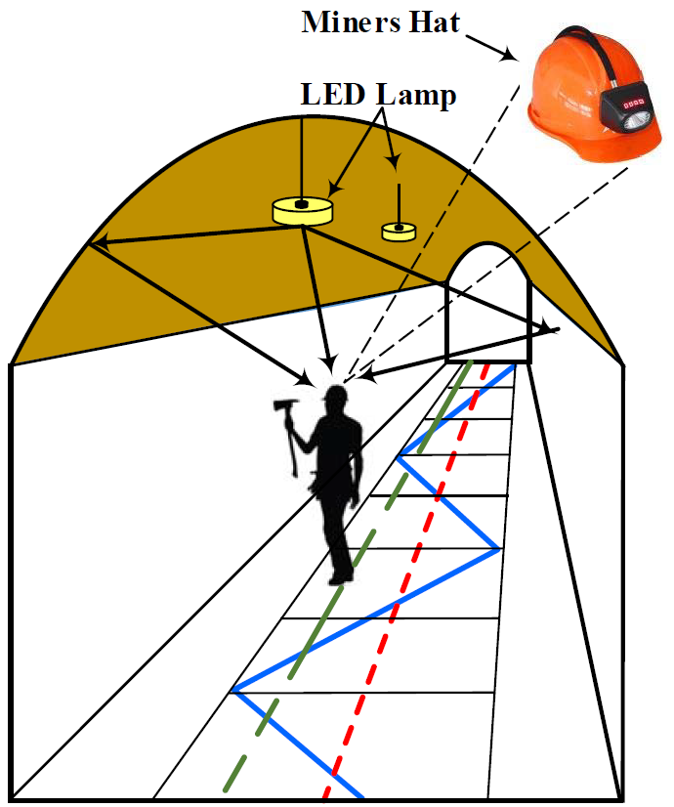
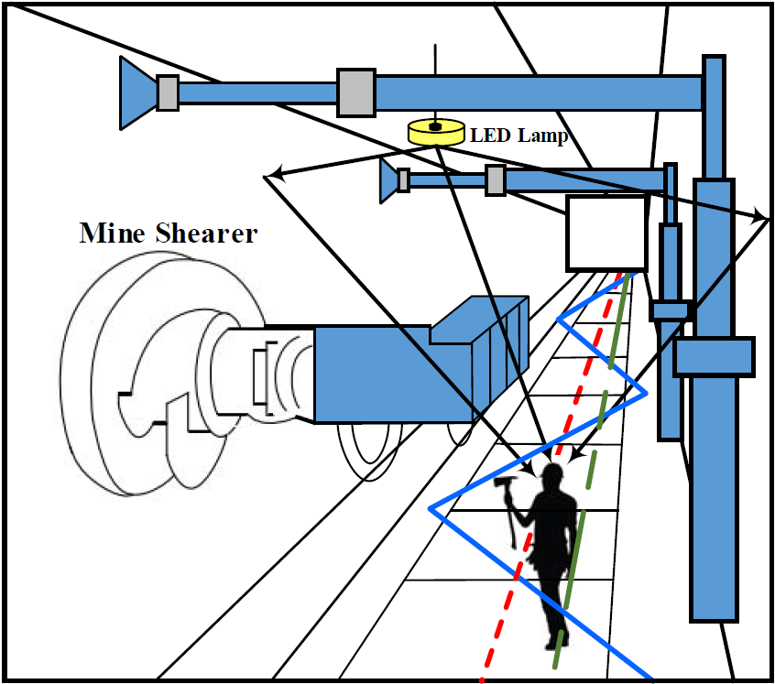
System Model
(a) Mining roadway
(b) Mine working face
Two separate scenario can be considered [2]
Mining Roadway
Mining Working Face

Slide 5
Topology
L=5M
W=2M
LED
Optical Signal
Lane
Miner’s Lamp
H=3~5M
D=1M

Slide 6
Proposed Set of Simulation Scenarios
 | Scenario Name | Topology | Management | Channel Model | Traffic profile [tentative]
1 | Underground (mining, subway, etc..) | E - Mining Roadway and Working Face e.g. ~2m x 5m x 3.7m (Mining Roadway) or ~2m x 5m x 4.7m (Working Face) size ~5s of STAs/AP, P2P pairs | Managed | Path Loss & Delay Spread [2] | Industrial
Parameter | Value
Environment description | 1 Mining Roadway and Mining Working Face Floors height : 3.7 m, 4.7 m Work cell size : 2 m x 5 m x 3.7 m
APs location | 1 per work cell, installed at ceiling of underground mining, with multiple transceivers facing different directions
STAs location | N per AP, located on the top of the work cell boundary
Channel Model | Path Loss and Delay Spread [2]

Slide 7
References
1. https://mentor.ieee.org/802.11/dcn/18/11-18-1422-00-TGbb-simulation
-scenarios.ppt
J. Wang, A. Al-Kinani, J. Sun, W. Zhang and C. Wang, “A Path Loss Channel
Model for Visible Light Communications in Underground Mines”, in Proc.
ICCC ‘17, 2017.
3. J. Wang, A. Al-Kinani, W. Zhang, and C.-X. Wang, “A new VLC channel
model for underground mining environments,” in Proc. IEEE IWCMC’17,
Valencia, Spain, June 2017.
4. G. Wu and J. Zhang, “Demonstration of a visible light communication
system for underground mining applications,” in Proc. IECT’16, Shanghai,
China, pp. 1–7, June 2016.
5. S. Yarkan, S. Guzelgoz, H. Arslan, and R. R. Murphy, “Underground
mine communications: A survey,” IEEE Commun. Surveys Tuts., vol. 11,
no. 3, pp. 125–142, 2009, 3rd Quarter.

