Slide 1
Possible Enhancement for Broadcast Services over WLAN
Date: 2018-09-14
Authors:

Slide 2
Abstract
This submission discusses usage scenario and possible enhancement for the broadcast services over WLAN.

Slide 3
Benefits of broadcast service over WLAN
Broadcast is an efficient way of providing information to many users simultaneously.
Broadcast could extend use cases and market of WLAN.
However,
Current usage of broadcast mechanism over the WLAN:
Transmission of some kinds of management frames such as Beacon and Probe Request.
Upper layer protocol setup such as ARP and DHCP.

Slide 4
Current Proposed Enhancements
Broadcast Services for unassociated STAs
AP is not required to manage information of STAs which enables huge number of STAs to received the broadcasted information.
→ A new way of using WLAN as a broadcast medium.
Authentication of information source
Security consideration.

Slide 5
Some Use Cases (1)
Distribution of information to:
User Devices; Smartphone, tablet
Display and/or Digital Signage
SALE!
SALE!
SALE!
SALE!

Slide 6
Some Use Cases (2)
Multi-lingual services:
Venue Information
Museum Guide
Translation in a conference

Slide 7
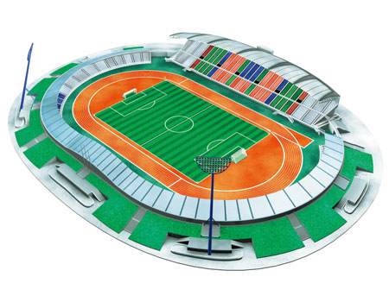
Availability of Broadcast Service
Due to the limitation of the transmit power and due to the limitation of association per AP, we need to install many APs to cover large area such as stadium and airport.
Efficiency may be degraded if all APs send the same copy of broadcast data.

Slide 8
BCS receiving STA
STA can be
Static or Moving
It may receive multiple copies of the same data frame transmitted by different APs.
AP
AP
AP
A STA could improve QoS / Reliability by utilizing those signals

Slide 9
Expectations for BCS over WLAN
BCS over WLAN should be efficient and reliable.
We want balanced solution between efficiency and reliaibility.
In our deployment scenario, i.e. the service area consists of multiple APs;
QoS/Reliability can be improved if broadcast data from different APs can be utilized.
There will be some ways to do that.

Slide 10
Summary
Some enhancements over the current spec are proposed for enhanced broadcast services over WLAN.
Additional consideration to improve QoS/reliability of broadcast data will be scope of this group.

Slide 11
References
[1] A PAR Proposal for Enhanced Broadcast Service (EBS), 11-18-0825-06
[2] A CSD Proposal for Enhanced Broadcast Services (EBS), 11-18-0826-06
[3] Some Use Cases for Broadcast Services over WLAN, 11-18-0561-00
[4] Use Cases of BCS, 11-18-0383-00
[5] Security Consideration for BCS, 11-18-0384-00
[6] Broadcast Use Cases from Event Producers, 11-18-1437-00

