Slide 1
HARQ for EHT
Date: 2018-9-3
Authors:

Slide 2
Background
Hybrid Automatic Repeat Request (HARQ) is a mechanism widely used in wireless/cellular technologies to improve link quality
In this presentation, we describe the existing retransmission operation in 802.11a/g/n/ac/ax
We then discuss HARQ operation, its main benefits, respective complexity and the applicability to the EHT standard
  Our aim is to integrate HARQ into 802.11 while making as few changes to the existing protocols as possible

Slide 3
Retransmissions in 802.11
The following protocol is used in 802.11a/g/n/ac/ax:
  The transmitter sends an (A-)MPDU
  Each MPDU contains a checksum which the receiver can use to verify it was decoded without errors
  The receiver responds with an ACK/Block-ACK, indicating which MPDU was decoded correctly
  Incorrectly decoded MPDUs are retransmitted; these can be aggregated with new MPDUs

Slide 4
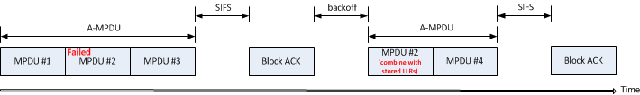
HARQ
HARQ is a mechanism in which soft-bits (LLRs) respective to past and current transmissions are combined in order to increase the probability of correct decoding
  Similar to MRC, yields combining and potentially diversity gain
The receiver stores LLRs of incorrectly decoded transmissions, indicates to the transmitter which transmissions failed, and the transmitter responds by retransmission

Slide 5
HARQ - Benefits
There are several benefits associated with HARQ:
  Improved link performance due to combining several retransmissions
  Link range extension (improved coverage), particularly at the low SNR region
  Offers effectively an extended set of MCSs, with finer granularity, thus making link adaptation (a weak point in 802.11) more robust and efficient → higher dataput
  Performance gain across the board, in every scenario/configuration (irrespective of BW, MIMO mode, etc.)

Slide 6
HARQ - Benefits
In the following figure, we compare between MCS 1 and MCS 2 with 1500B payload over a 242-tone RU and assuming SISO, in TGn-D NLOS, for two cases:
  Without HARQ: single
  transmission (no combining)
  With HARQ: combining two
  transmissions
HARQ yields a significant
benefit of ~4dB – as expected
The channel between the 1st
Tx and Re-Tx is highly correlated

Slide 7
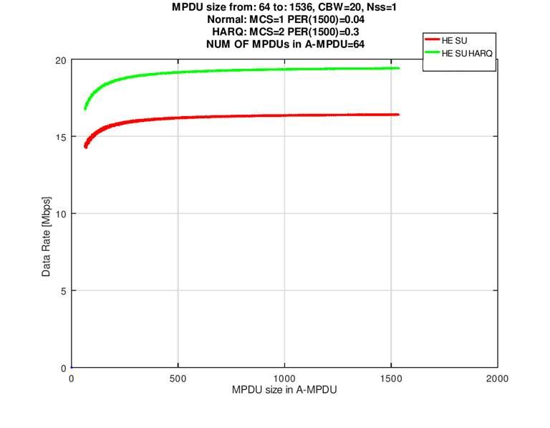
HARQ - Benefits
Based on the figure in the previous slide, we compute the data rate respective to the following two cases (SNR is 10dB):
  MCS 1, w/o HARQ, operating @PER=4%
  MCS 2, with HARQ, operating @PER=30%
The figure on the right shows
the data rate as a function of the
MPDU size within the A-MPDU
(containing 64 MPDUs)
As seen, HARQ yields
~20% throughput gain
irrespective of the MPDU size

Slide 8
HARQ - Benefits
We want to look at the impact of HARQ over the entire range of practical SNR values
We begin by looking at
the achievable throughput
where the best MCS
is chosen at each SNR,
without HARQ
Results are shown on the
right; we assume a SISO
configuration over a
TGn-D NLOS channel

Slide 9
HARQ - Benefits
The throughput for the same configuration is computed when HARQ is used, where the computation takes into account all durations (including backoff, preamble+payload, SIFS, Block-ACK, retransmission)
As shown, HARQ yields
benefits across the entire
SNR range
The HARQ throughput
result is much ‘smoother’
which effectively means
finer MCS granularity
10-30%
throughput
improvement
Improved
throughput
and coverage
~10%
throughput
improvement

Slide 10
HARQ - Benefits
Furthermore, we may try to incorporate slightly more advanced HARQ schemes, such as Incremental Redundancy (IR), to yield even better results
In the figure on the right,
we added the throughput
respective to IR HARQ
As shown, there is a
significant throughput
enhancement, especially
in the high SNR regime

Slide 11
HARQ – Complexity Aspects
In order to combine previous and current LLRs, the receiver must store these LLRs in memory
The more memory is allocated for HARQ, the higher the number of incorrectly decoded MPDUs that can be stored and combined with future retransmissions
This, however, increases the area & cost, so we want to analyze how much memory is really required

Slide 12
HARQ – Complexity Aspects
Let’s see how many LDPC codewords fail within a failed MPDU
We assume a 1500-Byte MPDU, transmitted at rate ½ which means 13 LDPC codewords, each 1944 bits; the data is
transmitted over a TGn-D
NLOS channel
The figure on the right shows the
distribution of number of failed
codewords
The average number of failed codewords
is ~6 for 10/20/30% PER
This means that ~6 out of 13 LDPC
codewords have to be stored, on average – half!
  It also means the receiver doesn’t need to process all LDPC codewords for failed MPDUs, reducing processing time and improving probability of correct decoding.

Slide 13
HARQ – Complexity Aspects
Let’s analyze how much memory is required for typical HARQ operation in 802.11
Consider the following assumptions:
  A-MPDU contains 16 MPDUs, each of size 1500B
  Each MPDU contains 13 LDPC codewords of size 1944 bits (coding rate = 1/2)
  1 Byte per LLR
  Operating at 30% PER
At every transmission, 0.3*16~=5 MPDUs fail, which means LLRs for 5*6=30 LDPC codewords have to be stored
This means 30*1944=58KB are required to store the LLRs of 5 MPDUs
No additional memories required at transmitter side
Considering density of existing memories, this is not a major issue

Slide 14
HARQ in EHT
HARQ is a well known method, used in other technologies (e.g. LTE in licensed and unlicensed bands), where it yields performance improvements
HARQ can significantly improve the performance of 802.11, as shown in the previous slides
The additional design complexity and HARQ related memory size are not significant
Since link adaptation is a (relatively) weak point of 802.11, incorporating HARQ will enable a decrease in the fade margin and operation at higher MCS values

Slide 15
Summary
HARQ is a proven technology, used in other wireless standards – also in the unlicensed bands (which are used for 802.11)
HARQ can be used in any scenario/configuration – regardless of the number of Tx or Rx antennas, MIMO mode, BW etc.
The performance improvements associated with HARQ can be used to significantly enhance the link adaptation mechanism in 802.11
We think that HARQ should be incorporated into the 802.11 protocol and become a part of the upcoming EHT standard

