Slide 1
Additional Details About Interoperable NGV PHY Improvements
Date: 2018-09-10
Authors:

Slide 2
Abstract
This submission provides additional technical details and new simulation results for the adaptive message retransmission technique for interoperable NGV PHY improvements initially described in submission 11-18/1186, which was presented in July 2018.

Slide 3
Background
Thousands of cars equipped with IEEE 802.11p are already on the road, and several major auto manufacturers have announced massive 802.11p roll-outs [including Toyota, VW, and GM]
Improvements to IEEE 802.11p by NGV need to take into account the large number of 802.11p systems that will be in service by the time NGV is adopted and deployed
In the 5.9GHz band, NGV needs to be fully interoperable with “legacy 802.11p”
We cannot segment the safety critical V2X applications between “legacy” and “NGV users” – Millions of lives are at stake
Therefore, it is highly desirable to identify and adopt techniques which improve PHY performance while retaining full interoperability with the IEEE 802.11p PHY

Slide 4
Introduction
In July, NXP presented document 11-18/1186, which proposed a series of fully-interoperable PHY improvements, addressing topics such as spectrum emission mask, receiver sensitivity, channel model, Doppler, and, most importantly, better link reliability and/or range through reduction of packet error rate.
The proposals are fully interoperable, and the technique for link reliability improvement provides benefits to 802.11p stations as well as NGV stations
These improvements can be classified into the following categories:
Transmitter RF improvements
Receiver performance improvements
Waveform design improvements

Slide 5
Transmitter RF Improvements
Adopt a tighter Spectrum Emission Mask (SEM) to reduce transmitter out-of-channel emissions for better Multiple Channel Operation (MCO)
Full interoperability with IEEE 802.11p
The underlying waveform is not modified
Vehicles can exchange messages even if one is using the NGV SEM and the other is using the 802.11p SEM – at worst the performance is equal to existing 802.11p
Less interference between adjacent channels → better SINR → increased range & increased safety
The standard should control usage of adjacent service channels so that they never reduce performance of the safety channel
The more cars with a safer SEM, the safer the MCO

Slide 6
Receiver Performance Improvements
Define receiver improvements which provide better performance on the roads, not just in the lab!
Receiver improvements are fully backward-compatible
Minimum sensitivity in static channels should be increased by about 6dB
NGV should add various multipath fading sensitivity requirements for reliable mobility support (with Doppler values aligned with use cases up to 500 km/h)
We propose the use of ITS-G5 V2V channel model for PHY feature acceptance criteria
We propose the use of Doppler spectrum offset of 2731 Hz (500 km/h)

Slide 7
Waveform Design Improvements
The new technique we are proposing is adaptive repetition of messages
Depending on channel load, the same PPDU is retransmitted zero, one, two, or three times
To avoid creating congestion, as channel load, determined by the Channel Busy Ratio measurement, increases, the number of retransmissions is reduced
This technique is fully interoperable – the individual PPDUs are standard 802.11p transmissions
This technique reduces packet error rate for communication from NGV stations to 802.11p stations, not just for communication between NGV stations

Slide 8
Benefits from Adaptive Repetition of Messages
802.11p stations see each retransmission as a standalone message
Performance is improved (1 to 2 dB) due to temporal diversity
Duplicated messages will be naturally filtered by application
Filtering of duplicate messages is already performed by higher protocol layers – no software update needed
The initial PPDU and retransmissions can be combined by NGV stations
Combining at LLR levels is the recommended technique, but other are possible
+4 dB performance boost for 1 retransmission
+7 dB performance boost for 3 retransmissions

Slide 9
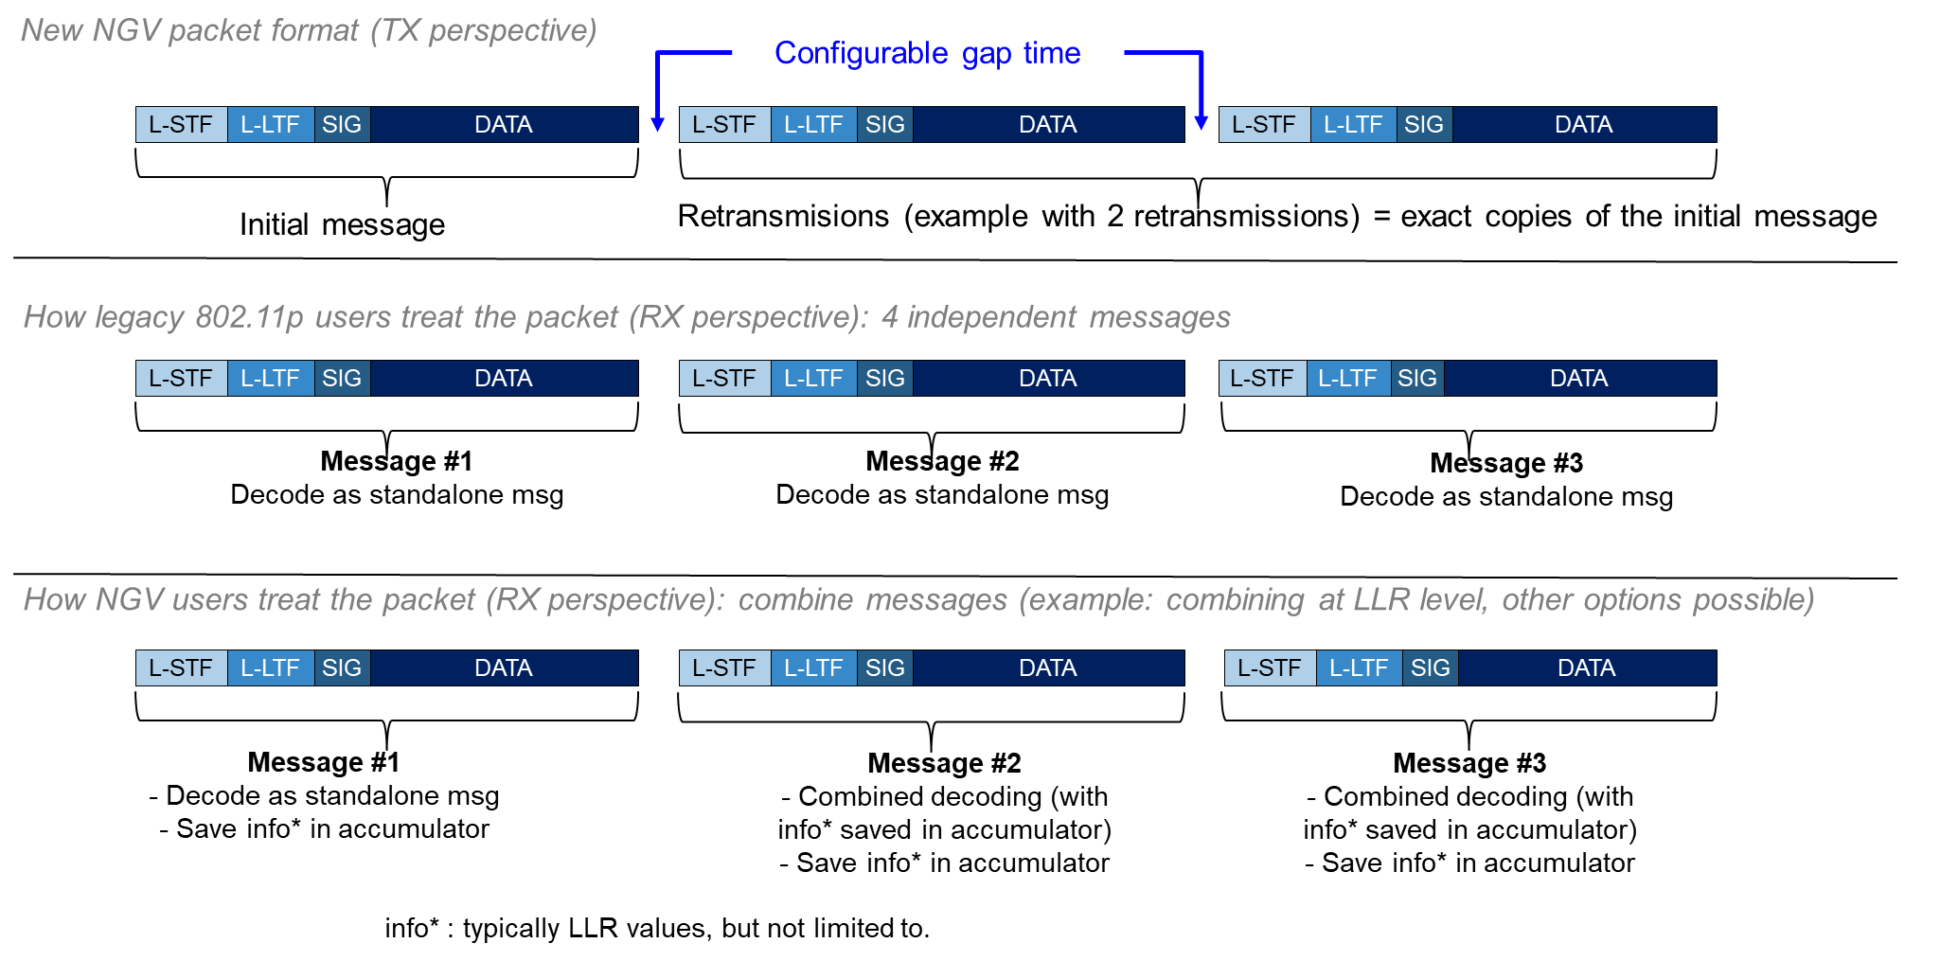
Example with Two Repetitions

Slide 10
Time Gap Between Repeated PPDUs
There are several alternatives for the time gap between repeated PPDUs:
The recommended approach sends the repetitions as a burst, separated by SIFS
SIFS is the minimum gap that maintains interoperability with 802.11p stations
Each PPDU burst looks like a single transmission to CCA at other stations within range
Another approach is to schedule each repetition as a separate transmission
Normal channel access under EDCA is used between each retransmission
To bound receiver memory requirements, a time limit needs to be defined, after which the receiver is not required to retain information from older PPDUs

Slide 11
Simulation Results Summary
Simulations with 1 retransmission indicate 0.5-0.8 dB improvement for 802.11p stations and 3-4 dB improvement for NGV stations
Simulations with 3 retransmissions indicate 1.0-1.7 dB improvement for 802.11p stations and 6-8 dB improvement for NGV stations
NXP is working on further simulations and is open to compare results with others
 |  | improvement for 802.11p stations | improvement for NGV stations
AWGN | 1 retransmission | 0.5 dB | 3.0 dB
 | 2 retransmissions | 0.7 dB | 4.7 dB
 | 3 retransmissions | 0.8 dB | 6.0 dB
G5-HighwayNLOS 886 Hz Doppler | 1 retransmission | 0.8 dB | 4.3 dB
 | 2 retransmissions | 1.4 dB | 6.7 dB
 | 3 retransmissions | 1.7 dB | 8.1 dB

Slide 12
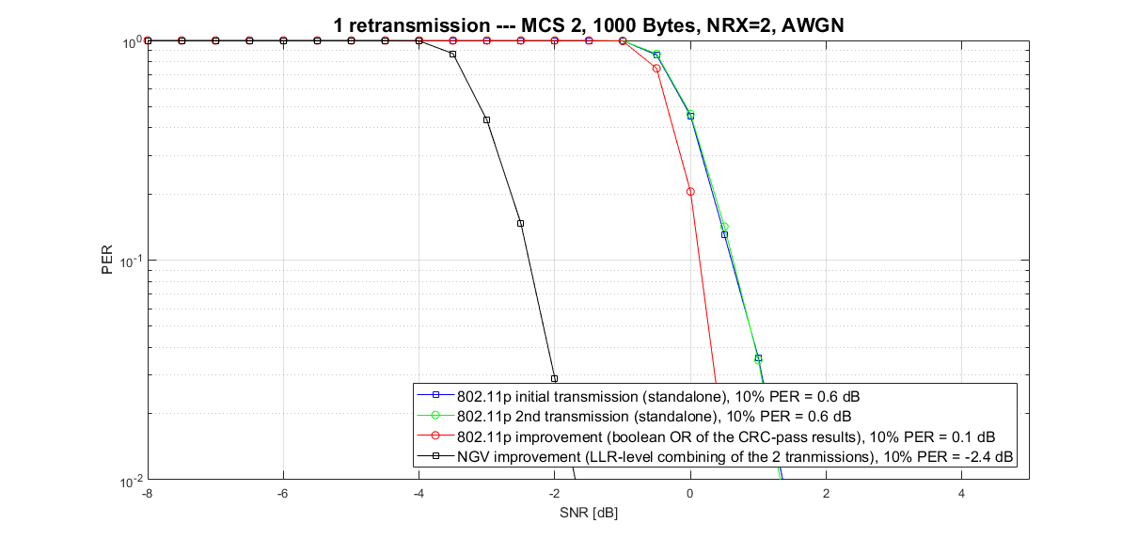
Simulation Results, Example (a)
-3.0 dB
-0.5 dB
NGV
802.11p with improvement
Current 802.11p

Slide 13
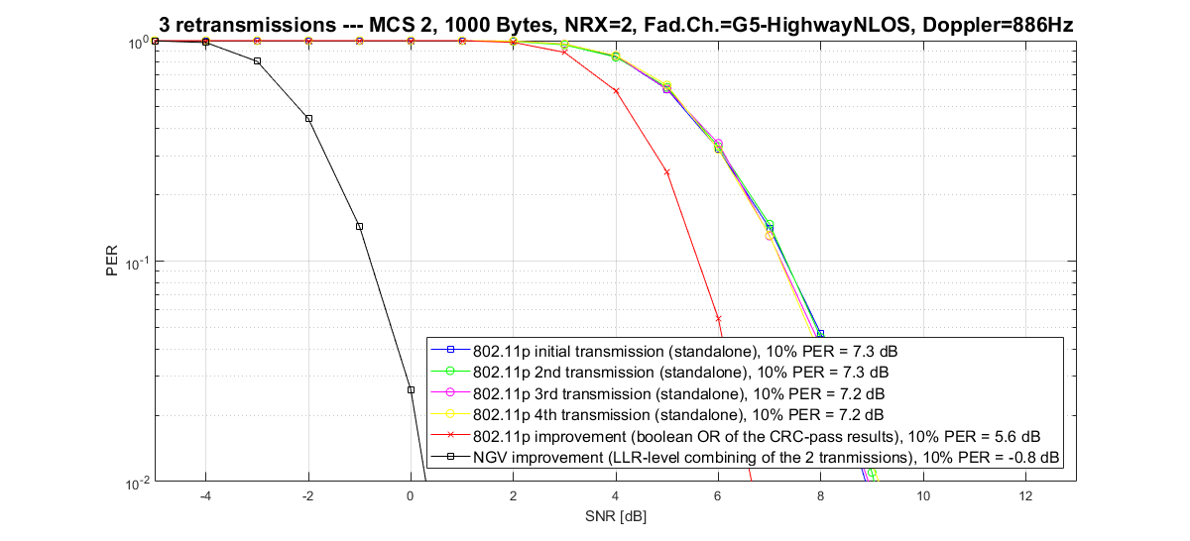
Simulation Results, Example (b)

Slide 14
Combining of Repeated PPDUs
For NGV stations, the substantial performance improvement comes from the combining of the multiple transmission of a message into a combined decoding
This allows the receiving station to fully leverage white-noise reduction and fading channel temporal diversity
The combining of different transmissions can be performed at different stages of the NGV receiver PHY
This includes, but not limited to, joint equalization or LLR generation
LLR-level combining is what is typically used in HARQ implementation for 3GPP LTE

Slide 15
Adaptive Retransmission Control
We propose adaptive control of the number of retransmissions (from 0 to 3) based on the measured congestion of the channel, using the Channel Busy Ratio (CBR, as described in ETSI TR 101 613)
Measured CBR | Number of retransmissions | Traffic increase (vs 802.11p) | Comment
≥ 0.6 | 0 | No increase in traffic | Congested environment situation. Retransmissions are disabled
[0.3 – 0.6[ | 0 or 1 (*) | x1 to x2 | The number of retransmissions is gradually increased as the occupancy of the channel goes down.
[0.2 – 0.3[ | 1 | x2
[0.15 – 0.2[ | 2 | x3
< 0.15 | 3 | x4
(*) Number of retransmissions = 0 or 1
Retransmission = random value with probability of retransmission = p = (0.6-CBR)/0.3
For example, CBR=0.30 ➔ p = (0.60-0.30)/0.3 = 0.3/0.3 = 1
For example, CBR=0.15 ➔ p = (0.60-0.45)/0.3 = 0.15/0.3 = 0.5
For example, CBR=0.60 ➔ p = (0.60-0.60)/0.3 = 0/0.3 = 0

Slide 16
Benefits
These techniques improve performance while maintaining interoperability, coexistence, backward compatibility, and fairness with 802.11p equipment
These techniques provide substantial improvements for communication between NGV stations, while also providing some improvement for communication to and from 802.11p stations that do not implement NGV
These techniques do not increase channel load in congested environments
These techniques do not require changing higher layers of the ITS protocol stack

