Slide 1
Considerations on AP Coordination
Date: 2018-09-08
Authors:
Name | Affiliations | Address | email
Bo (Boyce) Yang | Huawei | Nanjing, China | yangbo59@huawei.com
Roger Marks |  | Denver, USA | roger@ethair.net
Yunping (Lily) Lyu |  | Nanjing, China | lvyunping@huawei.com
Yuchen (Jason) Guo |  | Shenzhen, China | guoyuchen@huawei.com

Slide 2
Introduction
AP coordination has been suggested in several EHT TIG contributions ([1]-[5]) with the goals of improving throughput in typical scenarios.
AP coordination would be a major feature differentiating EHT from 802.11ax.
AP coordination comes in many possible forms. In general, the technologies can be classified into two types:
  MAC coordination
  PHY coordination

Slide 3
MAC Coordination
MAC-level control information exchange
  APs exchange MAC-level control information
Frame-level time synchronization
  Frame synchronization, can be achieved by coordinating trigger frames without additional hardware.
  Tolerance of ~0.8 µsec or better may be required in some scenarios
  Candidate approaches
    transmission coordination
    Non-Coherent Joint Transmission
    handover coordination
    interference nulling

Slide 4
Transmission Coordination
avoid inter-BSS interference and collisions
enhances spatial reuse for distant APs
AP 1
AP 2
AP 3
BSS 1
BSS 2
BSS 3
BSS ID
BSS 1 downlink
BSS 3 downlink
BSS 1 uplink
BSS 3 uplink
BSS 2 downlink
BSS 2 uplink
time slot

Slide 5
Non-Coherent Joint Transmission
AP1 and AP2 can transmit the same data frame, without precoding, to edge user to improve the signal quality
Data sharing
AP2 transmits the same data frame to STA1 at the same time
AP1 shares STA1’s data frame to AP2 beforehand
AP 1
AP 2
STA 1

Slide 6
Handover Coordination
Coordination between home AP and target AP can speed handover
Improves performance in, for example, warehouse and office scenarios
Example exchange:
  Home AP and target AP exchange signal strength information
  Target AP sends handover information to home AP
  Home AP sends Target AP handover information to STA
  STA uses Target AP handover information for speedy association
AP 1
AP 2
STA 1
moving towards AP 2

Slide 7
Interference Nulling
AP gathers CSI information from unassociated clients and then pre-codes to null signal there.
Downlink throughput can be improved significantly in typical scenarios.
PHY technique, but does not necessarily require PHY information exchange between APs .
CSI from AP 1 to STA 2 is need to null interference for STA 2
AP 1
AP 2
CSI from AP 2 to STA 1 is need to null interference for STA 1
mutual nulling
STA 1
STA 2

Slide 8
PHY Coordination
APs share data as well as control information.
  Joint precoding (spatial mapping) codes data for every stream in the joint transmission.
  Channel information exchange may be required, depending on precoding type,
  Data could be shared by wired or wireless link.
Strict synchronization requirement
  Transmission time must be precisely synchronized (may require nanosecond-level time synchronization).
  Carrier frequency offset and Sampling Frequency Offset must be compensated precisely.
  Phase synchronization is also needed for joint channel estimation and joint transmission.
  Candidate technology
    Distributed MIMO

Slide 9
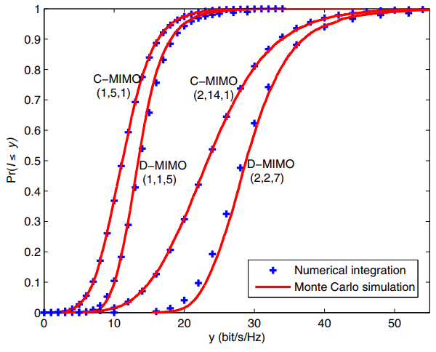
Distributed MIMO
Distributed MIMO (D-MIMO) coordinates a variable number of transmitters to improve throughput in typical scenarios.
  flexible number of spatial streams; for example, from 1 to 16
higher spectral efficiency than collocated MIMO (C-MIMO)
D-MIMO could be a signature differentiated feature in EHT, as is MU-MIMO in VHT and OFDMA in HE
Figure 2 [6]
Figure 1
Note: the 3-tuple (M, L, N) means
( number of sta, number of antennas per AP, number of AP )

Slide 10
Distributed MIMO requirements
Distributed MIMO requires time, frequency and phase synchronization
  Distributed transmitters need to transmit their signal simultaneously while maintaining CSMA compliance.
    A possible approach is to specify a Joint Transmission Trigger frame used to trigger simultaneous transmission from distributed APs and sent after one transmitter obtains a channel access opportunity.
  Carrier and sampling frequency of distributed transmitters must be synchronized accurately to avoid OFDM inter-symbol interference
    Carrier frequency offset can be measured when receiving the Joint Transmission Trigger frame, then the CFO can be compensated in the baseband.
    Distributed transmitters can also synchronize their reference clock over the backhaul to synchronize the RF.
  Phase synchronization is also needed as residual frequency error can lead to large phase drift in a long time interval.

Slide 11
Summary
We propose an overview of AP coordination candidate technologies
  MAC coordination is easier to achieve
  PHY coordination provides more opportunities to enhance performance.

Slide 12
References
[1] “Distributed MU-MIMO and HARQ Support for EHT” (802.11-18-1116-00-0eht)
[2] “Multi-AP Enhancement and Multi-Band Operations” (802.11-18-1155-01-0eht)
[3] “EHT Technology Candidate Discussions” (802.11-18-1161-00-0eht)
[4] “Discussion on EHT Study Group Formation” (802.11-18-1180-00-0eht)
[5] “Extremely High Throughput (EHT) 802.11 – Study Group Creation” (802.11-18-1271-00-0eht)
[6] “Spectral efficiency of distributed MIMO systems”[J]. IEEE Journal on Selected Areas in Communications, 2013, 31(10): 2112-2127.

Slide 13
Straw poll 1
Do your anticipate AP coordination as a key feature in a project arising from the EHT Study Group?
  Yes
  No
  Abstain

Slide 14
Straw poll 2
Which forms of AP coordination would you like to see in developed in an project arising from the EHT Study Group?
  Transmission Coordination
  Non-Coherent Joint Transmission
  Handover Coordination
  Interference Nulling
  Distributed MIMO

Slide 15
Appendix:
Distributed MIMO Architecture

Slide 16
Distributed MIMO Architecture
A single architectural AP, divided internally into a central AP-C and remote AP-Rs.
Connectivity could be by Ethernet.
AP-Rs are tightly synchronized and coordinated.
One coordinated MU-MIMO beamforming system.
No handover.

Slide 17
Distributed MIMO Architecture: variations
Variations of the distributed MIMO architecture, from one extreme to another:
  Type 1: AP-R is simply antenna plus amplifier, connected with RF cable.
  Type 2: AP-R contains lower PHY and analog RF. AP-C contains MAC layer functions and upper PHY. Various splits between upper and lower PHY are possible.
  Type 3: AP-C is a TSN-based Ethernet switch. AP-R is a full AP with D-MIMO capabilities.
Type 1
Type 2
Type 3

