Slide 1
Further study on potential EHT features
Date: 2018-09-12
Authors:

Slide 2
Abstract
We have discussed a number of candidate features in [1,2].
In this contribution, we share some further study and preliminary results on the following features:
  16 spatial stream throughput gain and sounding feedback overhead reduction
  Logic RU/distributed logic RU
  Multi AP coordination

Slide 3
16 Spatial Stream support
MU-MIMO
  16 antenna AP vs 8 antenna AP
  10 STAs each STA has 2 antenna
  16 antennas AP almost double the
  throughput of 8 antenna AP
16ss support is a promising
feature to significantly increase
peak throughput
Sounding feedback overhead is
the challenging problem.

Slide 4
Sounding feedback overhead
Supporting 320MHz BW and 16 spatial streams will lead to very large sounding feedback overhead.
  In particular, we are interested in overhead reduction for 16x1 and 16x2 cases.
  80MHz 16x1 feedback using MCS0 UL 20MHz HE PPDU requires 4.4ms air time
Size of V (Nr x Nc) | Number of angles (Na) | Number of feedback bits (80MHz, CB Info. = 1, Ng=4) | Number of feedback bits (80MHz, CB Info. = 0, Ng=16) | Number of feedback bits for (320MHz, CB Info. = 1, Ng=4) | Number of feedback bits for (320MHz, CB Info. = 0, Ng=16)
2x1 | 2 | 2,508 | 392 | 10,008 | 1,544
8X1 | 14 | 17,508 | 2,696 | 70,008 | 10,760
8x2 | 26 | 32,516 | 5,008 | 130,016 | 19,984
8x8 | 56 | 70,064 | 10,816 | 280,064 | 43,072
16x1 | 30 | 37,508 | 5,768 | 150,008 | 23,048
16x2 | 58 | 72,516 | 11,152 | 290,016 | 44,560
16x8 | 184 | 230,064 | 35,392 | 920,064 | 141,376
16x16 | 240 | 300,128 | 46,208 | 1,200,128 | 184,448

Slide 5

Sounding feedback overhead reduction
We encourage the group to working on solutions for this problem.
One possible way to save feedback overhead is to reduce the feedback dimension for feedback subcarriers.
  Potential method: Hybrid beamforming – Wideband/sub band beamforming feedback combined with subcarrier beamforming feedback with reduced dimension
    Wideband/sub band beamforming matrix could has dimension N_{TX} × K where N_{TX} is Number of transmit antennas and K is design parameter for dimension reduction. This is to project the space of channel H to its K dimensional principal subspace.
    Subcarrier beamforming feedback will have reduced dimension N_{RX} × K
Feedback Wideband beamforming matrix $V_{WB}$ of N_{TX} × K
For each sub carrier/group of subcarriers,
feedback beamforming matrix $V_{sc}$ of N_{RX} × K

Slide 6
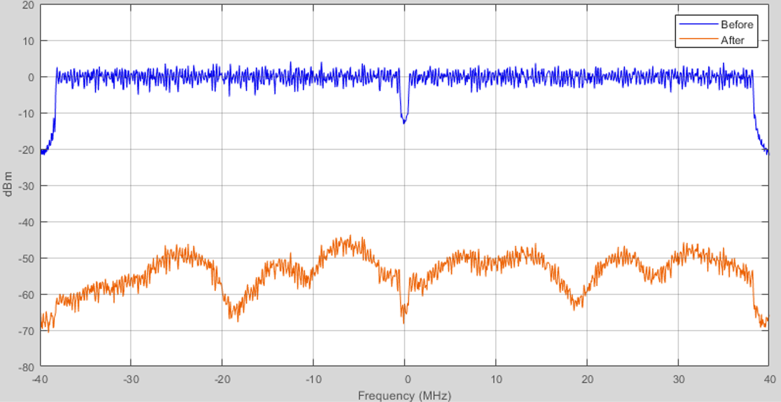
Distributed logic RU
WLAN frequency selective channel
  Coherence BW:
    Channel B: RMS delay spread 15ns,
    Coherence BW ~ 13.3MHz
    Channel D: RMS delay spread 50ns,
    Coherence BW ~ 4MHz
  For small RUs (RU106/52), performance
  highly rely on good scheduling based on accurate channel state information(CSI).
    Scheduling algorithm optimized based on CSI could be complicate.
    CSI could be outdated. Sounding may not be very often.
    Sounding is not likely to happen before sending small packets.
    Random RU allocation or RU allocation optimized based on
    outdated CSI may lead to severe performance loss.
Distributed logic RU will benefit from diversity gain.
  Logic RU distributed over a wider bandwidth.
Combine 26 tone RU
1,3,5,7,9 as logic RU 1
Combine 26 tone RU
2,4,6,8 as logic RU 2

Slide 7
Preliminary results
Distributed RU defined on wider operation BW will achieve larger diversity gain.
> 1.5dB gain for 1Tx 2Rx with low MCSs
  More beneficial in uplink transmission.
 | dB gain at 1% BLER | 1Tx 2Rx Channel D | 2Tx 2Rx Channel D | 4Tx 2Rx Channel D | 1Tx 2Rx Channel B | 2Tx 2Rx Channel B | 4Tx 2Rx Channel B
80MHz | MCS1, 106RU vs 4x26 | 2.3882 | 1.6114 | 0.5665 | 3.5547 | 2.195 | 0.6413
 | MCS3, 106RU vs 4x26 | 2.4029 | 1.7022 | 0.4928 | 3.5916 | 2.2707 | 0.7486
 | MCS6, 106RU vs 4x26 | 2.1091 | 1.5016 | 0.4425 | 2.8277 | 1.9353 | 0.7882
40MHz | MCS1, 52RU vs 2x26 | 1.8739 | 1.2613 | 0.2175 | 2.0726 | 1.3356 | 0.0499
 | MCS3, 52RU vs 2x26 | 1.9401 | 1.2741 | 0.1907 | 2.2512 | 1.43 | 0.0184
 | MCS6, 52RU vs 2x26 | 1.3051 | 1.0765 | 0.1774 | 1.1423 | 1.091 | 0.0066
20MHz | MCS1, 106RU vs 4x26 | 1.2202 | 0.7818 |  | 1.1517 | 0.5684
 | MCS3, 106RU vs 4x26 | 1.3089 | 0.8362 |  | 1.1366 | 0.6168
 | MCS6, 106RU vs 4x26 | 1.1645 | 0.8164 |  | 0.8428 | 0.4973
 | MCS1, 52RU vs 2x26 | 1.5679 | 1.0997 |  | 1.6626 | 0.792
 | MCS3, 52RU vs 2x26 | 1.6918 | 1.0741 |  | 1.7404 | 0.9463
 | MCS6, 52RU vs 2x26 | 1.1901 | 0.9327 |  | 0.874 | 0.7794

Slide 8
Multi AP coordination – Virtual BSS
There are many categories/levels of multi AP
coordination[3].
  A simple way of multi AP coordination will be
  optimal AP selection
  Also seamless roaming among APs is an
  important feature for multi AP coordination.
Virtual BSS concept
  A group of coordinated APs may form a
  virtual BSS
  In a virtual BSS, all member APs share
    SSID and maybe BSSID
    One time association/authentication for STAs
    roaming within the virtual BSS
    Each STA may have one or more anchor AP(s) in the
    virtual BSS. Anchor AP defines the routing of data path.
Virtual BSS
Master AP
Slave AP 1
Slave AP 2
Link quality
metric.
Example:
RSSI.
Link quality
metric.
Example:
RSSI.
STA

Slide 9
Seamless roaming in the virtual BSS
Sharing association/authentication in the virtual BSS will fasten the handover procedure between member APs.
STA driven anchor AP selection will make handover seamless
  STA has better knowledge on link quality to neighboring member APs.
  STA can select/update its anchor AP in the virtual BSS based on its own measurements.
  Member APs may also send some information in the beacon to assist STA on anchor AP selection.
  When STA decides to switch to a new anchor AP, it can directly send UL frame to the new anchor AP with 4 MAC address frame format.
  Master AP will update the routing to the STA when it received the UL frame forwarded by the new anchor AP.

Slide 10
Reference
[1] 11-18-0857-00-0wng-beyond-802-11ax-throughput-enhancement-utilizing-multi-bands-across-2-4-5-6ghz-bands
[2] 11-18-1184-01-0EHT-followup-discussions-throughput-enhancement
[3] 11-18-1509r0-Features for Multi-AP Coordination

