Slide 1
LC Frontend Models
Date: 2018-09-08
Authors:

Slide 2
Background
To support the channel modeling work of TG 11bb, this document proposes wideband LC Tx and Rx frontend models based on real measurements.

Slide 3
LC Tx frontend
LC Tx comprises sophisticated driver and LED/laser diode.
Tx DSP has single-ended or differential 50 Ω interface to the driver
Driver does impedance matching (50 Ω to few Ω at LED)
Aims at wide bandwidth through sophisticated circuit design
Bandwidth of high-power LEDs is limited by large area of active zone, radiative/non-radiative recombination effects play a minor role
Driver is custom-designed for each LED (e.g. infrared, visible)
Modulation and bias currents can be changed in the driver
Modulation current has an impact on the reach of the LC link
Tx DSP
driver

Slide 4
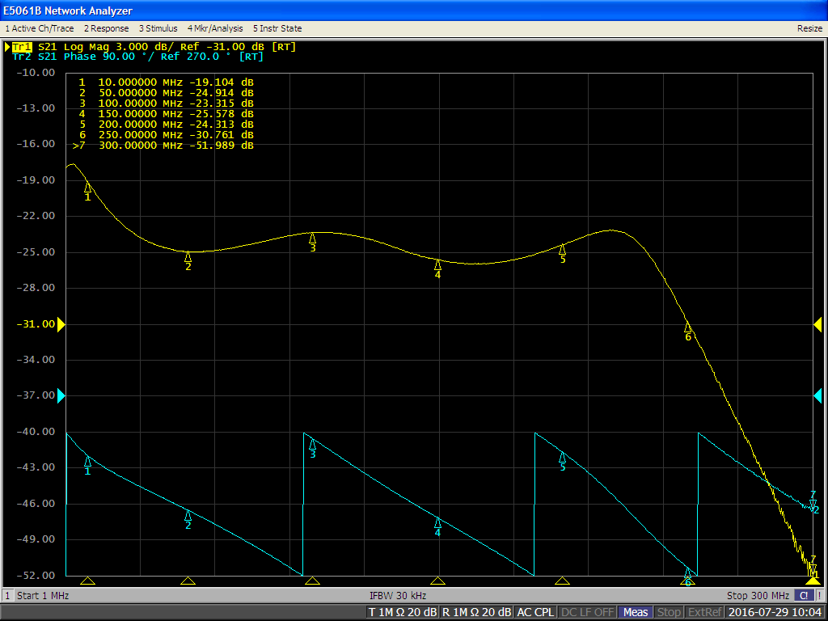
LC Tx frontend response
Measured with vector network analyzer from DC to 300 MHz using Rx with multiple GHz BW
LED: CREE XPE RED-L1-R2_N3
Amplitude and phase
Higher pass ~ 100 kHz
Some more gain up to 10 MHz
Almost flat response with little ripple until 240 MHz
Steep low-pass thereafter

Slide 5
Proposed LC Tx frontend model
VG
N^{th} order low-pass
1st order high-pass
e/o
VGA
+
bias
Variable gain [V/A] amplifier to set RMS modulation current [A]
N^{th} order low-pass with variable cut-off e.g. f_{g} = 20, 100, 200 MHz
May be matched to the highest Tx signal bandwidth
1st order high-pass f_{g} = 100 kHz → may cause baseline wander effects!
Added constant bias current [A]
e/o converter with infinite BW and conversion efficiency [W/A]
Any non-linear effects should be ignored for now, may be included later

Slide 6
Tx filter model generation
Steps (see MATLAB code on the right):
Generate Butterworth highpass IIR filter n = 4, f_{c} = 400 kHz, f_{bw} = 1 GHz
Generate Butterworth lowpass IIR filter n = 13, f_{c} = 237 MHz, f_{bw} = 1 GHz
Transform Butterworth filters to second-order sections form
Combine highpass and lowpass filters
Output:
sos: Second-order sections parameter matrix (see next slide)
g: Gain factor (see next slide)
H: Matlab filter object
f_bw = 1e9; % Reference bandwidth (Hz)
%% Highpass filter
n_hi = 4; % Filter order
% Highpass cut-off frequency (Hz)
f_c_hi = 4e5;
[z_hi, p_hi, k_hi] = ...
butter(n_hi, f_c_hi/f_bw, 'high');
[sos_hi, g_hi] = ...
zp2sos(z_hi, p_hi, k_hi);
%% Lowpass filter
n_lo = 13; % Filter order
% Lowpass cut-off frequency (Hz)
f_c_lo = 2.37e8;
[z_lo, p_lo, k_lo] = ...
butter(n_lo, f_c_lo/f_bw);
[sos_lo, g_lo] = ...
zp2sos(z_lo, p_lo, k_lo);
%% Combined bandpass filter
passband_gain = -23.17; % Passb. gain (dB)
sos = [sos_hi; sos_lo];
g = g_hi*g_lo*10^(passband_gain/20);
H = dfilt.df2sos(sos, g);

Slide 7
Filter parameters
Parameter matrix sos:
Gain factor g: 1,40529980810704e-08
Further information: https://de.mathworks.com/help/signal/ref/zp2sos.html
b₀ | b₁ | b₂ | 1 | a₁ | a₂
1 | -2 | 1 | 1 | -1,997679153411600 | 0,997680730716874
1 | -2 | 1 | 1 | -1,999037095803730 | 0,999038674181191
1 | 1 | 0 | 1 | -0,438344960151427 | 0,000000000000000
1 | 2 | 1 | 1 | -0,887102175721872 | 0,206305166337290
1 | 2 | 1 | 1 | -0,919219818954179 | 0,249979593051648
1 | 2 | 1 | 1 | -0,975816547084403 | 0,326941331405787
1 | 2 | 1 | 1 | -1,061972527809740 | 0,444098528743552
1 | 2 | 1 | 1 | -1,185825678654060 | 0,612517342065797
1 | 2 | 1 | 1 | -1,359712686983980 | 0,848973527438837

Slide 8
Graphical representation

Slide 9
LC Rx frontend
LC Rx comprises of PD + sophisticated transimpedance amplifier (TIA).
TIA enables impedance matching (~MΩ at PD to 50 Ω)
Bandwidth limitation of PDs comes from large area as well
TIA aims at wider bandwidth through sophisticated bootstrap design
Compensates the capacitance of large-area PD at the cost of more noise
Bootstrap TIA is custom-designed for a given PD
TIA has single-ended or differential 50 W interface to the Tx DSP
Bootstrap TIA
Rx DSP

Slide 10
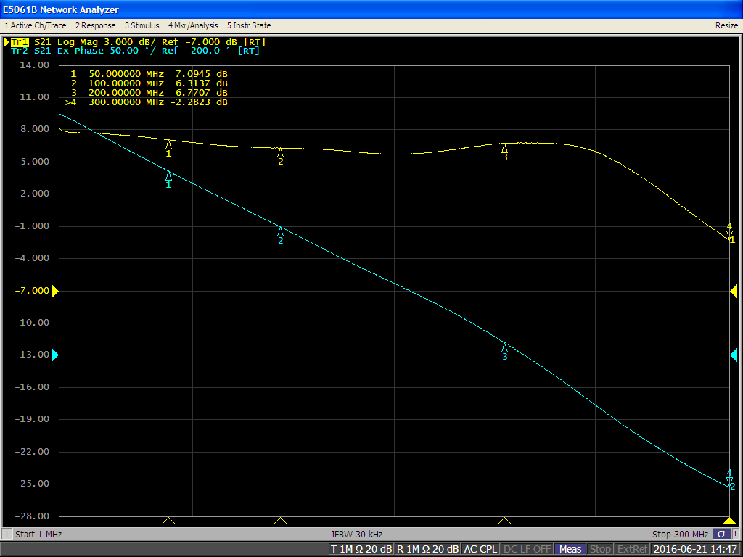
LC Rx frontend response
Measured with vector network analyzer from DC to 300 MHz using laser with several GHz BW
Amplitude and phase
Higher pass ~ 100 kHz blocks DC, modulated ambient light
Almost flat response with little ripple until 250 MHz
1st order low-pass thereafter

Slide 11
Proposed LC Tx frontend model
o/e
1st order high-pass
VG
1th order low-pass
+
AGC
noise
For now, ignore the shot noise, may be added later
o/e converter for PD with infinite BW and conversion efficiency [A/W]
1st order high-pass f_{g} = 100 kHz → block DC + low frequencies
Add random noise RMS [A] → SNR
AGC [V/A] to compensate overall attenuation in Tx/channel/Rx
1th order low-pass with variable cut-off e.g. f_{g} = 20, 100, 200 MHz
Matched to the required Rx signal bandwidth

Slide 12
Summary
Tx and Rx models are derived and proposed to TGbb based on measurements on real LC frontends, manufactured in our lab.
The models include major optical frontend effects which are relevant for the waveform design at the physical layer.
First simulations fitting to the measurements were presented for the Tx, to be added for the Rx

