Slide 1
Benefits of Multi-hop Communications in 802.11ay
Date: 2018-09-12
Authors:
Name | Affiliation | Address | Phone | Email
Morteza Hashemi | Sony | 1730 N. First Street, San Jose CA 95112 | +1-408-352-4055 | Morteza.Hashemi (at) sony (dot) com
Kazuyuki Sakoda | Sony |  |  | kazuyuki.sakoda(at)sony.com
Mohamed Abouelseoud | Sony |  |  | Mohamed.Abouelseoud (at) sony (dot) com

Slide 2
Agenda
Motivation and Highlight
Recap on Consumer Device Use Cases
Usage Model 3: AR/VR Headsets
Simulation Setup and Results
Observations
Usage Model 2: 8K UHD Wireless Transfer
Simulation Setup and Results
Observations
Conclusion

Slide 3
Motivation
802.11ay use case document [1] contains the list of use cases for next generation 60GHz communications, including consumer device use cases
High-throughput and low-latency are critical for consumer devices use cases
Challenges: (1) Human blockage; (2) Limited coverage
This contribution provides simulation results to demonstrate benefits of multi-hop communications for 802.11ay

Slide 4
Highlight: Multi-hop is beneficial
Enabling multi-hop capability in 802.11ay devices mitigates the effects of human blockage and provides an extended range of communications (beyond LOS)
Source
Sink
Relay device

Slide 5
Recap on Consumer Device Use Cases
UM3 and UM2 in [1] reflect typical usage and requirements for consumer applications
UM3: AR/VR headsets and
other high-end wearables
UM2: 8K UHD wireless transfer at Smart Home

Slide 6
Recap on Consumer Device Use Cases
Use case and requirement matrix is shown below
Use case | Application | Venue | Range | Bandwidth | Latency
VR headset | Video streaming | Indoor | 5-10m (~20m) | >Gbps | <5msec
UHD transfer | Video streaming | Indoor | 5-10m (~20m) | >Gbps | <5msec

Slide 7
Usage Model 3: AR/VR Headset
UM3: AR/VR headset
For now, game is the prominent application of VR
Game console and VR headset may be located in the same room
However, console and headset might not be in LOS or may suffer human blockage

Slide 8
Usage Model 3: AR/VR Headset
Requirements: High-throughput; low-latency
Challenge: Human blockers
Leveraging multi-hop capability to combat human blockage
Source
(Console)
Sink
(Headset)
Blockers
move

Slide 9
Simulation Setup
802.11ad SC PHY with performance shown in 11-10/431r3 “PHY Simulations and Methodology” [2], AWGN case
STA with Tx power of 18dBm
Human blockage:
Simulated as an additional path loss
Surface loss of 6dB; Inner loss of 25dB
Body dimensions: length: 0.5m; width: 0.5m; height: 1.8m
Channel access is based on CBAP, and TXSS is performed for each BHI
BI = 100ms; BHI = 5ms; DTI = 95ms
STA generates unidirectional traffic of 1.2Gbps
Buffer size of 8MB for STAs

Slide 10
Simulation Setup
Before accessing channel, STAs perform CCA using omni RX pattern (0dBi)
PD is set to -68dBm, where noise level equals to -70.6dBm (-174 dBm/Hz thermal noise; 1.76GHz BW; NF=10dB; 1dB additional loss)
Energy detection (ED) threshold is set to -48dBm
Given PHY performance model and PD level, link budget is restricted by PD level
MCS selection activated with ARF
Use RTS/CTS all the time, performing omni CCA before the beginning of TXOP
All the frames (RTS/CTS/Data/BACK) are transmitted with Beamforming
RX BF is operated after transmitting/receiving RTS frame
RTS/CTS frame are transmitted with MCS4
All the traffic are transmitted with AC=BE (EDCA)
1500 octet datagram, up to 64 A-MPDU, TXOP duration up to 300usec

Slide 11
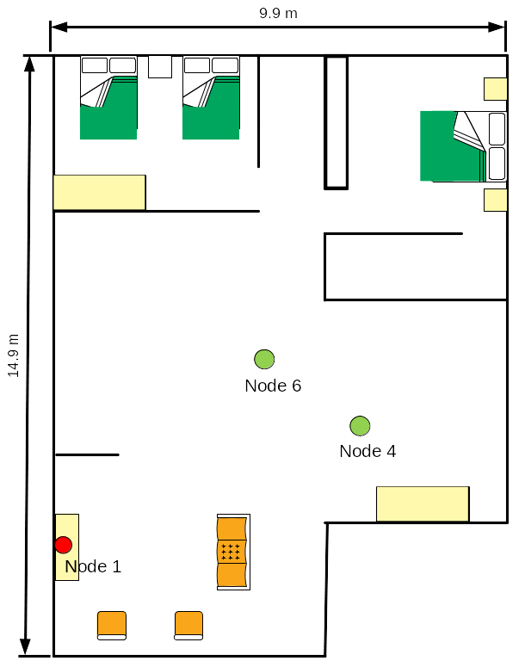
Simulation Scenario
1 Source (i.e., Node 1)
1 Sink (i.e., Node 6)
1 relay (i.e., Node 4)
Single human blocker
Blocker moves and blocks the link between Node 1 and Node 6 for 1 seconds.
Blocker

Slide 12
Propagation Model
We use ray-tracing with the following configurations:
Number of computed paths: 25
Number of reflections: 3
Number of diffraction: 1
Number of transmissions: 3

Slide 13
Simulation Scenario
Node 6
Case 1:
Single-hop communications only
Direct link from Node 1 to Node 6
Case 2:
Dynamic Multi-hop communications
Node 1 dynamically adjusts and chooses its next hop based on a link condition when the ongoing link is blocked
Blocker
Node 4
Node 1
Node 6
Blocker
Node 4
Node 1

Slide 14
Simulation Scenario
Key Performance Indicators:
Throughput = $\frac{RcvdBits}{SimulationTime}$
Delay: end-to-end delay from Node 1 to Node 6
Delay CDF: Cumulative distribution of delay
Durations:
Simulation: 4 seconds
1.2Gbps traffic generated at Node 1 from 1 to 3 second
Link between Node 6 and Node 1 is blocked from 2 and 3 second.

Slide 15
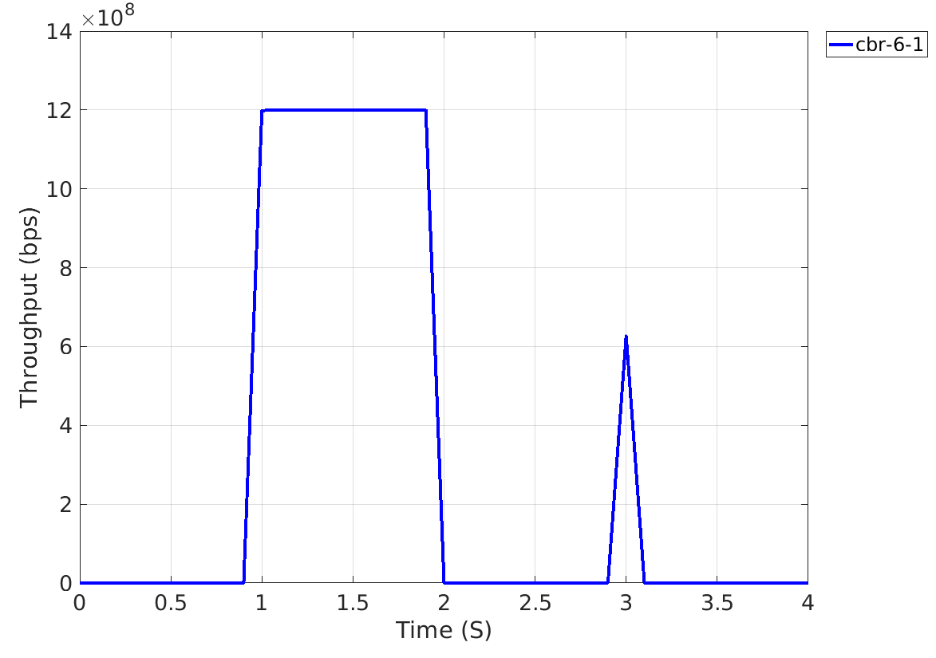
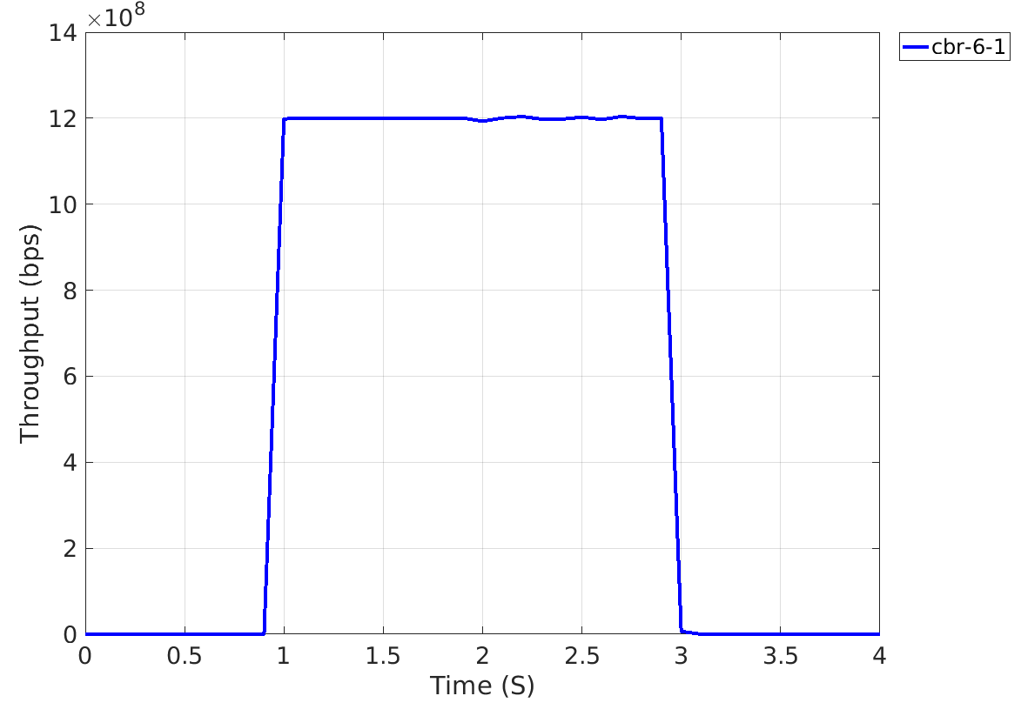
Simulation Results: Throughput
Case 1: Single-hop
Case 2: Dynamic Multi-hop
Multi-hop maintains
high-throughput performance
Blocked by human body

Slide 16
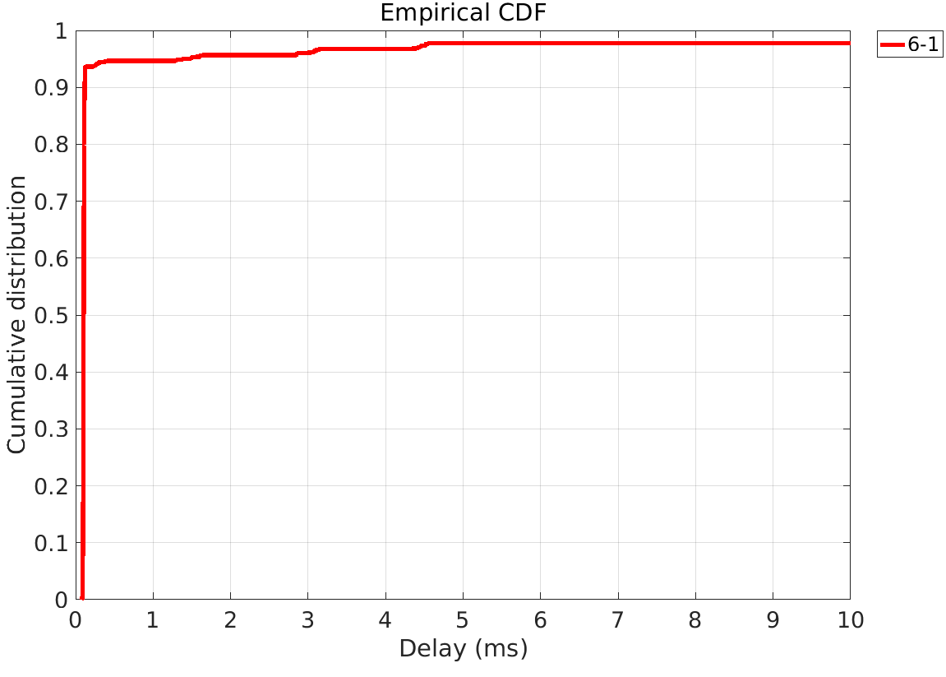
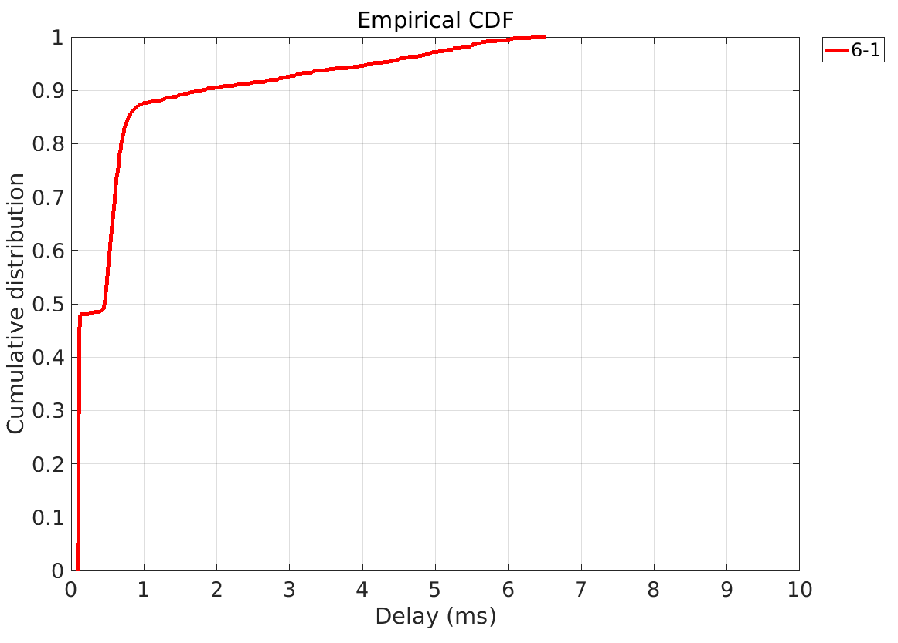
Simulation Results: Delay CDF
Case 1: Single-hop
Case 2: Dynamic Multi-hop
90th percentile ~ 2ms
98th percentile ~ 5ms

Slide 17
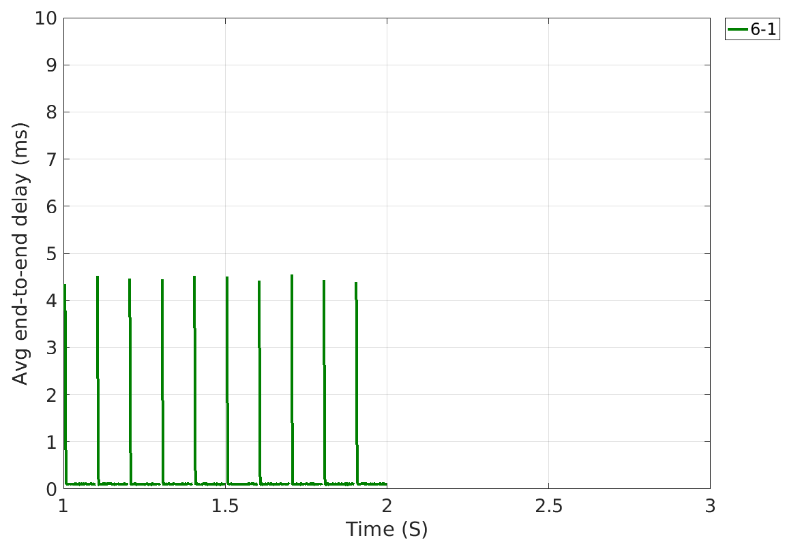
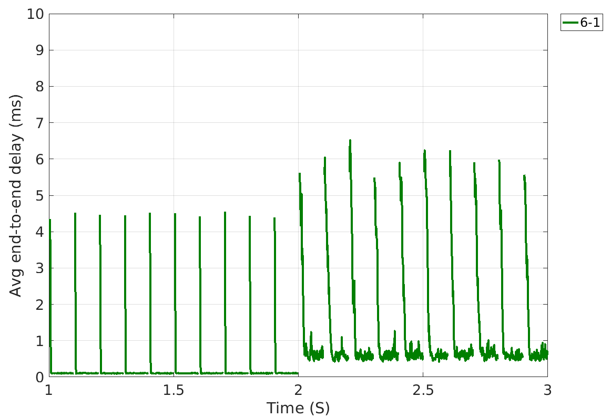
Simulation Results: Delay
Case 1: single-hop
Case 2: Dynamic Multi-hop
Delay spikes: BHI effect
Delay spikes: BHI effect
No data was received
Time switched to multi-hop

Slide 18
Observations
Dynamic multi-hop provides a reliable and robust high-throughput solution.
Delay performance is (mostly) under 5ms.
High delay spikes are due to BHI overhead.
To improve the delay performance, we should minimize the BHI overhead.

Slide 19
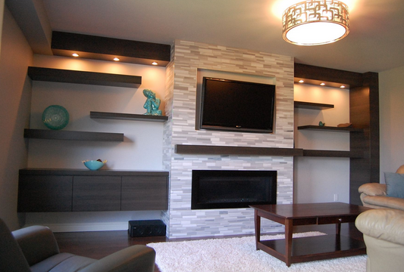
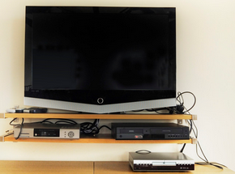
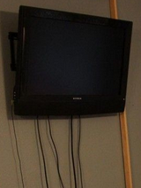
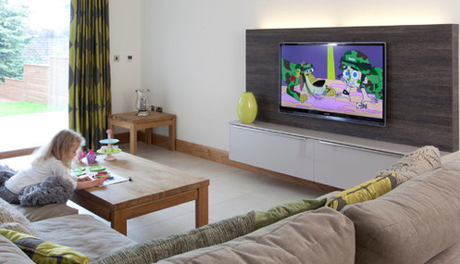
Usage Model 2: 8K UHD Wireless Transfer
UM2: UHD for display
The goal of UM2 is to eliminate or reduce ugly cables, and give users flexibility of device installation

Slide 20
Usage Model 2: Challenges
STB/Tuner might be located places where LOS signal cannot travel
STB/Tuner might be located behind sofa and/or humans

Slide 21
Simulation Scenario
Case 1:
Source -> Sink
Case 2:
Source -> Relay -> Sink
Case 1
Case 2

Slide 22
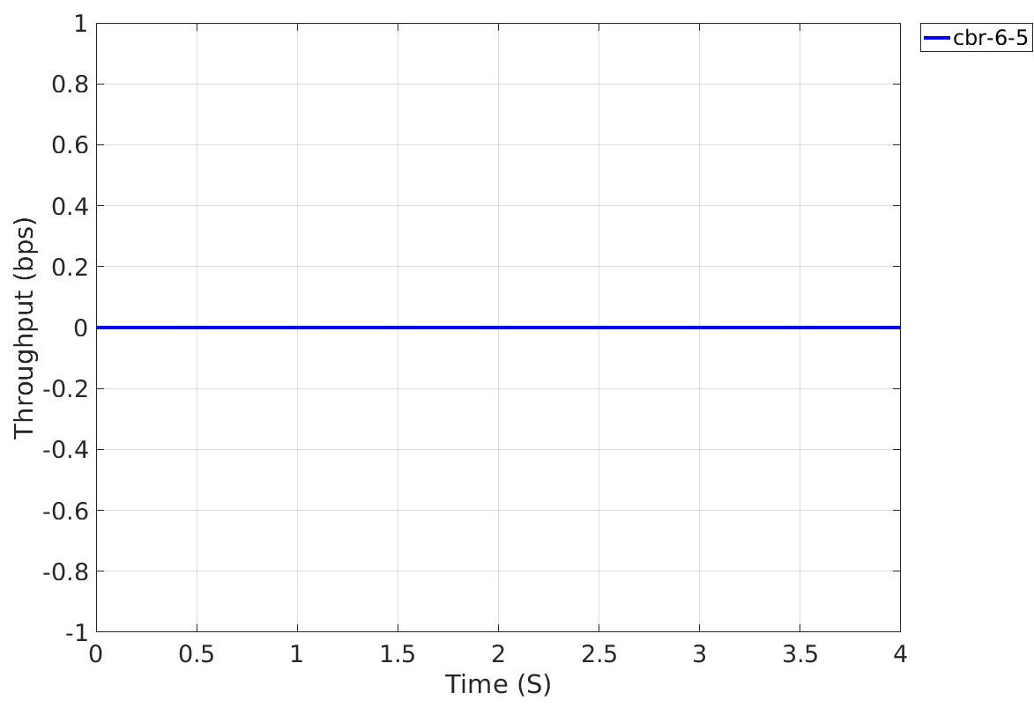
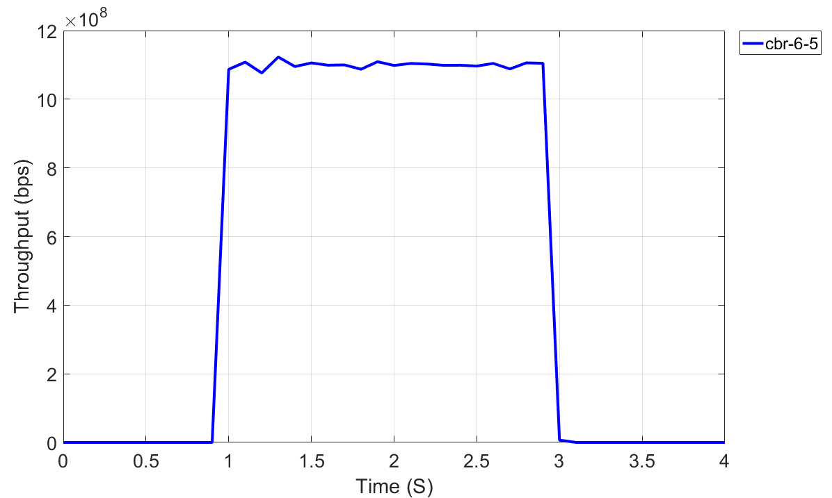
Simulation Results: Throughput
Case 1: Single-hop
Case 2: Multi-hop
No coverage with single-hop.
Multi-hop provides range extension.

Slide 23
Simulation Results: Delay
Case 2: Multi-hop
Delay spikes: BHI effect

Slide 24
Observations
Dynamic multi-hop provides 60GHz communications beyond LOS.
Delay performance is (mostly) under 6ms (98th percentile)
High delay spikes are due to BHI overhead
To improve the delay performance, we should shrink the BHI overhead.

Slide 25
Conclusion
Revisited consumer device use cases:
Latency, robustness, and flexibility of device installation are important for these use cases
802.11ay device should leverage multi-hop capability:
To mitigate the effects of human blockers
To enable beyond LOS communications (e.g., room-to-room)
Multi-hop communications is beneficial to combat with blocker and extended communication coverage

Slide 26
References
[1] IEEE 802.11-15/0625r7 “IEEE 802.11 TGay Use Cases”
[2] IEEE 802.11-10/431r3 “PHY simulations and Methodology”, Shadi Abu-Surra, et.al.

