Slide 1
CSD recommendations for example sequences
Date: 2018-09-06
Authors:

Slide 2
Introduction
Similar to OOK waveform, it has been agreed by TGba not to mandate specific CSD values, but specify examples in the TGba spec
  Three examples for 4 us and 2 us OOK waveforms have been specified in TGba D0.4
  Need to specify example CSD values that go with the three OOK waveforms

Slide 3
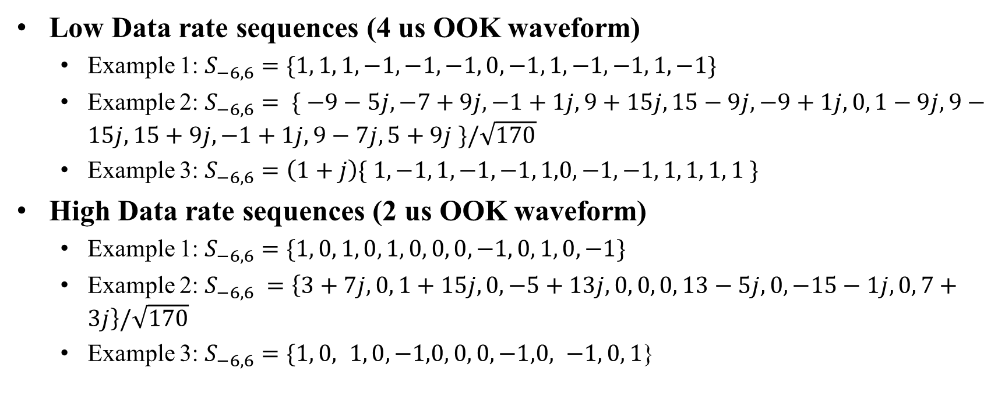
OOK waveform examples in TGba D0.4
Low Data rate sequences (4 us OOK waveform)
  Example 1: $S_{−6,6}=\{1, 1, 1, −1, −1, −1, 0, −1, 1, −1, −1, 1, −1\}$
  Example 2: $S_{−6,6}= \{ −9−5j, −7+9j, −1+1j, 9+15j, 15−9j, −9+1j,0, 1−9j, 9−15j, 15+9j, −1+1j, 9−7j, 5+9j \}/\sqrt{170}$
  Example 3: $S_{−6,6}=\left(1+j\right)\{ 1, −1, 1, −1, −1, 1,0, −1, −1, 1, 1, 1, 1 \}$
High Data rate sequences (2 us OOK waveform)
  Example 1: $S_{−6,6}=\{1, 0, 1, 0, 1, 0, 0, 0, −1, 0, 1, 0, −1\}$
  Example 2: $S_{−6,6} =\left\{3+7j, 0, 1+15j,0, −5+13j,0, 0, 0, 13−5j,0, −15−1j,0, 7+3j\right\}/\sqrt{170}$
  Example 3: $S_{−6,6}=\{1, 0, 1, 0, −1,0, 0, 0, −1,0, −1, 0, 1$}

Slide 4
CSD Studies
Based on the studies in 11-18/772r0 and 11-18/1164r2 [1,2], we recommend the following CSD values:
  The proposed CSD values were optimized for the OOK waveform Example 3
  In [2], the proposed CSD values were shown to work well with all the three OOK waveforms
In 11-18/1198r0 [3], CSD values optimized for the OOK waveform Example 1 were proposed
4 us OOK waveform
2 us OOK waveform
Number of antennas | CSD setting (ns)
2 | [0 3000]
3 | [0 1500 3000]
4 | [0 1000 2000 3000]
5 | [0 750 1500 2250 3000]
6 | [0 600 1200 1800 2400 3000]
7 | [0 500 1000 1500 2000 2500 3000]
8 | [0 450 850 1300 1700 2150 2550 3000]
Number of antennas | CSD setting (ns)
2 | [0 1500]
3 | [0 750 1500]
4 | [0 500 1000 1500]
5 | [0 400 750 1150 1500]
6 | [0 300 600 900 1200 1500]
7 | [0 250 500 750 1000 1250 1500]
8 | [0 200 450 650 850 1050 1300 1500]

Slide 5
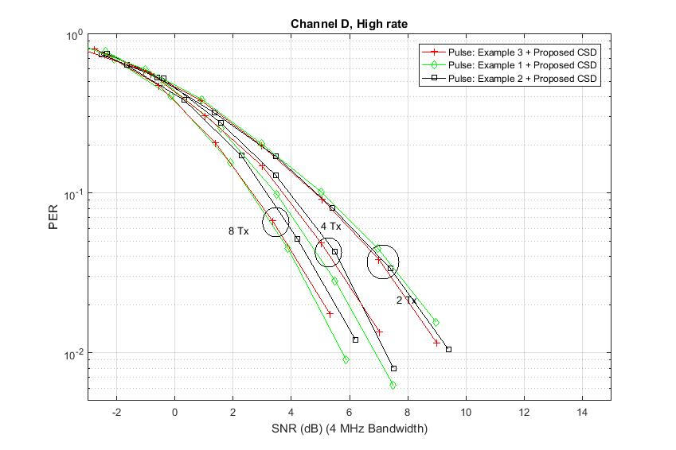
HDR Performance in Channel D
SNR @ 10% PER
 | Example 3 | Example 1 | Example 2
2 TX antenna | 4.33 dB | 4.82 dB | 4.85 dB
4 TX antenna | 3.71 dB | 3.46 dB | 3.93 dB
8 TX antenna | 2.65 dB | 2.60 dB | 3.15 dB
Proposed CSD works well for the three OOK waveform examples
  ~0.5 dB performance gap between different OOK waveforms

Slide 6
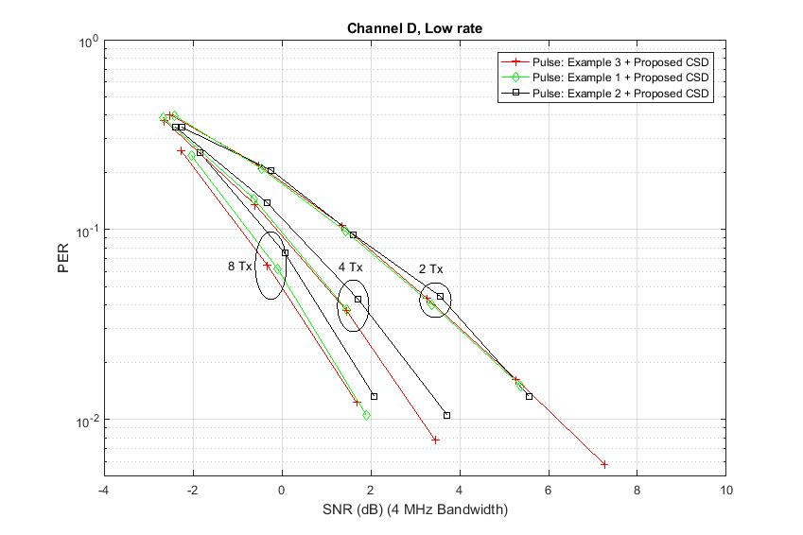
LDR Performance in Channel D
SNR @ 10% PER
 | Example 3 | Example 1 | Example 2
2 TX antenna | 1.46 dB | 1.38 dB | 1.46 dB
4 TX antenna | -0.12 dB | -0.05 dB | 0.23 dB
8 TX antenna | -0.93 dB | -0.76 dB | -0.38 dB
Proposed CSD works well for the three OOK waveform examples
  ~0.5 dB performance gap between different OOK waveforms

Slide 7
Conclusions
The proposed CSD values work well for the OOK waveform examples in TGba D0.4
We suggest to use the proposed CSD values for the OOK waveform Example 2 and Example 3
We suggest to use the CSD values proposed in 11-18/1198r0 [3] for the OOK waveform Example 1

Slide 8
References
[1] Vinod Kristem, Shahrnaz Azizi, Thomas Kenney, “IEEE 802.11-18/772r0 Updated results on WUR performance with multiple TX antennas”, May 2018
[2] Vinod Kristem, Shahrnaz Azizi, Thomas Kenney, “IEEE 802.11-18/1164r2 Recommendations on OOK waveform and CSD setting”, July 2018
[3] Steve Shellhammer, et.al, “IEEE 802.11-18/1198r0 Simulations with Recommended Symbols and CSD,” July 2018

Slide 9
Straw poll 1
Do you support to update the 2 us example waveform table in spec text (Annex AB) to the following?
  Yes/No/Abstain:
Sequence Examples | Example of CSD (nsec)
S_(-6,6)={1,0,1,0,1,0,0,0,-1,0,1,0,-1} | 1 Antenna [0] 2 Antennas [0, 1000] 3 Antennas [0, 1000, 500] 4 Antennas [0, 1000, 500, 250] | 5 Antennas [0, 1000, 500, 250, 1250] 6 Antennas [0, 1000, 500, 250, 1250, 750] 7 Antennas [0, 1000, 500, 250, 1250, 750, 1000] 8 Antennas [0, 1000, 500, 250, 1250, 750, 1000, 250]
S_(-6,6) ={3+7j,0,1+15j,0,-5+13j,0,0,0,13-5j,0,-15-1j,0,7+3j}/√170 | 1 Antenna [0] 2 Antennas [0, 1500] 3 Antennas [0, 750, 1500] 4 Antennas [0, 500, 1000, 1500] | 5 Antennas [0, 400, 750, 1150, 1500] 6 Antennas [0, 300, 600, 900, 1200, 1500] 7 Antennas [0, 250, 500, 750, 1000, 1250, 1500] 8 Antennas [0, 200, 450, 650, 850, 1050, 1300, 1500]
S_(-6,6)={1,0,1,0,-1,0,0,0,-1,0,-1,0,1} | 1 Antenna [0] 2 Antennas [0, 1500] 3 Antennas [0, 750, 1500] 4 Antennas [0, 500, 1000, 1500] | 5 Antennas [0, 400, 750, 1150, 1500] 6 Antennas [0, 300, 600, 900, 1200, 1500] 7 Antennas [0, 250, 500, 750, 1000, 1250, 1500] 8 Antennas [0, 200, 450, 650, 850, 1050, 1300, 1500]

Slide 10
Straw poll 2
Do you support to update the 4 us example waveform table in spec text (Annex AB) to the following?
  Yes/No/Abstain:
Sequence Examples | First Example of CSD (nsec)
S_(-6,6)={1, 1, 1, −1, −1, −1, 0, −1, 1, −1, −1, 1, −1} | 1 Antenna [0] 2 Antennas [0, 2000] 3 Antennas [0, 2000, 1000] 4 Antennas [0, 2000, 1000, 500] | 5 Antennas [0, 2000, 1000, 500, 2500] 6 Antennas [0, 2000, 1000, 500, 2500, 1500] 7 Antennas [0, 2000, 1000, 500, 2500, 1500, 2000] 8 Antennas [0, 2000, 1000, 500, 2500, 1500, 2000, 500]
S_(-6,6) ={{ −9−5𝑗, −7+9𝑗, −1+1𝑗, 9+15𝑗, 15−9𝑗, −9+1𝑗,0, 1−9𝑗, 9−15𝑗, 15+9𝑗, −1+1𝑗, 9−7𝑗, 5+9𝑗 }/√170 | 1 Antenna [0] 2 Antennas [0, 3000] 3 Antennas [0, 1500, 3000] 4 Antennas [0, 1000, 2000, 3000] | 5 Antennas [0, 750, 1500, 2250, 3000] 6 Antennas [0, 600, 1200, 1800, 2400, 3000] 7 Antennas [0, 500, 1000, 1500, 2000, 2500, 3000] 8 Antennas [0, 450, 850, 1300, 1700, 2150, 2550, 3000]
S_(-6,6)=(1+𝑗) {1, −1, 1, −1, −1, 1,0, −1, −1, 1, 1, 1, 1 } | 1 Antenna [0] 2 Antennas [0, 3000] 3 Antennas [0, 1500, 3000] 4 Antennas [0, 1000, 2000, 3000] | 5 Antennas [0, 750, 1500, 2250, 3000] 6 Antennas [0, 600, 1200, 1800, 2400, 3000] 7 Antennas [0, 500, 1000, 1500, 2000, 2500, 3000] 8 Antennas [0, 450, 850, 1300, 1700, 2150, 2550, 3000]

