Slide 1
Padding Design for FDMA
Date: 2018-09-11
Authors:

Slide 2
Introduction
At the July meeting the Task Group agreed to the following
“The FDMA packet shall pad all 20 MHz channels to the same length” [1]
Padding is needed because of possibly different data rates and/or different MAC Frame lengths, on the different channels
Here we provide a few requirements for padding and consider several padding designs
We include a straw poll on the Padding Design
In this revision we simulated one additional Padding Design, which was proposed in [2]

Slide 3
Possible Differences in Durations
We need to handle all possible differences in durations
There are several sources of time differences
The duration of the Sync Field can be different depending on the data rates. This time difference is either 0 or 64 µs
The MAC Frame length (in bytes) can take on the following values: {6, 8, 10, … 22} bytes
The duration of the MAC frame (in µs) will depend on both the MAC Fame length (in bytes) and the data rate
If we consider the smallest possible time difference, it turns out to be 64 µs (two bytes times 4 µs at the HDR)
So the padding duration can be an integer multiple of 64 µs
Requirement: Support padding duration of integer multiples of 64 µs

Slide 4
Minimize False Alarm in Sync Detector
We do not want Sync Detector false alarms when receiving the Padding Field
Requirement: the Sync Detector should have a low output value when input is from the Padding Field
The CDF of the Sync Detector output due to the Padding Field should be lower than the CDF of the Sync Detector output from AWGN. This will limit false alarms on the Padding Field

Slide 5
Design Approach
We will let the Padding Field be constructed by concatenating one or more 64 µs Padding subfields
Build up the 64 µs Padding subfield from 4 µs or 2 µs MC-OOK symbols
Hence the Padding subfield consists of 16 bits when using 4 µs symbols ($16×4 μs=64 μs)$
Possible bit sequences for the Padding Subfield are listed below
Design | Symbol Duration (µs) | Bit Sequence
A | 4 | {1,0,1,0,1,0,1,0,1,0,1,0,1,0,1,0}
B | 4 | {1,1,0,0,1,1,0,0,1,1,0,0,1,1,0,0}
C | 4 | {1,1,1,1,0,0,0,0,1,1,1,1,0,0,0,0}
D | 4 | {1,1,1,1,1,1,1,1,0,0,0,0,0,0,0,0}
E | 4 | {1,1,1,1,1,1,1,1,1,1,1,1,1,1,1,1}
F | 2 | {1,0,1,0,1,0,1,0,1,0,1,0,1,0,1,0 …}

Slide 6
Simulations
Ran simulations with seven possible inputs
AWGN (2 ms)
Padding Designs A through F
640 µs (ten copies of the 64 µs subfield)
Processed by the normalized Sync Field Detector
For each simulation we selected the largest output of detector
Considered both the HDR and LDR Sync Detectors
Plotted CDF curves for all seven possible inputs

Slide 7
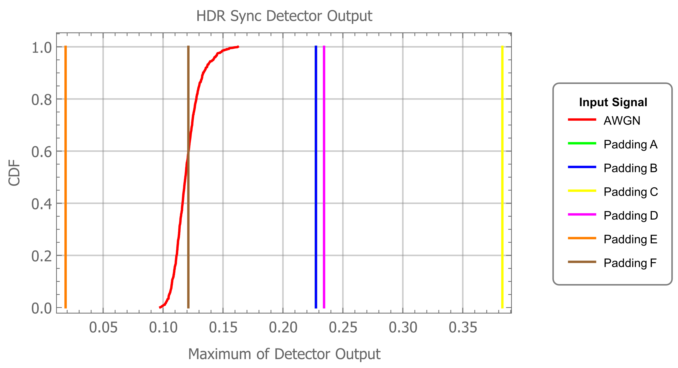
HDR Sync Detector
CDF of Maximum output of HDR Sync Detector
CDF curves for Padding A and B are the same
So the curve for Padding A is hidden behind the curve for Padding B

Slide 8
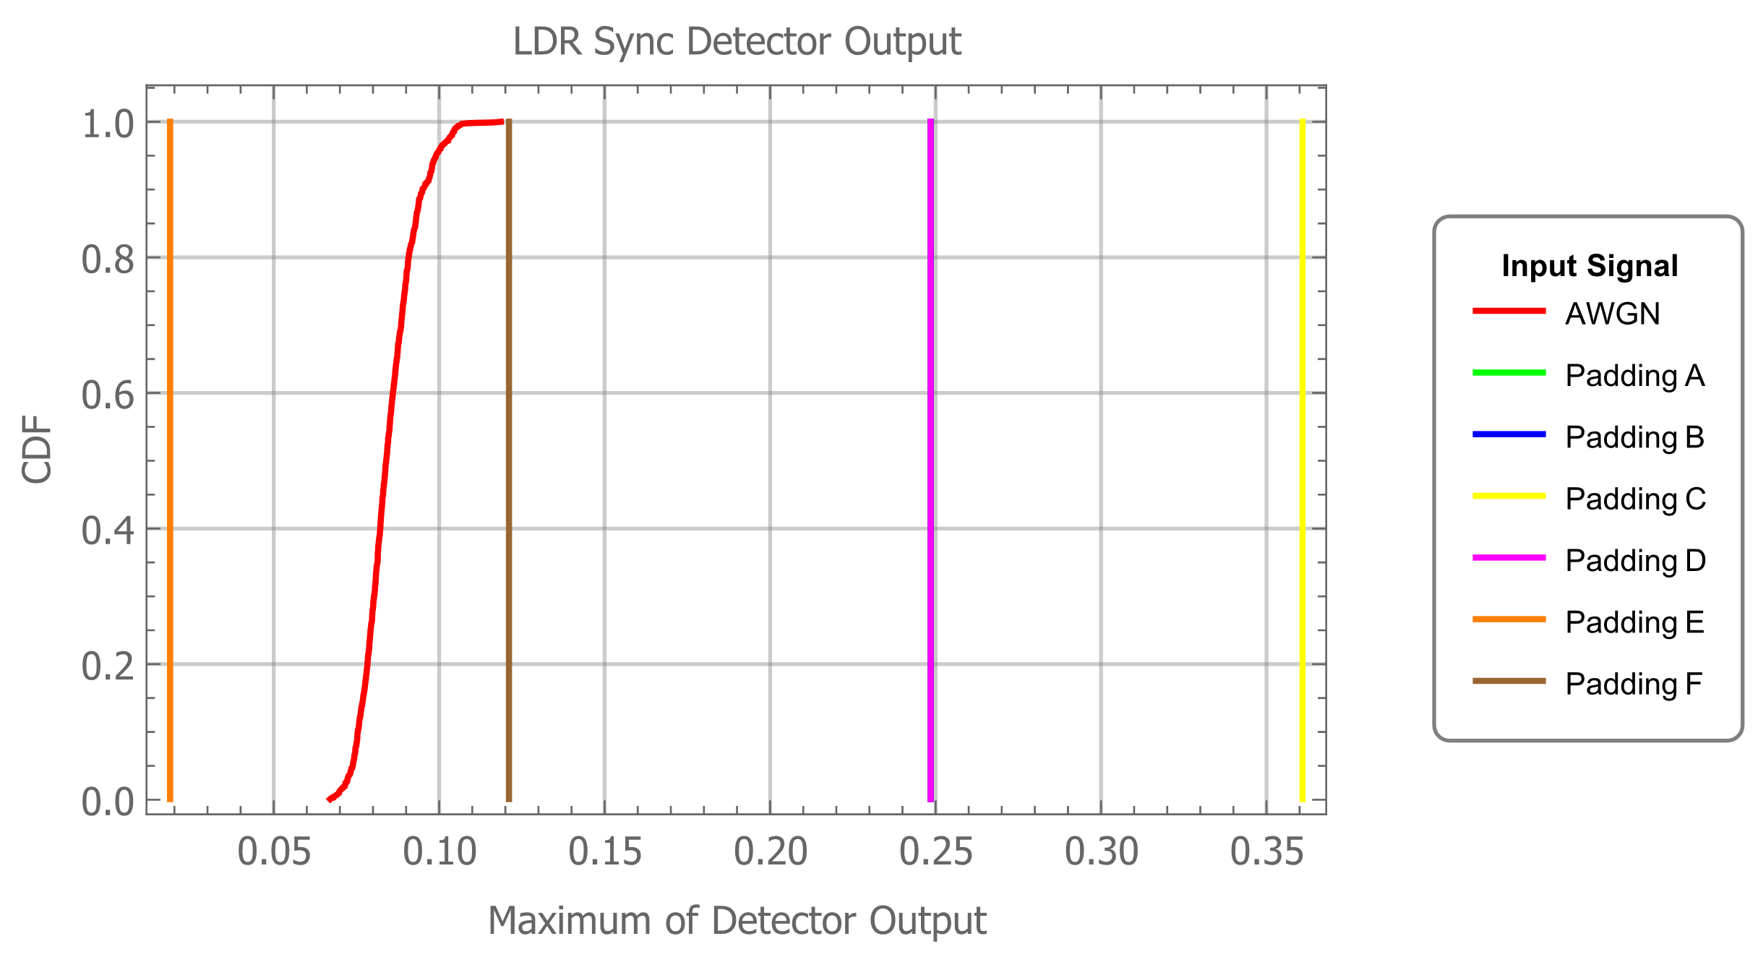
LDR Sync Detector
CDF of Maximum output of LDR Sync Detector
CDF curves for Padding A, B and D are all the same
So the curves for Padding A and B are hidden behind the curve for Padding D

Slide 9
Observations & Recommendations
The choice of the Padding Field design affects the output of the HDR and LDR Sync detectors
The only Padding Field design that results in Sync Detector values less than the response to AWGN is Padding Design E: All Ones
Recommendation: Use Padding Design E
All Ones using 4 µs MC-OOK symbols
In this revision, we added simulations for alternating 2 µs On and Off symbols (Design F)
The results are better than alternating 4 µs On and Off symbols, as was shown in [2]
For the HDR Sync Detector the CDF is within that of AWGN
For the LDR Sync Detector the CDF is a little larger than AWNG

Slide 10
Straw Poll
Do you agree to add the following to the draft?
“The Padding Field should be chosen to minimize correlation with the HDR and LDR Sync Fields, to avoid false alarms of WUR Sync detection. One recommended padding design is a continuous sequence of 4 µs MC-OOK On symbols.” (All On Symbols)
Yes 2
No 5
Abstain 5

Slide 11
References
Leif Wilhelmsson, James Lepp, Po-Kai Huang, “IEEE 802.11ba Task Group Meeting Minutes for July 2018 Meeting, San Diego, USA,” IEEE 802.11-1355r1, July 2018
Rui Cao, Hongyuan Zhang, “WUR FDMA Padding Content,” IEEE 802.11-1463r0, September 2018

