Slide 1
RTA Optimization proposal Sep Kona Meeting
Date: 2018-09-07
Author:

Slide 2
Abstract
This presentation contains technical discussion of RTA TIG.

Slide 3
Outline
Problem flashback
Problem analysis
Optimization direction and desirable features

Slide 4
Problem flashback
◆ High latency
➣ High latency will cause packets delay
➣ It can be because of signal quality, interference, loading or geolocation (not in scope)
◆ Jitter/Spike/Worst case latency
➣ The average latency is acceptable
➣ The jitter is the problem to solve
➣ The jitter between STA and AP have considerable correlation with lagging

Slide 5
Problem flashback
◆ Traffic characteristics
➣ average 30ms / packet
➣ size 30-500Bytes
◆ Traffic model
➣ Frame sync
➣ Status sync
Please refer to IEEE 802.11-18/1419r5 for more details
An effective mechanism to identify real-time gaming traffic by the packet characteristics of different gaming stages is under research

Slide 6
Latency breakdown from client to game server
Client
AP
Game server
Relatively stable
Latency/ms | Game experience
<100 | No lagging
100-200 | Lagging expected
>200 | Bad experience
460 | Disconnection
Random spike
Worst case latency can go up to 100+ ms
latency varies from 30ms to 200ms per geolocation
latency<100ms to ensure good game experience
100-200ms for acceptable game experience
latency spike cause the supposed satisfied game experience not acceptable ☹

Slide 7
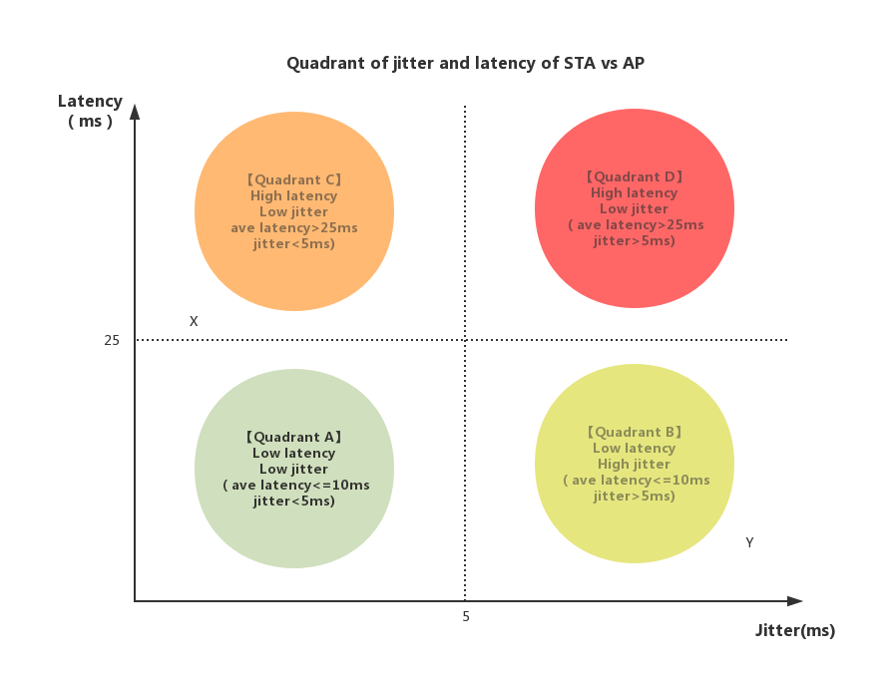
Quadrant of jitter and latency between STA and AP
Quadrant A: Network status between STA and AP is good. This is best scenario.
Quadrant B: Network status between STA and AP might impact the game experience.
Quadrant C: Network status between STA and AP impact game experience.
Quadrant D: Network status between STA and AP impact game experience negatively.
Game experience of point X and Y shall be enhanced by the trade-off of latency and stability
Latency is from STA to AP RTT. Jitter is standard deviation of latency.

Slide 8
Network Requirements between STA and AP
Specification | Value
Average latency | <10ms
Packet loss | <0.1%
Jitter | <5ms
High latency packet(>30ms) | <1%
The average latency between STA to AP is 7ms.
To control worst case spike, the average latency can go up to 25ms for stability.
When latency between STA and AP reach 30ms, it will start to impact gaming experience severely.

Slide 9
To wrap things up
Real-time mobile gaming usually low throughput, small packets (30-500Bytes)
Sometimes the experience of RTA is non reversible
Satisfying user experience requests consistent stable latency, preferable low
The latency request is not a problem in theory, but in practice

Slide 10
Optimization direction
Concurrent dual link transmission
Most AP and STA support dual band
2.4GHz is congested
5GHz is fast but have coverage issue
Random spike appear at both 2.4GHz and 5GHz, but less likely concurrently
Dual link transmissions are recommended for stability

Slide 11
Traffic flow
STA
AP
Duplication
2.4GHz
2.4GHz
MAC
2.4GHz
Sequence check
MAC
Sequence generation
5GHz
Management entity
Duplication
Removal
Management entity
Sequence check
2.4GHz
Duplication
5GHz
5GHz
Sequence generation
5GHz
Duplication
Removal
Dual band connection and transmission are simultaneously at both ends
A sequence number is generated for duplication detection at peer end
Management entity will decide when and how duplication/de-duplication is done

Slide 12
Dual link use case in RTA
John is playing real-time mobile game with his phone connected to dual-band router in his home.
While John is within the range of both 2.4GHz ,5GHz range of his router and he is very sensitive to game experience, he does not want any lagging during game. So he enabled dual link function on his phone before he starts the game.
Based on signaling from the AP and phone, each packet, both UL and DL during the game is replicated. The process manner at each end is based on first come, first serve. Only the 1st packet is accepted, while the 2nd is dropped directly at Phone and AP.
Dual link enabled
Dual link enabled
2.4GHz
Duplicated data transmission
1st transfer, 2nd drop
5GHz
Simultaneous dual band
Simultaneous dual band

Slide 13
Current solutions…
SU-MIMO
multiple streams of data to be simultaneously transmitted or received between two Wi-Fi devices using multiple antennas and beamforming technology
Fast BSS Transfer
2nd AP association can be done before 1st AP disassociation
FST
Different streams can be sent over different bands to/from same STA, transparently or non-transparently to higher layers
To send same stream over different band between AP and STA
- A mechanism to identify the specific traffic which requests this feature
A mechanism for STA to associate two bands concurrently
A mechanism to replicate and de-duplicate frames from different bands is requested
Hardware and OS compatibility are needed. Ex. More antennas

Slide 14
Other Guideline for IEEE WG meetings
All IEEE-SA standards meetings shall be conducted in compliance with all applicable laws, including antitrust and competition laws.
Don’t discuss the interpretation, validity, or essentiality of patents/patent claims.
Don’t discuss specific license rates, terms, or conditions.
Relative costs of different technical approaches that include relative costs of patent licensing terms may be discussed in standards development meetings.
Technical considerations remain the primary focus
Don’t discuss or engage in the fixing of product prices, allocation of customers, or division of sales markets.
Don’t discuss the status or substance of ongoing or threatened litigation.
Don’t be silent if inappropriate topics are discussed … do formally object.
---------------------------------------------------------------
For more details, see IEEE-SA Standards Board Operations Manual, clause 5.3.10 and Antitrust and Competition Policy: What You Need to Know at http://standards.ieee.org/develop/policies/antitrust.pdf

Slide 15
Participation in IEEE 802 Meetings
Participation in any IEEE 802 meeting (Sponsor, Sponsor Subgroup, Working Group, Working Group Subgroup, etc.) is on an individual basis
Participants in the IEEE standards development individual process shall act based on their qualifications and experience. (https://standards.ieee.org/develop/policies/bylaws/sb_bylaws.pdfsection 5.2.1)
IEEE 802 Working Group membership is by individual; “Working Group members shall participate in the consensus process in a manner consistent with their professional expert opinion as individuals, and not as organizational representatives”. (subclause 4.2.1 “Establishment”, of the IEEE 802 LMSC Working Group Policies and Procedures)
Participants have an obligation to act and vote as an individual and not under the direction of any other individual or group. A Participant’s obligation to act and vote as an individual applies in all cases, regardless of any external commitments, agreements, contracts, or orders.
Participants shall not direct the actions or votes of any other member of an IEEE 802 Working Group or retaliate against any other member for their actions or votes within IEEE 802 Working Group meetings, see https://standards.ieee.org/develop/policies/bylaws/sb_bylaws.pdf section 5.2.1.3 and the IEEE 802 LMSC Working Group Policies and Procedures, subclause 3.4.1 “Chair”, list item x.
By participating in IEEE 802 meetings, you accept these requirements. If you do not agree to these policies then you shall not participate.
(Latest revision of IEEE 802 LMSC Working Group Policies and Procedures: http://www.ieee802.org/devdocs.shtml)

