Slide 1
Error Correction Message
Date: 2018-09-12
Authors:

Slide 2
Background
During the last meeting, the concept of adding outer code was presented
  IEEE802.11-18-1214
  The suggestion was sending parity bytes of outer code post packet utilizing the large 10MHz DIFS
Alternative scheme, using a dedicated packet to send the parity bytes of outer code, is presented

Slide 3
Dedicated Error Correction Packet
A new packet, containing only parity bytes, is sent immediately after the original packet
  For high utilization, packets are separated by SIFS
The parity packet may have a dedicated marking
Original packet
Parity packet
SIFS

Slide 4
Byte Interleaved Outer Code
Transmitted
Original Data Packet
Pre-encoding interleaving
Parity Bytes
Transmitted
parity packet
post-interleaving
RS encoding
Data Block #1
Bytes
Data Block #2
RS encoding
Data Block #N
Errors are usually grouped in bursts
Consecutive bytes are mapped to different blocks, for equalizing number of errors amongst blocks, hence increasing ability to correct errors
  Byte interleaved scheme gain is up to 1.5dB

Slide 5
Outer Code Configuration
Rigid setting of block size simplifies decoding, yet limits ability to adjust to varying channel load
Dynamic setting of block size can be applied according to channel load
  Block size may vary from RS(32, 16) (100% overhead) to RS (240, 224) (7% overhead)
  Parity packet may be received with errors as well, hence explicit RS parity block size indication cannot be trusted. Therefore, implicit indication is used
  Basic properties should be determined: RS with 16 parity bytes
  Number of blocks = ceil (parity packet length / 16)
  Block size = ceil (data packet length / number of blocks)

Slide 6
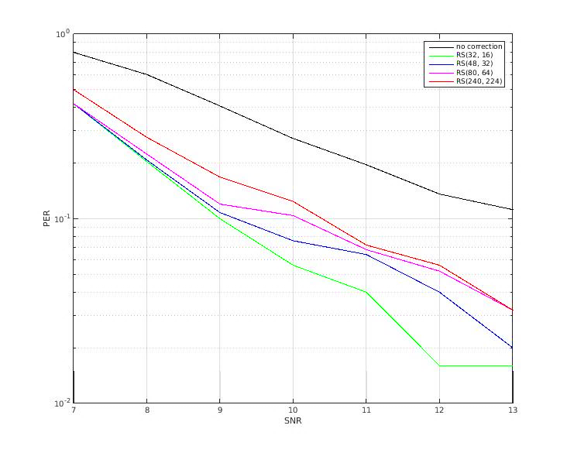
Very High Speed Example
C2C_highway_NLOS_enhanced (Doppler=2352Hz). 300 bytes packet. MCS=1

Slide 7
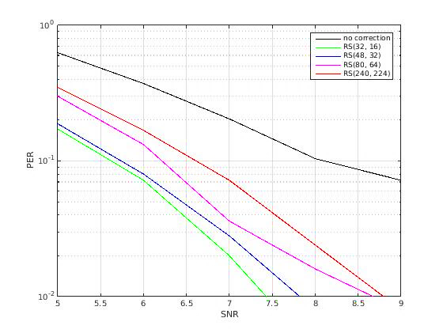
Low Speed Example
C2C_Approaching_LOS (Doppler=886Hz). 300 bytes packet. MCS=1

Slide 8
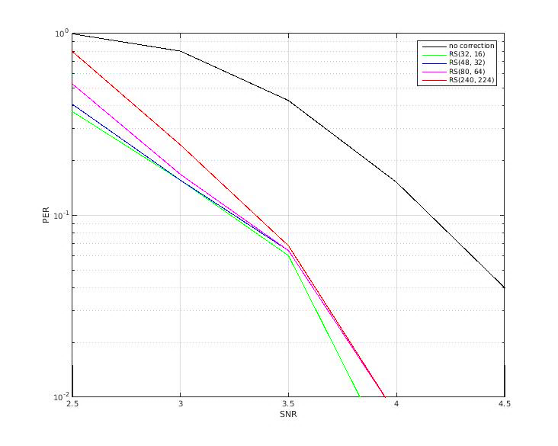
AWGN Example
300 bytes packet. MCS=1

Slide 9
Observations
RS(48, 32) and RS(32, 16) have similar gain
  Packet failing RS(48, 32) error correction is so badly corrupted that RS(32, 16) will not help much
Gain difference between RS(32, 16) and RS(240, 224) is ~1-1.5dB at mobility
RS(80, 64) gain is in between the gains of RS(32, 16) and RS(240, 224)

Slide 10
Dynamic Overhead Reduction Scheme
Overhead is adjusted according to vehicle speed and network load
  Protection should be increased in high speed
  Lower overhead should be applied in a loaded network
For example
  Vehicle is moving
    Low channel load: RS(48, 32) [50% overhead]
    Medium channel load: RS(80, 64) [25% overhead]
    High channel load: RS(240, 224) [7% overhead]
  Vehicle is static (or near-static)
    Low channel load : RS(240, 224) [7% overhead]
    Medium or high channel load: no protection

Slide 11
Transmitter Concept
Determine block size
(According to speed and channel load)
Interleave and encode parity bytes
Transmit the original data packet
Wait SIFS
Transmit the parity bytes in a dedicated packet

Slide 12
Receiver Concept
Packet received
Yes
CRC good?
No
Erase data
Yes
Data stored?
No
Good packet
Re-decode stored data using current packet as parity
Store current packet as data
Erase data
No recovery
Recalculate CRC

Slide 13
Textual Receiver Operation Description
Data packet is received
  Data integrity (i.e. CRC) is checked
  If valid, then packet is accepted
  If invalid, the packet would be treated as parity packet to previous stored packet. Obviously, this error correction attempt would fail, and the current received packet would be stored in case a parity packet would follow
Parity packet is received
  Data integrity check on received packet alone will always fail. If previous packet failed, then error correction would be attempted. Corrected previous packet would be accepted if the attempt is successful (i.e. passed CRC recalculation)

Slide 14
Summary
A scheme carrying error correction parity bytes in a dedicated packet was presented
Backward compatible operation
  Improving performance of new receivers
Dynamic overhead reduction (7-50%)
  Future proof: gain is provided even for high channel load
High processing gain
  3-4 dB gain for high speed NLOS
  0.75-1 dB gain for AWGN
  Low memory footprint and low complexity

