Slide 1
WUR Duty Cycle Operation Clarifications
Date: 2018-09-5
Authors:

Slide 2
Introduction
WUR Duty Cycle operation is defined in 802.11ba
  Support of WUR Duty Cycle operation is mandatory for WUR APs.
  Support of WUR Duty Cycle operation with on duration smaller than duty cycle period is optional for WUR STAs.
In this presentation we want to:
  Clarify the field size/units of some parameters of WUR Duty Cycle operation.
  Clarify WUR STA behavior before the start of WUR Duty Cycle operation.

Slide 3
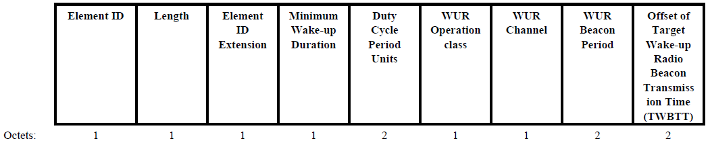
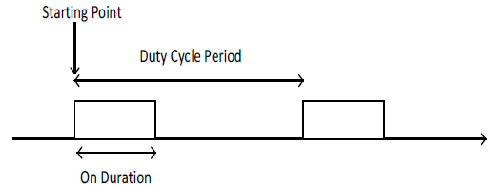
WUR Duty Cycle Operation
WUR Duty Cycle operation is determined by following parameters:
  AP advertises the Minimum Wake-up Duration and the Duty Cycle Period Units in the WUR Operation element.
During WUR Mode setup negotiation:
  STA indicates the desired On Duration and Duty Cycle Period in the WUR Mode element.
  AP indicates the Starting Point in the “Starting Time Of the WUR Duty Cycle” field in the WUR Mode element.

Slide 4
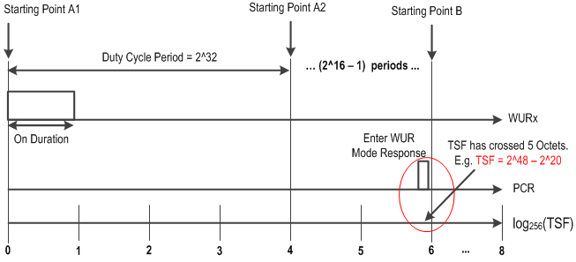
Starting Point (1/2)
AP indicates the Starting Point in the “Starting Time Of the WUR Duty Cycle” field in the WUR Mode element (in Enter WUR Mode Response).
Intended Starting Point
If the TSF of the intended Starting Point requires more than 5 octets to signal, the “Starting Time Of the WUR Duty Cycle” field cannot indicate the TSF of the Intended Starting Point B but may signal an earlier Starting Point for example Starting Point A1, A2 etc.
1) Clarification is required for a WUR STA to figure out the Intended Starting Point.

Slide 5
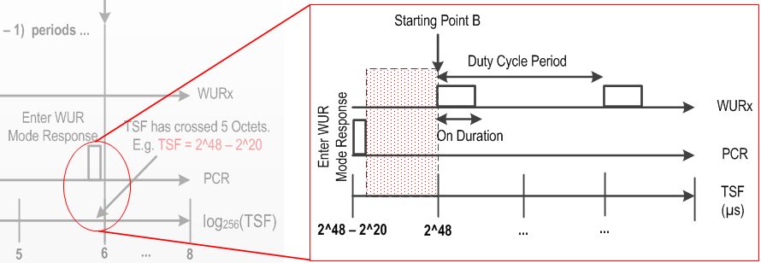
Starting Point (2/2)
In some cases the intended Starting Point B may be very far from current TSF (if the Duty Cycle Period is very large).
WUR STA behavior in the red dotted zone (time between Starting Point B and the Tx time of the ACK for the Enter WUR Mode Response) is not clear. Should it continue in the PCR mode, or can the WUR STA transition to the WUR mode (If it does, should the WURx be in the awake or doze state)?
2) Clarification is required for a WUR STA’s behavior in the red dotted zone.

Slide 6
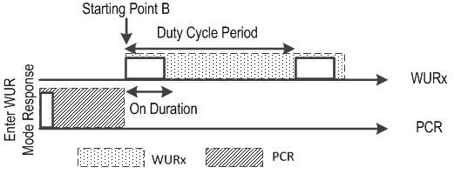
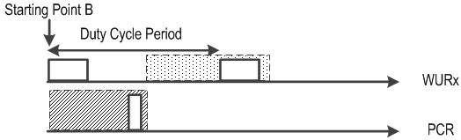
Proposed changes 1
Clarification point 1
  Option 1 (Preferred): Signal the TSF of the intended Starting Point explicitly by using 8 octets for the “Starting Time Of the WUR Duty Cycle” field.
  Option 2: Clarify that the WUR STA may need to calculate the TSF of the intended Starting Point based on the (5 octets) “Starting Time Of the WUR Duty Cycle” field.
Clarification point 2
  Option 1 (Preferred):
    Clarify that WUR STA only transitions to WUR Mode at the intended Starting Point and stays in the PCR mode until then (following existing PCR power management modes).
    If the TSF has already passed the intended Starting Point, WUR STA may immediately transition to the WUR Mode (and follow negotiated WUR Duty Cycle Operation).
  Option 2:
    Clarify that after completing a successful WUR Mode setup negotiation, WUR STA may transition to the WUR Mode at any time (before the intended Starting Point).

Slide 7
On Duration
The units of various parameters related to Duty Cycle Operation and the maximum possible values are listed below:
Parameter | Unit (µs) | Field Size (bits) | Maximum value (µs)
Duty Cycle Period Units | 4 | 16 | 4 * 2¹⁶ ⁼ 2¹⁸
Duty Cycle Period |  | 16 | 2¹⁸ * 2¹⁶ ⁼ 2³⁴
Minimum Wake-up Duration | 256 | 8 | 256 * 2⁸ ⁼ 2¹⁶
On Duration | 256 | 32 | 256 * 2³² ⁼ 2⁴⁰
Since the maximum value of On Duration only need to match the maximum value of Duty Cycle Period (2³⁴), the unit of On Duration period can be reduced to 4µs. The maximum value for On Duration = 4 * 2³² ⁼ 2³⁴
Proposed Change 2:
The unit of the On Duration field is 4µs.

Slide 8
Summary
In this presentation we discussed changing the field size/units of some parameters of WUR Duty Cycle operation and clarified the behavior of WUR STA before the start of WUR Duty Cycle operation.
We proposed to:
  Change the “Starting Time Of the WUR Duty Cycle” field size to 8 octets to explicitly signal the TSF of the intended Starting Point.
  WUR STA only transitions to WUR Mode at the intended Starting Point and stays in the PCR mode until then (following existing PCR power management modes). If the TSF has already passed the intended Starting Point, WUR STA may immediately transition to the WUR Mode (and follow negotiated WUR Duty Cycle Operation).
  Changing the unit of the On Duration field to 4µs.

Slide 9
Straw Poll 1
Do you agree to change the “Starting Time Of the WUR Duty Cycle” field size to 8 octets to explicitly signal the TSF of the intended Starting Point?
Y/N/A

Slide 10
Straw Poll 2
Do you agree that:
After successfully completing a WUR Mode setup negotiation, a WUR STA transitions to WUR Mode at the Starting Point and stays in the PCR mode until then (following existing PCR power management modes). If the TSF has already passed the Starting Point, WUR STA may immediately transition to the WUR Mode (and follow negotiated WUR Duty Cycle Operation).
Y/N/A

Slide 11
Straw Poll 3
Do you agree to change the unit of the On Duration field to 4µs?
Y/N/A

Slide 12
References
[1] IEEE 802.11ba-D0.4

