Slide 1
EHT Multi-Channel Operation
Date: 2018-09-06
Authors:
Name | Affiliation | Address | Phone | Email
Liwen Chu | Marvell | 5488 Marvell Lane, Santa Clara, CA, 95054 |  | liwenchu@marvell.com
Jinjing Jiang
Hongyuan Zhang

Slide 2
Overview
Interests have been shown on multi-channel operations for EHT [1][2].
This presentation gives some benefit analysis for multi-channel operation, especially when it operates at Frequency Division Duplex (FDD) mode.

Slide 3
Multi-Channel FDD
As shown in [1], we expect broad deployments of dual radio EHT devices.
Multi-Channel FDD: different channels operated on the same device may be allocated for Tx and Rx at the same time.
Key benefits:
  Efficiency improvements
  Security enhancement

Slide 4


FDD for Latency/Efficiency Improvements
Scenario 1: DL Streaming
  A Single BSS: 16 STAs, all downlink streaming traffic using TCP
  Based on empirical data, assume the size of AMPDU that carries TCP Data is 8 times of that of TCP ACK
  Operation Mode
    Downlink: HE DL OFDMA (PPDU length 4ms)
    Uplink: SU
    HE MCS: MCS 7, 1ss
    Legacy Rate for Control Frame: 6Mbps

Slide 5
TDD vs Multi-Channel FDD
DL OFDMA (TCP Data i)
DL OFDMA (TCP Data i+1)
DL OFDMA (TCP Data i+2)
TDD
UL SU (TCP ACKs)
UL SU (TCP ACKs)
80M
DL OFDMA (TCP Data i)
DL OFDMA (TCP Data i+1)
DL OFDMA (TCP Data i+2)
Multi-Channel
FDD
20M
UL SU (TCP ACKs)
UL SU (TCP ACKs)
UL SU (TCP ACKs)

Slide 6
Delay Comparison
The throughput is inversely proportional to the delay

Slide 7
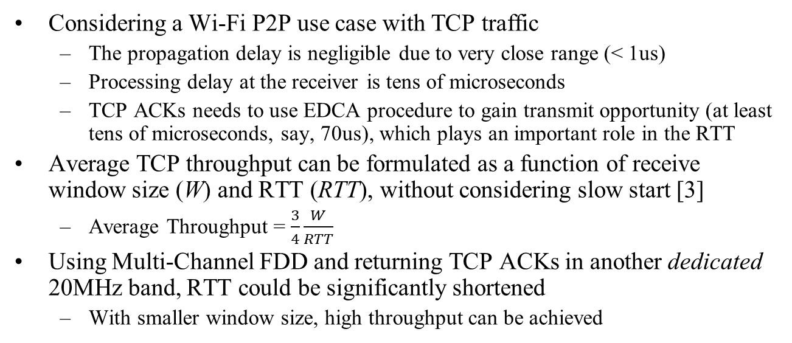
Scenario 2: P2P TCP Throughput
Considering a Wi-Fi P2P use case with TCP traffic
  The propagation delay is negligible due to very close range (< 1us)
  Processing delay at the receiver is tens of microseconds
  TCP ACKs needs to use EDCA procedure to gain transmit opportunity (at least tens of microseconds, say, 70us), which plays an important role in the RTT
Average TCP throughput can be formulated as a function of receive window size (W) and RTT (RTT), without considering slow start [3]
  Average Throughput = $\frac{3}{4}\frac{W}{RTT}$
Using Multi-Channel FDD and returning TCP ACKs in another dedicated 20MHz band, RTT could be significantly shortened
  With smaller window size, high throughput can be achieved
W
W/2

Slide 8

Multi-Channel FDD Helps Hidden Node Problem
Neighborhood A
STA A.1
STA B.1
Neighborhood B
Suppose the STAs in neighborhood A are always hidden nodes to STAs in the neighborhood B
Half duplex (either 80M or 100M)
  When STA A.1 transmit, STA B.1 could transmit too. Two packets collides and no goodput for this channel use
Multi-Channel FDD
  Assume the AP can indicate the ongoing transmission
  Before STA A.1 transmit, STAB.1 already knows through AP’s indication. Then STA B.1 goes to transmit on another idle 20M band. Both transmission could succeed
In other channel use instances, if the hidden node pair (STA A.x, STA B.y) appears frequently in the channel access, the gain for spectrum efficiency would be good!
  For example, if the probability of the event that the hidden node pair happens to use the channel is 15%; then the overall BSS throughput gain over 100MHz band would be (1/0.85-1)=17%

Slide 9
Multi-Channel FDD Helps Security
Serious timing side channel attack is possible due to the fact that 802.11 operation is half duplex [4]
Essentially, the adversary can guess the TCP sequence number by sending probing TCP packets and check whether triggering TCP ACK generation at the receiver
  If the TCP ACK is triggered, the RTT is longer because the new probing packet needs to contends with the TCP ACK
Correct guessing of TCP sequence number leads to TCP traffic injection attacks
Such side channel attack is infeasible with Multi-Channel FDD operation

Slide 10
Conclusions
Multi-Channel FDD is a promising technology for EHT
  Greatly reduce latency and improve throughput in some usage scenarios
  Remove a security issue due to half duplex operation in 802.11

Slide 11
References
[1] 11-18-1161-00-0eht-EHT-Technology-Candidate-Discussions
[2] 11-18-1155-01-0eht-multi-ap-enhancement-and-multi-band-operations
[3] James F Kurose, Keith W. Ross, “Computer Networks: A Top-Down Approach,” Pearson, 2012
[4] Weiteng Chen, Zhiyun Qian, “Off-Path TCP Exploit: How Wireless Routers Can Jeopardize Your Secret”, 2018

Slide 12
Half Duplex with DL MU + UL SU
Total time to serve a STA once (Delay): ~7.8ms
  HE DL OFDMA + SIFS + Polled BA/BAR
  SU AMPDU (TCP Ack) + SIFS + BA
  AIFS, Backoff
Assume perfect fairness between STAs, the above calculation does not count the collisions among 16 UL SU. If collision happens, the TCP ACKs for all 16 STAs could take at least twice the time to finish
The delay: ~12ms
Notes:
AIFS+Backoff (DL+UL) =17*71us= 1.207ms
HE DL OFDMA: 4ms
Polled BA: 1.428ms
AMDPU(TCP Ack)+BA= 16x(16us+32us+1/8*4ms/16) = 1.268ms

Slide 13
FDD: DL MU + UL SU
80M
DL OFDMA (TCP Data i)
DL OFDMA (TCP Data i+1)
DL OFDMA (TCP Data i+2)
20M
UL SU (TCP ACKs)
UL SU (TCP ACKs)
UL SU (TCP ACKs)
FDD setup: 80M Downlink, 20M Uplink
  Synchronized transmission: the Uplink PPDUs happens inside one DL PPDU (TXOP)
AMDPU(TCP Ack) + SIFS + BA: ~2.7ms
Even if collision happens in UL SU, the total time to serve each STA once in 20MHz is ~5ms
The delay is reduced to ~5ms
The delay is reduced from ~12ms to ~5ms using FD FDD
The throughput is proportional to the inverse of the delay
Notes:
AMDPU(TCP Ack) + SIFS + BA = 16 x (1/8*4ms/16*4+16us+32us) = 2.768ms
1/8: the ppdu length ratio between uplink/downlink
1/16: the PPDU length in 80M, but it is in the reverse direction using 20M, so the total should be 1/16*4

